Slide 1
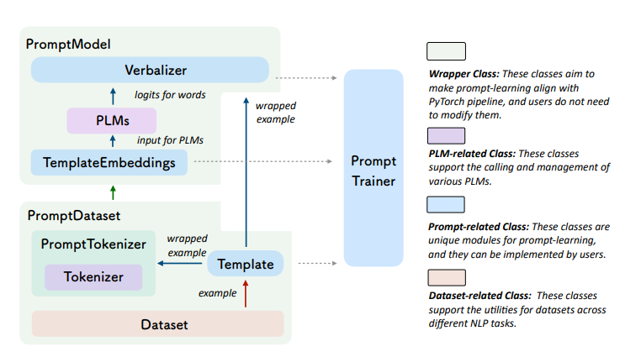
OpenPrompt Design and Implementation
參考論文:OpenPrompt: An Open-source Framework for Prompt-learning

Slide 2
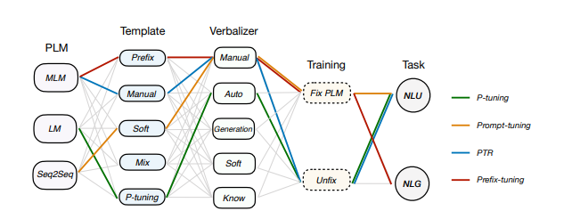
實作方式
Hard-prompt
參考論文:OpenPrompt: An Open-source Framework for Prompt-learning

Slide 3
Template and Verbalizer design
Hard-prompt | Manual Template: 标题：{"title"} 网页正文：{"message"}问题：上述内容是不是活动网页？ 答案:{"mask"}',
 | Manual Verbalizer: "不是": ["不", "否"], "是的": ["是"],
Prompt-tuning (Freeze Langue Model) | Soft Template: '{"soft":"标题："}{“title"} {"soft":"网页正文"}{"message”} {"soft":"问题：上述内容是不是活动网页？"} 答案:{"mask"}'
 | Manual Verbalizer: "不是": ["不", "否"], "是的": ["是"],
P-tuning | P tuning Template: '标题：{"title"} 网页正文：{"message”} 问题：{"soft":"上述内容是不是活动网页？"} 答案:{"mask"}',
 | Automatic Verbalizer

Slide 4
Pretrained models : Bert
Train-data:196, Test-data:49
 | precision | recall | macro-f1 | micro-f1 | accuracy
Word-embedding + ANN | 0.8366 | 0.8366 | 0.8366 | 0.8366 | 0.8367
Fine-tuning | 0.8027 | 0.8121 | 0.7952 | 0.7959 | 0.7959
Hard-prompt | 0.7483 | 0.7543 | 0.75 | 0.7551 | 0.7551
Prompt-tuning | 0.7603 | 0.7603 | 0.7347 | 0.7347 | 0.7347
P-tuning | 0.5083 | 0.5086 | 0.5050 | 0.5102 | 0.5102

Slide 5
Pretrained models : Bert
Train-data:380,Val-data:20, Test-data:100
 | precision | recall | macro-f1 | micro-f1 | accuracy
Word-embedding + ANN | 0.7728 | 0.7381 | 0.7426 | 0.76 | 0.76
Fine-tuning | 0.8231 | 0.8120 | 0.8166 | 0.83 | 0.83
Hard-prompt | 0.8090 | 0.7806 | 0.7898 | 0.81 | 0.81
Prompt-tuning | 0.7313 | 0.6570 | 0.6600 | 0.72 | 0.72
P-tuning | 0.5248→0.8381 | 0.5263→0.7025 | 0.5152→0.7116 | 0.52→0.77 | 0.52→0.77
P-tuning (freeze) | 0.6797 | 0.5497 | 0.4982 | 0.65 | 0.65

Slide 6
Hard-prompt
Train-data:400, Test-data:100
 | precision | recall | macro-f1 | micro-f1 | accuracy
Bert | 0.8090 | 0.7806 | 0.7898 | 0.81 | 0.81
T5 | 0.8121 | 0.6498 | 0.6447 | 0.73 | 0.73
GPT2 | 0.7774 | 0.7848 | 0.78031 | 0.79 | 0.79

Slide 7
Prompt-tuning
Train-data:400, Test-data:100
 | precision | recall | macro-f1 | micro-f1 | accuracy
Bert | 0.7313 | 0.6570 | 0.6600 | 0.72 | 0.72
T5 | 0.8196 | 0.5395 | 0.4631 | 0.65 | 0.65
GPT2 | 0.8298 | 0.5789 | 0.5338 | 0.68 | 0.68

Slide 8
P-tuning
Train-data:400, Test-data:100
 | precision | recall | macro-f1 | micro-f1 | accuracy
Bert | 0.5248 | 0.5263 | 0.5152 | 0.52 | 0.52
T5 | 0.5222 | 0.5233 | 0.5076 | 0.51 | 0.51
GPT2 | 0.5327 | 0.5335 | 0.5096 | 0.51 | 0.51

Slide 9
Pretrained models : Bert 交叉驗證
Train-data:400, Test-data:100
 | precision | recall | macro-f1 | micro-f1 | accuracy
Word-embedding + ANN
Fine-tuning
Hard-prompt
Prompt-tuning
P-tuning

