Slide 1
IMPROVED DES ALGORITHM BASED ON IRRATIONAL NUMBERS
Monil Parikh
Yogesh Patel
Chinar Vartak
Notes:
Monil Parikh
Yogesh Patel
Chinar Vartak

Slide 2
INTRODUCTION
DES (Data Encryption Standard) is a cryptographic
standard. However, the applications of it are limited because of the small key space.
Based on irrational numbers, an improved scheme that enhances the randomness of sub-Key is proposed, in which the permutation is controlled by irrational number

Slide 3
The plaintext is encrypted to cipher text by the key with
a length of 64 bits, in which 56 bits are used for
encryption .
It is no longer a question to attack the 56-bit key with the development of computer technology. The attacker can decipher DES within 20 hours through exhaustive key search .

Slide 4
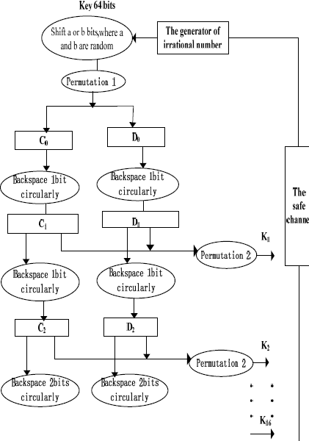
DES based on irrational number
Notes:
DES based on irrational number

Slide 5
GENERATION OF IRRATIONAL NUMBER
The 64-bit key is controlled by irrational number to shift before the sub-key
being produced. Therefore the key is not directly involved in the production of the sub-keys.
In order to increase the randomness of sub-key, the production and the selection of ‘a’ and ‘b’ are all controlled by irrational number. The Location information of ‘a’ and ‘b’, used for shifting, is transmitted to the receiver through the safe channel. The location information will be one part of the key.
Notes:
GENERATION OF IRRATIONAL NUMBER

Slide 6
ADVANTAGES
The running time that DES took as much as that of the DES based on irrational number
Based on the same plain text and key , the cipher text of DES after several simulations is the same
Notes:
Advantages

Slide 7
THANK YOU...........
Notes:
THANK YOU...........

