Slide 1

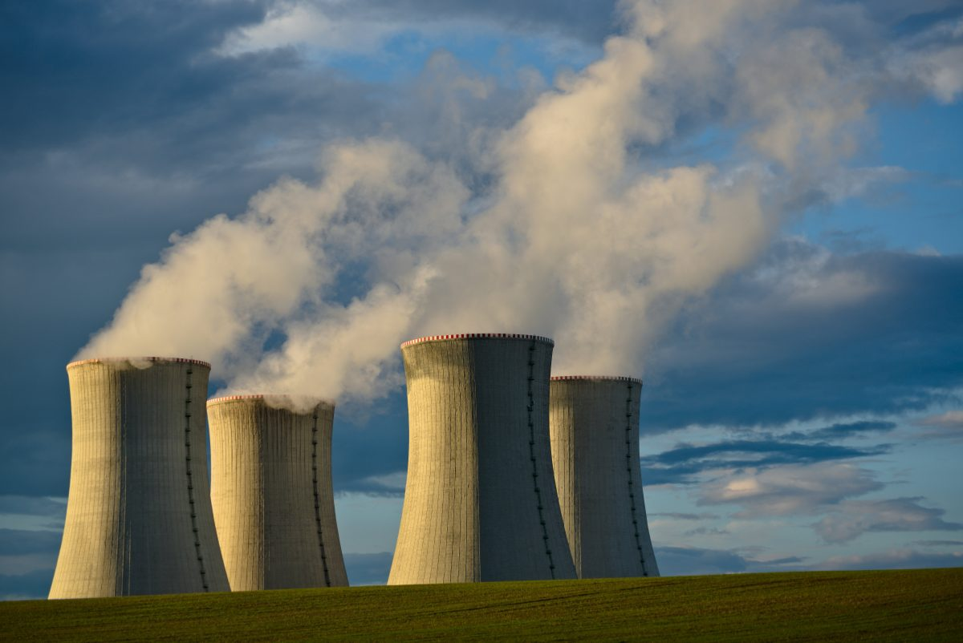
INTRODUCTION TO MLOPS
DANG TRUNG KIEN
SWITCH ON
ENERGY & DIGITAL FOR ENERGY TRANSFORMATION

Slide 2
CONTEXT
“The challegen for machine learning in production is to generalize to constantly changing edge cases”
  Use massive data because more data can lead to better generalization.
  Build infracstructure that allows models to learn to adapt to real time.
“Not all the companies have enough data to build a strong AI model.”
Notes:
There is a lot of sucess with #1 solution(big firm companies such as google, facebook), but #2 is so underrated. That’s why we need a new concept which make it real, and we call it MLops

Slide 3
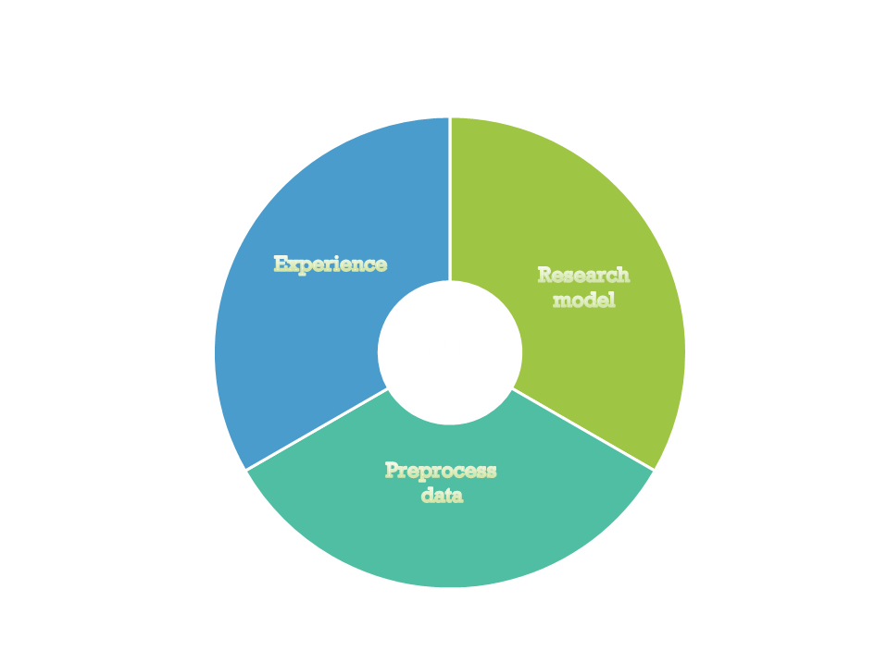
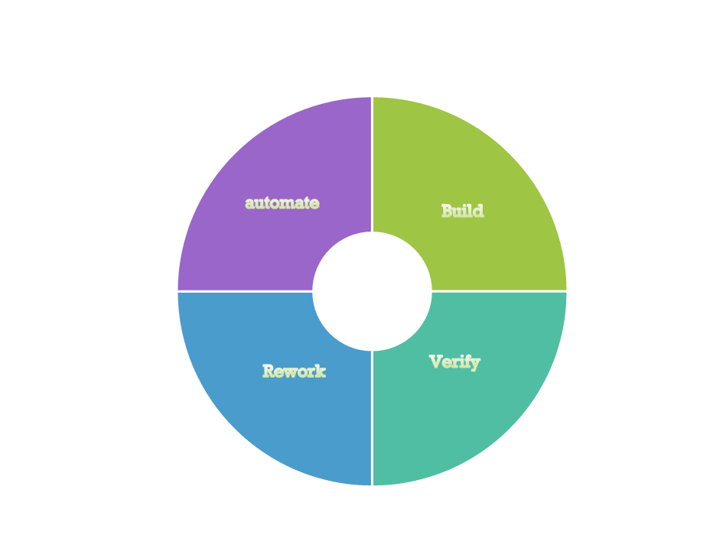

WHAT IS MLOPS ?
ML + Dev + Ops = MLOps
+
+

Slide 4
STATE OF AI IN THE LAST DECADE
Notes:
MLOps Level 0
For organizations starting on their ML journey, requiring infrequent deployment of models to production, may be only a few times in a year. At this stage, these organizations will have a small team of data scientists working individually on small datasets which are slow to change, manually deploying the models to production.
MLOps Level 1
For organizations with some experience in applying ML to business problems, requiring models to be trained and deployed more frequently, possibly monthly. At this level of maturity, the ML pipeline stage is automated while the testing and deployment of the models can still be manual. For such organizations, data scientists focus on model development, while the automation is handled by a separate team.
MLOps Level 2
For organizations dealing with rapidly changing web-scale datasets, daily if not hourly, it becomes necessary to be at this level, to allow for continuous retraining and deployment of ML models to multiple nodes or servers. At Level 2 maturity, the ML lifecycle activities will be spread across multiple teams responsible for data engineering, model experimentation and development, deployment, and monitoring.

