Slide 1

年輕人功德無量大隊
旅遊串流平台
Mates : 黃智輝、黃信翔、
林順德、馮上昀

Slide 2

1. Topic Introduction
2. Problems and Demands
Contents
3. Solutions
4. Used Datasets
5. Core Skills

Slide 3

01
Topic Introduction

Slide 4

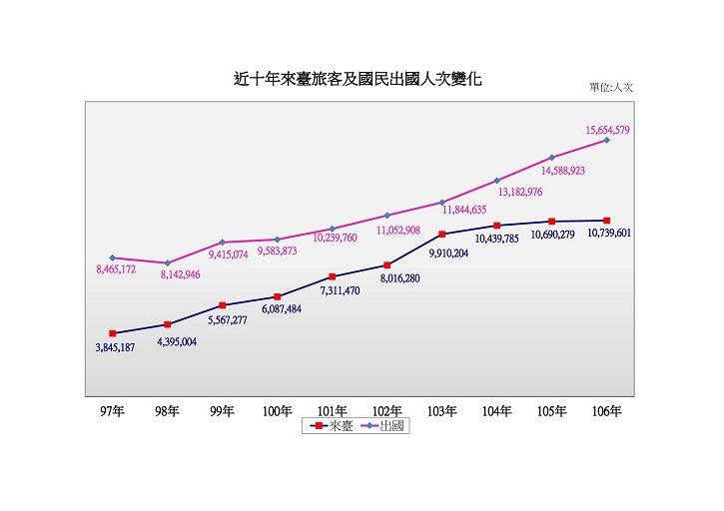
Topic Introduction
The tourists take a huge part of the travelers population.
In the wake of consumption capacity, the purposes of traveling abroad is not only for working,studying or visiting friends and relatives.
In the survey of passengers coming to Taiwan in the past five years, the number of passengers for tourism accounted for more than 70%. There is a trend of increasing year by year

Slide 5
02
Problems and Demands

Slide 6


Problems and Demands
Geographical environment
To prevent getting lost, the travelers usually locate themselves frequently in unfamiliar environment.
Language
There has a lot opportunities which could talk with foreigners in traveling way, but not all the travelers are having the languabe ability of other countries.
Emergency
It’s inconvenient when people meet with emergency. For example: getting sick, property get lost etc. In hence we need quick solutions to deal with it.

Slide 7
03
Solutions

Slide 8
Solutions
Travel Planning
Login Platform
Users can plan their traveling path through the collected dataset.
Login Google to use our services.
PART 01
PART 02
Language Translation
The platform offers language translation to solve the communicating problem between three countries. It can do lots of effort when meet with emergency.
PART 04
Map Location
PART 03
The map location can not only know the users location but also search the important facilities nearby.

Slide 9
04
Used Datasets

Slide 10
Used Datasets
Analysis
Visitor statistics from Taiwan Tourist Bureau
Refugee shelter locations
Public toilet locations
Locate
Accommodation
Accommodation locations from Taiwan Tourist Bureau
Locations of landscape from Taiwan Tourist Bureau
Landscape
Restaurant
Locations of restaurants from Taiwan Tourist Bureau

Slide 11
05
Core Skills

Slide 12
Core Skills
Other Kits:
Base:
Website Cloud Background:
Axios 、Bootstrap、Vue-Google-map、Vue-draggable
Vue-cli
Firebase

Slide 13
Demo

