Slide 1
AT968
Ip:192.168.160.1
192.168.160.3
Account:admin
Password:v6pbx

Slide 2
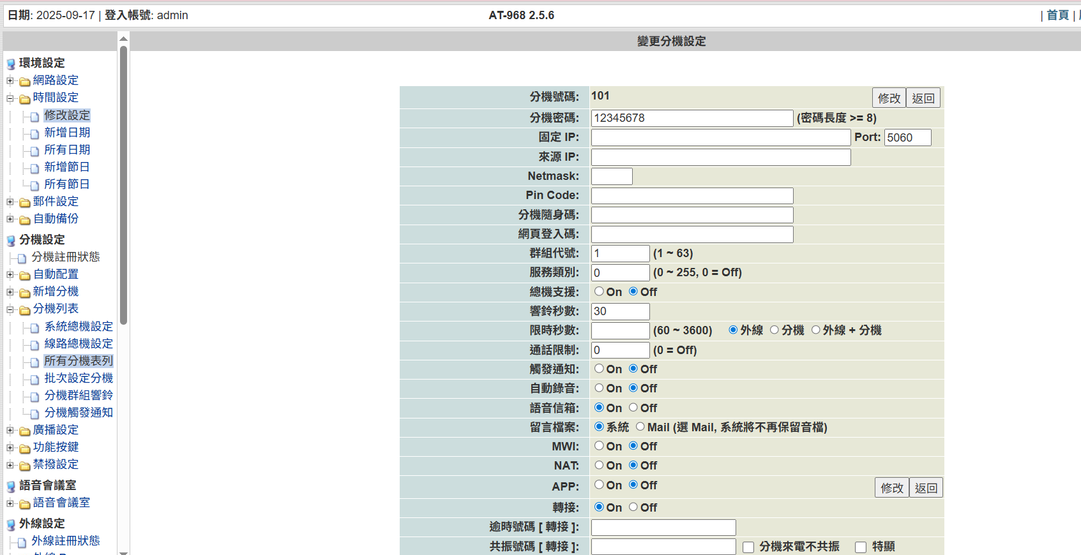

Slide 3
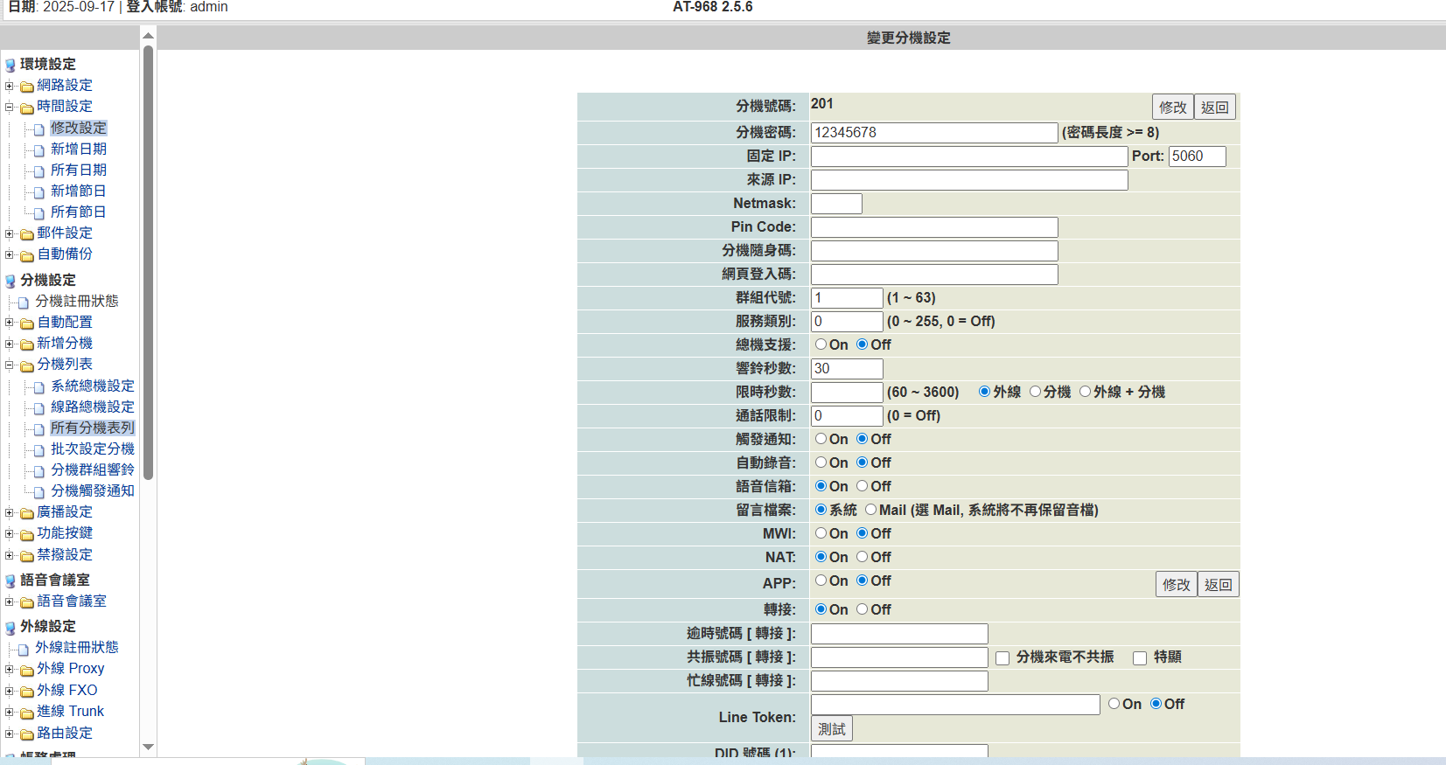

Slide 4
SP1700
Ip:192.168.160.2
Empty account&password
Click login

Slide 5
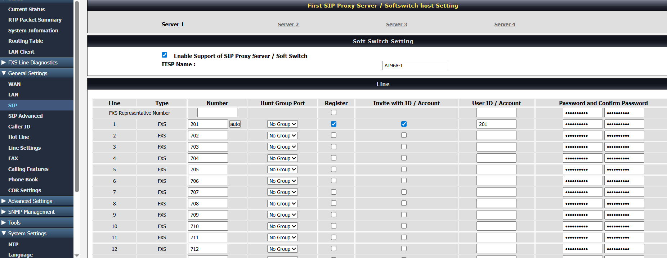

Slide 6
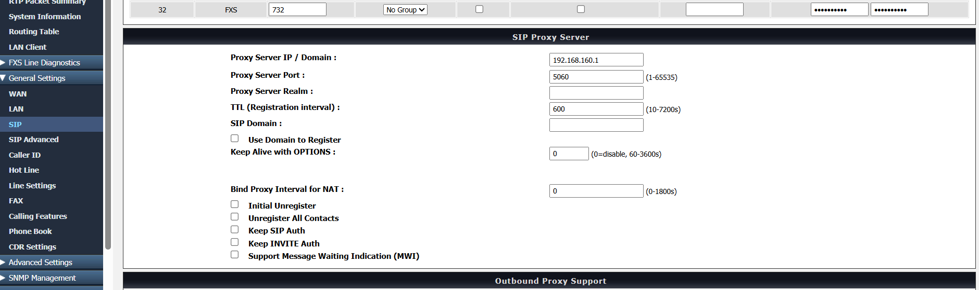

Slide 7
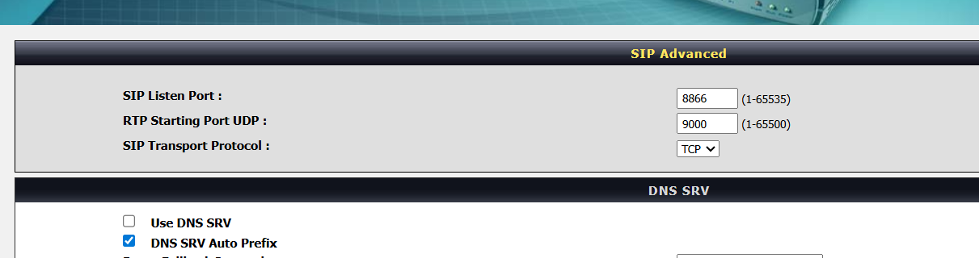
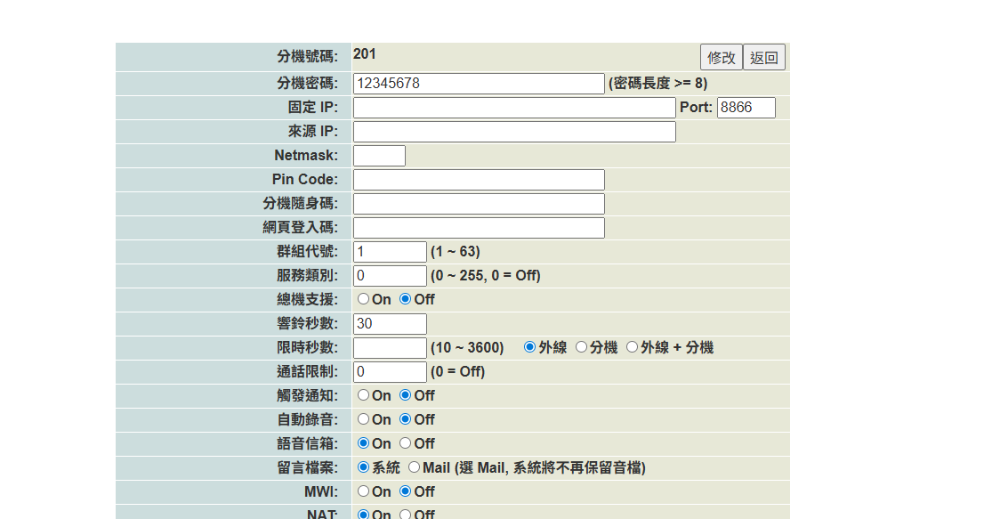

Slide 8
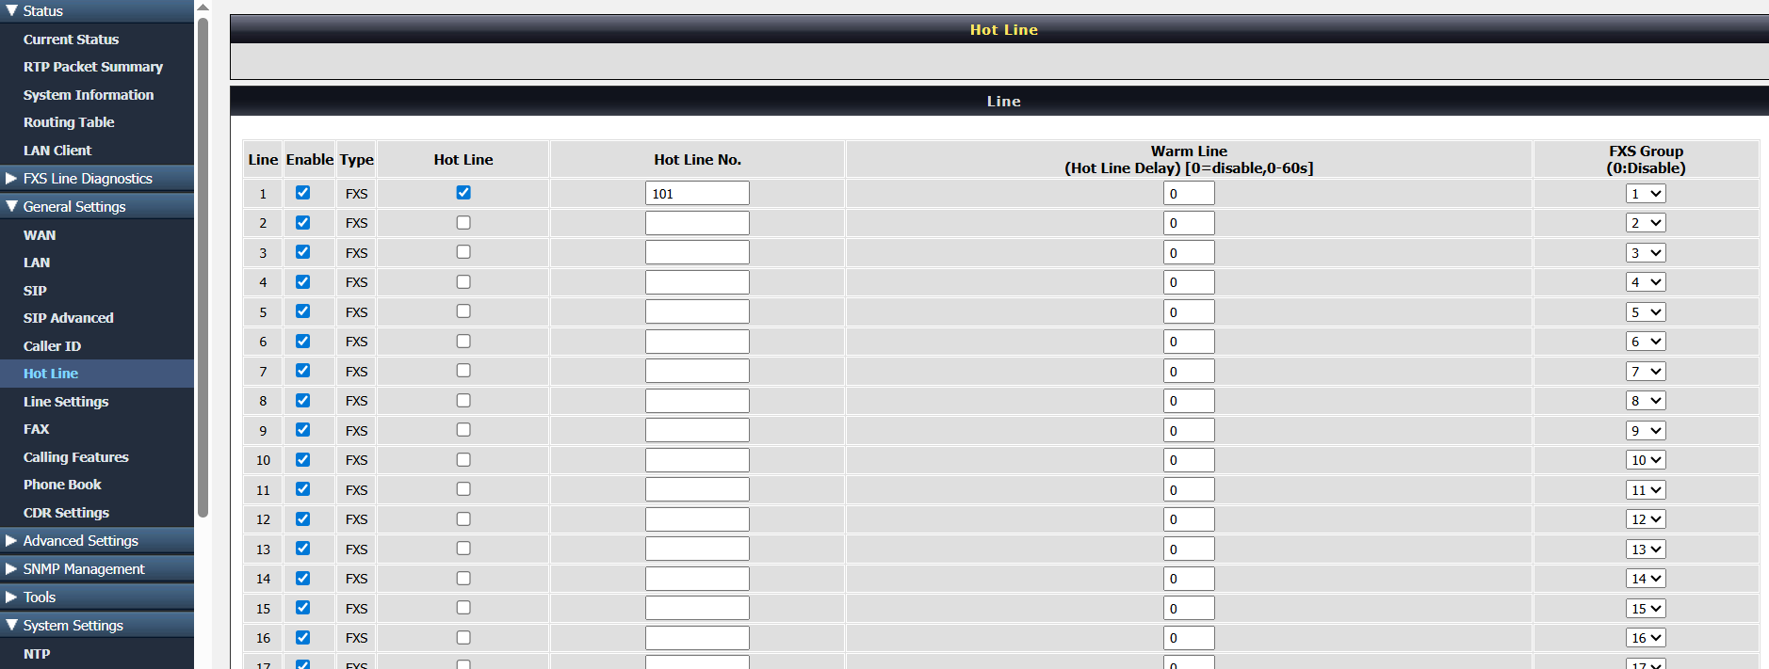

Slide 9
ALE300
ALE300 is noe mode at first.For changing to sip mode,follow steps:
1.Change tftp ip to an oxe cpu
2.Reboot
3.Change system info>run mode>noe mode to sip mode
4.Reboot and wait
5.Change DM ip address to http://xxx.xxx.xxx.xxx
6.Reboot
7.ale300 will login in a sip server by a xml file that is put on http server

Slide 10
ALE300(Noe mode)
Change sip mode
&get sip firmware
OXE CPU(tftp)
1
Get ale300 sip
parameter xml
ALE300(SIP mode)
HTTP Server
2

Slide 11
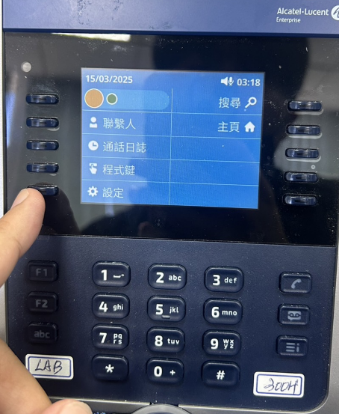
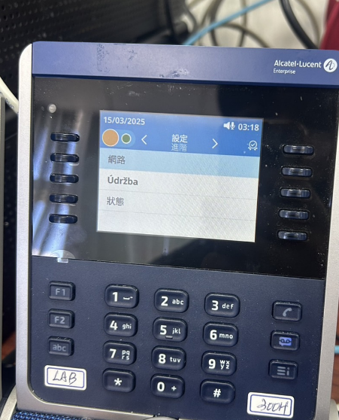
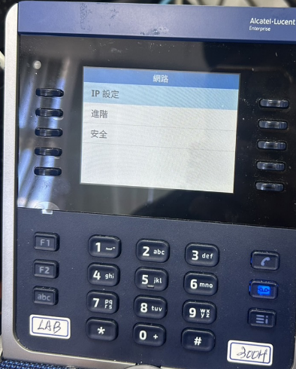
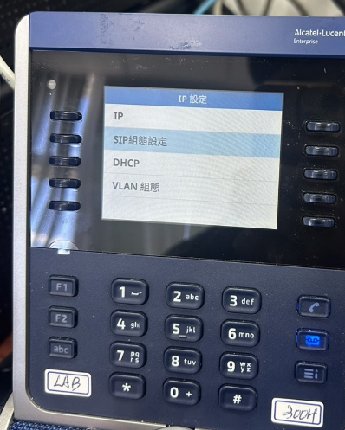
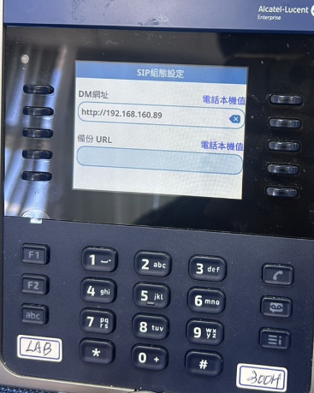
://

Slide 12
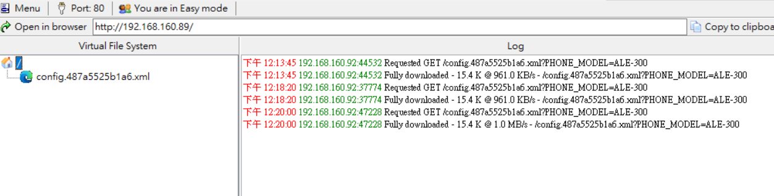
ALE 300
MAC

Slide 13
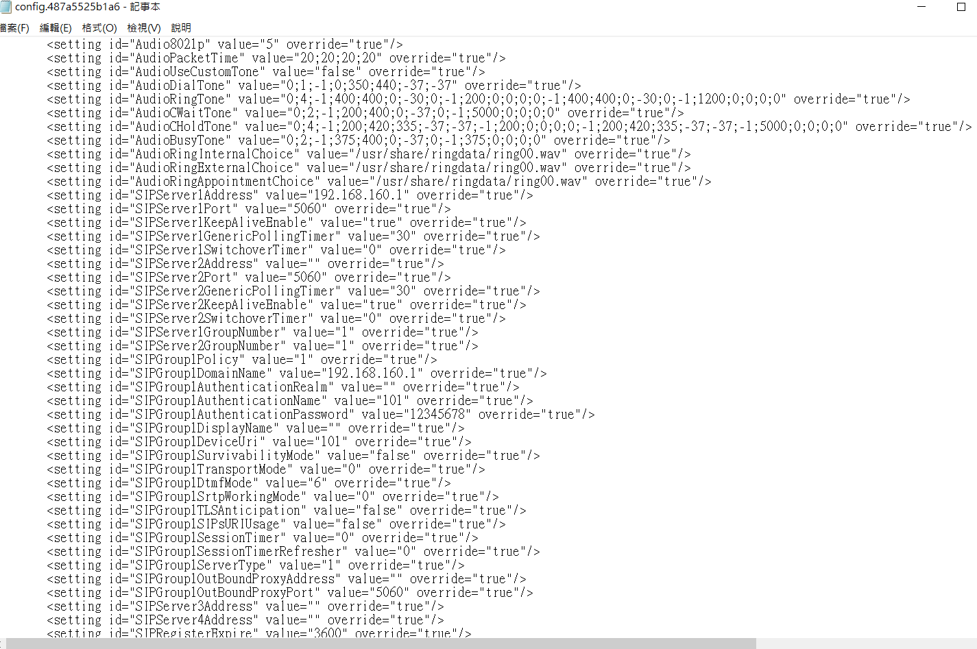

Slide 14
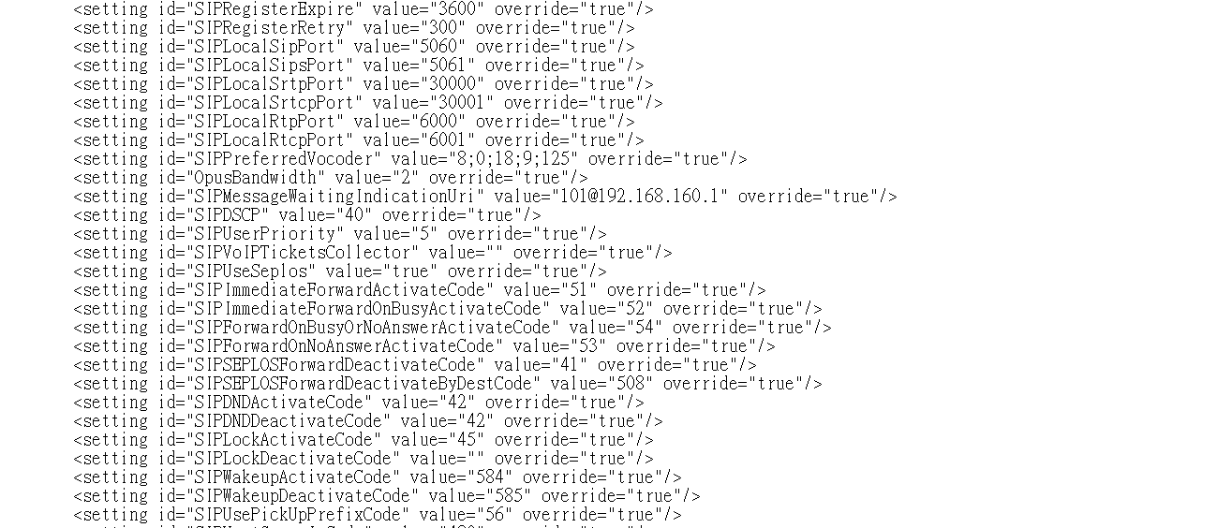

Slide 16
ALE300
Enable Conference

