Slide 1

Green Pace
Security Policy Presentation
Developer: Lufranc Kousse Akodjo
CS 405 Secure Coding | Project Two
Notes:
Hello, my name is Lufranc Kousse Akodjo. This presentation explains the Green Pace secure development policy, how the policy prioritizes coding risks, and how testing and automation make the controls repeatable. I will cover the ten security principles and coding standards, encryption and Triple-A, unit testing, DevSecOps automation, risks and benefits, and recommendations for maintaining the policy.

Slide 2


OVERVIEW: DEFENSE IN DEPTH
Green Pace needs one repeatable secure-development policy so security is built into design, coding, testing, release, and operations.
Defense in depth layers validation, secure coding, authentication, authorization, encryption, automated testing, logging, and monitoring so one failed control does not expose the system.
Notes:
Green Pace needs a consistent security policy because secure behavior should not depend on an individual developer remembering a best practice. The policy supports defense in depth by combining multiple controls. Input validation, secure coding standards, authentication, authorization, encryption, testing, logging, and monitoring each protect a different part of the system. If one control fails, another control can still prevent, detect, or limit the problem.

Slide 3
THREATS MATRIX
LIKELY
STD-002, 003, 008
High impact; low-cost fixes
PRIORITY
STD-004, 005, 007, 009
High impact + likely exposure
Threat level uses severity, likelihood, remediation cost, and priority.
Level 5 = greatest threat.
Levels 4 = high priority.
Levels 2–3 = monitor and remediate.
LOW PRIORITY
STD-006, 010
Medium severity; low-cost fixes
UNLIKELY
STD-001
High severity but lower likelihood
Notes:
The threat matrix groups the ten coding standards using the risk assessments from Project One. SQL injection is the highest priority because it received threat level five and can directly affect database confidentiality and integrity. Several likely high-impact issues, including unsafe values, string access, input conversion, integer overflow, memory ownership, and exception handling, are level four. Assertions and resource management are medium-level concerns, while the data-type standard is high severity but less likely. This organization helps the team decide what to fix first instead of treating every warning as equal.

Slide 4
10 PRINCIPLES
1 Validate Input Data — STD-001, 002, 003, 004, 008, 009
2 Heed Compiler Warnings — STD-001, 006, 009
3 Architect/Design for Security — STD-004, 005, 007, 010
4 Keep It Simple — STD-005, 007, 010
5 Default Deny — STD-008 + access-control policy
6 Least Privilege — STD-005, 010 + authorization policy
7 Sanitize Data Sent to Other Systems — STD-004
8 Defense in Depth — STD-002, 004, 007, 010
9 Effective QA Techniques — STD-006, 007
10 Adopt a Secure Coding Standard — STD-003, 005, 009
Notes:
These are the ten guiding security principles and their relationship to the coding standards. Validation is the broadest principle because it applies to data types, values, strings, SQL input, numeric conversion, and integer arithmetic. Compiler warnings support type safety, assertions, and integer correctness. Simplicity and secure standards support RAII and exception handling. Default deny and least privilege also extend into the Triple-A authorization policy. The main idea is that the principles explain why the standards exist, while the standards turn those principles into repeatable coding rules.

Slide 5
CODING STANDARDS
Priority order (highest risk first)
1. STD-004 SQL Injection — Level 5
2. STD-002 Data Value — Level 4
3. STD-003 String Correctness / STR53-CPP — Level 4
4. STD-008 Input Validation — Level 4
5. STD-009 Integer Overflow — Level 4
6. STD-005 Memory Protection — Level 4
7. STD-007 Exceptions — Level 4
8. STD-006 Assertions — Level 3
9. STD-010 Resource Management — Level 3
10. STD-001 Data Type — Level 2
Ranking emphasizes exploit impact and likelihood, then remediation cost.
Notes:
I ranked the coding standards primarily by threat level, then by exploit impact and likelihood. SQL injection is first because it is the only level-five item. Level-four standards follow, with issues that can expose memory, corrupt calculations, bypass validation, or reveal sensitive information placed ahead of lower-severity concerns. Assertions and resource management are level three, and the data-type standard is level two because its likelihood was rated lower. The ranking is a triage system, not permission to ignore lower-ranked findings.

Slide 6
ENCRYPTION POLICIES
IN FLIGHT — TLS 1.2+ with certificate validation for protected traffic crossing process, host, network, or trust boundaries.
AT REST — Approved strong encryption such as AES-256 for sensitive databases, disks, backups, cloud storage, and removable media; keys protected separately and rotated.
IN USE — Minimize plaintext lifetime and copies, restrict process privileges, clear sensitive temporary buffers when practical, and use protected/confidential computing when required.
Notes:
The encryption strategy protects data in each state. Data in flight uses TLS 1.2 or later with certificate validation. Data at rest uses approved strong encryption such as AES-256, with keys protected separately and rotated. Data in use is harder to protect because the application needs plaintext to process it, so the policy minimizes plaintext lifetime and copies, restricts process privileges, clears sensitive temporary buffers when practical, and allows protected-compute technologies when the threat model requires them.

Slide 7
TRIPLE-A POLICIES
AUTHENTICATION — Unique identities, secure credential handling, and MFA for privileged or sensitive access.
AUTHORIZATION — Default deny + least privilege. Check role/attribute permissions for every protected operation.
ACCOUNTING — Protect and retain audit logs for successful/failed logins, privilege changes, new users, database changes, sensitive-file access, and administrative actions.
Notes:
Triple-A means authentication, authorization, and accounting. Authentication proves identity and requires unique identities, secure credential handling, and multifactor authentication for privileged or sensitive access. Authorization determines what that identity can do and follows default deny and least privilege on every protected operation. Accounting creates the audit trail. Green Pace should log login results, privilege changes, new users, database changes, sensitive-file access, and administrative actions, and protect those logs from unauthorized modification.

Slide 8
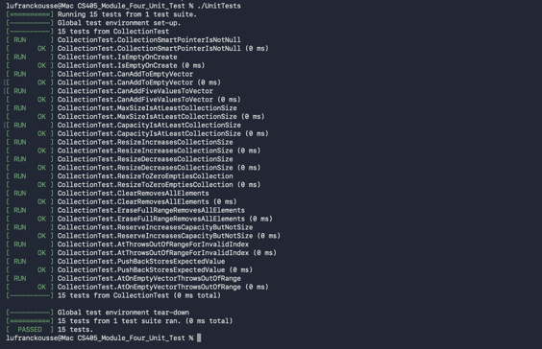
Does a new collection start empty?
Vulnerability focus: unsafe state assumptions / bounds use
Type: Positive
Framework: Google Test
Check: EXPECT_TRUE(collection.empty()) and size == 0
Result: PASS in completed Module Four suite
Take further: run automatically on every build to catch initialization regressions.
Notes:
The unit-testing portion uses the Google Test work from Module Four. The first positive test asks whether a new collection begins empty. This matters because code that assumes a container has elements can later perform unsafe indexing. The test verifies the empty state and a size of zero. In the completed Module Four suite, the test passed. In a DevSecOps workflow, this test should run on every build so initialization regressions are caught immediately.

Slide 9
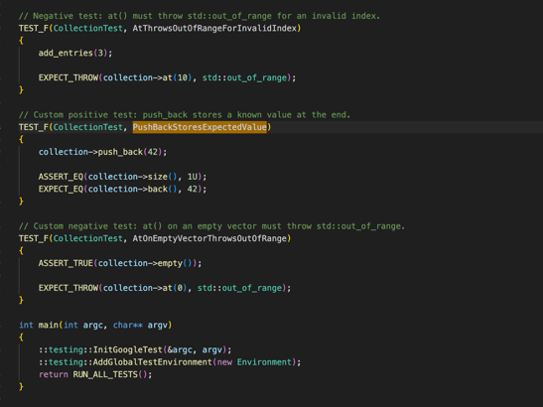
Can values be added while preserving expected size?
Vulnerability focus: container state correctness
Type: Positive
Framework: Google Test
Check: add values, then verify size and stored values
Result: PASS in completed Module Four suite
Take further: add boundary-size and repeated-operation cases.
Notes:
The second positive test verifies that values can be added while the vector maintains the expected size and contents. This checks normal container behavior before we focus on failure cases. The completed Module Four suite used ASSERT and EXPECT macros to make these conditions observable and the implemented tests passed. A next step would be to add boundary-size cases and repeated operations so the same behavior is tested under more demanding conditions.

Slide 10
Does reserve increase capacity without changing logical size?
Vulnerability focus: unsafe container assumptions
Type: Positive
Framework: Google Test
Check: reserve capacity; verify capacity >= request AND size unchanged
Result: PASS in completed Module Four suite
Take further: test multiple reserve sizes and memory-pressure behavior.
Notes:
The third positive test focuses on reserve. Reserve changes capacity but should not change the logical number of elements. My Module Four correction explicitly checked both requirements: capacity must increase to at least the requested amount and size must remain unchanged. This is a good example of a test proving two related conditions instead of checking only that the program continues to run.

Slide 11
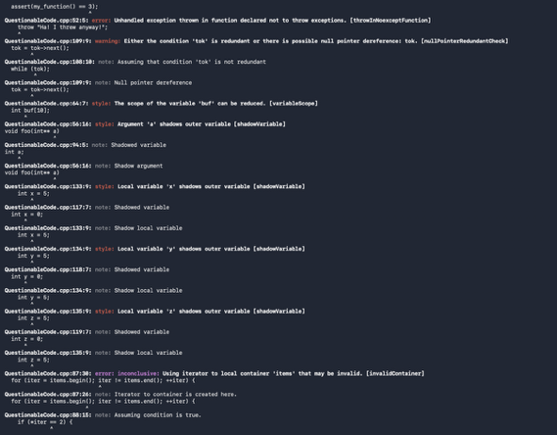
Does at() reject an out-of-range index?
Vulnerability focus: out-of-bounds access
Type: Negative
Framework: Google Test
Check: EXPECT_THROW(collection.at(invalidIndex), std::out_of_range)
Result: PASS in completed Module Four suite
Take further: pair with fuzzed/boundary indexes and sanitizer runs.
Notes:
This negative test checks out-of-range access. Using vector at with an invalid index should throw std::out_of_range instead of allowing unchecked access. EXPECT_THROW makes the expected failure behavior explicit. This connects directly to the Green Pace data-value and string-correctness policies because bounds must be validated before element access. Boundary indexes and sanitizer runs can extend this test further.

Slide 12
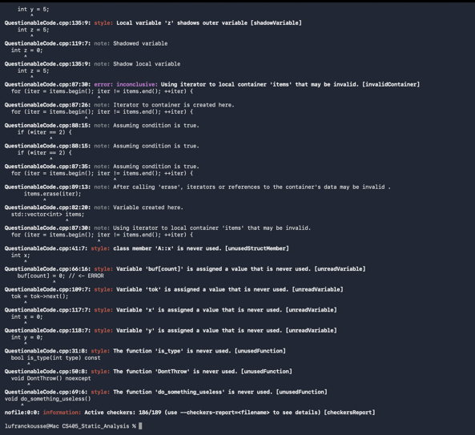
How should negative testing be strengthened?
Module Four feedback showed the two custom negative tests exercised the same exception condition.
Improvement: add a DISTINCT failure mode, such as invalid input rejected with a failure return/status rather than repeating the same out-of-range exception.
This strengthens graceful-failure coverage and directly addresses instructor feedback.
Notes:
The Module Four feedback identified an important improvement: my two custom negative tests produced the same exception, so they did not represent two distinct failure modes. For Project Two, I would strengthen the test plan with a different negative condition, such as rejecting invalid input through a failure status or validation result instead of repeating the same out-of-range exception. This makes negative testing more meaningful because it verifies graceful failure across different error paths.

Slide 13

AUTOMATION SUMMARY
Security gates move left: Create/Build → Verify/Test → Pre-production → Production monitoring
Notes:
This diagram shows where security belongs in the delivery lifecycle. Green Pace should move security left into pre-production while continuing to monitor production. Planning defines security requirements, design establishes trust boundaries, build enables compiler and static-analysis checks, and verify and test runs vulnerability scanning and unit tests. Production still needs monitoring, detection, response, and stabilization. Security is therefore continuous rather than a final gate.

Slide 14
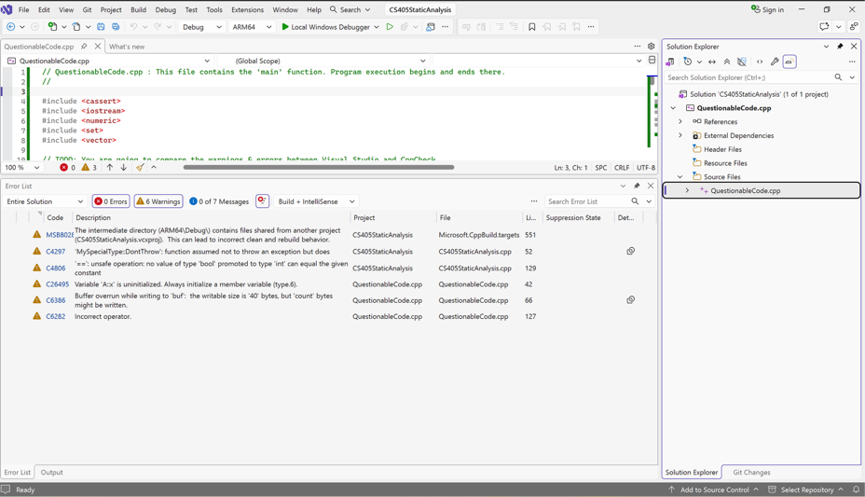
TOOLS
  CREATE / BUILD — Compiler warnings, Visual Studio code analysis, local Cppcheck.
VERIFY / TEST — CI runs Cppcheck/SAST, Google Test positive/negative tests, and selected sanitizers. High-priority failures block merge/release.
PRE-PRODUCTION / RELEASE — Preserve test and analysis reports as audit evidence.
PRODUCTION — Protected logs, monitoring, and alerting verify controls remain effective.
External testing evidence used in this course: Cppcheck 2.22.0 and Visual Studio code analysis; unit testing uses Google Test.
Notes:
The automation strategy places specific tools at each stage. During create and build, developers use compiler warnings, Visual Studio code analysis, and local Cppcheck. During verify and test, continuous integration runs Cppcheck or SAST, Google Test positive and negative tests, and selected sanitizers. High-priority failures block the merge or release unless an approved exception is documented. Reports are preserved for audit evidence, while production logging and alerting confirm that controls remain effective after deployment.

Slide 15
RISKS AND BENEFITS
ACT NOW
• Fix SQL injection first: Level 5, direct path to unauthorized database operations.
• Next address out-of-bounds/string/input/integer/memory/exception issues: mostly Level 4.
• Automate checks so defects are blocked before release.
IF WE WAIT
• Vulnerabilities become more expensive to correct after integration or deployment.
• Repeated manual checks can be skipped or applied inconsistently.
TRADEOFF
Automation can create false positives/noise, so findings still require developer review and documented exceptions.
Notes:
The largest benefit of acting now is reducing exposure before vulnerable code reaches production. SQL injection should be addressed first because it is the only level-five threat. Level-four memory, bounds, validation, arithmetic, and exception issues follow. Waiting increases remediation cost because the vulnerable behavior can spread into more components and become harder to change. Automation also has a limitation: static-analysis tools can generate noise or false positives, so developers still need to review findings rather than treating every tool message as a confirmed vulnerability.

Slide 16
RECOMMENDATIONS
    Current gaps and improvements
• Expand distinct negative tests beyond repeated exception cases.
• Add dynamic analysis/sanitizers and dependency scanning to complement static analysis.
• Define measurable security gates and exception-expiration dates in CI/CD.
• Review cryptographic configuration and key rotation on a scheduled basis.
• Test authorization at every protected operation, not only at login.
• Correlate application audit events with existing OS, firewall, and anti-malware logs.
Notes:
The current policy can be improved in several areas. Negative testing should cover distinct failure modes. Dynamic analysis, sanitizers, and dependency scanning should complement static analysis. CI/CD needs measurable security gates and time-limited exceptions. Cryptographic configuration and key rotation should be reviewed regularly. Authorization should be tested on every protected operation, and application audit events should be correlated with the operating system, firewall, and anti-malware logs Green Pace already collects.

Slide 17
CONCLUSIONS
Adopt and continuously enforce:
• SEI CERT C++ secure coding guidance, including STR53-CPP range checking.
• Parameterized SQL and strict input/range validation.
• RAII and safe resource ownership.
• Runtime validation instead of security-critical assertions.
• TLS 1.2+ in flight and approved strong encryption at rest.
• Default deny, least privilege, MFA, and protected audit logging.
• Automated static analysis + unit/negative testing in CI/CD.
Security should be intrinsic to development—not a final-stage activity.
Notes:
My recommendation is to keep the ten standards but enforce them continuously. Green Pace should use SEI CERT C++ guidance such as STR53-CPP, parameterized SQL, strict validation, RAII, safe exception handling, strong encryption, and Triple-A access controls. Automated static analysis and unit testing should be required in the pipeline. The larger principle is that security cannot be postponed until the end of development. It has to be part of design, implementation, testing, release, and operations.

Slide 18
REFERENCES
Carnegie Mellon University Software Engineering Institute. (n.d.). SEI CERT C++ Coding Standard: STR53-CPP, Range check element access.
https://cmu-sei.github.io/secure-coding-standards/sei-cert-cpp-coding-standard/rules/characters-and-strings-str/str53-cpp/
National Institute of Standards and Technology. (2020). Security and Privacy Controls for Information Systems and Organizations (SP 800-53 Rev. 5).
https://csrc.nist.gov/pubs/sp/800/53/r5/upd1/final
OWASP Foundation. (n.d.). OWASP Cheat Sheet Series.
https://cheatsheetseries.owasp.org/
Google. (n.d.). GoogleTest documentation.
https://google.github.io/googletest/

