Slide 1
I'd just like to interject for a moment. What you’re referring to as Linux, is in fact, GNU/Linux, or as I’ve recently taken to calling it, GNU plus Linux. Linux is not an operating system unto itself, but rather another free component of a fully functioning GNU system made useful by the GNU corelibs, shell utilities and vital system components comprising a full OS as defined by POSIX. Many computer users run a modified version of the GNU system every day, without realizing it. Through a peculiar turn of events, the version of GNU which is widely used today is often called “Linux”, and many of its users are not aware that it is basically the GNU system, developed by the GNU Project. There really is a Linux, and these people are using it, but it is just a part of the system they use. Linux is the kernel: the program in the system that allocates the machine’s resources to the other programs that you run. The kernel is an essential part of an operating system, but useless by itself; it can only function in the context of a complete operating system. Linux is normally used in combination with the GNU operating system: the whole system is basically GNU with Linux added, or GNU/Linux. All the so-called “Linux” distributions are really distributions of GNU/Linux.
Why you should use Linux

Slide 2
OOOOH high tech gadgetry, Ben Ten Omniverse! It's like I've got my own JARVIS in the Pentagon, guarded by a firewall with more black wires, blue wires, and green wires than you can imagine. I'm practically a hacker man with my smartness, Intel inside my Lenovo, channeling the spirit of Steve Jobs and his Mark 1 creations. It's all about that very, very technology that makes my Tardis of a computer hum with the efficiency of a robot terminator assembly. I'm talking about bits and bytes, Object-Oriented Programming in Python, iterators, lists, and pickles, all neatly stored in dictionaries. My bots automate tasks faster than you can say "RAM, hard disks, SSDs, Intel processors, AMD processors, Qualcomm processors, 7-nanometer process, overclocking, heating issues." My MacBooks and Dell ultrabooks are like the cool kids in the water cooling club, keeping things as chill as a Linux penguin on a hot summer day. But wait, there's more! For loops, while loops, OCR to catch those pesky errors, and compilation that rivals a symphony. I'm multitasking like a pro, juggling Linux with its GNOME and awesome, KDE plasma, and macOS, as well as all the *nix systems in between. My AI and machine learning skills are so POSIX compliant that they could run a shell terminal emulator simulator in their sleep, all while managing threads, cores, quad-core processors, and multithreading like a boss.
5 Reasons to Use Linux

Slide 3
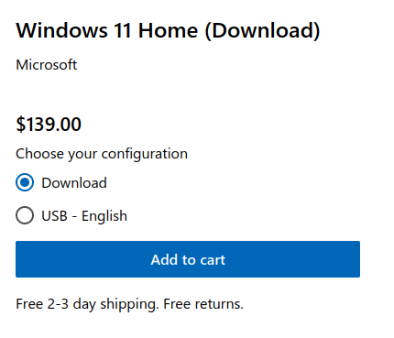
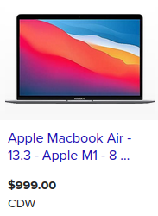
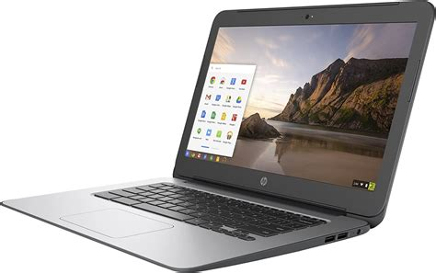
Reason #5 - It’s Literally Free
Not Free
Very Not Free
Basically free if you hate yourself

Slide 4
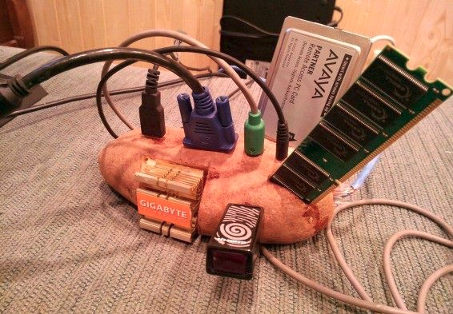
Reason #4 - Lightweight
Windows 11 Minimum Requirements
1 GHz Processor
4GB RAM
64 GB Storage
Internet Connection
720p Display
Linux Minimum Requirements

Slide 5
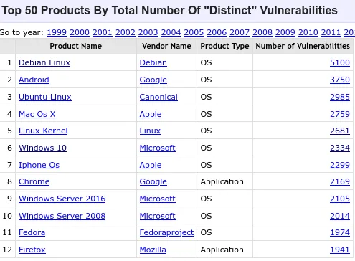
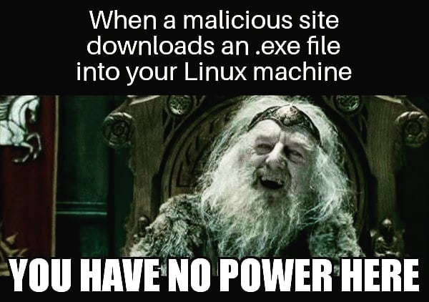
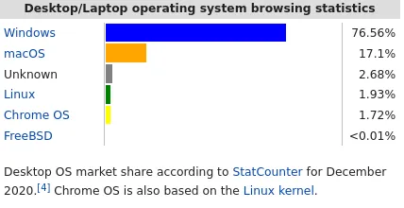
Reason #3 - It’s Secure
Notes:
package mangers
user permissions
open source means more bugs are found faster

Slide 6

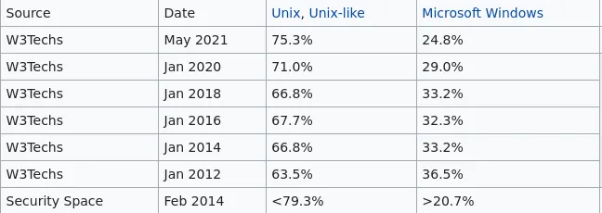

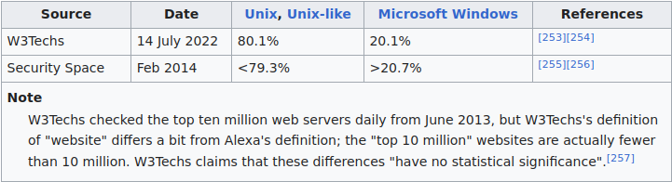
Reason #2 - Built for Development
Installing gcc on Linux mental gymnastics
> sudo apt-get install gcc
Installing gcc on Windows mental gymnastics
> select the right components
> realize you have to install WSL for testing
> go to website and find the right link
> make sure the right path is in env variables
> download and open install gui

Slide 7
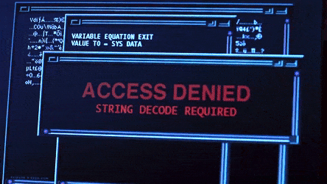




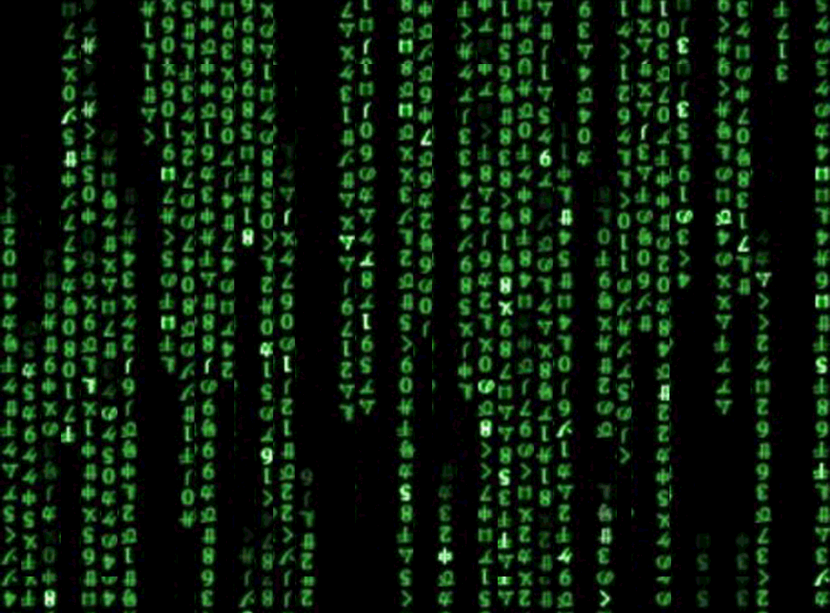
Reason #1 -
Reason #1 - Makes you feel like a Hacker

