Slide 1

Vision, Mission, Plans for the Future,
Roadmap for Growth

Slide 2
Our Vision
Software development is a huge industry
Outsourcing is only going to continue to grow
No clear leader
India the first country emerge
Now the global competition
Where does Svitla fit in – grow to one of the largest outsourcing companies not just in Ukraine but in Eastern Europe

Slide 3
Svitla Story
How it all started – October 17th, 2003 - our company Day
Svitla meaning and Svitla’s Roman “legend”
What we want to do next
  Growth, growth, growth
  Discomfort when growing and evolving
  Key to growth and replicate the process with the growth

Slide 4
Svitla Advantage
Ability to get sales – Svitla’s one of the key advantage
Location in Silicon Valley
Access to Stanford entrepreneurs and networks
Strong technical talent
Ability to recruit and bring new people is important
Processes and motivation schemes
Svitla’s advantage for people

Slide 5
Developers Gradation Within Svitla
 | Stazhor | Junior | Middle | Senior/Team Leader
Kyiv/Elsewhere in Ukraine | $250-500 | $600-1000 | $1100-1600 | $1700-3000
Average Expectation to move | 3 – 6 months | 1-2 years | 2-3 years

Slide 6
Juniors/Middle Developers
Perform on the project, keep the customer happy
Utilization levels are important !
Do the project work and do it well
Grow technically
Develop good communication skills
English in Svitla is a must, improve English skills

Slide 7
Team Leaders Responsibilities
Make customers happy!
Manage and grow the team
Communicate holidays schedules, coordinate vacations, etc with the customer in advance
Work with HR and sales department

Slide 8
Compensation with Svitla
For stazhory, juniors and middle – reviews twice a year
Process for review - team leader is primary input, HR, and
management team input
Key criteria for evaluation in review:
  Performance on projects & customer satisfaction is key
  Utilization on project basis
  Technical/professional growth
  Bringing/referring new people to the team

Slide 9
Compensation in Svitla – Team Leaders
Annual bonus in the form of 13th month salary
3 buckets equally weighted
Bucket 1. Performance on current projects
  no decrease in the team
  happy customer
  no loss of projects
Bucket 2. Work with HR and Sales department
Input and reviews from Maria and Andriy
Bucket 3. Adding new people onto the team/spinning out new team leaders

Slide 10
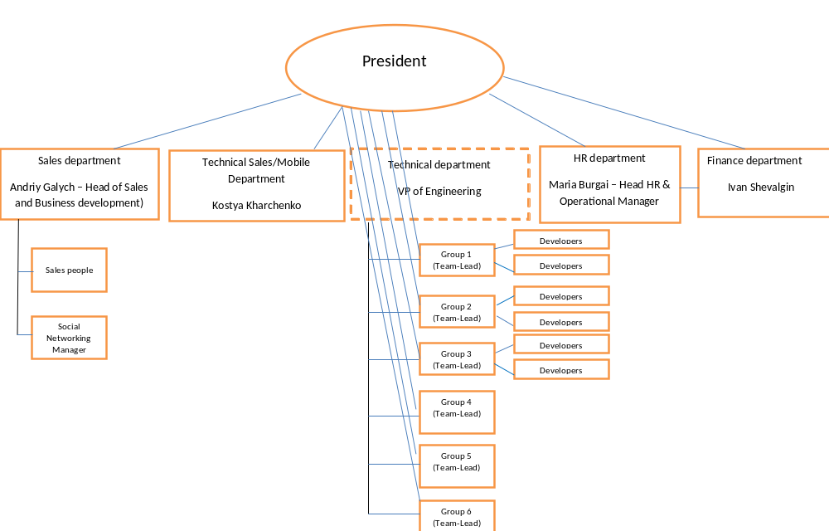
Org Chart

Slide 11
What is HR doing?
Taking care of people
Recruiting, interviewing, close collaboration with Sales
Monthly “Open door “ Policy – last Friday of each - with the Management team
Conduction of the evaluations
Track vacations – Nina , Maria
Maria’s short presentation

Slide 12
What is Finance Department Responsibilities?
Take care of compensation # 1 priority
Do all the paperwork related to P. E.
Computer/hardware related purchases
Utilization tracking and time reports

Slide 13
What Does Sales Department Do?
Sales are key for growth, cannot be done in a vacuum, maximum
Support to our sales department from team leaders
Sales department road map
Andriy’s short presentation

Slide 14
Off we go to a merry start!
Questions, discussion and
NOW WE PARTY!!!

