Slide 1
Augmenting Physical State Prediction Through Structured Activity Inference
Nam Vo & Aaron Bobick
ICRA 2015

Slide 2
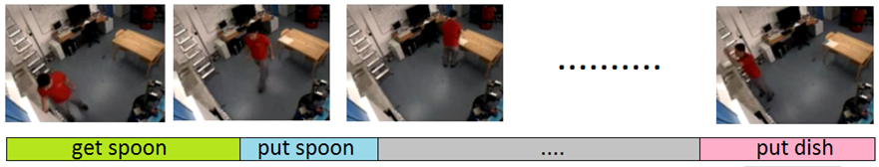
Structured Activity
Long sequence composed of multiple actions with a temporal structure (defined by a grammar).
Sequential Interval Network (SIN):
recognize the sequence of actions
predict the timing
Segment the sequence temporally

Slide 3
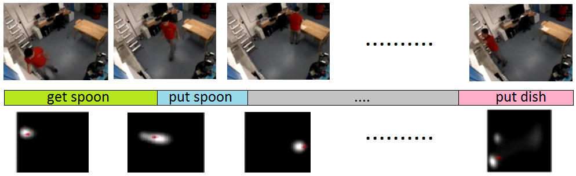
Problem
This paper extends SIN
predict the state (human position/movement) during the activity
High level ideal:
Learn the prior distribution of the state during each action
+ infer which action happens when
➔ predict the state at any moment in time.

Slide 4
High level ideal
Extend SIN framework
Learn the prior distribution of the state during each action + infer which action happens when => predict the state at any moment in time.
Demonstration:
https://www.youtube.com/watch?v=Mvs2MjVdYAI

Slide 5
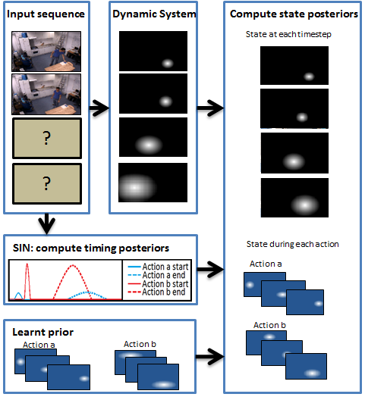
System Pipeline
Training: SIN & state prior of primitive actions.
Testing: given a partially observed sequence
Run a Dynamic System to get estimations.
Run SIN to get timing posteriors of actions.
Run the final inference to get state posteriors

Slide 6
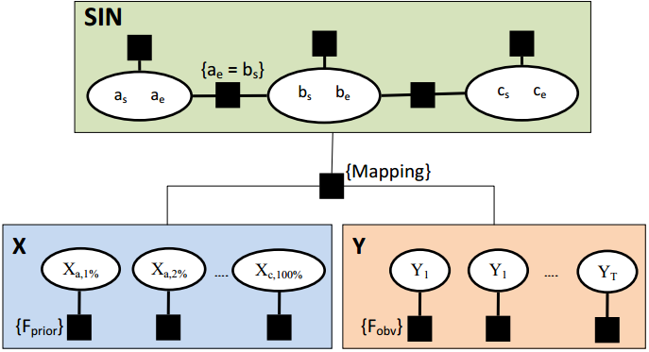
The Graphical Model

Slide 7

The Graphical Model
The timing variables from SIN:
$α_{s}, α_{e}$ is the start time and end time of action $α$. For every action (S, a, b, c, etc)
Perform inference to obtain their posteriors.

Slide 8
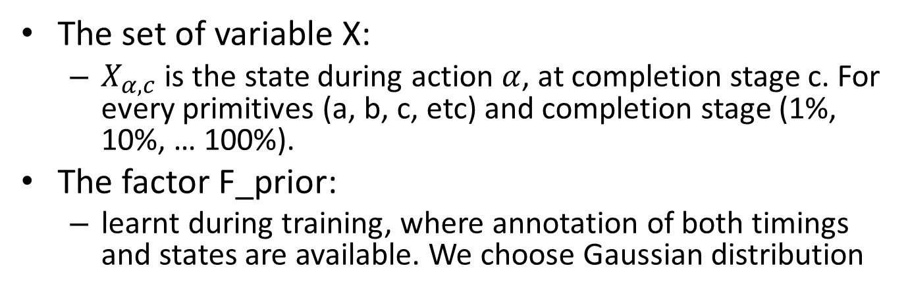
The Graphical Model
The set of variable X:
$X_{α, c}^{}$ is the state during action $α$, at completion stage c. For every primitives (a, b, c, etc) and completion stage (1%, 10%, … 100%).
The factor F_prior:
learnt during training, where annotation of both timings and states are available. We choose Gaussian distribution

Slide 9

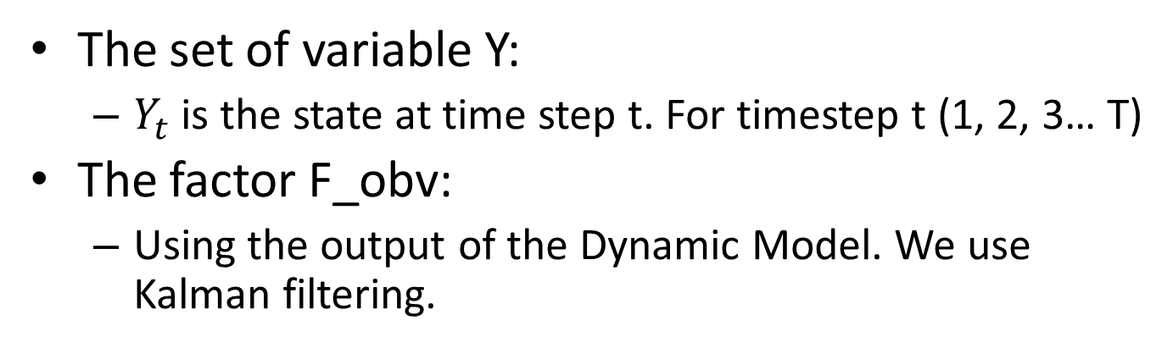
The Graphical Model
The set of variable Y:
$Y_{t}^{}$ is the state at time step t. For timestep t (1, 2, 3… T)
The factor F_obv:
Using the output of the Dynamic Model. We use Kalman filtering.

Slide 10
The Graphical Model

Slide 11
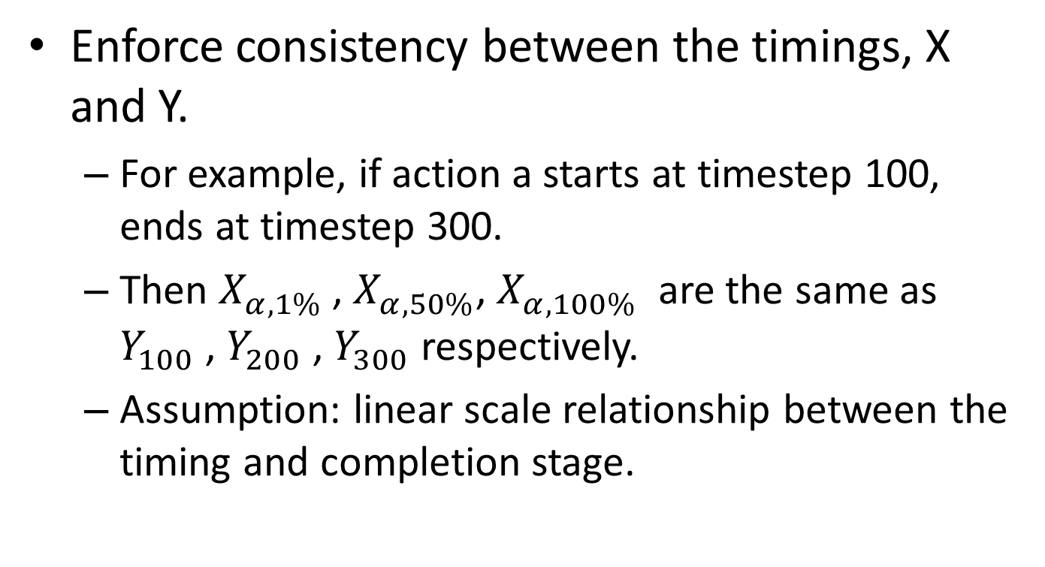
The mapping
Enforce consistency between the timings, X and Y.
For example, if action a starts at timestep 100, ends at timestep 300.
Then $X_{α, 1\%}^{}$ , $X_{α, 50\%}^{}$, $X_{α, 100\%}^{}$ are the same as $Y_{100}^{}$ , $Y_{200}^{}$ , $Y_{300}^{}$ respectively.
Assumption: linear scale relationship between the timing and completion stage.

Slide 12
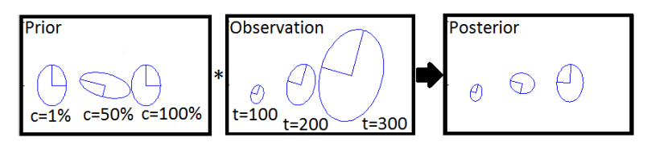
Inference, the simple case
Assume the timings are known, that is all mapping between X and Y have been resolved.
Use: posterior ~ Prior * Likelihood
F_prior on X acts as prior
F_obv on Y acts as likelihood
Posterior is for both X and Y. It’s a Gaussian

Slide 13
Inference
We don’t know the exact value of the timing, but we know its posterior (using SIN).
Perform integral (weighted sum) on every possible timings.
The posteriors of the state (X & Y) in this case will be mixtures of Gaussians.

Slide 14
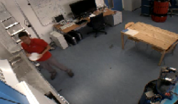
TUM Kitchen Dataset
Activity: setting a table (“robotic version”).
Defined by the grammar as a sequence of 14 primitive actions.
The subject moves back and forth to retrieve 7 objects
Task: movement
Prediction & smoothing.

Slide 15
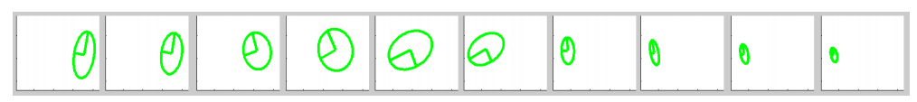
TUM Kitchen Dataset
Example of learnt prior distribution of the action get-spoon. The subject will move from the table (on the right) to the kitchen (on the left) in order to get a spoon inside the drawer.

Slide 16
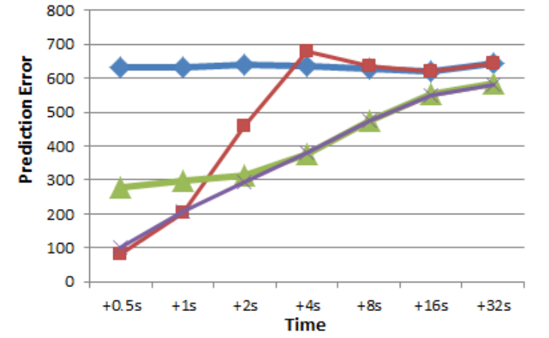
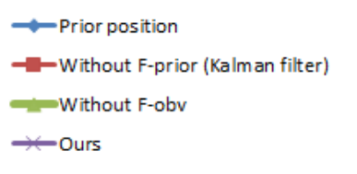
TUM Kitchen Dataset
Prediction task: running in streaming mode and predict the position in 7 points in the future

Slide 17
TUM Kitchen Dataset
Prediction task: running in streaming mode and predict the position in 7 points in the future

Slide 18
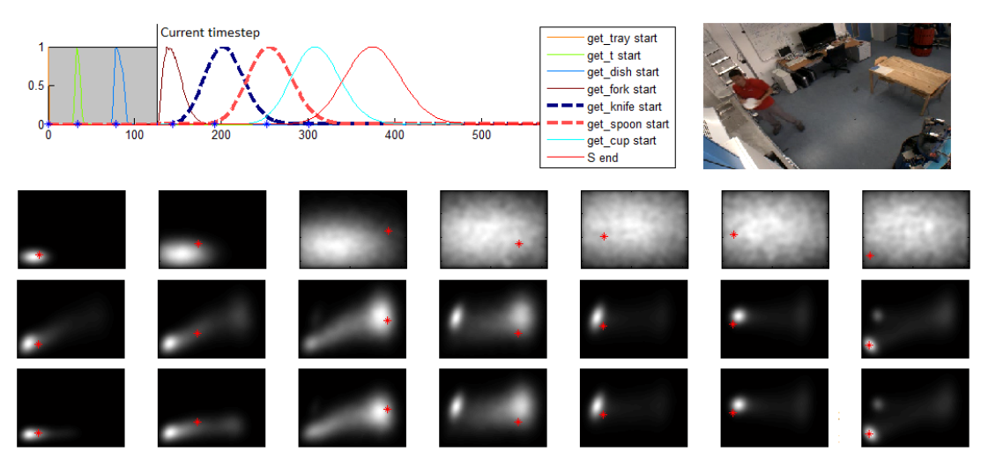
TUM Kitchen Dataset
Snapshot: prediction of the timing and position

Slide 19
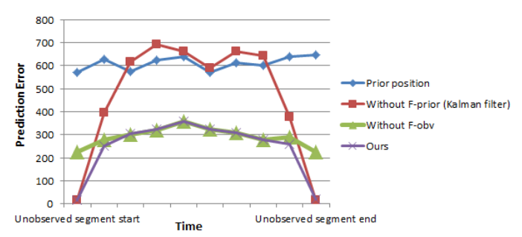
TUM Kitchen Dataset
Smoothing task

Slide 20
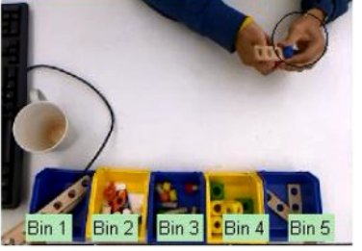
Toy Assembly Dataset
Activity: assembly 1 of 3 different toy models. There’s 12 variations in the course of actions (defined by a grammar) and 40 different primitives actions (each is getting a part from 1 of 5 bins and assemble it).
Task: predict active
hand’s movement

Slide 21
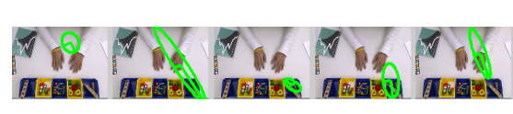
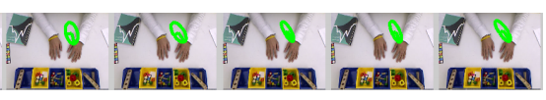
Toy Assembly Dataset
Example of learnt prior distribution during a particular action (getting a piece from bin 5 and assemble it)

Slide 22
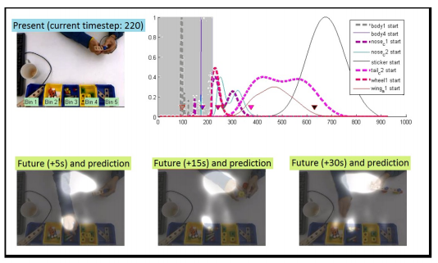
Toy Assembly Dataset
Parsing online: prediction of the timing and state

Slide 23
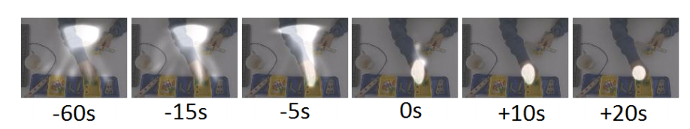
Toy Assembly Dataset
Parsing online: prediction gets better

Slide 24
Conclusion
Parsing structured activity:
Recognize the course of action & prediction of the timings
Prediction of the state (position/movement)
Combine:
timing information
the prior, with respect to the action’s completion stage
the observation, with respect to time
Output the posterior of the state:
w.r.t. action: X, useful for action analysis.
w.r.t. timestep: Y, useful for future prediction or smoothing.
Questions?
http://www.cc.gatech.edu/~nvo9/phy_icra2015/

