Slide 1
GBM Project SP039: CD45+ Cell Isolation and T Regulatory Cell Reclustering
Second Meeting 14-11-23
Simone Puccio

Slide 2
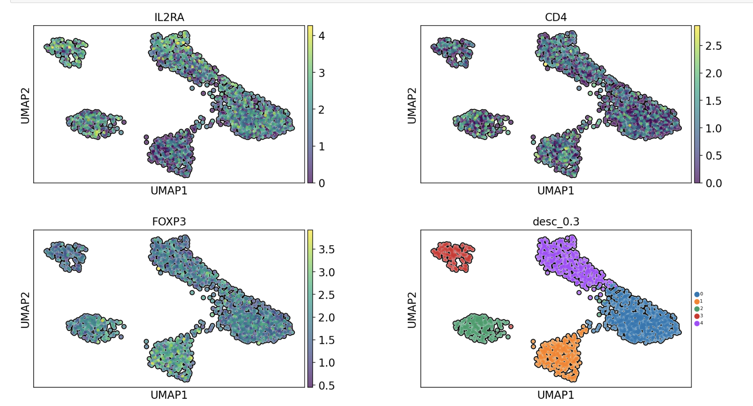
Resolution 3 - Reclustering

Slide 3
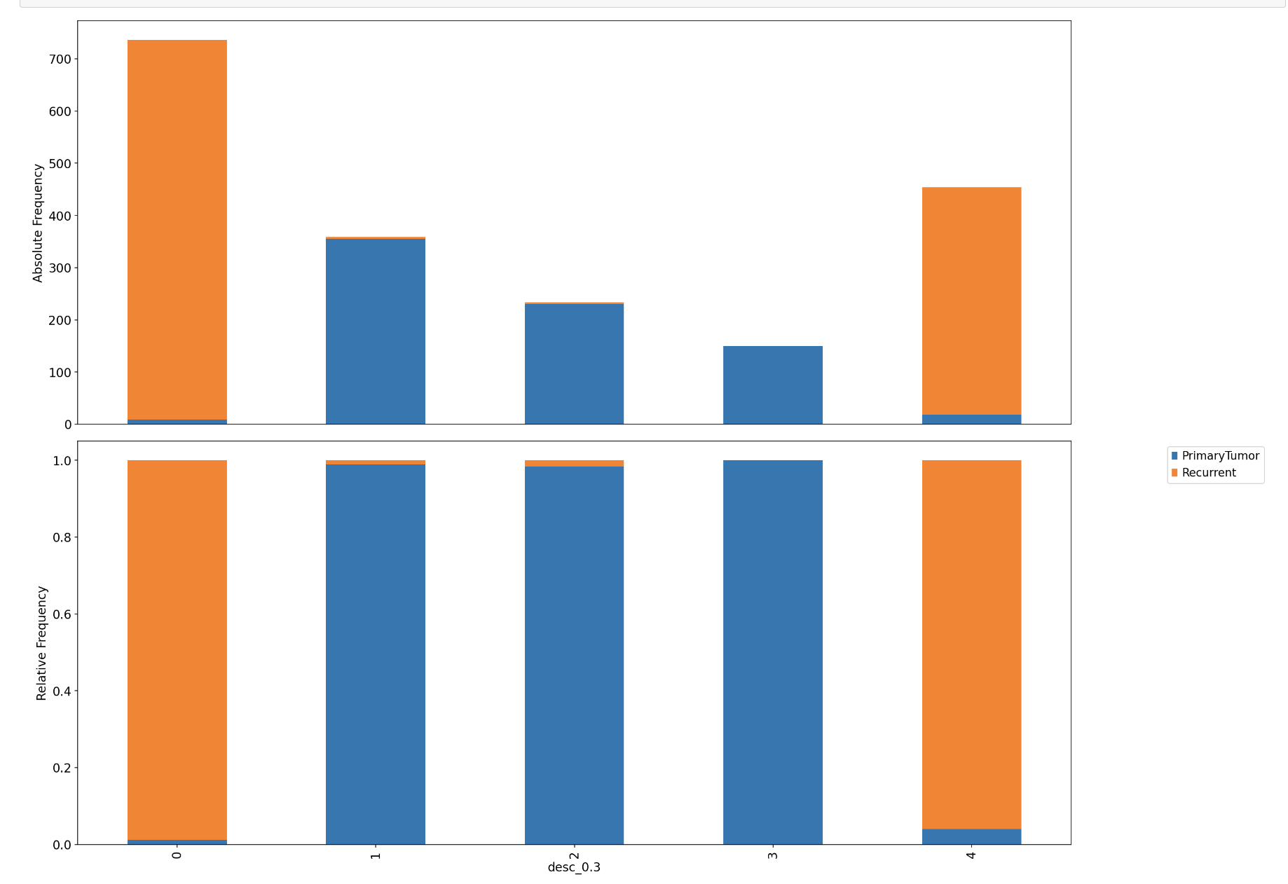
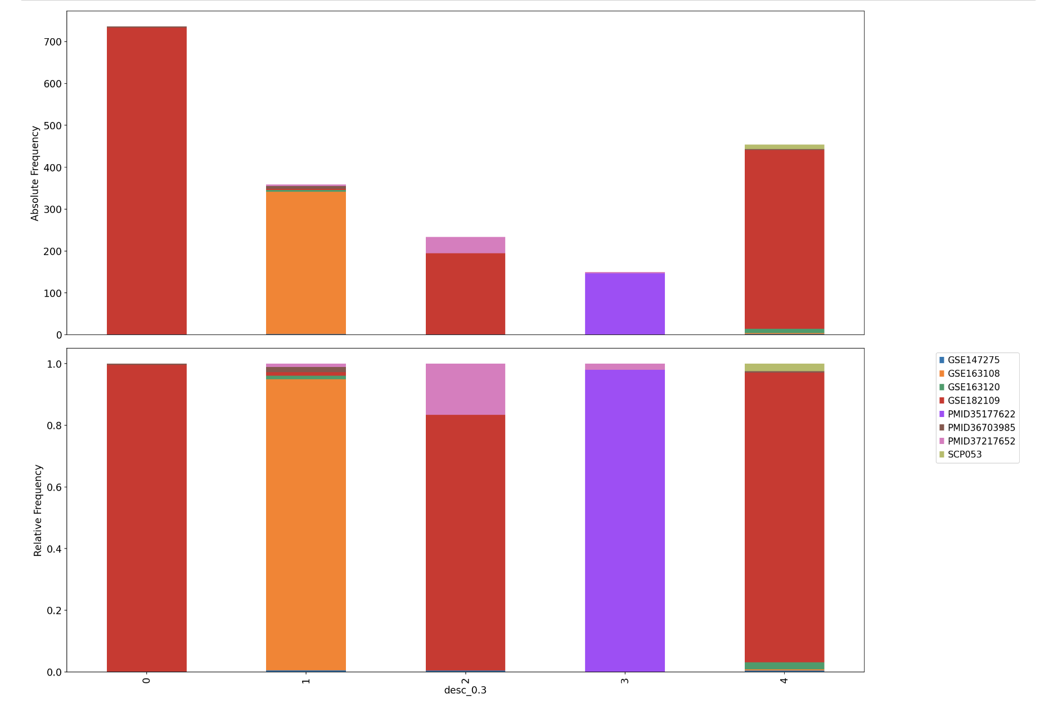
Resolution 3 – Cluster frequency

Slide 4
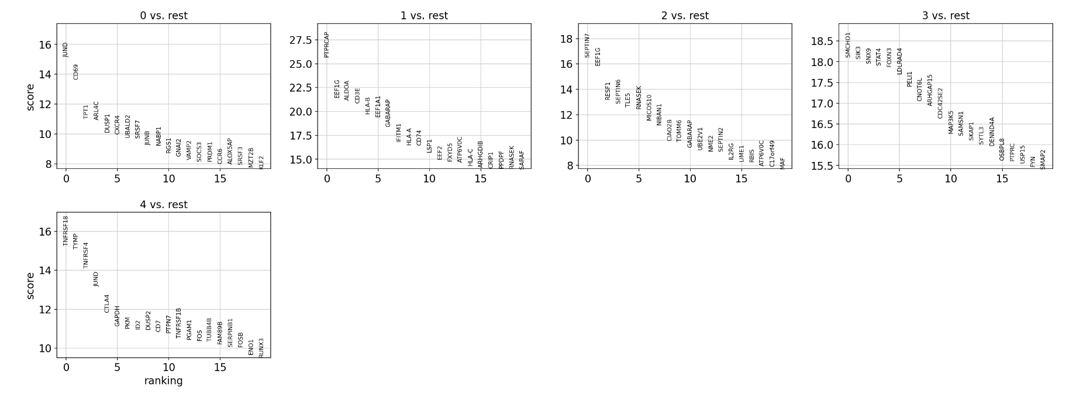
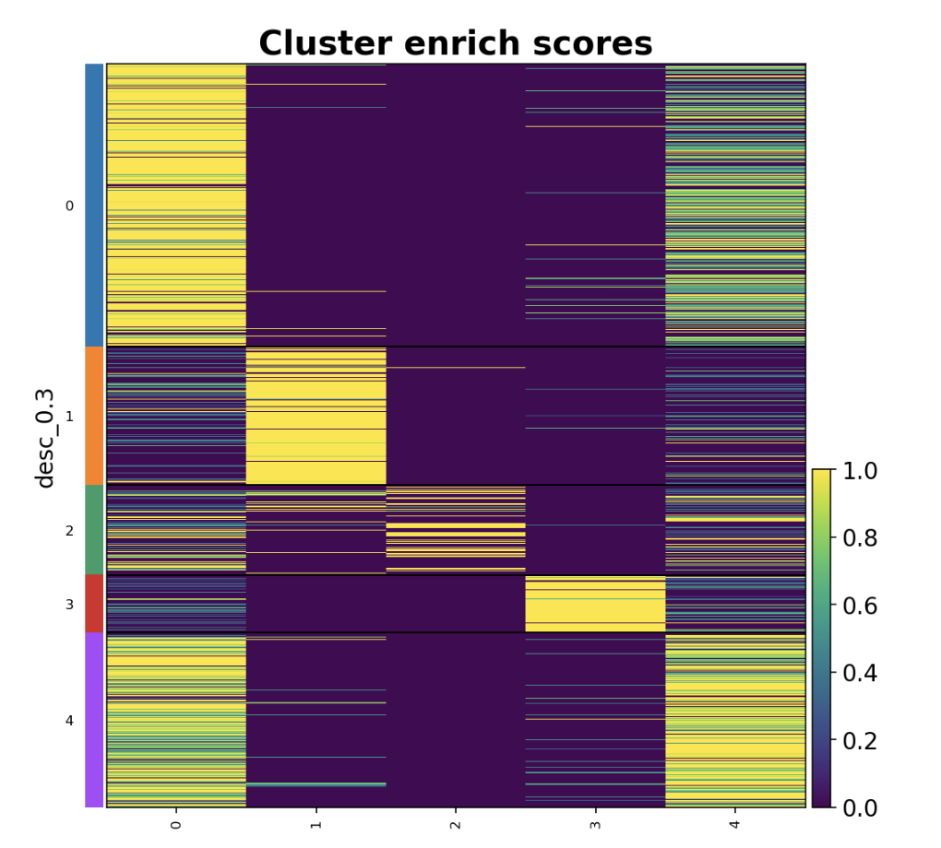
Resolution 3 – DEGS

Slide 5
First Request
The genes we would like to include as violin plots are: FOXP3, CTLA4, TIGIT, TNFRSF4, TNFRSF18, BATF, CTSC, IL2RA and AC133644.2 and LINC00152. Not sure if these last two genes will be detected in your data.

Slide 6
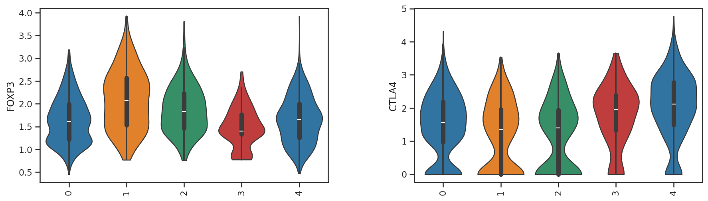
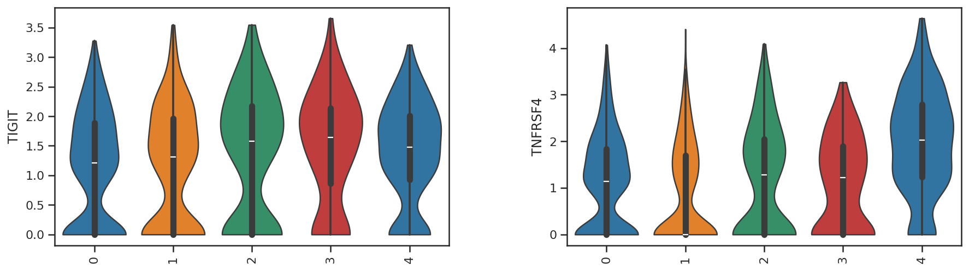

Slide 7
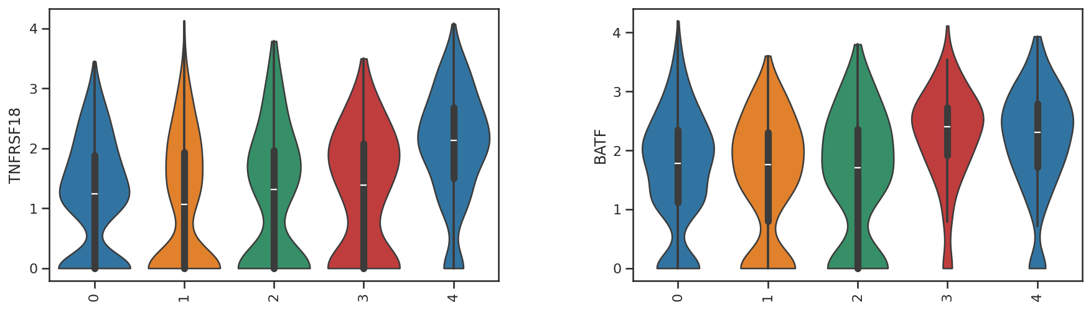
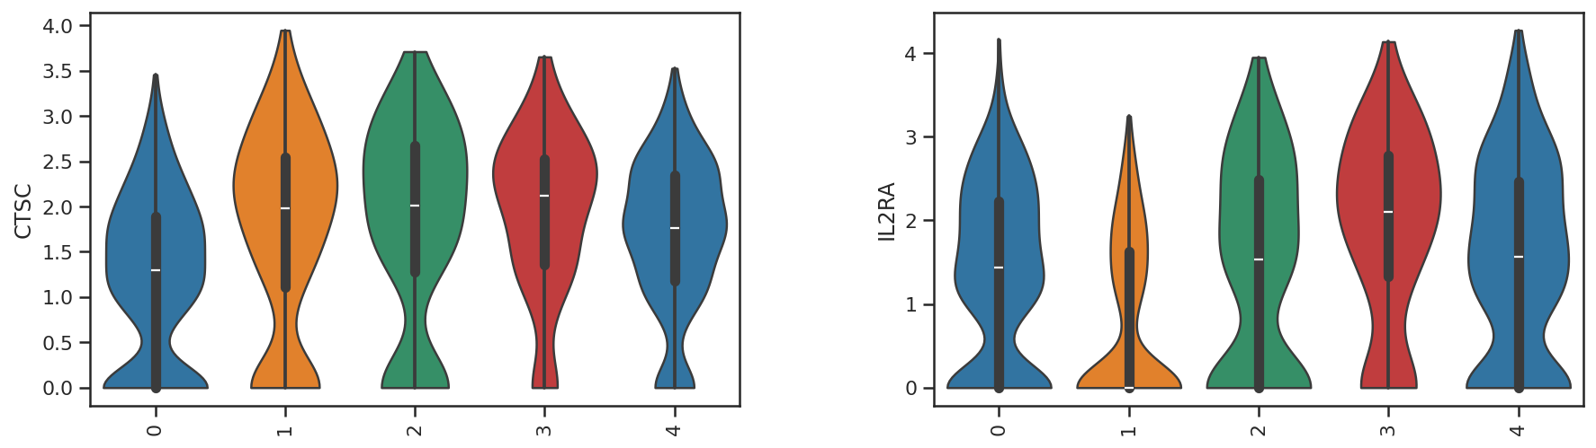

Slide 8
Second Request
One last question that we have is basically which cluster of these Tregs is more likely to be activated and/or receiving TCR stimulation. In the CSV file attached, you can find two signatures of TCR stimulation that would be great to apply and check in your data, these are the NeoTCR4 and NeoTCR8.

Slide 9
