Slide 1
Data science assesment
myscheduling Search and match PILOT
Search and Content Analytics

Slide 2
Section 1
overview

Slide 3

Who are we? Search and content analytics
Part of
We have Search and Match experience with global large customers such as:
Stepstone
Adecco
These projects have included:
Robust matching including global and local requirements
Explainable and transparent results
For MyScheduling, we have:
Designed and implemented statistical models and matching techniques, taking advantage of Accenture’s cultural knowledge and internal resources (e.g. skills ontology)
Implemented machine learning to learn from usage feedback to optimise results’ accuracy

Slide 4
Section 2
Model Design

Slide 5
Overview of matching

Slide 6

overview
Filters
Vectors
Multipliers
Region
Location
Skills
Topic
Terms
Career Level
Geographic Unit

Slide 7
MODELLING METHODOLOGY(TRAINING)

Slide 8
Methodology Used
Compares Similarities between Items
Characteristics To Compare
People (Candidates)
List of Skills
Roles (Jobs)
Region Value
Location Value
Career Level Filter
Geographical Unit Filter
List of Key Terms
List of Topics

Slide 9
Variables
List of Skills
List of Key Terms
Skills required by the role or possessed by the person with its proficiencies, which are scaled from 1 to 5
Terms which appear many times in an item’s summary (profile or job description) but are less frequent in others.
Proximity skills: Additional set of skills related with the original skills (based on Accenture’s skills ontology)
List of Topics
Groups or clusters or related terms that tend to appear together. For example: safety, health, risk assessment, etc.

Slide 10
Variables (continued)
Region
Location
Filters
Penalties for jobs or candidates from other regions
Penalties for jobs or candidates based on distance (using latitude/longitude coordinates)
Only show required career level by the job
Same geographical unit

Slide 11
Cosine similarity (and adjustments)

Slide 12
Cosine similarity
Algorithm
Adjustments
Measures the similarity between two items. Their score will be high if they share a lot of characteristics and those characteristics are important to those items.
In the recruitment space, additional characteristics don’t necessary imply a bad match (i.e. a person with multiple skills that exceed a role’s requirements). Therefore, unmatched characteristics have less impact in the final score.
The Cosine Similarity formula has been adjusted from a measure of absolute similarity to a measure of how well requirements are meet.

Slide 13
Final calculationS

Slide 14
Methodology Used (evaluation)
Similarity Between variables
List of Skills: 50%
The similarity between two items will be high if they share a lot of characteristics
List of Key Terms: 40%
List of Topics: 10%
Contributions to the Final Score (Weights)
Calculation
(Skill Similarity Score * 50%) + (Key Term Similarity Score *40%) + (Topic Similarity Score * 10%)
NOTE: Once the solution is in production, these factors are to be adjusted using machine learning techniques, based on users’ usage and feedback

Slide 15
Methodology Used (evaluation)
Region and Location Variables
After the score is calculated, it could be reduced if certain criteria is not met:
Calculation
Similarity Score * reduction factor
For example: If region is different, then the original score is reduced by 10%
Different region
Too far from target item
NOTE: Once the solution is in production, these factors are to be adjusted using machine learning techniques, based on users’ usage and feedback

Slide 16
Section 3
Model Generation

Slide 17
architecture

Slide 18
Architecture
Involved Technologies
Elasticsearch
NodeJS
Python
MongoDB
AngularJS
Aspire (Java based content processing tool)

Slide 19
ARCHITECTURE (CONTINUED)
Pilot
Production
Static input data
UI is provided for evaluation purposes
Feedback gathering capabilities
Explainability feature
Not yet implemented
Data will be collated and extracted directly from Content Analytics Platform
Bulk and incremental data updates
Search and Match services exposed via API
Continuous machine learning from live feedback
Machine Learning integration

Slide 20
Pilot architecture blueprint

Slide 21












Big Data Core
AIP Environment
Model Creation Workflow
No scheduled execution
CSV
Input Data
For the pilot, there will no be incremental updates
These were obtained by another team
CAP Non-Standard
Data Journey Workflow
No scheduled execution
1
Process triggered manually
1
Process triggered manually
File Extraction
Geo Location
Enrichment
2
TFIDF
3
Flask
(Creates vectors)
Kibana
Model
Creation
Field Mapping
…
LSI
Data Index
API
2
Vector
Creation
3
Vector
Scorer
Plugin
Resources
(dictionaries,
ontologies, etc)
Data Models
Post to ES
Spacy,
Gensim
Matching Services
Process Text
Aspire
Elasticsearch
No sensitive data is stored
on MongoDB
4
Status/Preferences
Storage
MongoDB
Stores
preferences
API
UI
Search Stack
ESO - Single Page App
5
All internal access controlled by security groups (IPs/ports)

Slide 22
PRODUCTION architecture blueprint
* Already approved by Enterprise Architects

Slide 23
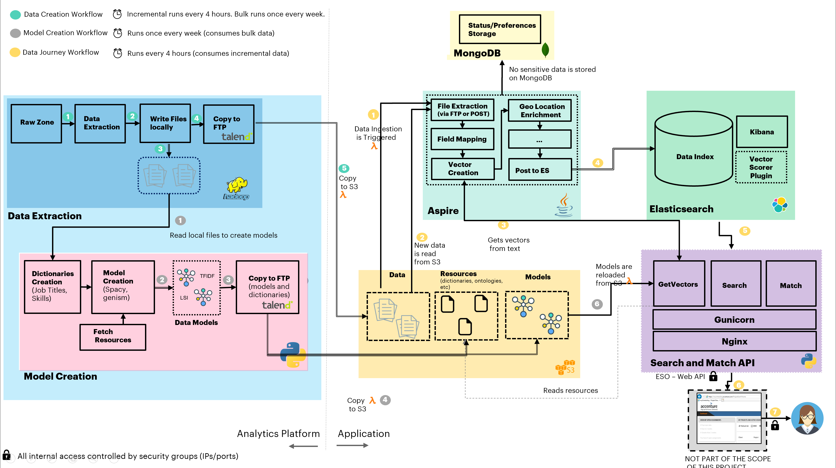

Slide 24
Data preparation & feature engineering

Slide 25
Data cleansing & preparation
File Merge
Character Removal
Language Detection
Data consolidation into a single master file
Avoid CSV-character based issues
Natural Language Processing
Enabled for multiple languages going forward, leveraging the team’s experience in multi-lingual search and match solutions (Italian, French, Spanish, German, Dutch, Japanese, etc.)

Slide 26
Key features extraction
Statistical Analysis
Structured Data
Tokens (collection of 1 or more words) and phrases are gathered
List of unique skills created upon available data
Natural Language Processing (NLP) is used to understand and classify token by semantic utilization
Language is normalized (e.g. “is”, “are” become “be”)
Token dictionary creation including tokens’ frequency
Non-meaningful tokens are discarded

Slide 27
VECTOR MODEL GENERATION
TF-IDF
LSI
Term Frequency – Inverse Document Frequency
Latent Semantic Indexing
Assigns weights to tokens based on its number of occurrences in an item and the number of occurrences in the entire database of items.
The Key Terms vector is created from this model.
Creates groups or clusters of terms that tend to appear together in the content.
The Topics Vector is created from this model.

Slide 28
VECTOR MODEL GENERATION (CONTINUED)
Skills
Provided skills are analysed and expanded based on Accenture’s skills ontology
A vector containing the original + proximity skills is created
Proximity skills weights are calculated taking into account the original skill’s weight and the correlation factor (defined on the ontology)
Original skills weights are determined by the proficiency level (1- 5)

Slide 29
Section 4
Model maintenance & machine learning

Slide 30
Ongoing Algorithm Maintenance

Slide 31
Maintenance
New Data
The pilot uses static data but re-indexing can generate new models
In production, regenerating the dictionaries and models will add new terms, as new data becomes available.
New features

Slide 32
Maintenance
Initial Tuning
The pilot has been tuned following an expert advice driven approach based on:
Screener’s feedback
Configuration analysis and experimentation
Team’s previous expertise with Search and Match solutions

Slide 33
Self-learning Ability

Slide 34
Self learning
Evaluation Positive and Negative results
Thumbs up/thumbs down feedback has been gathered from the screeners
Parameters to be optimized
Weights
Location
Region
Key Terms List Weights
Using machine learning, an optimization algorithm is executed to evaluate positive and negative results and predict optimum values for system parameters

Slide 35
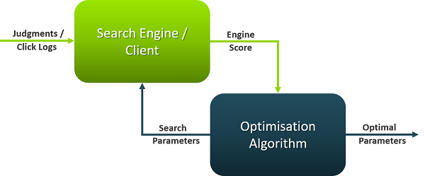
Self learning
Optimization/Machine Learning
The optimization component is a general-purpose component which can be integrated with any API
It sits side-by-side with the application and it consumes its services in order to adjust parameters and find optimum values

Slide 36
Self learning
Pilot
This exercise has been done for the pilot, however predicted values were not used as the training data (thumbs up/thumbs down) was not enough.
Production
For production, users’ behavior, actual placements and other judgements can be tracked in order to learn from them periodically and to improve the performance of the solution.

Slide 37
Section 5
other

Slide 38
Explainability

Slide 39
Explainability
Transparency
Detailed explanations for every single match score is provided, including matched terms, partial scores and other factors that affected the final score.
Some of the matching parameters can be modified via API so the user can measure the effect of adjusting weights manually.

Slide 40
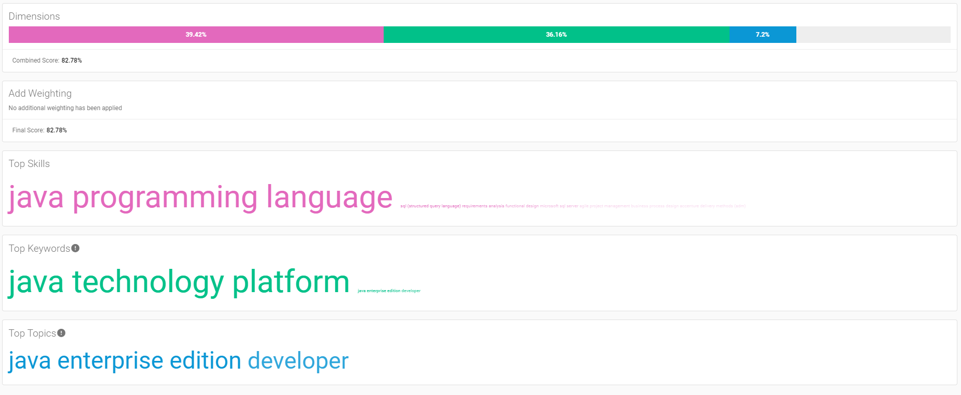
Sample of a good match (high score)

Slide 41
Bias Assessment

Slide 42
Actions
Equality
Analyze words and terms that suggest/imply specific biases, such as gender
Results
Based on gathered evidence, the implemented models and algorithms wouldn’t introduce significant bias towards any particular demographic group

