Slide 1
Fine-tuning a LLM Internship Recommendation Explanation and Skill Gap Analysis for Statistics-related jobs
● 小组成员：吴炎彤,陈泳伶,陆冠行,李明泽

Slide 2
1
Overall Project Overview
1.Background and Motivation
2.Expected Implementation Path
Database Construction
CONTENTS
2
1.Data Crawling and Data Cleaning
2.SFT Dataset Construction Pipeline
3
Model Training and Hyperparameter Tuning
1.Model Comparison and Evaluation
2.Model Comparison and Evaluation
3.Hyperparameter Tuninng
4
Comparison and Ablation Study
Taguchi Orthogonal Design

Slide 3
Overall Project Overview
1.Background and Motivation
2.Expected Implementation Path

Slide 4
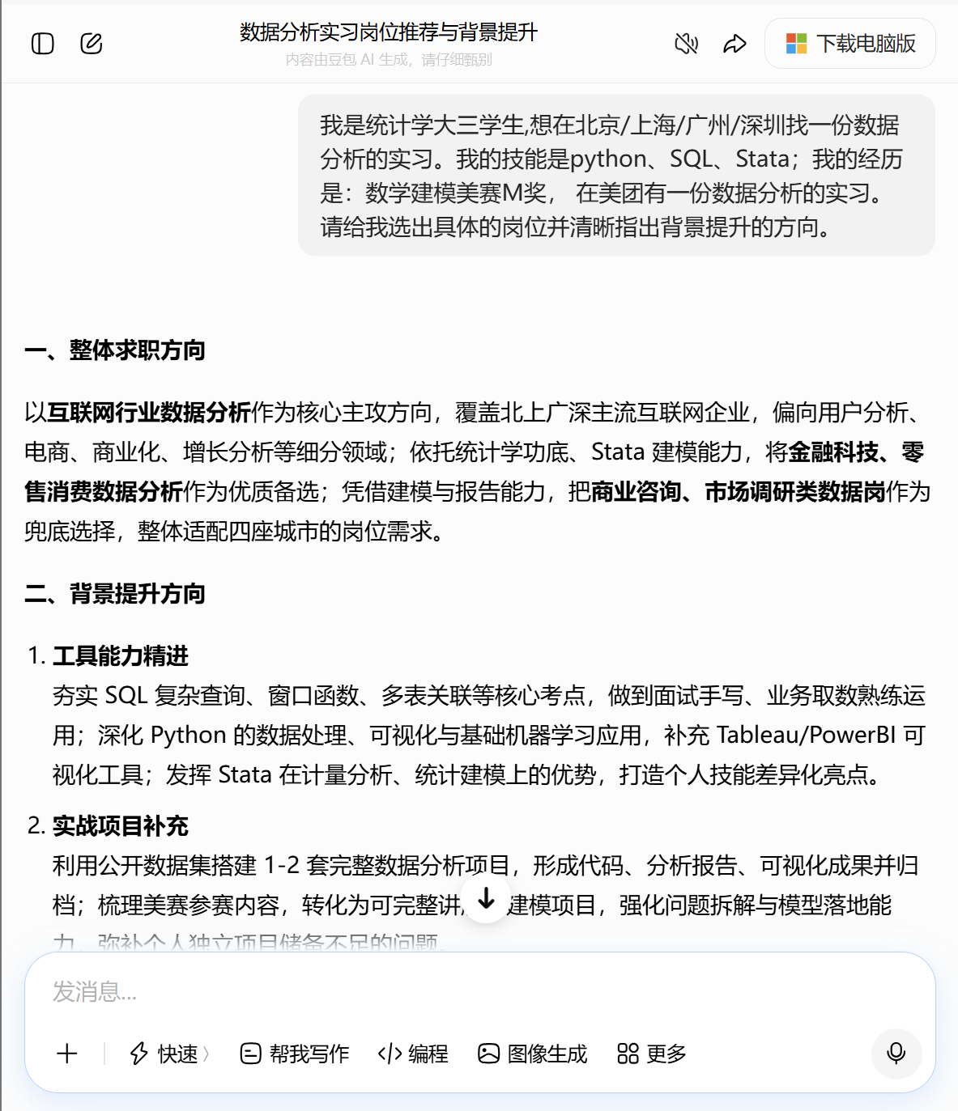

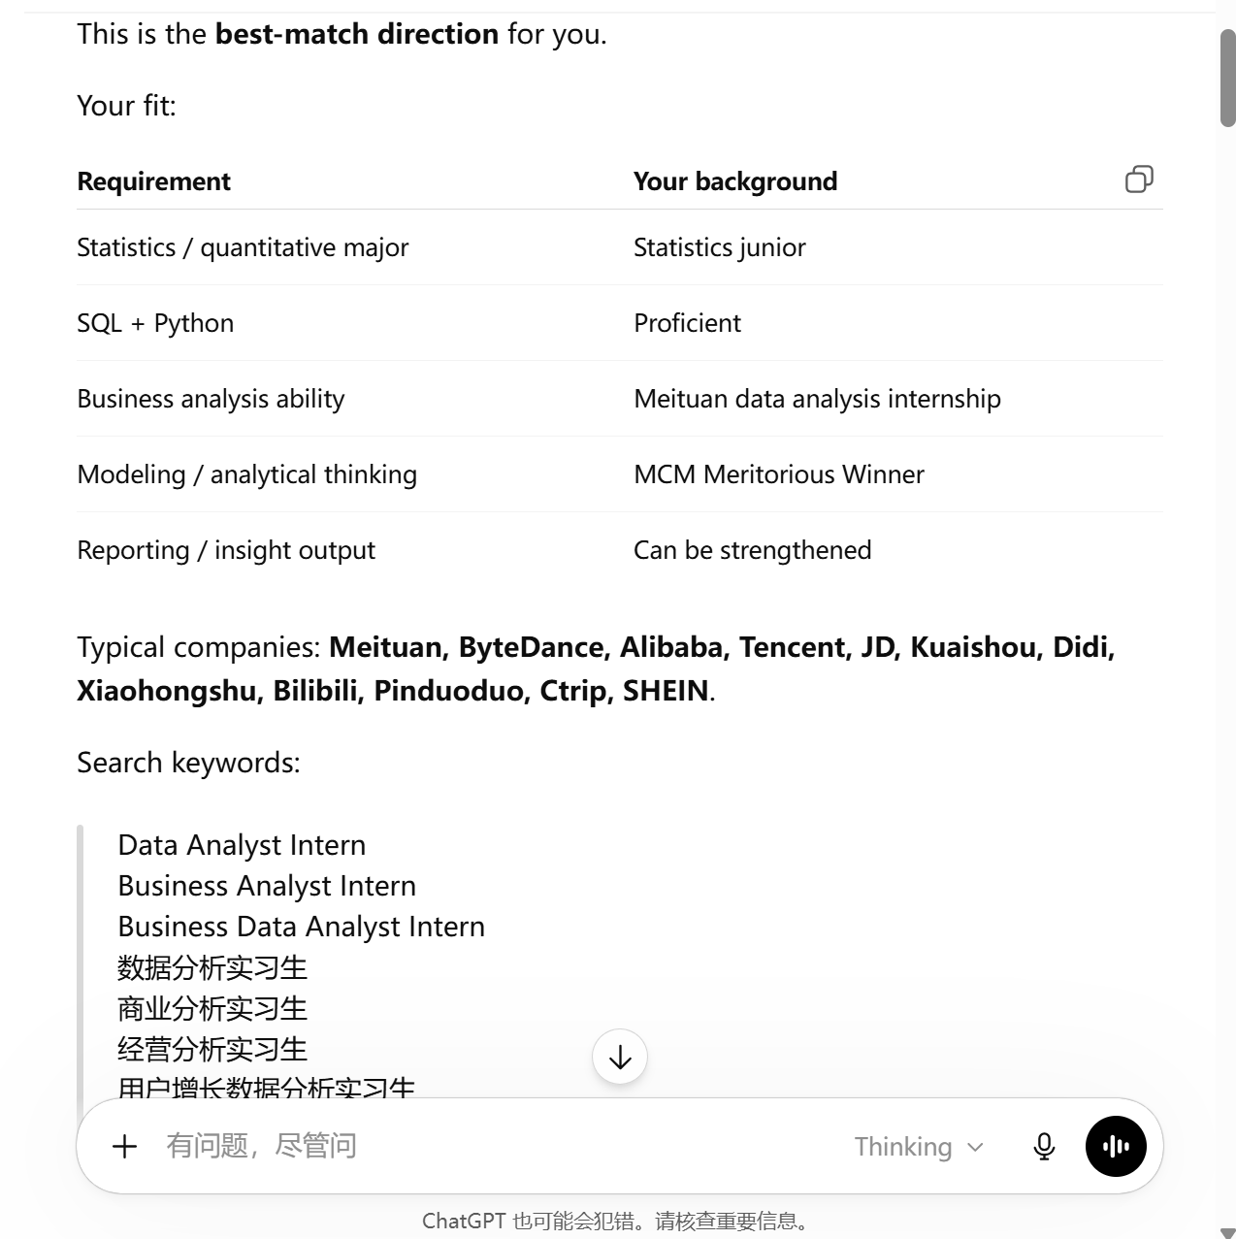

    Overall Project Overview
1.Background and Motivation
Background: Junior students majoring in Statistics often face the problem of “too many positions, diverse career directions, and difficulty in matching suitable roles” when seeking jobs. When asking AI, they can usually only obtain general career directions, but AI cannot help them identify specific suitable positions or clearly point out how to improve their professional background.

Slide 5
    Overall Project Overview
1.Background and Motivation
Motivation: Fine-tune a large language model for domain-specific tasks, making it better suited to internship recommendation and skill analysis. This helps Statistics students quickly find internship positions that match their needs and interests simply by interacting with AI, thereby improving job-search efficiency.

Slide 6
    Overall Project Overview
2.Expected Implementation Path
Convert the preprocessed .csv file into a .json file for fine-tuning.
Taguchi Orthogonal Design
Fine-tuning Dataset Conversion
Comparison and Ablation Study
Data Crawling and Data Cleaning
Model Training and Hyperparameter Tuning
Crawl or manually collect data from the “Campus Recruitment / Internship Recruitment” pages of major companies such as Tencent, Alibaba, and ByteDance, and perform data preprocessing.
Use LLaMA-Factory to train Qwen, LLaMA3, and GLM4, and conduct a comparative analysis.

Slide 7
Database Construction
1.Data Crawling and Data Cleaning
2.SFT Dataset Construction Pipeline

Slide 8
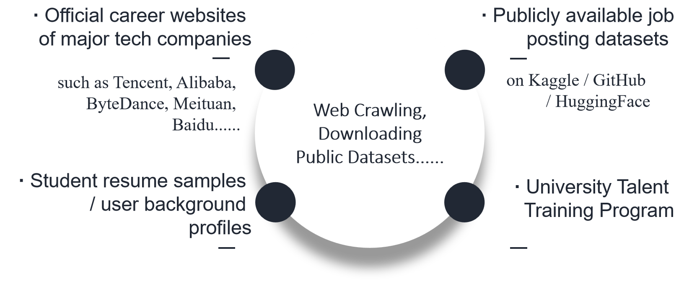
Database Construction
1.Data Crawling and Data Cleaning
Sources of Data

Slide 9
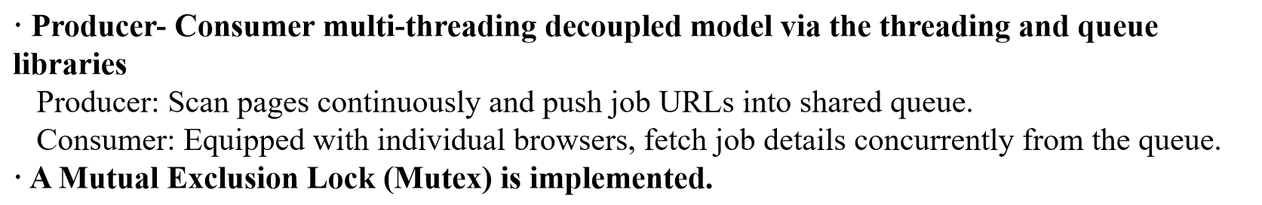
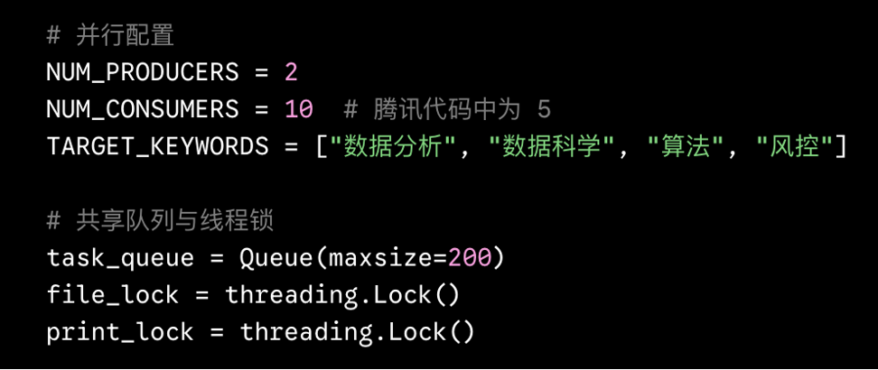
Database Construction
1.Data Crawling and Data Cleaning
Data Crawing

Slide 10
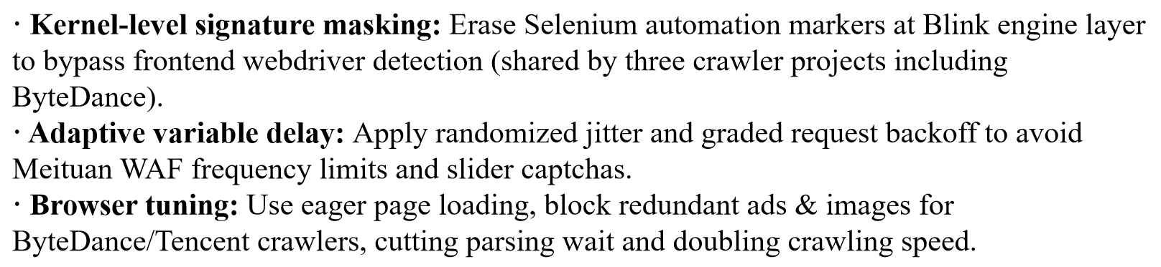
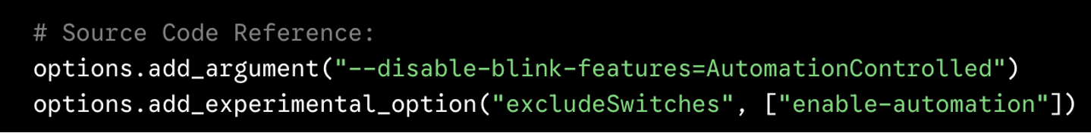
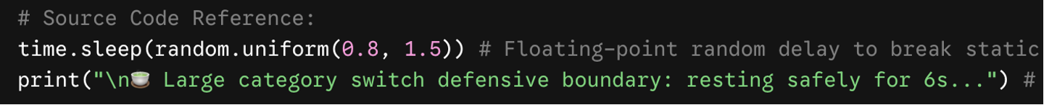
Database Construction
1.Data Crawling and Data Cleaning
Data Crawing

Slide 11
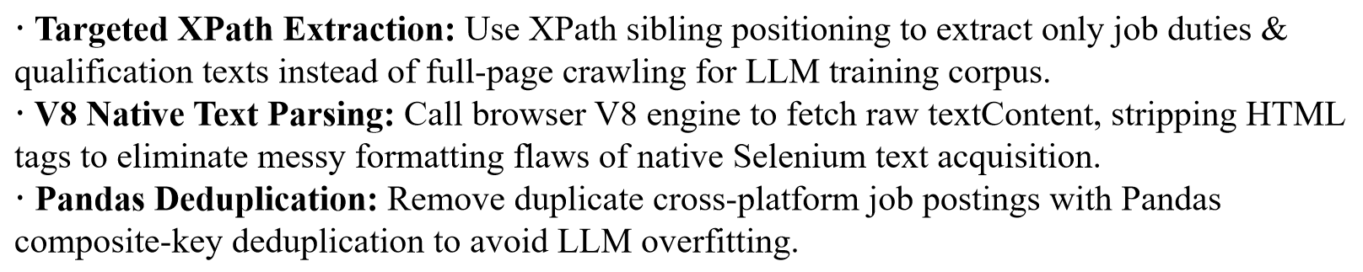
Database Construction
1.Data Crawling and Data Cleaning
Data Cleaning

Slide 12
Database Construction
2.SFT Dataset Construction Pipeline
02 Job Matching and Scoring
01 User Profile Generation
Each user-job pair is scored using a customized Scoring Mechanism and Data Scale: 50 points from job-side features and 50 points from user preference, target city, and mastered skills.
Based on the constructed dataset, AI generates 300 mock job seeker profiles, including major, education background, skills, target city, and career preference.
01
02
04 Top 3 Recommendation
03 Skill Matching Support
For each user, the system selects the Top 3 most suitable jobs from the job dataset.
04
03
A skill JSON file is used to store job-related skill labels and support the calculation of skill matching scores.

Slide 13
Database Construction
2.SFT Dataset Construction Pipeline
06 SFT Dataset Construction
05 Explanation Generation
All samples are converted into instruction-input-output format for supervised fine-tuning.
DeepSeek 3.0 is used to generate recommendation reasons, skill gap analysis, and improvement suggestions for each recommended job.
05
06
07 Train / Test Split
07
A total of 900 samples are generated: 810 for training and 90 for testing.

Slide 14
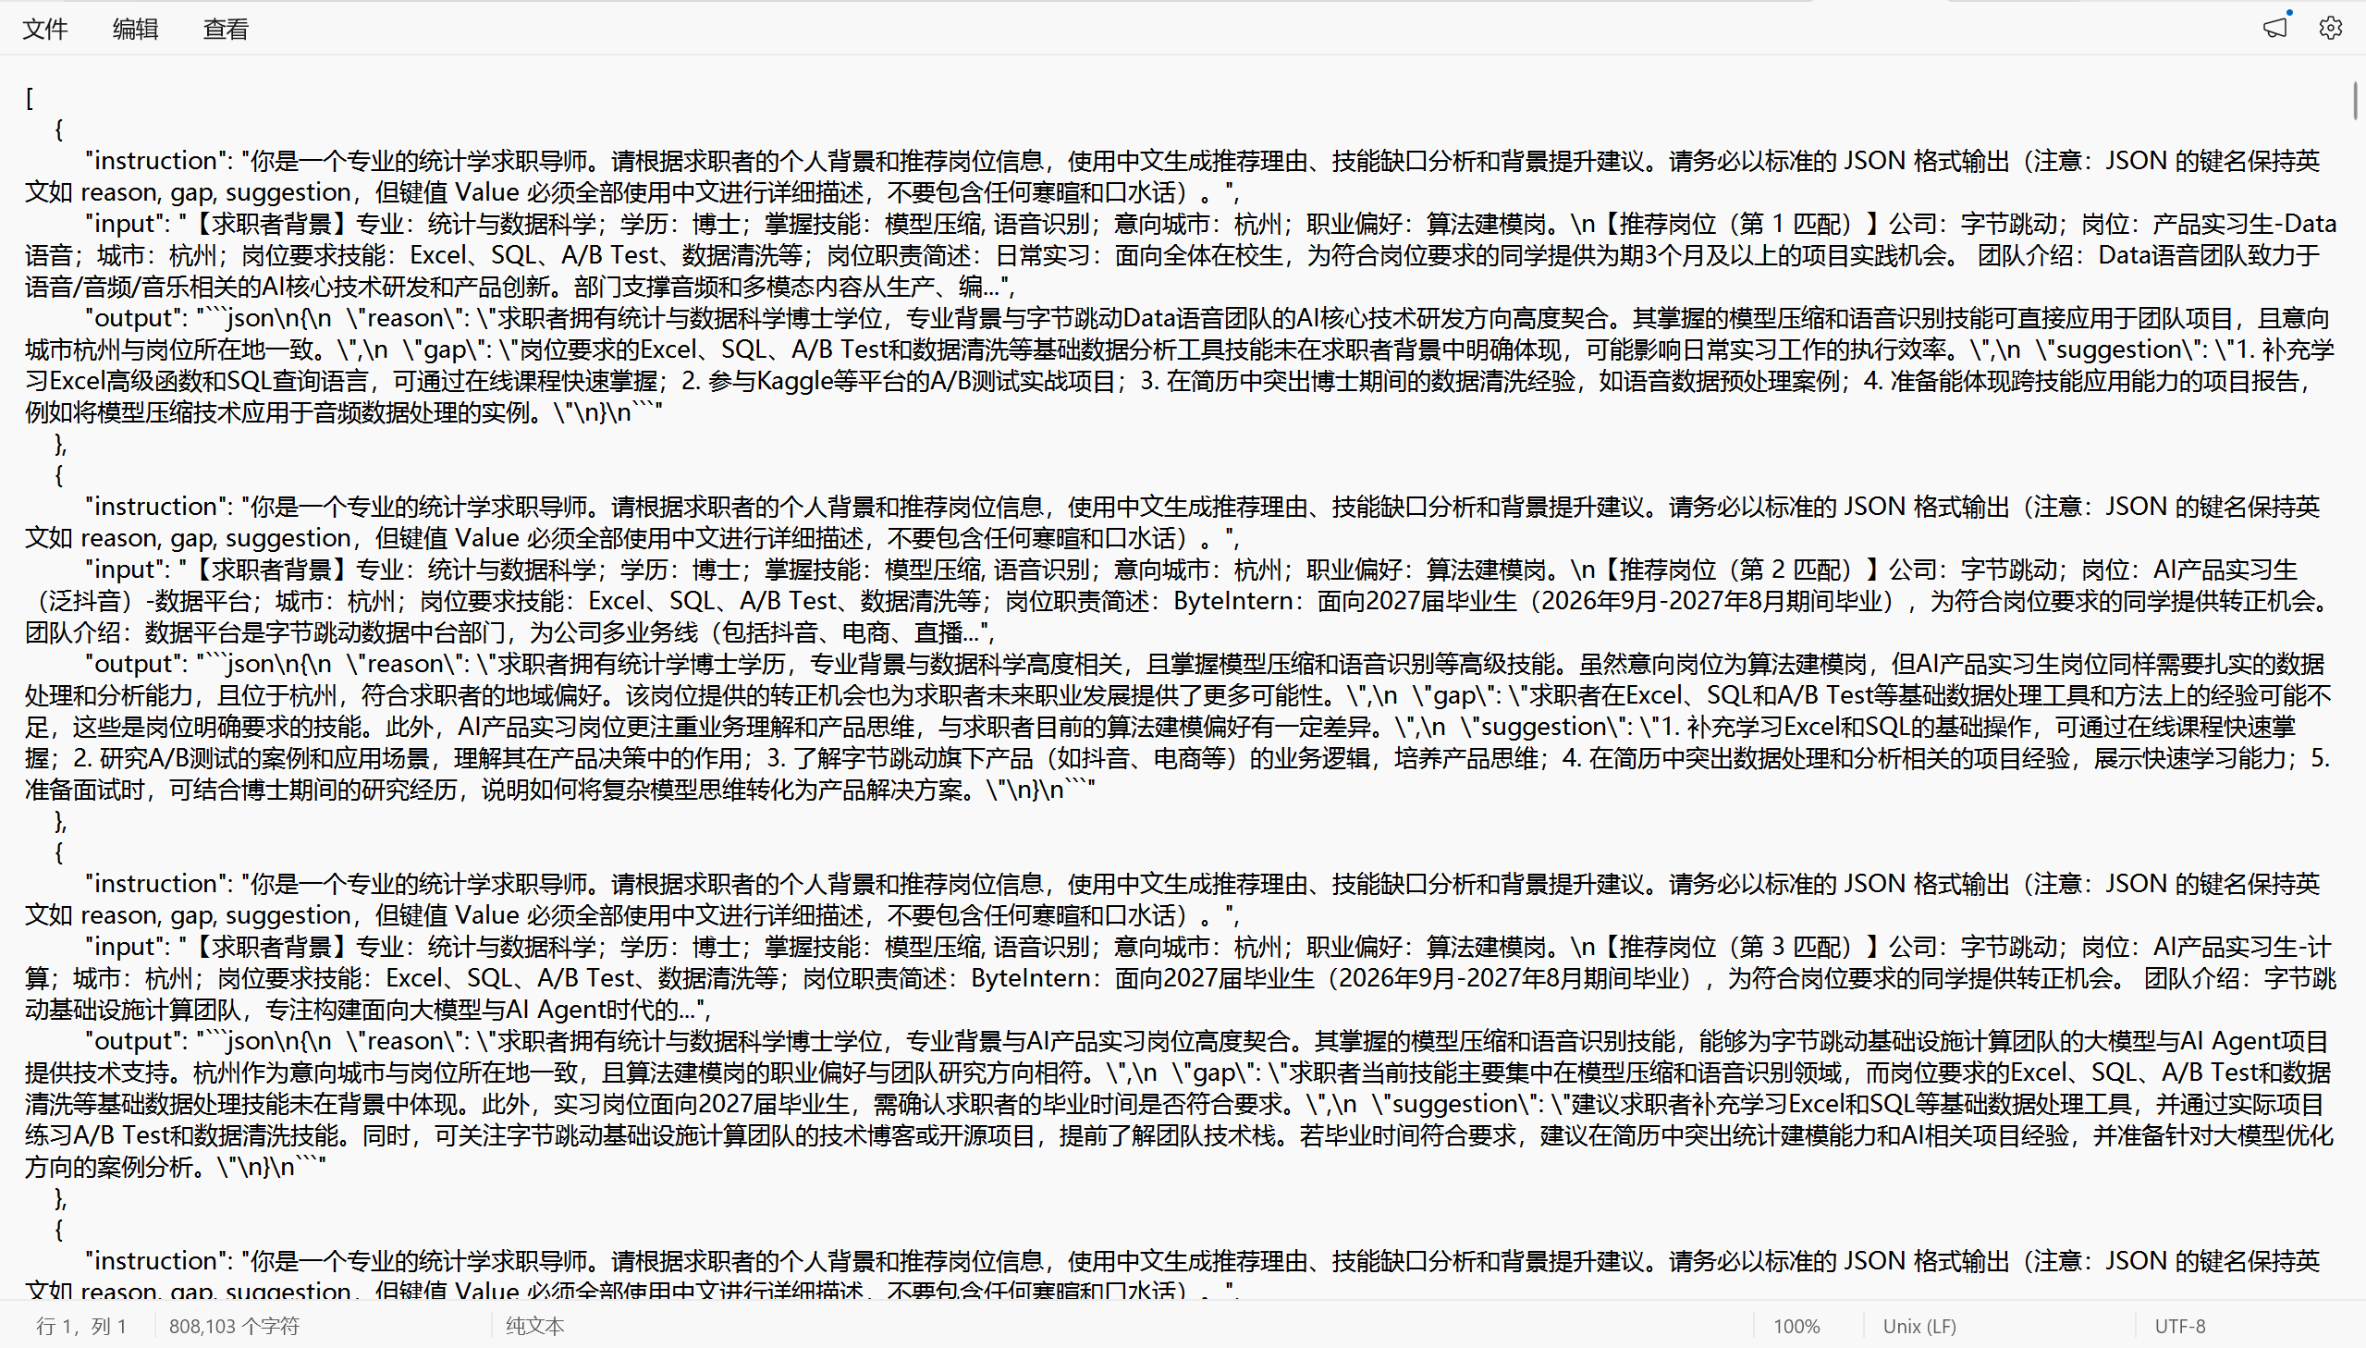
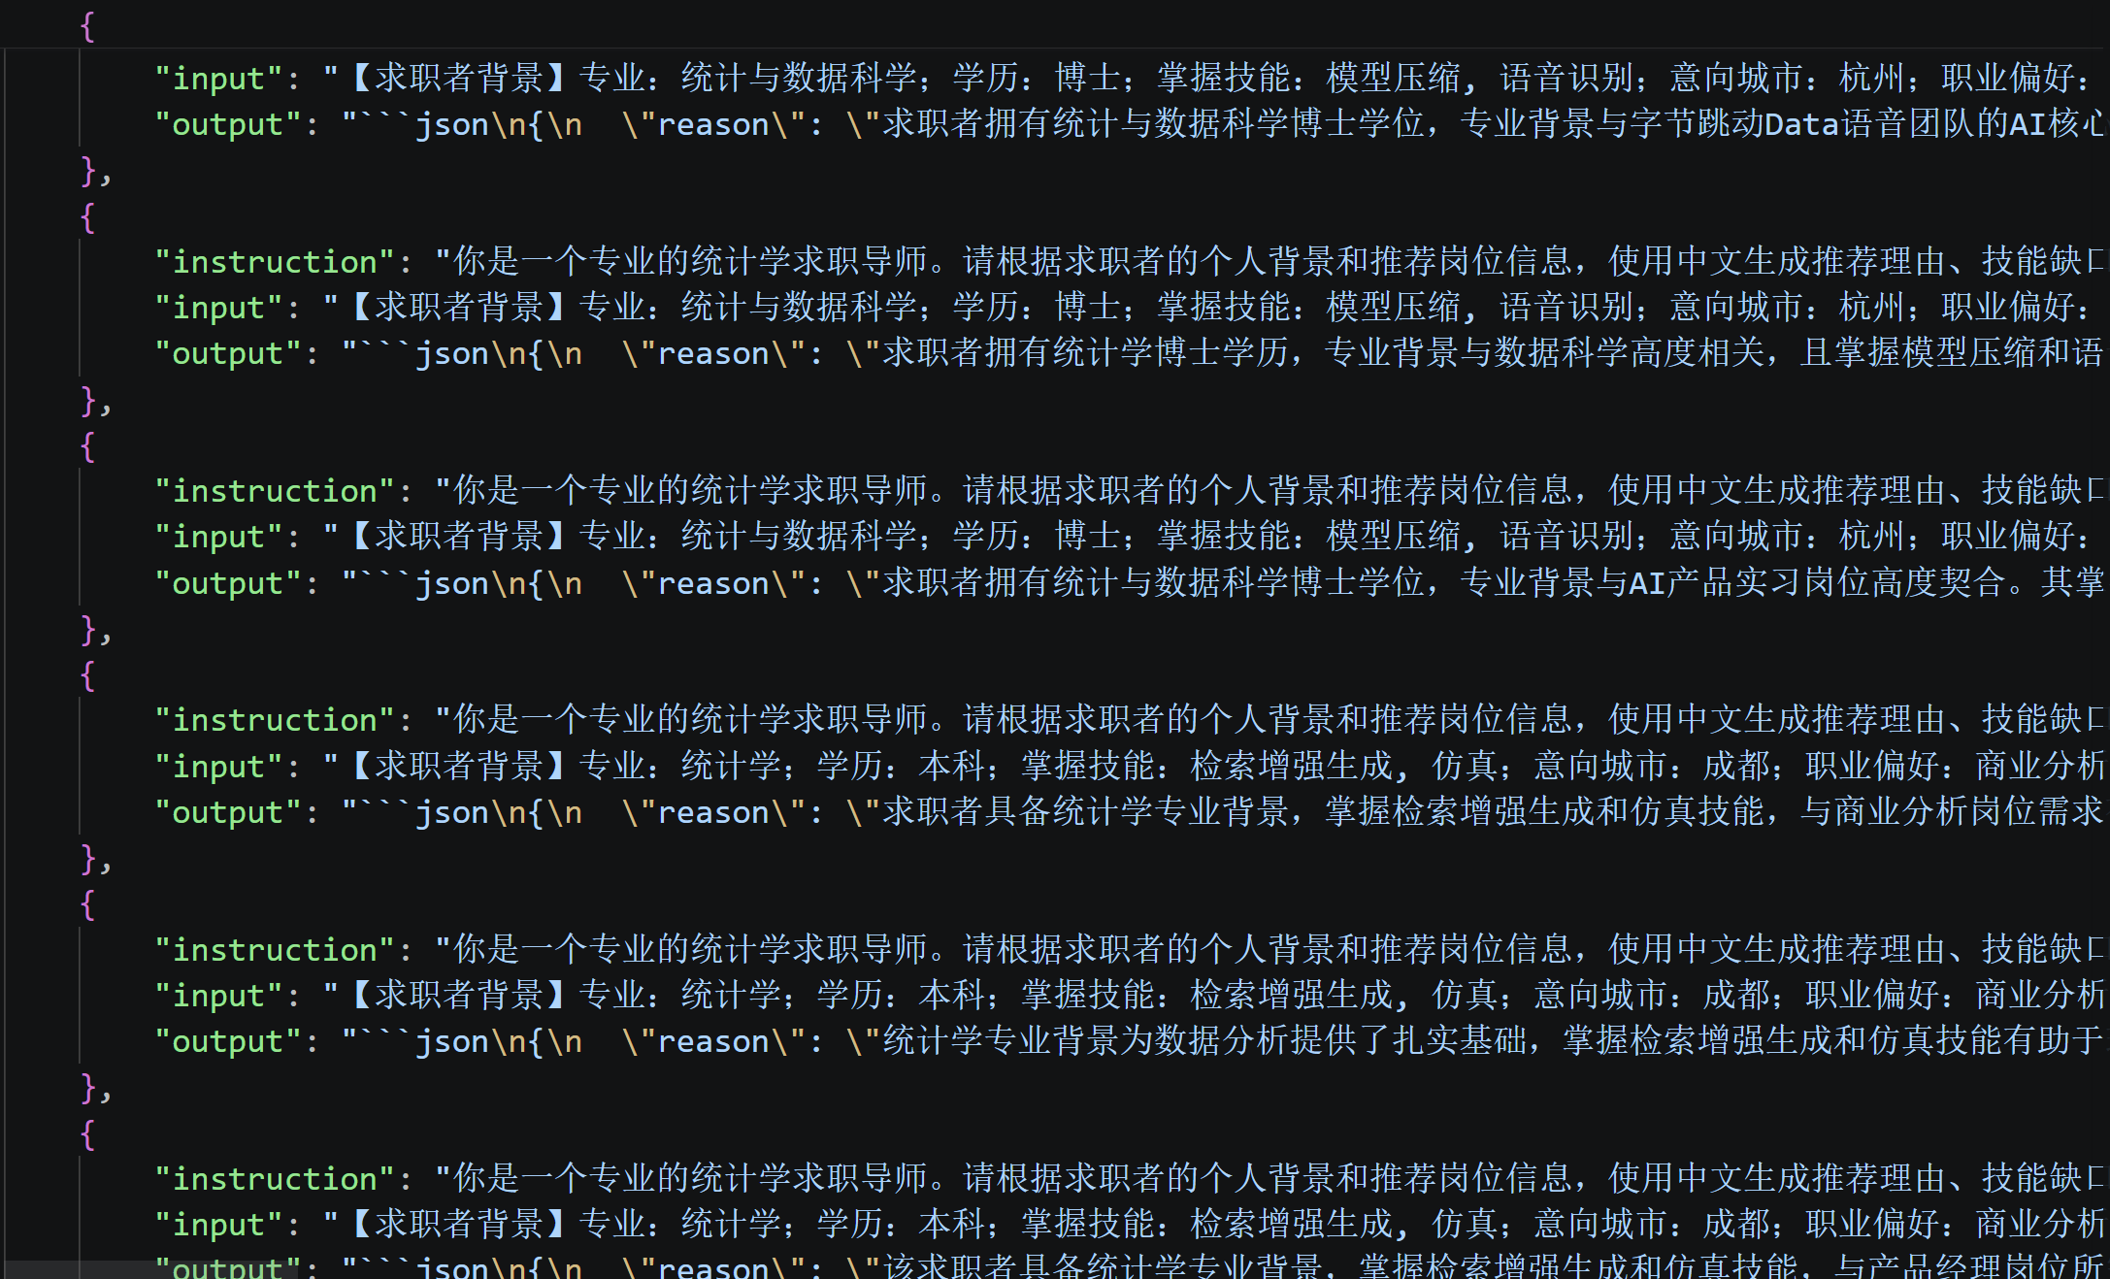
Database Construction
2.SFT Dataset Construction Pipeline
Supervised Fine-tuned Dataset Demo

Slide 15
Model Training and Hyperparameter Tuning
1.Implementation Path
2.Model Comparison and Evaluation
3.Hyperparameter Tuninng

Slide 16
    Model Training and Hyperparameter Tuning
1.Implementation Path
SFT （ Supervised Fine-Tuning ）
Based on the pre-trained large language models Qwen2-7B, LLaMA3-8B, and GLM-4-9B, we further train the models using supervised samples from tech_advisor_sft_data.json, whose outputs are structured as ["reason", "gap", "suggestion"], in order to improve the output stability and task-matching ability of the models in the internship recommendation scenario for statistics students.
Core Algorithm — QLoRA
① 4-bit Base Model Quantization
Load the original large language model weights in 4-bit precision, which significantly reduces GPU memory requirements.
② LoRA (Low-Rank Adaptation)
Instead of directly updating all parameters of the large language model, LoRA adds a small number of trainable low-rank matrices to the model and only trains these additional matrices.

Slide 17
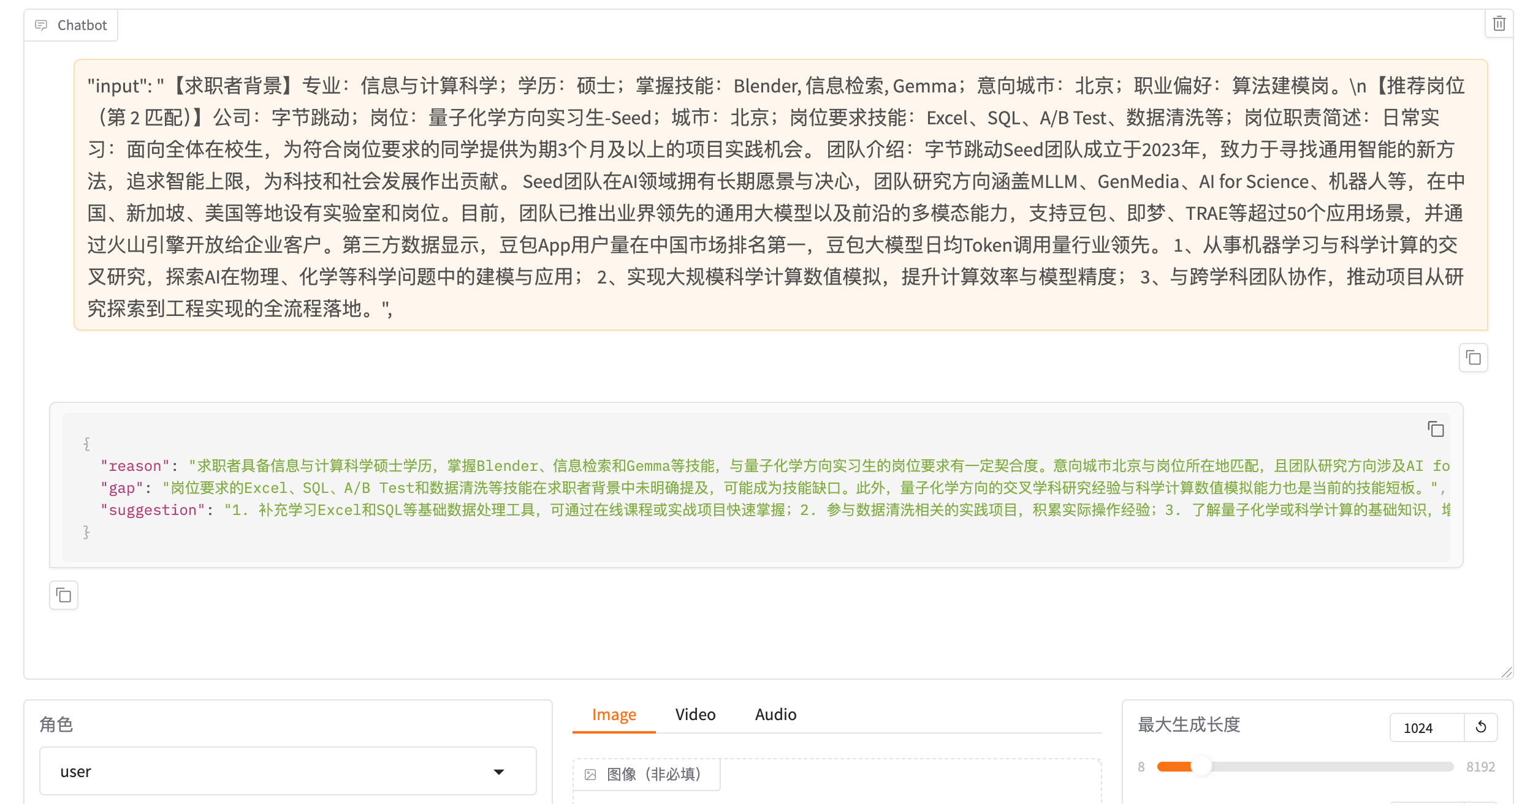
    Model Training and Hyperparameter Tuning
1.Implementation Path
Fine-tuned Model Web Interface Demo

Slide 18
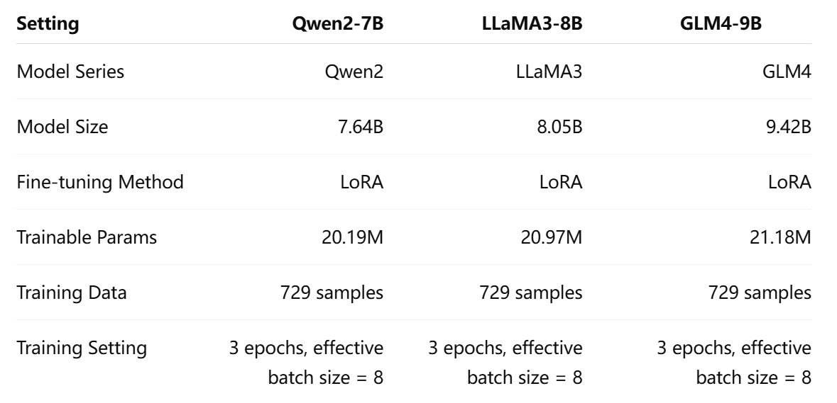

Model Training and Hyperparameter Tuning
2.Model Comparison and Evaluation
Training Setup Comparison
The three models were fine-tuned under the same training setting, while differing in model family and parameter scale, enabling a fair comparison of model performance and efficiency.
learning-rate(η) = 2e-4 The magnitude of parameter adjustment when the model corrects its errors each time.
Loss function measures the difference between the model’s predicted output and the target answer. During fine-tuning, the model gradually makes its output closer to the target answer by continuously reducing the loss.

Slide 19
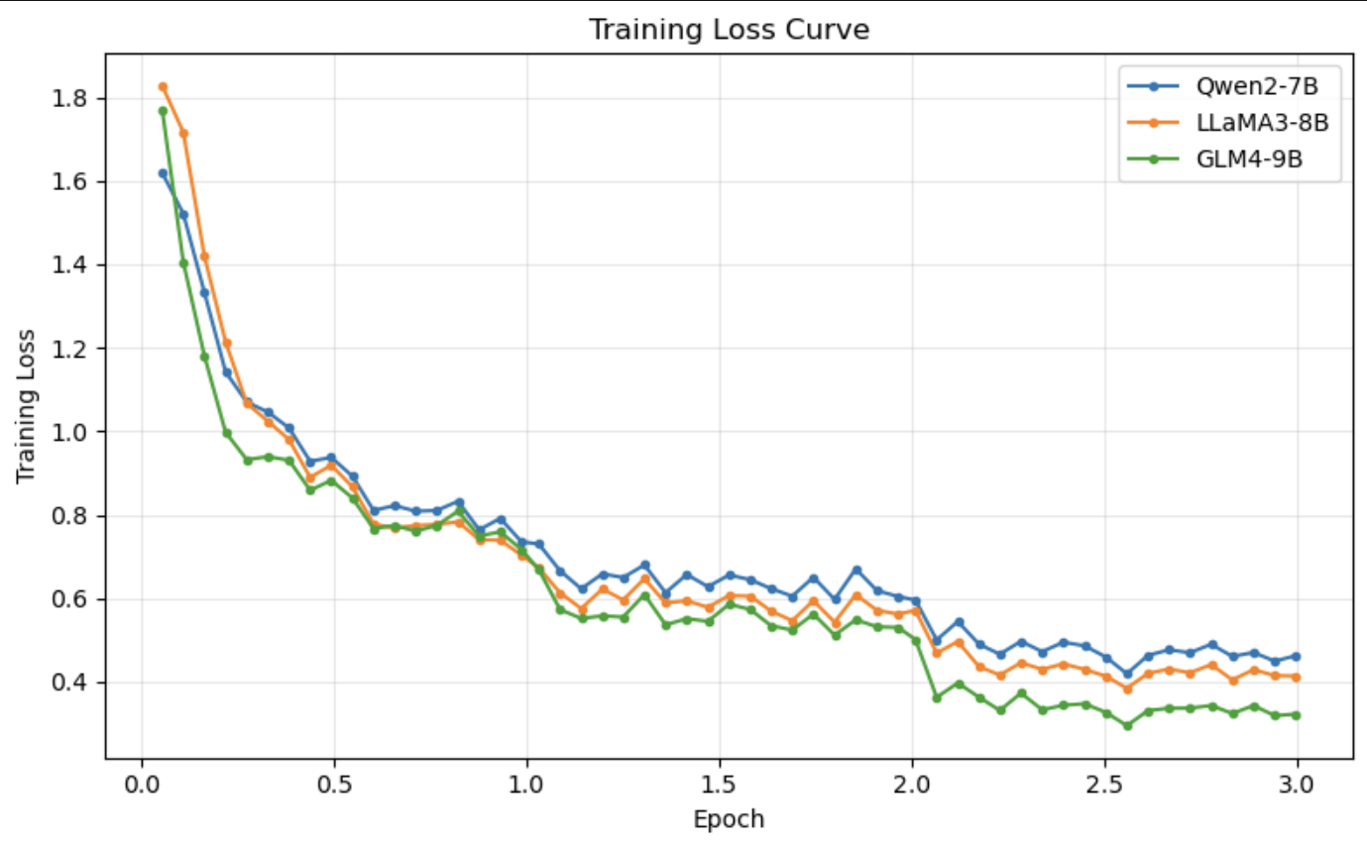
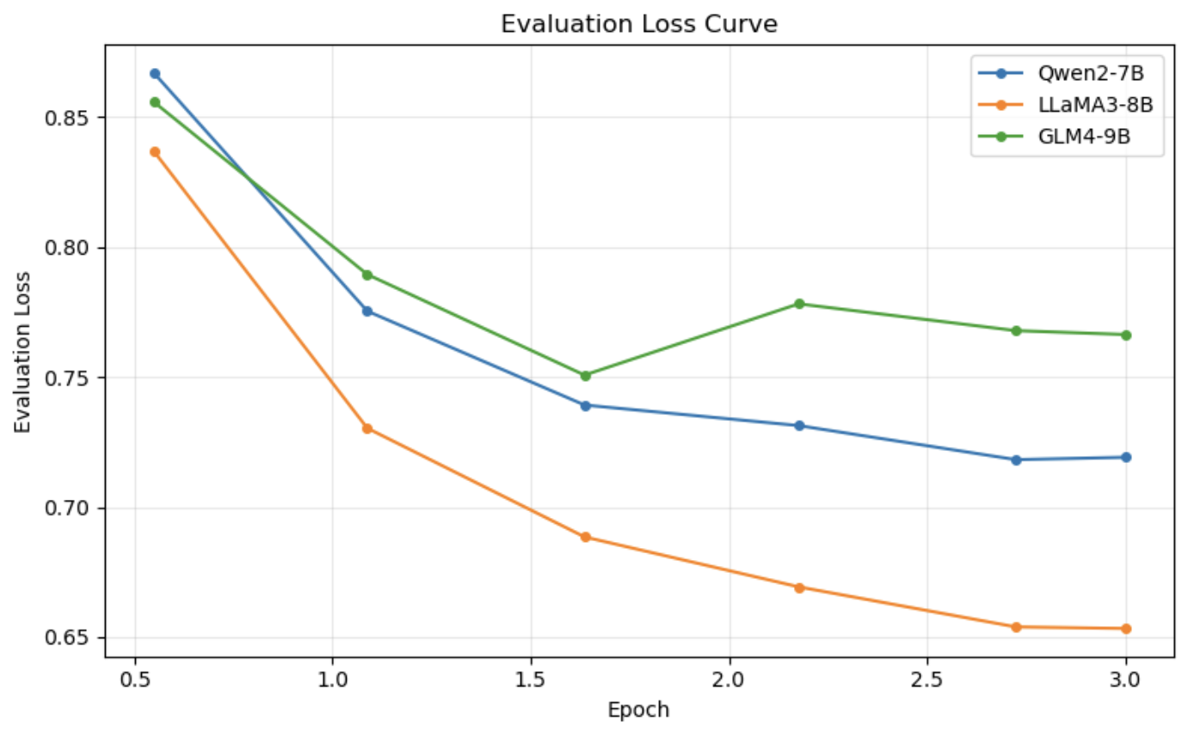
Model Training and Hyperparameter Tuning
2.Model Comparison and Evaluation
Loss Curve Comparison
Interpretation:
①All three curves show a clear downward trend, indicating that all three models successfully converged.
②GLM4-9B may fit the training set more strongly, but its performance on the validation set is not as good as LLaMA3-8B.
③LLaMA3-8B performs best on the validation set and shows the best overall performance among the three models.

Slide 20
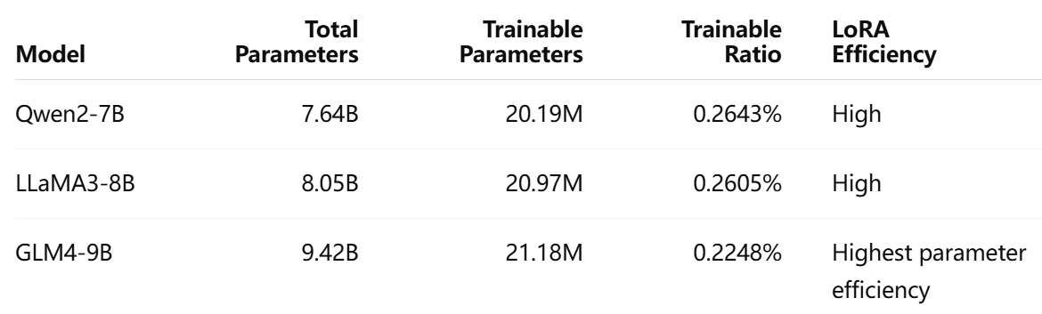
Model Training and Hyperparameter Tuning
2.Model Comparison and Evaluation
LoRA Efficiency Comparison
All three models update less than 0.3% of their total parameters during LoRA fine-tuning.
(LoRA only trains a very small proportion of parameters, yet it can still fine-tune 7B–9B models effectively.)

Slide 21
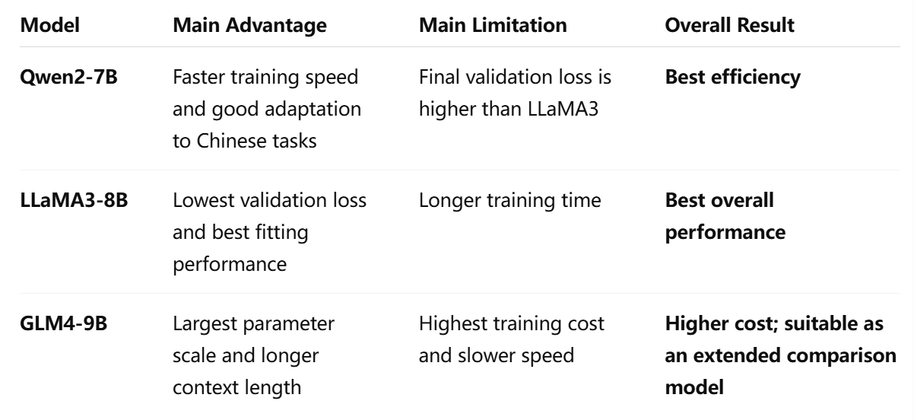
Model Training and Hyperparameter Tuning
2.Model Comparison and Evaluation
We compare three models: ①Qwen2-7B shows the best training efficiency and performs well on Chinese tasks.
②LLaMA3-8B achieves the lowest validation loss, indicating the best fitting performance, so it is selected as the best overall model.
③GLM4-9B has the largest parameter scale and longer context length, but its training cost is higher, so it is mainly used as an extended comparison model.
Conclusion：After the baseline comparison, LLaMA3-8B is selected as the main model for further hyperparameter tuning because it achieved the lowest validation loss among the completed baseline models.

Slide 22
Model Training and Hyperparameter Tuning
3.Hyperparameter Tuninng
在上一步中，本研究基于 GPTQ 量化后Qwen2-7B, LLaMA3-8B, GLM-4-9B模型进行了 LoRA 微调,并选出表现最好的LLaMA3-8B作为后续分析的基线模型。接下来，本研究在该微调框架的基础上，将超参数选取与调优分为两个阶段。阶段一采用BOHB（Bayesian Optimization and Hyperband），首先调节 LoRA 参数，其次调节学习率、warmup ratio 和 scheduler 等优化过程参数；阶段二进一步将 NEFTune 作为训练阶段的正则化增强方法纳入调参框架，以提升模型的泛化能力和输出稳定性。

Slide 23
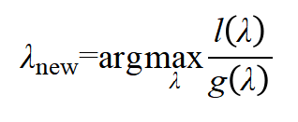

Model Training and Hyperparameter Tuning
3.Hyperparameter Tuninng
stage1——BOHB（Bayesian Optimization and Hyperband）
BOHB（Bayesian Optimization and Hyperband）是一种高级超参数优化方法,由 Falkner, Klein 和 Hutter 在 2018 年提出，核心目标是在有限资源下实现更高效、鲁棒的超参数搜索。它把贝叶斯优化和 Hyperband 早停机制 结合起来：一方面，BOHB 不像 grid search 那样盲目遍历所有组合，而是根据已有实验结果预测哪些超参数更可能有效；另一方面，它会像 Hyperband 一样先给很多候选配置分配少量训练资源，并提前淘汰表现差的配置，从而节省大模型微调的计算成本。
研究围绕 LoRA rank、LoRA alpha、LoRA dropout、learning rate、warmup ratio 和 lr scheduler 等 LoRA 结构参数与优化过程参数构建 12 组 BOHB-style 候选配置并进行实验。

Slide 24
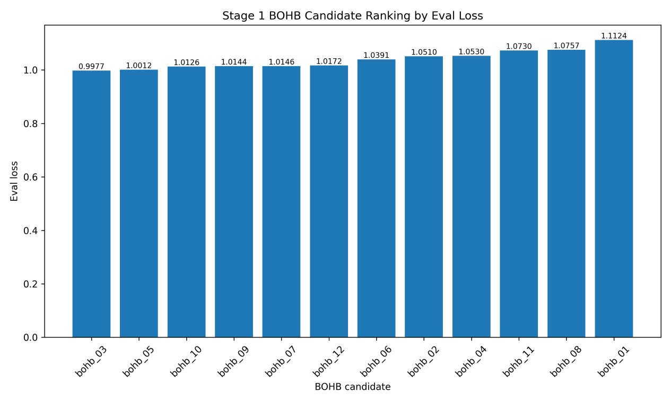
Model Training and Hyperparameter Tuning
3.Hyperparameter Tuninng
eval loss ranking
bohb_03 的 eval_loss 最低，但它和 bohb_05、bohb_10、bohb_09、bohb_07 的差距并不是特别大。

Slide 25
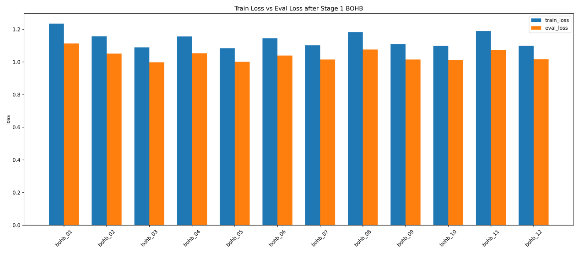
Model Training and Hyperparameter Tuning
3.Hyperparameter Tuninng
Train loss vs Eval loss
从不同候选配置之间的比较来看，bohb_03、bohb_05 和 bohb_10 的验证损失相对较低，其中 bohb_03 的 eval_loss 最低，说明该配置在验证集上的表现最好。相比之下，bohb_01、bohb_08 和 bohb_11 的训练损失与验证损失均相对较高，表明这些配置在当前短训预算下的拟合效果和泛化效果都不占优势。

Slide 26
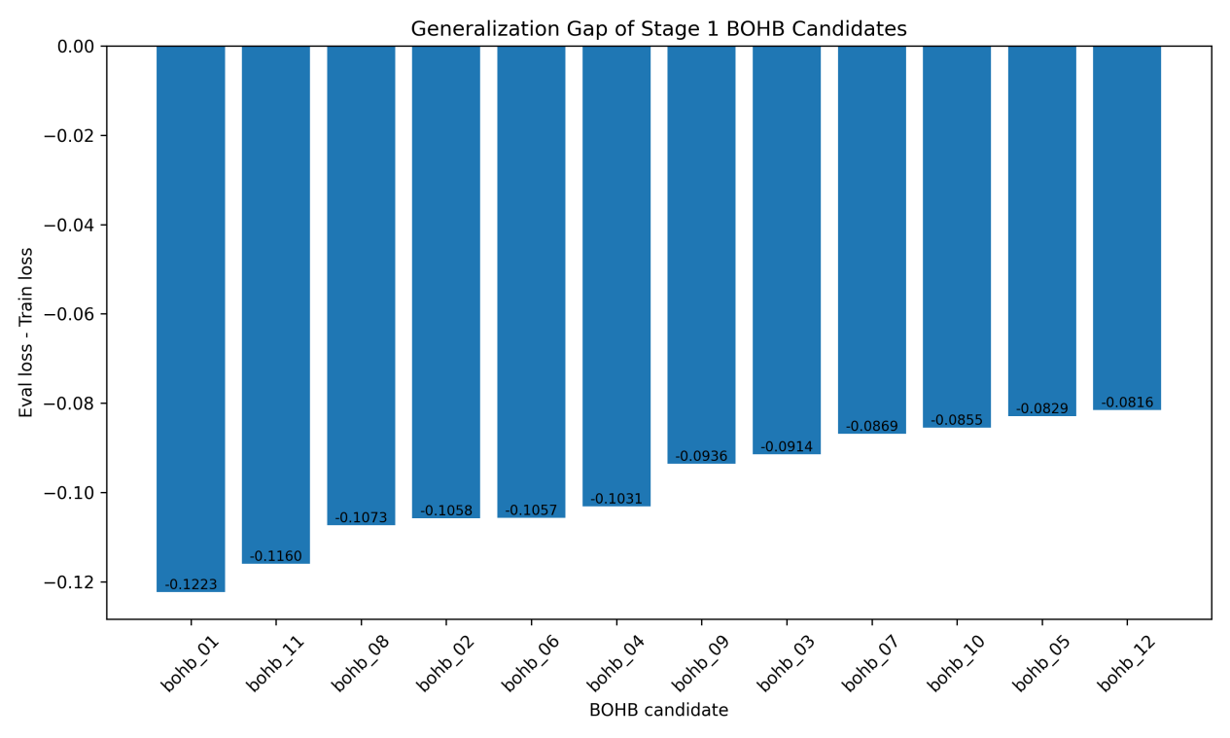
Model Training and Hyperparameter Tuning
3.Hyperparameter Tuninng
Eval loss vs generalization gap
图中展示了 12 组 BOHB 候选配置的 generalization gap，即验证损失与训练损失之差。结果显示，所有候选配置的 gap 均为负值，说明各组配置的验证损失均低于训练损失，未出现典型的训练集损失低而验证集损失高的过拟合现象。从 gap 的绝对值来看，部分配置如 bohb_12、bohb_05 和 bohb_10 的训练—验证损失差距较小，表现更为平衡；而 bohb_01、bohb_11 等配置的差距相对较大。综合验证损失排名与 generalization gap，bohb_03 在取得最低 eval_loss 的同时并未表现出异常的泛化差距，因此可作为 Stage2 的基础配置。

Slide 27
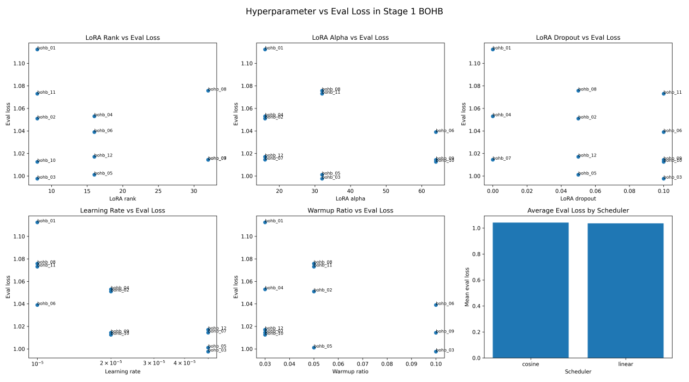
Model Training and Hyperparameter Tuning
3.Hyperparameter Tuninng
Hyperparameter
vs eval_loss 汇总图
较大的 LoRA rank 并不必然带来更低的验证损失，说明单纯增加可训练参数量并不能稳定提升泛化表现。
相比之下，learning rate 与 warmup ratio 对验证损失的影响更为明显，其中 bohb_03 在当前搜索空间中取得最低 eval_loss。scheduler 的平均表现差异较小，说明其在本轮短训中的区分度有限。

Slide 28
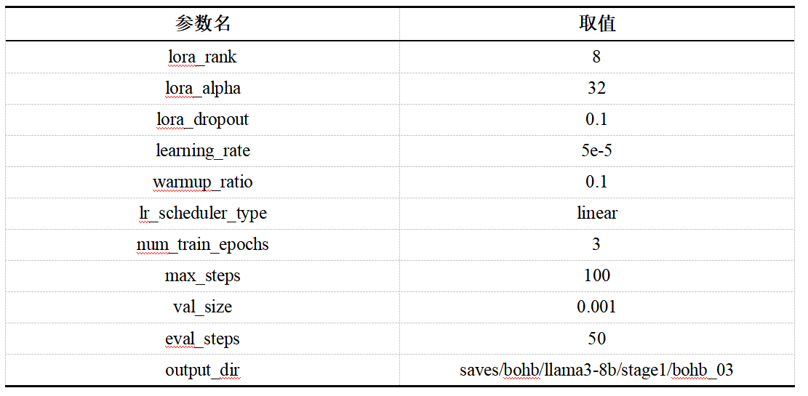
Model Training and Hyperparameter Tuning
3.Hyperparameter Tuninng
最优超参数配置(bohb_03)
bohb_03 的优势来自多个超参数的共同作用，因此可作为后续 Stage 2 正则化增强实验的基础配置

Slide 29
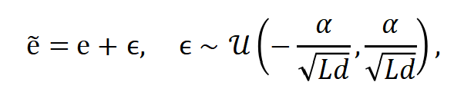
Model Training and Hyperparameter Tuning
3.Hyperparameter Tuninng
stage2——NEFTune
NEFTune 是一种面向大语言模型指令微调的正则化增强方法，其核心思想是在训练阶段向 token embedding 中加入随机噪声，从而增强模型对输入表示扰动的鲁棒性。具体而言，设原始 token embedding 为 e，NEFTune 在前向传播时将其替换为加入噪声后的表示 e，即
在阶段二中，我们固定阶段一选出的最优基础配置 bohb_03，只额外比较 NEFTune 正则化增强效果。换句话说，本研究仅调整 neftune_noise_alpha，比较无 NEFTune、NEFTune alpha = 5 和 NEFTune alpha = 10 三组结果。通过比较 eval_loss、train_loss、generalization gap 和训练时间，可以判断 NEFTune 是否在不显著增加训练成本的情况下提升模型泛化能力。

Slide 30
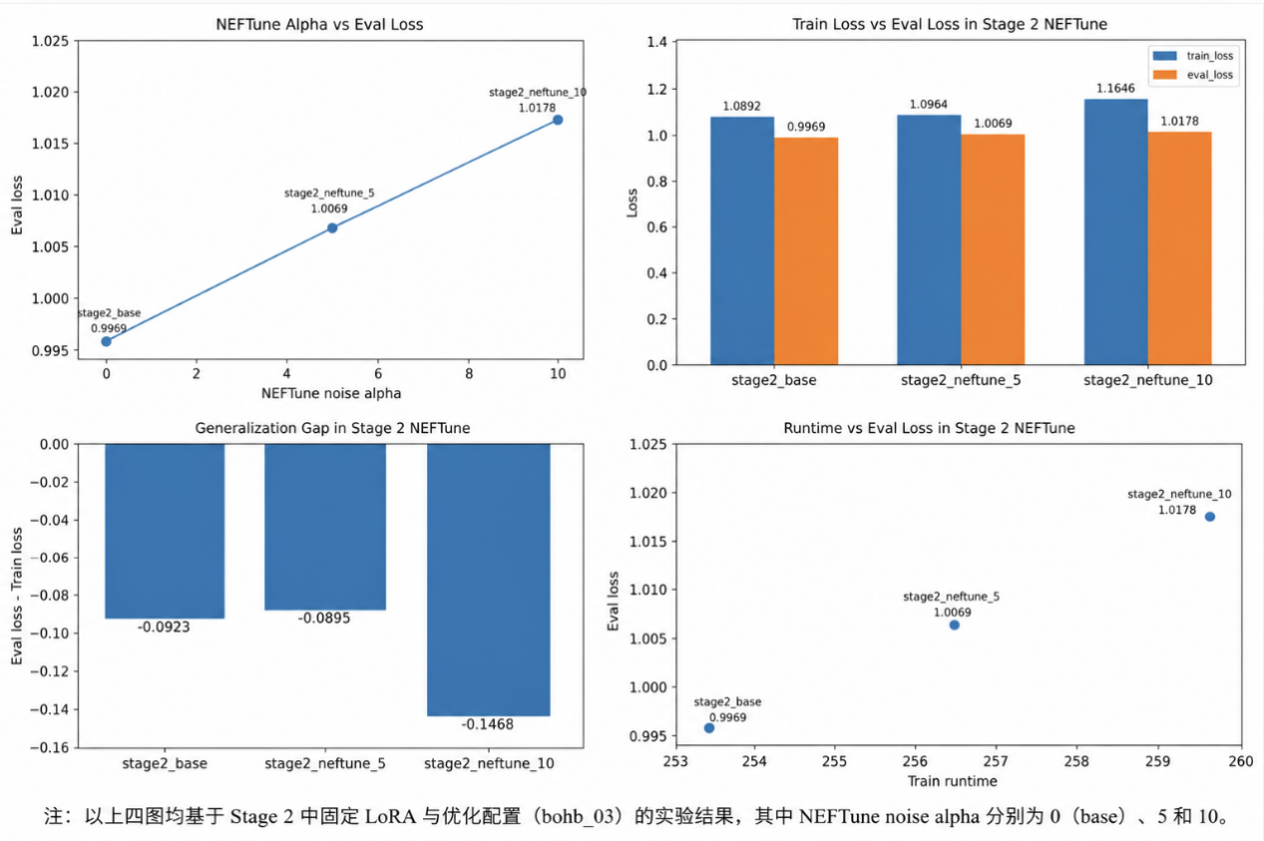
Model Training and Hyperparameter Tuning
3.Hyperparameter Tuninng
NEFTune 正则化增强实验结果对比
随着 neftune_noise_alpha 从 0 增加到 5 和 10，模型的 eval_loss、train_loss 以及训练时间均呈上升趋势，说明在当前 GPTQ + LoRA 微调设置下，NEFTune 并未进一步提升模型泛化能力，较强的 embedding 噪声反而可能增加训练难度并削弱验证集表现。因此，综合验证损失、训练稳定性与计算成本，本研究最终保留 stage2_base 作为更优配置。

Slide 31
Comparison and Ablation Study
Taguchi Orthogonal Design

Slide 32
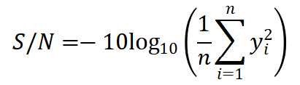
Comparison and Ablation Study
Taguchi Orthogonal Design
Taguchi 正交设计是一种基于正交表的实验设计方法，能够在多个因素、多种水平同时存在时，用少量代表性实验替代完整全因子实验。其核心思想是使各因素水平在实验组合中均衡出现，从而以较低计算成本分析不同因素对结果的主要影响。相比普通正交设计，Taguchi 方法进一步强调实验结果的稳定性和鲁棒性。
若评价指标为损失值，且目标是“越小越好”，可使用小望目信噪比：
其中，yi 表示第 i 次实验的损失值，n 表示实验或评价次数。S/N 越大，说明该配置的损失越小且表现越稳定。
本研究采用 Taguchi 正交设计思想构建 L9 实验矩阵，但考虑到计算资源限制，当前主要完成其中与 LLaMA3-8B 主线相关的代表性实验，并结合已有 BOHB、NEFTune 和数据规模实验进行主效应分析。

Slide 33
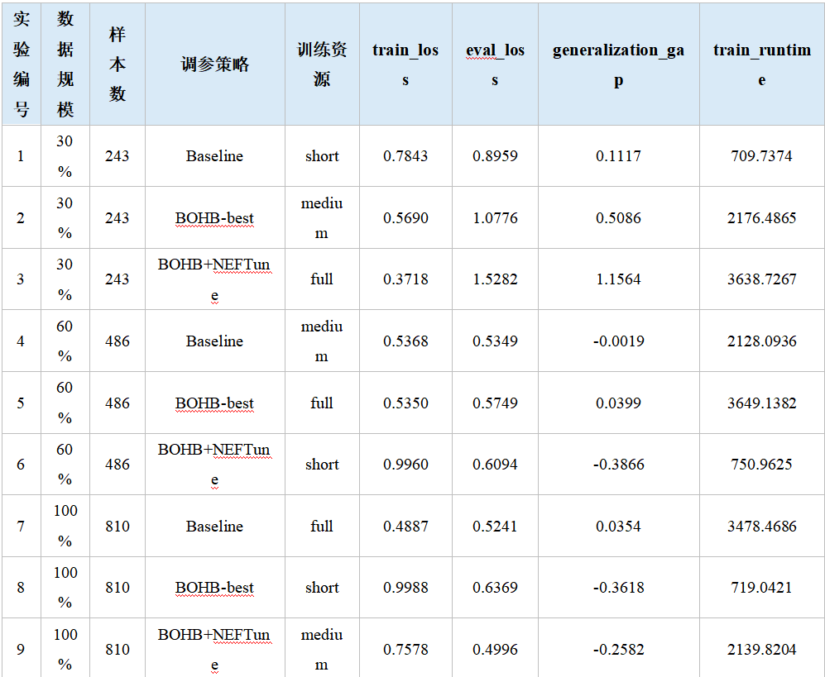
Comparison and Ablation Study
Taguchi Orthogonal Design
Taguchi L9 实验结果汇总
该表展示了 Taguchi L9 正交实验的完整结果。该表将数据规模、调参策略和训练资源作为三个主要因素，每个因素设置三个水平，并通过 9 组实验比较不同组合下的模型表现。

Slide 34
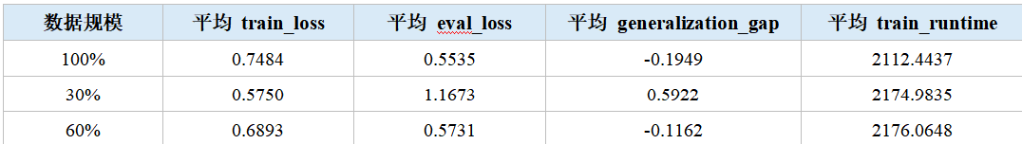
Comparison and Ablation Study
Taguchi Orthogonal Design
数据规模主效应分析
通过比较 30%、60% 和 100% 三种数据规模下的平均 eval_loss 可以发现，100% 数据规模取得最低平均 eval_loss，为 0.5535；60% 数据规模次之，为 0.5731；而 30% 数据规模的平均 eval_loss 高达 1.1673，明显高于另外两组。这说明数据规模对模型表现具有显著影响，尤其是训练数据过少时，模型难以充分学习岗位推荐任务中的稳定模式，导致验证集表现明显下降。因此，在本实验中，数据规模是影响模型泛化能力的最重要因素之一。

Slide 35
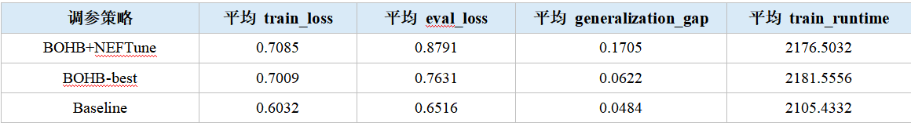
Comparison and Ablation Study
Taguchi Orthogonal Design
调参策略主效应分析
结果显示，Baseline 的平均 eval_loss 为 0.6516，BOHB-best 为 0.7631，BOHB+NEFTune 为 0.8791。从平均表现来看，Baseline 反而取得较低的验证损失，说明 BOHB 和 NEFTune 并不在所有组合下都稳定优于基础配置。不过需要注意的是，在单组实验中，BOHB+NEFTune 对应的 T9 取得了全局最低 eval_loss，说明该策略在合适的数据规模和训练资源下仍然可能带来提升。因此，调参策略的效果具有明显的条件依赖性，不能脱离数据规模和训练资源单独判断。

Slide 36
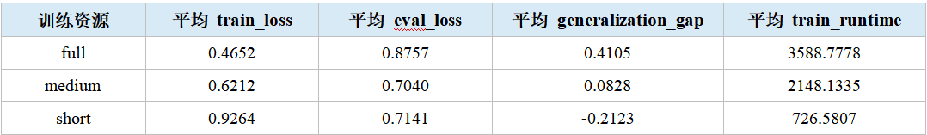
Comparison and Ablation Study
Taguchi Orthogonal Design
训练资源主效应分析
结果显示，medium 训练资源取得最低平均 eval_loss，为 0.7040；short 训练资源略高，为 0.7141；而 full 训练资源的平均 eval_loss 最高，为 0.8757。这说明在当前实验设置下，训练资源并非越多越好。适中的训练步数可能更有利于模型在训练成本和泛化能力之间取得平衡，而过长训练在部分配置下可能增加训练成本，却没有带来更好的验证集表现。因此，训练资源也是影响模型表现的重要因素，但其作用需要结合具体配置进行分析。

Slide 37
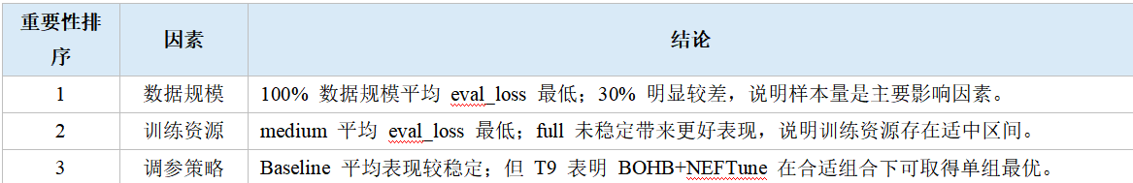
Comparison and Ablation Study
Taguchi Orthogonal Design
因素重要性总结
综合 Taguchi L9 正交实验结果可以看出，三个因素对模型表现的影响并不相同。其中，数据规模的影响最明显，100% 数据规模整体表现最好，而 30% 数据规模明显不足；训练资源的影响次之，medium 训练资源在平均验证损失上表现最佳，说明适中的训练预算更有利于当前任务；调参策略的作用则具有较强条件依赖性，虽然 BOHB+NEFTune 的平均表现并非最优，但其在 T9 组合中取得了最低 eval_loss，说明高级调参策略需要在合适的数据规模和训练资源下才能充分发挥作用。因此，本实验中影响模型表现的重要性大致可以概括为：数据规模最重要，其次是训练资源，调参策略则需要结合具体实验条件进行判断。

Slide 38
Thanks for listening!

