Slide 1
Backend
_{Web development - session 3}
5 April 2023

Slide 2
WHAT IS BACKEND?
Back-end development means working on server-side software, which focuses on everything you can’t see on a website.
Back-end developers ensure the website performs correctly, focusing on databases, back-end logic, application programming interface (APIs), architecture, and servers.
They use code that helps browsers communicate with databases, store, understand, and delete data.

Slide 3
WHY DO YOU NEED BACKEND?
Are you dealing with login forms?
Are you dealing with real time changing data?
Are you requiring authentication?
Do you want to handle data privacy?
=============BACKEND into PLAY=============

Slide 4
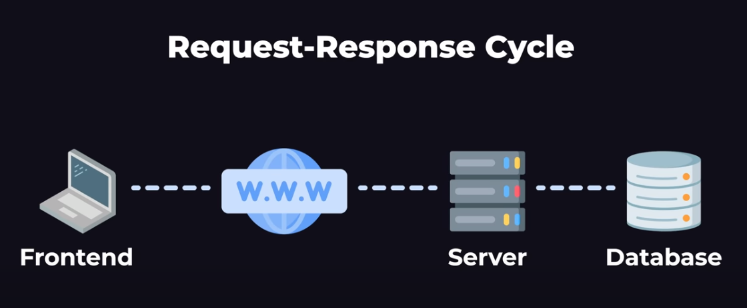
WHAT IS BACKEND?

Slide 5
WHAT IS API?
Application Programming Interface.
Allows us to connect and integrate frontend to backend.
Has endpoints/URLs that allows frontend to connect with the backend.

Slide 6
EXAMPLE TIME!!

Slide 7
CORS
Cross origin resource sharing
Allows your browser to receive/send data from different URLs/server

Slide 8

CORS

Slide 9

CORS

Slide 10

CORS

Slide 11
Example - 2
Paper Title | Summary | Pros & Cons
Design science in NFC research Busra Ozdenizci, M. N. Aydin, V. Coskun, Kerem Ok | This paper rigorous and holistic literature review with the modern applications of NFC in field of technology and paved path for further research in this field. | Cons:payment processing fraud Pros:Ease of Pansfrayment
Current benefits and future directions of NFC services | This paper examined existing NFC applications, prototypes and studies from both academia and industry and analyzed these applications by classifying them into NFC operating modes to surface the nature of underlying value-added services and benefits that they provide | Cons:Low Area Field Pros:Very fast and easy to use.
Mobile NFC Services: Adoption Factors and a Typology of Business Models | The chapter articulates the vision of a cooperative model that can enable the sharing of services, infrastructure, cost, and revenues among various NFC ecosystem players and adopts a four-tier classification approach to categorize NFC business models into a number of typologies | Cons: Security Issues Pros: eavesdropping and replay attacks.
Adoption of Near Field Communication (NFC) for Mobile Payments in the UAE: A Merchants' Perspective Mohanad Halaweh, H. A. Qaisi | Security, promptness and business sustainability were found to be important factors for merchants to contemplate before adopting the new technology, and technology infrastructure, switching cost, availability and ecosystem complexity impeded the spreading of NFC mobile payment technology in the UAE market | Cons: Low Data Transfer Rates Pros: Versatile—works with more than just payment systems
NFC-enabled City Maps Measuring their Perceived Value E. Ronay | This paper presents an innovative form of NFC usage in the Tourism field: NFC enabled travel maps. A prototype of such a map was developed and tested by the authors with the aim of measuring their perceived value. | Cons: Can be pricey when deployed for large-scale operations. Pros: compatible with existing RFID networks
NFC in industrial applications for monitoring plant information R. Ramanathan, Jahanzaib Imtiaz | A use case of NFC technology in Industrial Environment is discussed, which helps to deliver localization based information of a production plant just by simply touching the NFC tag with NFC enabled smart phone
Offloading Computations to Mobile Devices and Cloudlets via an Upgraded NFC Communication Protocol Dimitris Chatzopoulos, Carlos Bermejo, Sokol Kosta, P. Hui | A new NFC communication protocol is designed that overcomes the limitations of the default NFC protocol; removing the need for constant user interaction, the one–way communication restraint, and the limit on low data size transfe | Cons: Not every phone is equipped with NFC tags and thus cannot be used for digital payments. Pros: Improved operational efficiency
NFC Enabled Location Tracking System Nida Saiyed, P. Bafna, Anagha Vaidya, T. Khatri | Proposed system uses NFC-supported tag which will not only mark the presence of child in the bus, but also monitor the location of the child and send timely updates to the parents | Cons: Lack of User Knowledge. Pros: Reducing manual errors:
Using NFC Health Monitoring and Document Retrieval S. Pisey, Y.A. Sonavane, Sakshi Jagtap, Sanket Angchekar, Shreya Zaveri | A step-by-step approach in the design of two Near Field Communication (NFC) product for pervasive healthcare monitoring using NFC-enabled mobile phones for facilitating the patients in low resource environment is undertaken. | Cons: Radio Waves can prove to be harmful for the body. Pros: Being a New Vector for Fraud · Limited Range

Slide 12
Request
Request
GET /hello.htm HTTP/1.1
User-Agent: Mozilla/4.0 (compatible; MSIE5.01; Windows NT)
Host: www.tutorialspoint.com
Accept-Language: en-us
Accept-Encoding: gzip, deflate
Connection: Keep-Alive

Slide 13
Response
Response
HTTP/1.1 200 OK
Date: Mon, 27 Jul 2009 12:28:53 GMT
Server: Apache/2.2.14 (Win32)
Last-Modified: Wed, 22 Jul 2009 19:15:56 GMT
ETag: "34aa387-d-1568eb00"
Vary: Authorization,Accept
Accept-Ranges: bytes
Content-Length: 88
Content-Type: text/html
Connection: Closed

Slide 14
GET METHOD
GET Method
A GET request retrieves data from a web server by specifying parameters in the URL portion of the request. This is the main method used for document retrieval.

Slide 15
POST METHOD
POST method:
A POST request is used to send data to the server, for example, customer information, file upload, etc. using HTML forms.

Slide 16
RESPONSE CODES
Used to show the status of the request. (successfully processed or not)
HTTP response status codes indicate whether a specific HTTP request has been successfully completed. Responses are grouped in five classes:
Informational responses (100 – 199)
Successful responses (200 – 299)
Redirection messages (300 – 399)
Client error responses (400 – 499)
Server error responses (500 – 599)

Slide 17
JSON
Javascript Object Notation
{
"employees":[
{"firstName":"John", "lastName":"Doe"},
{"firstName":"Anna", "lastName":"Smith"},
{"firstName":"Peter", "lastName":"Jones"}
]
}

