Slide 1
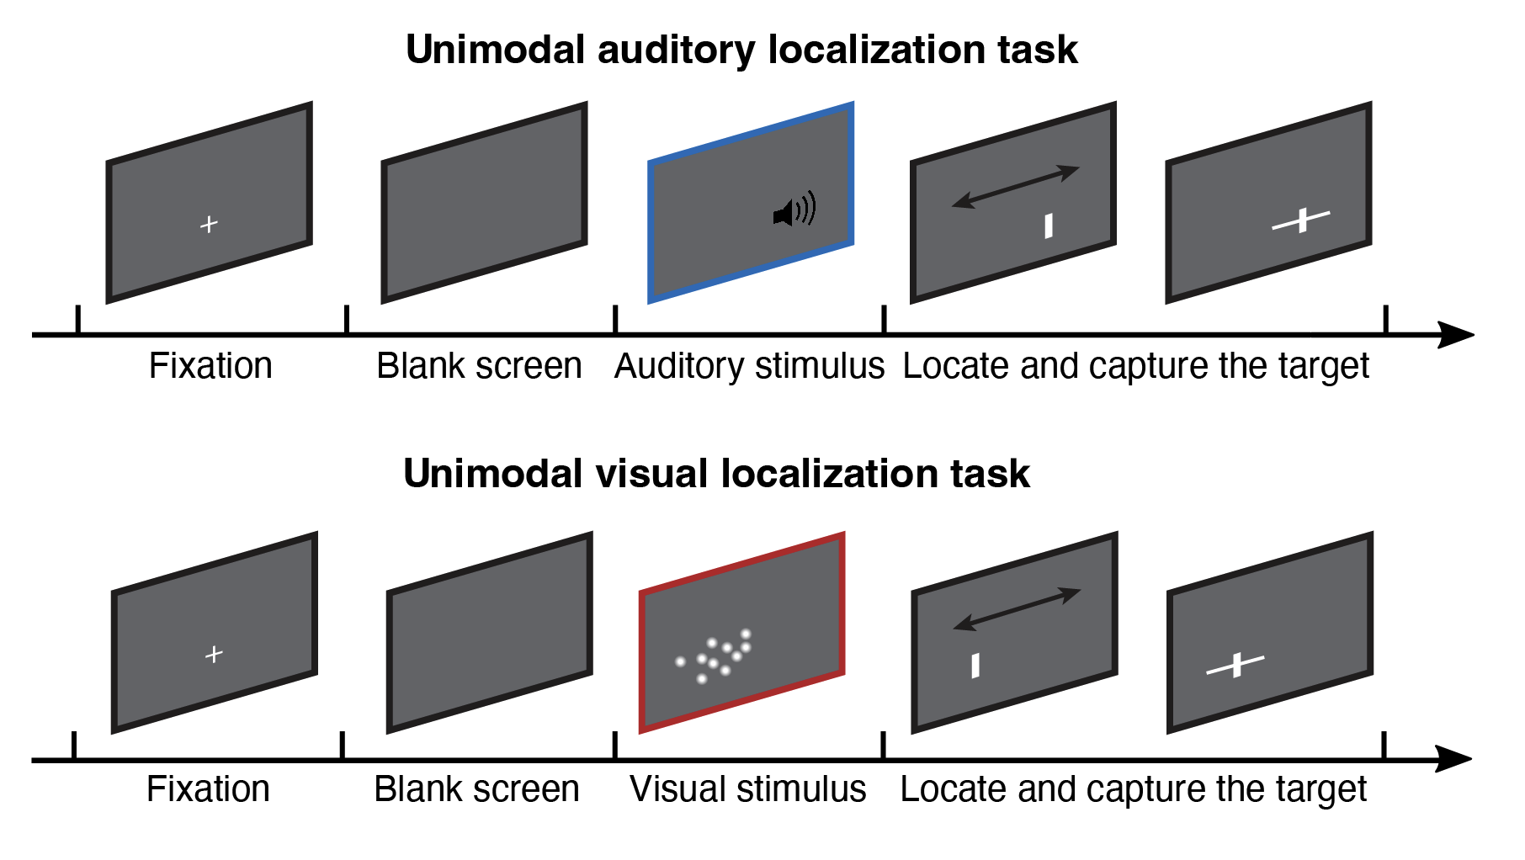
Unimodal coin capture task
Notes:
Imagine the screen as surface of water. Your task is to locate an unseen coin that a person had dropped into the water. The coin will cause a splash. In one session, you will only hear the sound. In another session, you will only see the bubbles. There’s also a visual mask after the bubble.
After indicating your estimate of the coin location, you will use a net, represented by a horizontal line centered around your estimate point, to capture the coin. You can adjust the width to of the net to get a score.

Slide 2
Unimodal coin capture task – Score system
In each trial, you will score between 0-1
The score is jointly determined by your estimate and the net length.
A closer estimate to the coin gives higher score.
A narrower net gives higher score. Missing the coin leads to 0 score.
In the practice, you will see two scores. The potential score reflects how narrow your net is. But if you miss the target, even if the potential score is high, your actual score will be 0.
In the main experiment, you will only see the potential score. You can only see the total actual scores during the break.
Actual score: 0
Potential score: 0.71
0.52
Practice
Main experiment

Slide 3
Unimodal coin capture task – Sessions
Main auditory task
8 blocks, around 15 minutes
Main visual task
8 blocks, around 30 minutes

Slide 4
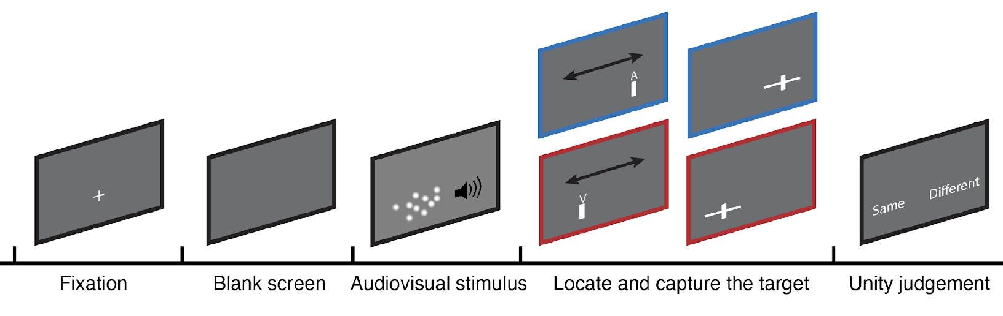
Bimodal coin capture task
Notes:
You will see and hear the splash at the same time. Sometimes they come from the same coin, sometimes they come from two different coins. After the splash, you will receive a post-cue indicating whether you should locate and capture the coin based on either the sound or the bubbles.
When you adjust the net, the point
You need to determine whether the sound and bubbles come from the same coin.

