Slide 1
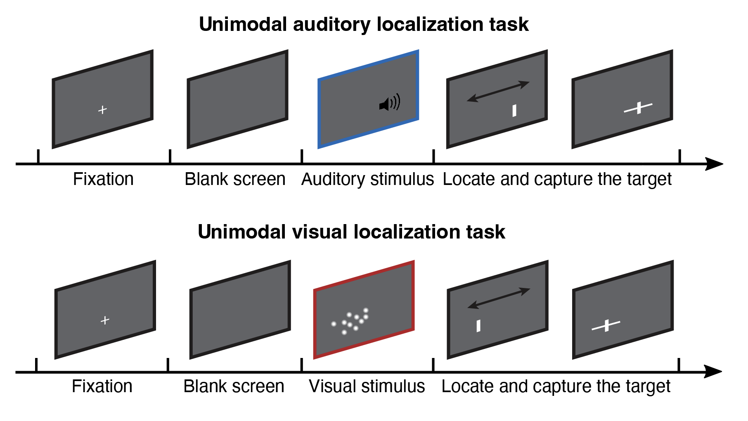
Coin capture task - unimodal
Notes:
Imagine the screen as surface of water. Your task is to locate an unseen coin that a person had dropped into the water. The coin will cause a splash. In one session, you will only hear the sound. In another session, you will only see the bubbles.
After indicating your estimate of the coin location, you will use a net, represented by a horizontal line centered around your estimate point, to capture the coin. You can adjust the width to of the net. A narrower net gives higher point, but missing the coin yields no point.

Slide 2
Coin capture task - unimodal
Score system
In each trial, you will score between 0-1
The
A narrower net gives higher score, but missing the coin yields no point
In the practice, you will also see the actual score to get a sense of where the actual target is. If you missed the target, the actual score will be 0.
In the main experiment, you will only see the potential score, which reflects how narrow your net is. You can only see the your actual total score during the break.
Actual score: 0
Potential score: 0.71
0.52
Practice
Main experiment

Slide 3
Coin capture task - unimodal
Main auditory task
8 blocks, around 15 minutes
Main visual task
8 blocks, around 30 minutes

