Slide 1
Coin capture task - unimodal
Imagine the screen as surface of water. Your task is to locate an unseen coin that a person had dropped into the water. The coin will cause a splash. In one session, you will only hear the sound. In another session, you will only see the bubbles.
After indicating your estimate of the coin location, you will use a net, represented by a horizontal line centered around your estimate point, to capture the coin. You can adjust the width to of the net. A narrower net gives higher point, but missing the coin yields no point.

Slide 2
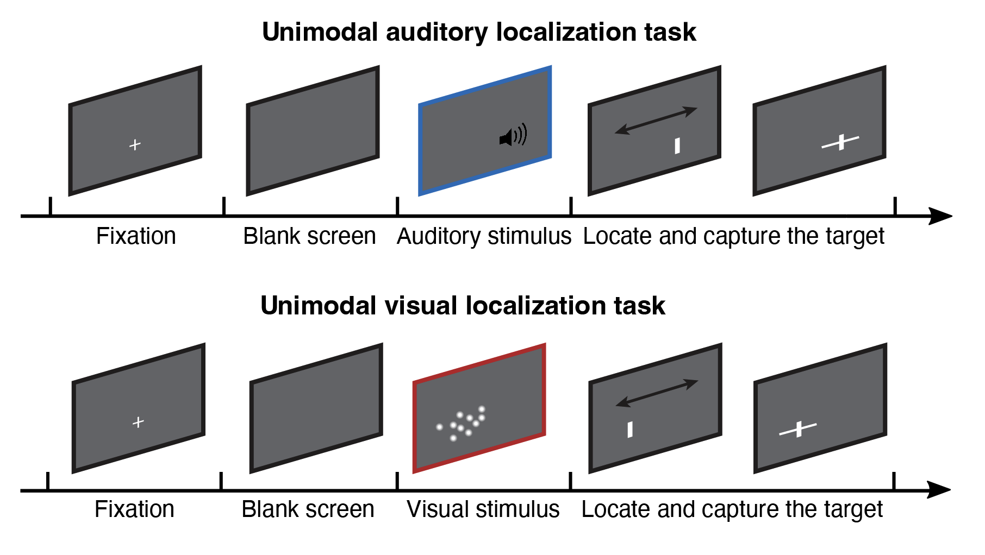
Coin capture task - unimodal
Notes:
Imagine the screen as surface of water. Your task is to locate an unseen coin that a person had dropped into the water. The coin will cause a splash. In one session, you will only hear the sound. In another session, you will only see the bubbles.
After indicating your estimate of the coin location, you will use a net, represented by a horizontal line centered around your estimate point, to capture the coin. You can adjust the width to of the net. A narrower net gives higher point, but missing the coin yields no point.

Slide 3
Coin capture task - unimodal
Practice:
You’ll see two rows of scores in the practice.
The first row is the actual score, which becomes zero if your net is too narrow to enclose the coin. You WON’T see this actual score in the real task.
The second row is the potential score, which will also be visible in the actual experiment.
Main auditory task
8 blocks, around 15 minutes
Main visual task
8 blocks, around 30 minutes

