Slide 1
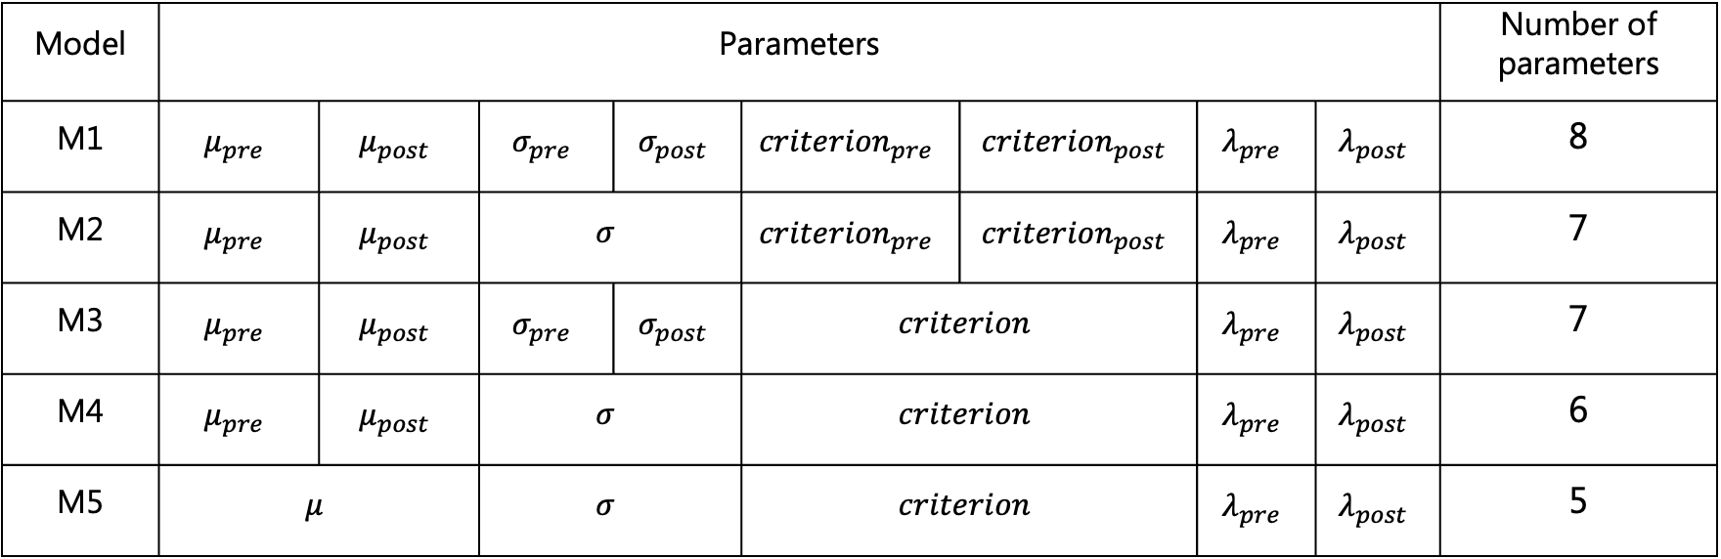
Models
Model | Parameters |  |  |  |  |  |  |  | Number of parameters
M1 | $$μ_{pre}$$ | $$μ_{post}$$ | $$σ_{pre}$$ | $$σ_{post}$$ | $${criterion}_{pre}$$ | $${criterion}_{post}$$ | $$λ_{pre}$$ | $$λ_{post}$$ | 8
M2 | $$μ_{pre}$$ | $$μ_{post}$$ | $$σ$$ |  | $${criterion}_{pre}$$ | $${criterion}_{post}$$ | $$λ_{pre}$$ | $$λ_{post}$$ | 7
M3 | $$μ_{pre}$$ | $$μ_{post}$$ | $$σ_{pre}$$ | $$σ_{post}$$ | $$criterion$$ |  | $$λ_{pre}$$ | $$λ_{post}$$ | 7
M4 | $$μ_{pre}$$ | $$μ_{post}$$ | $$σ$$ |  | $$criterion$$ |  | $$λ_{pre}$$ | $$λ_{post}$$ | 6
M5 | $$μ$$ |  | $$σ$$ |  | $$criterion$$ |  | $$λ_{pre}$$ | $$λ_{post}$$ | 5

Slide 2
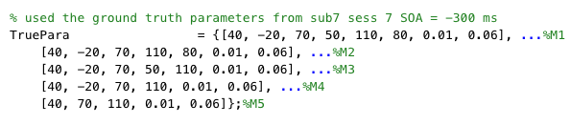
Simulated model parameters were based on fitting values from one subject, one session

Slide 3
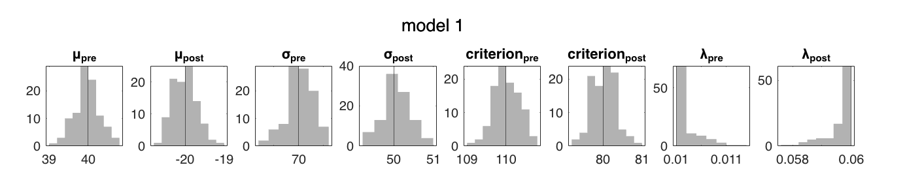
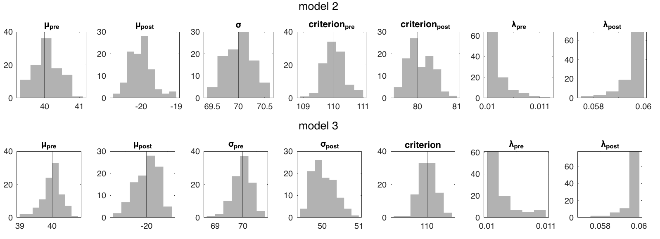
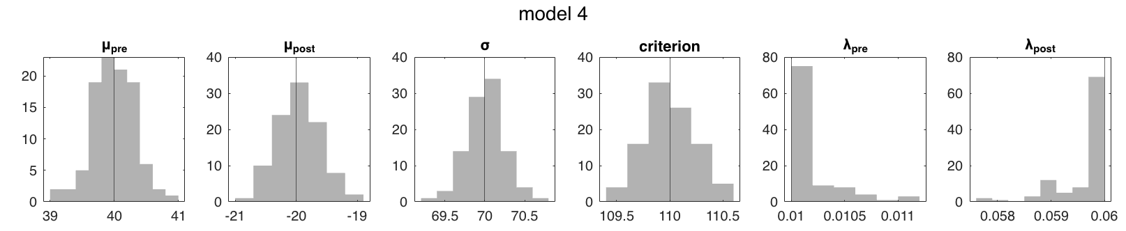
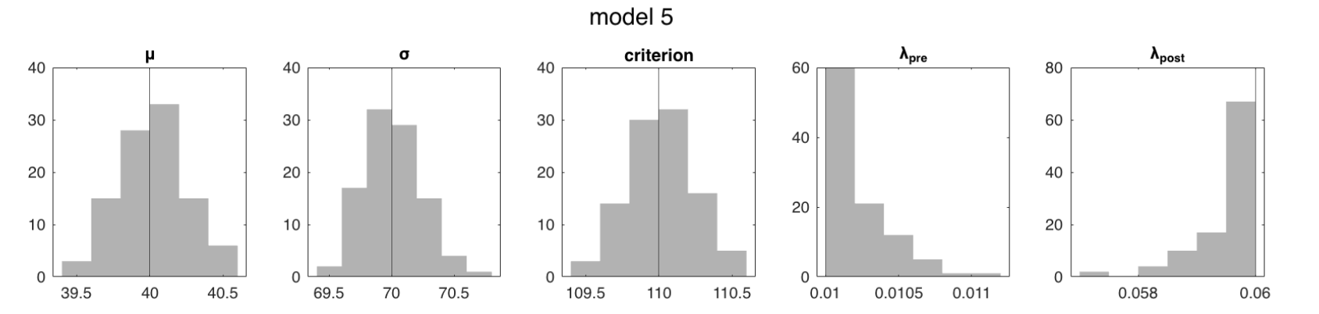
Parameter recovery: passed debugging with 1,000 trials per SOA
Notes:
Simulate from M1-M5, fit with the same simulating model
Increasing trials per SOA to 1e4 decreases simulation noise and thus simulated data should be closer to the true parameters
trials per SOA = 1000;
Fitting trial = 100;

Slide 4
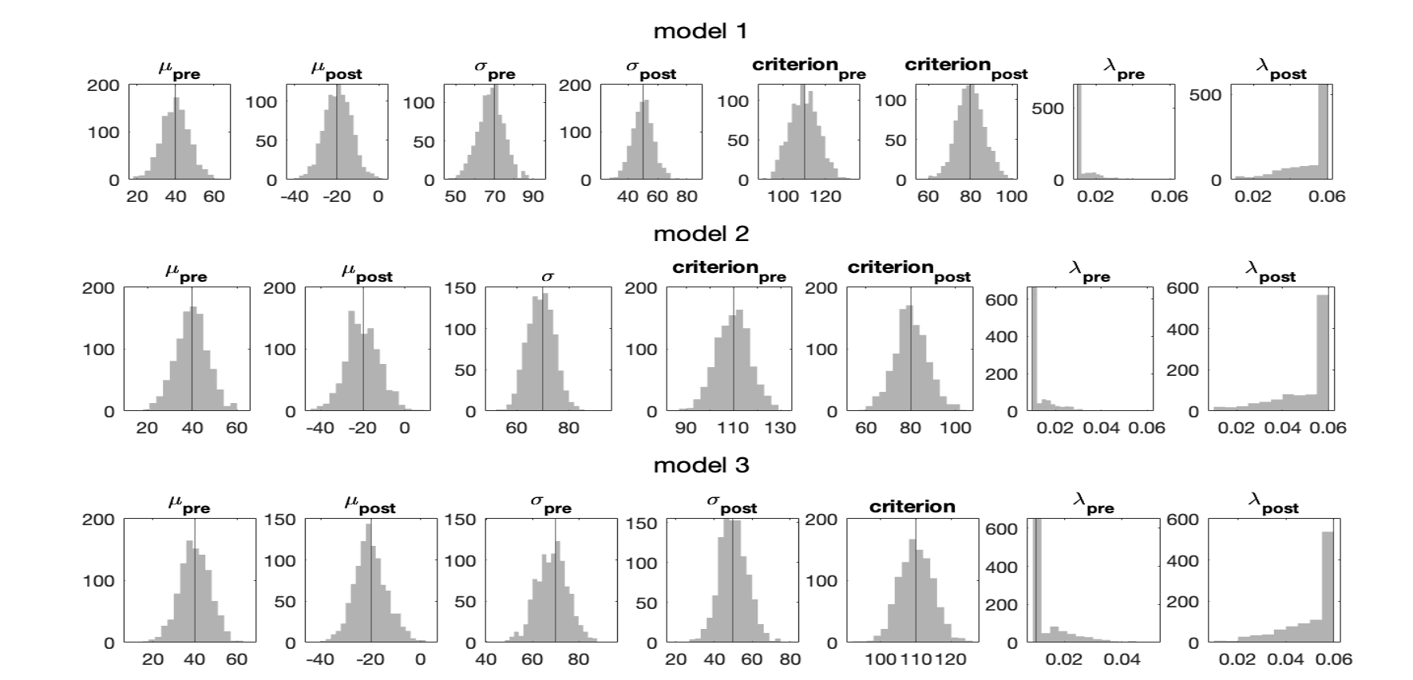
Parameter recovery: histogram of recovered parameters, M1-M3
Notes:
*vertical line: true parameter value
Simulate from M1-M5, fit with the same generating model
trials per SOA = 20;
Fitting trial = 1000;

Slide 5
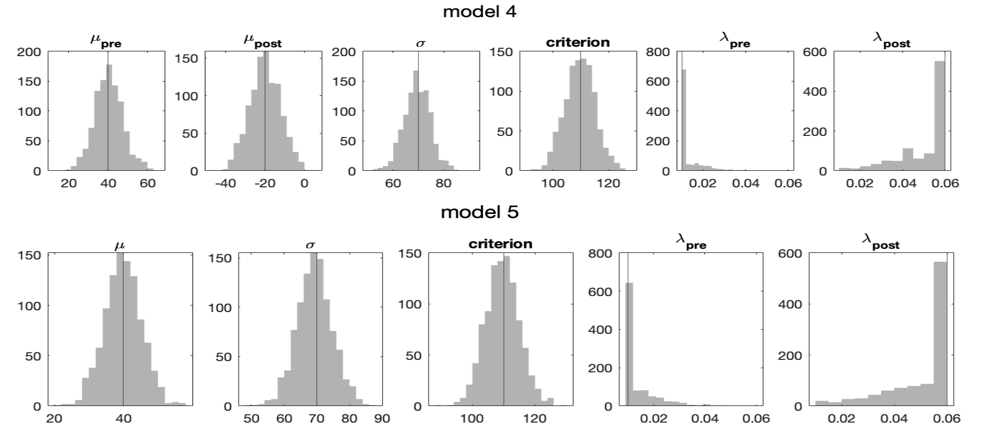
Parameter recovery: histogram of recovered parameters, M4-M5
Notes:
Simulate from M1-M5, fit with the same generating model
trials per SOA = 20;
Fitting trial = 1000;

Slide 6
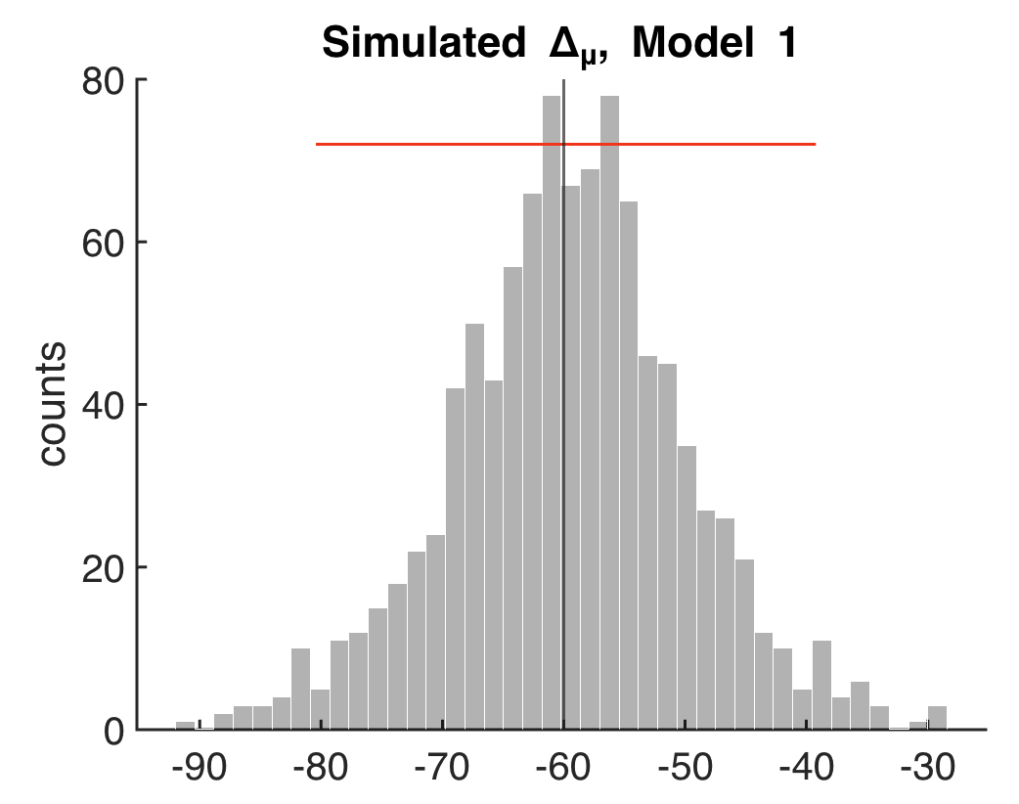
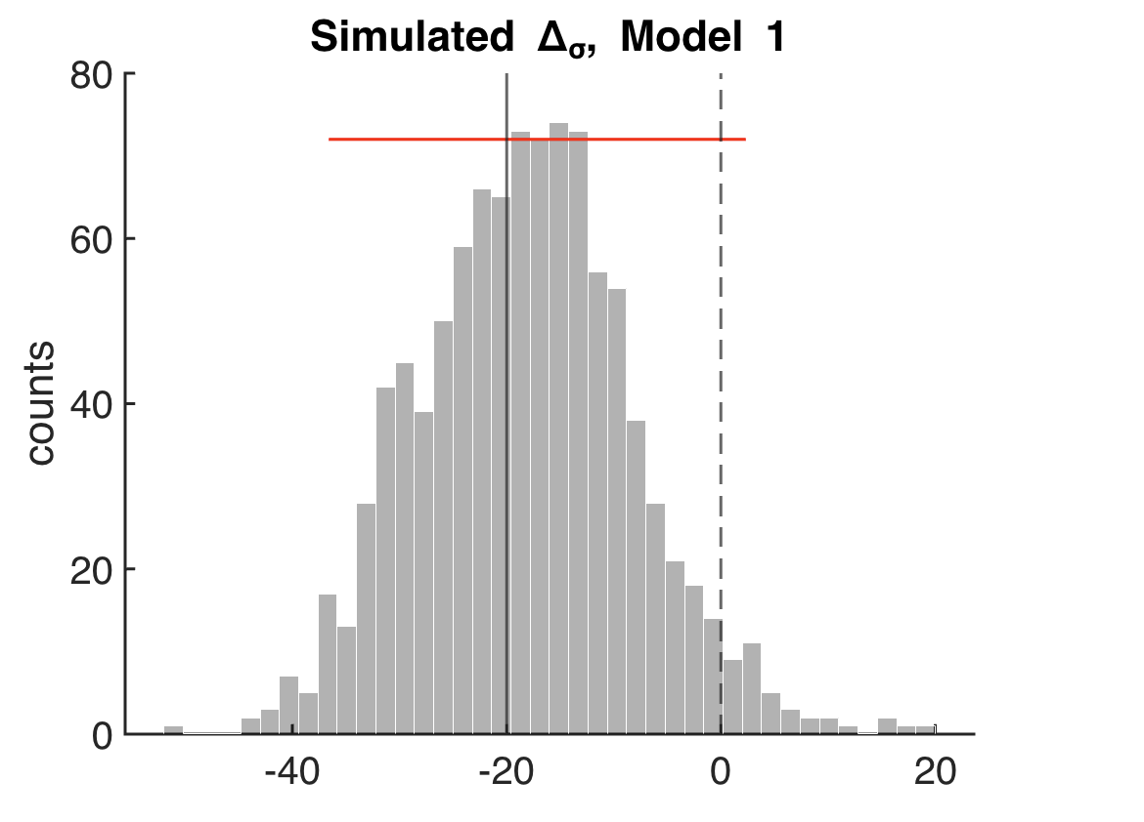
Parameter recovery: simulated delta_mu but not delta_sigma was significant in M1
Notes:
But not for the del

Slide 7
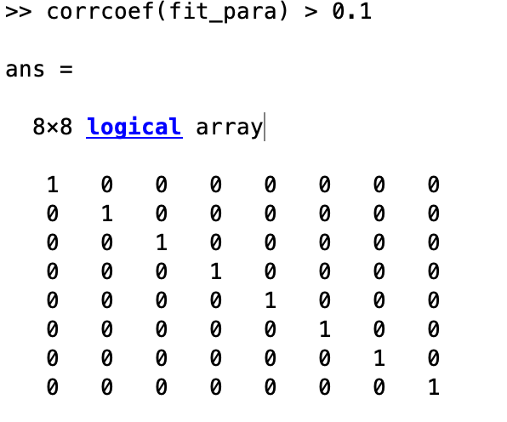
Parameter recovery: didn’t find correlation between parameters within each model
Example from M1:
Notes:
Simulate from M1-M5, fit with the same generating model
trials per SOA = 20;
Fitting trial = 1000;

Slide 8
Model recovery: confusion matrix
Simulate and fit with all models
Fitting trial = 100;

Slide 9
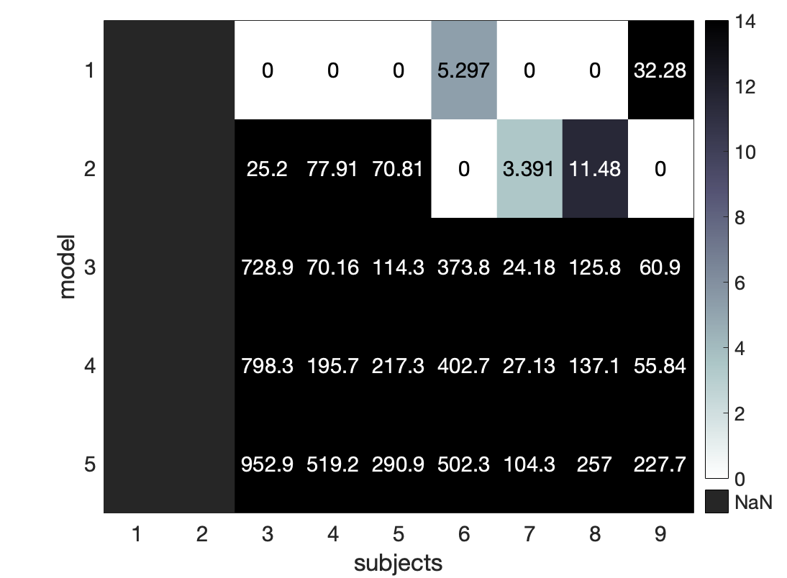
Model comparison: number of subjects best fit by each model
nWin
5
2
0
0
0
Notes:
Value: delta_AIC summed across 9 sessions
exceedance probabilities?

Slide 10
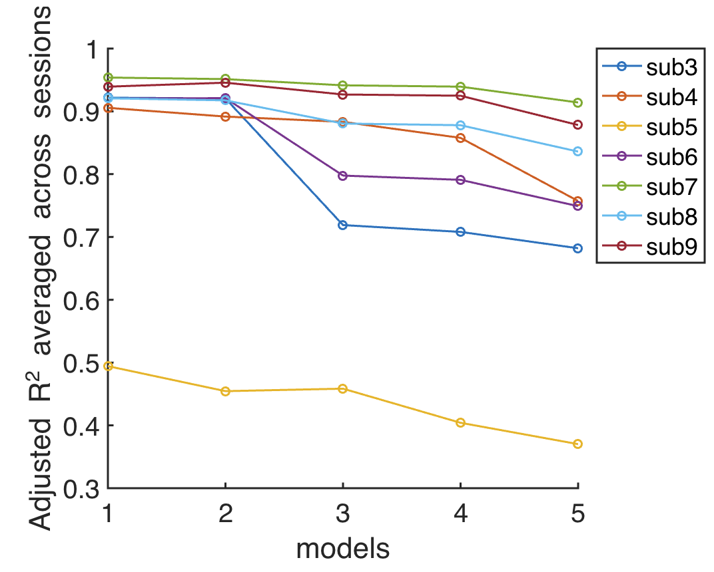
Parameter fits: adjusted r squares were highest for M1, and the worst for sub5 (who had large sigma)
Notes:
Adjusted R^2 for 5 models fitted to each subject, each session, then averaged across sessions

Slide 11
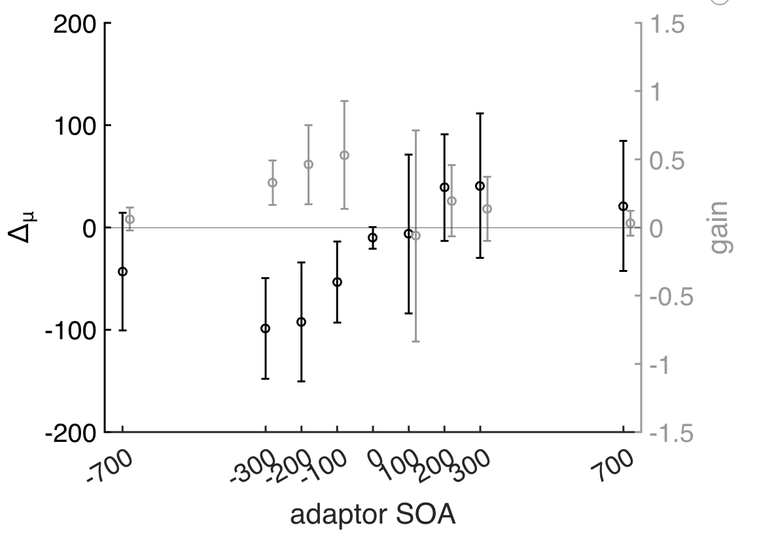
Parameter fits: group-level mu shifts indicated causal inference
Notes:
Fitting model = individual winning model
Errorbar = between-subject s.d.

Slide 12
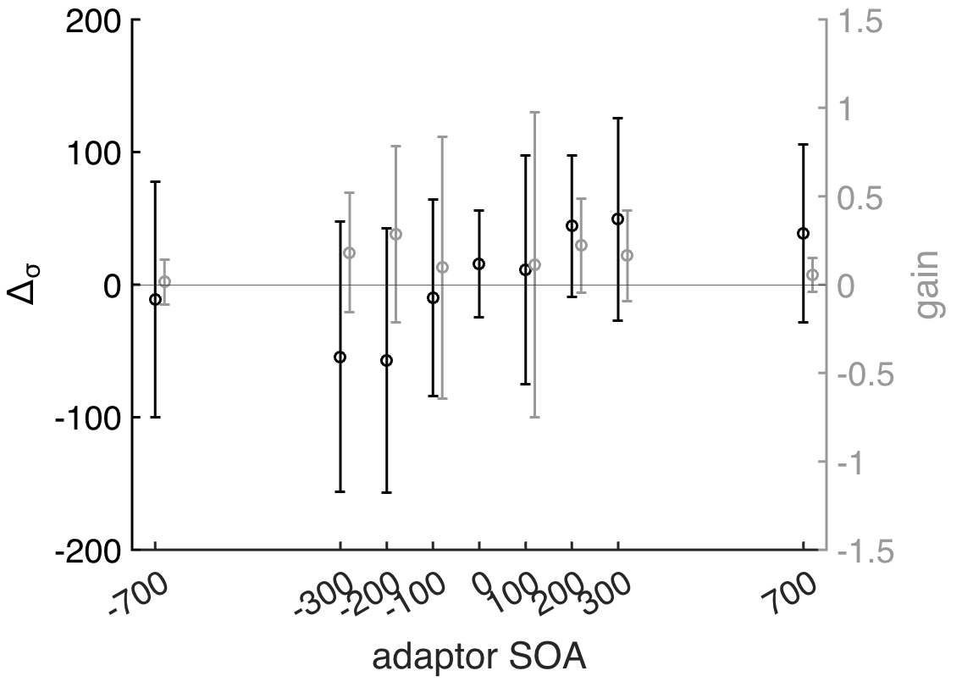
Parameter fits: group-level sigma shifts showed weak recalibration effect?

