Slide 1
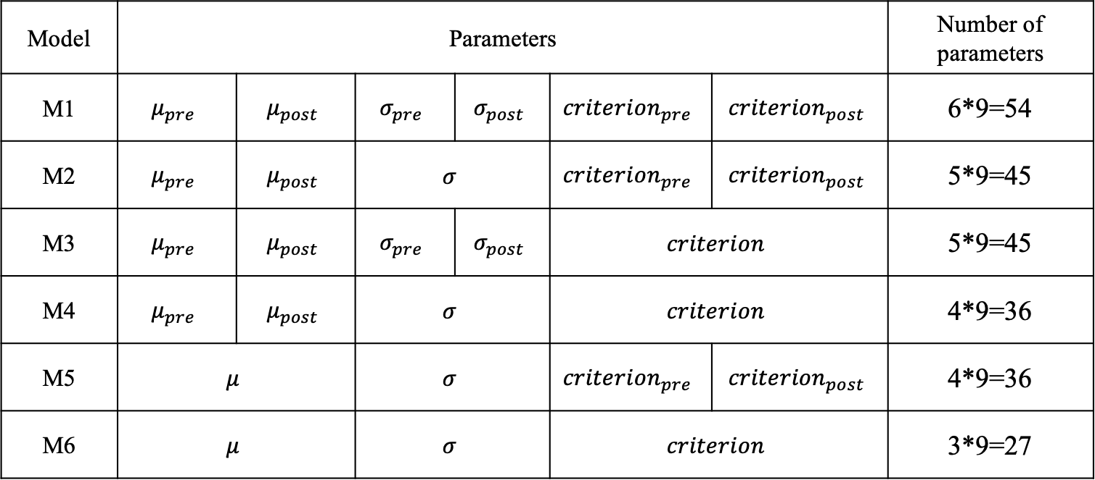
Models
Model | Parameters |  |  |  |  |  | Number of parameters
M1 | $$μ_{pre}$$ | $$μ_{post}$$ | $$σ_{pre}$$ | $$σ_{post}$$ | $${criterion}_{pre}$$ | $${criterion}_{post}$$ | 6*9=54
M2 | $$μ_{pre}$$ | $$μ_{post}$$ | $$σ$$ |  | $${criterion}_{pre}$$ | $${criterion}_{post}$$ | 5*9=45
M3 | $$μ_{pre}$$ | $$μ_{post}$$ | $$σ_{pre}$$ | $$σ_{post}$$ | $$criterion$$ |  | 5*9=45
M4 | $$μ_{pre}$$ | $$μ_{post}$$ | $$σ$$ |  | $$criterion$$ |  | 4*9=36
M5 | $$μ$$ |  | $$σ$$ |  | $${criterion}_{pre}$$ | $${criterion}_{post}$$ | 4*9=36
M6 | $$μ$$ |  | $$σ$$ |  | $$criterion$$ |  | 3*9=27
Lambda fixed at 0.03; Each session is fitted independently; delta_AIC is summed across sessions for each model, each subject
Notes:
M1 is the full model, with 6 parameters x 9 sessions, fitted independently
Lambda is fixed across everything

Slide 2
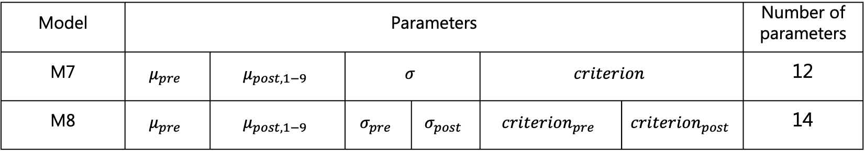
Reduced model
Model | Parameters |  |  |  |  |  | Number of parameters
M7 | $$μ_{pre}$$ | $$μ_{post, 1−9}$$ | $$σ$$ |  | $$criterion$$ |  | 12
M8 | $$μ_{pre}$$ | $$μ_{post, 1−9}$$ | $$σ_{pre}$$ | $$σ_{post}$$ | $${criterion}_{pre}$$ | $${criterion}_{post}$$ | 14
Lambda fixed at 0.03; All sessions are fitted together; delta_AIC is summed across sessions for each model, each subject

Slide 3
Delta-AIC

Slide 4
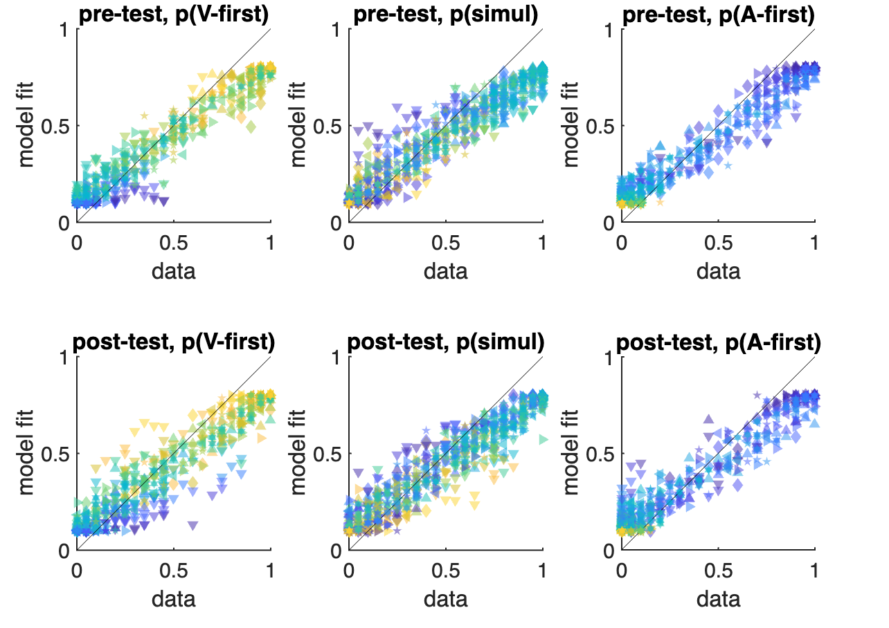
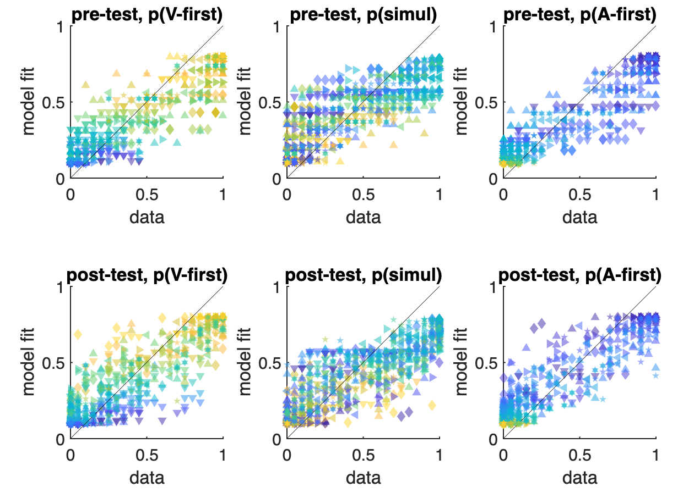
Model prediction of M1 and M7
M1
M7
Notes:
Colorcode: test SOA
Marker: subject

Slide 5
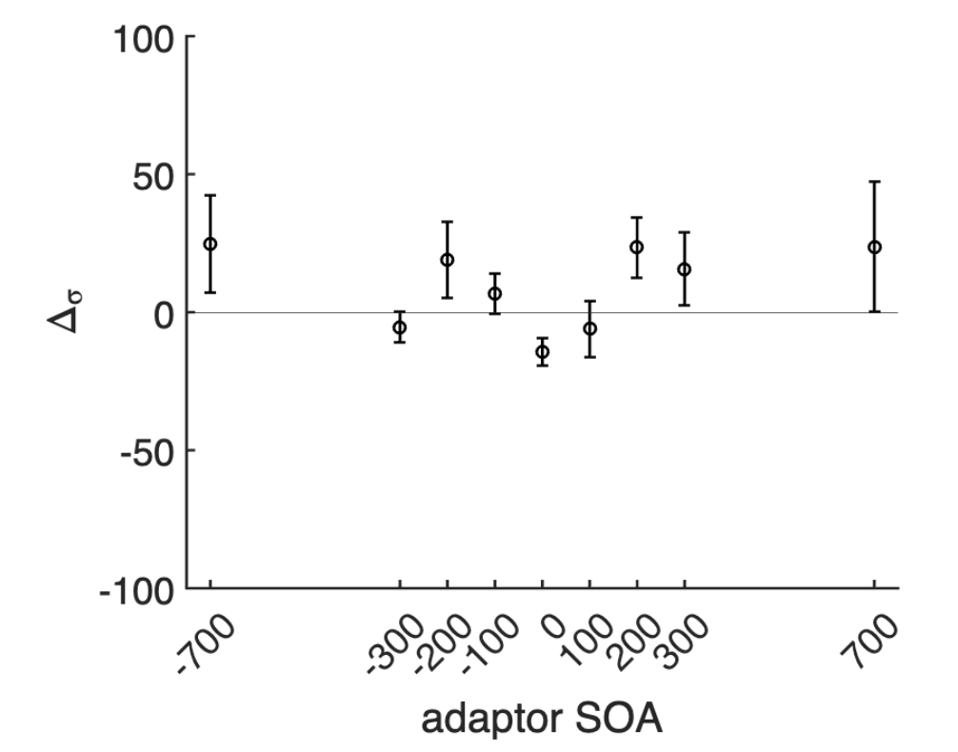
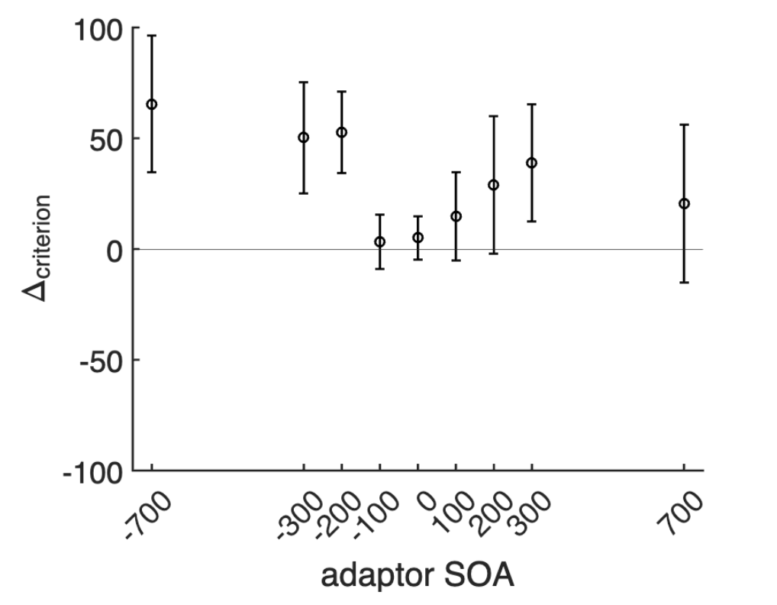
Parameter from the full model (72 parameters)

Slide 6
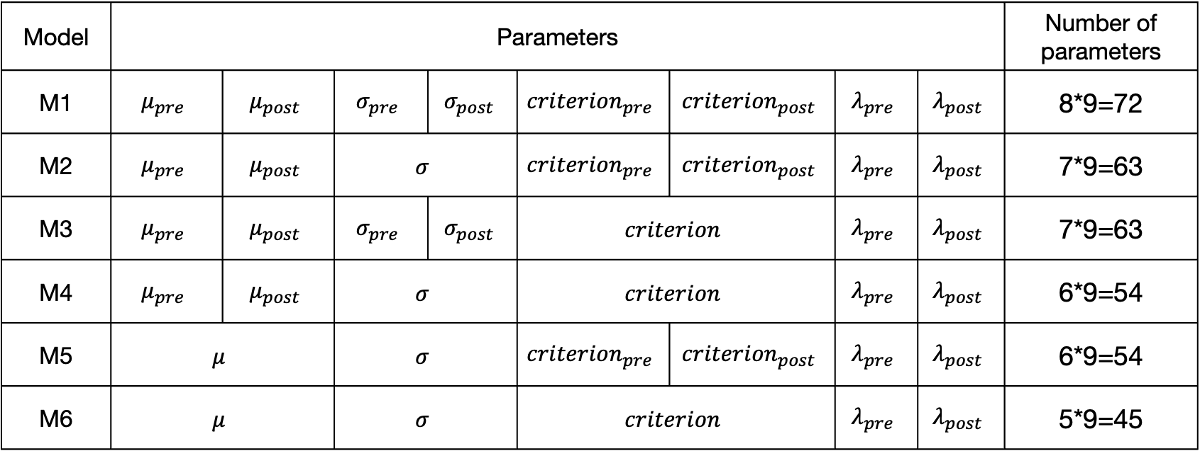
Model the recalibration effect
Model | Parameters |  |  |  |  |  |  |  | Number of parameters
M1 | $$μ_{pre}$$ | $$μ_{post}$$ | $$σ_{pre}$$ | $$σ_{post}$$ | $${criterion}_{pre}$$ | $${criterion}_{post}$$ | $$λ_{pre}$$ | $$λ_{post}$$ | 8*9=72
M2 | $$μ_{pre}$$ | $$μ_{post}$$ | $$σ$$ |  | $${criterion}_{pre}$$ | $${criterion}_{post}$$ | $$λ_{pre}$$ | $$λ_{post}$$ | 7*9=63
M3 | $$μ_{pre}$$ | $$μ_{post}$$ | $$σ_{pre}$$ | $$σ_{post}$$ | $$criterion$$ |  | $$λ_{pre}$$ | $$λ_{post}$$ | 7*9=63
M4 | $$μ_{pre}$$ | $$μ_{post}$$ | $$σ$$ |  | $$criterion$$ |  | $$λ_{pre}$$ | $$λ_{post}$$ | 6*9=54
M5 | $$μ$$ |  | $$σ$$ |  | $${criterion}_{pre}$$ | $${criterion}_{post}$$ | $$λ_{pre}$$ | $$λ_{post}$$ | 6*9=54
M6 | $$μ$$ |  | $$σ$$ |  | $$criterion$$ |  | $$λ_{pre}$$ | $$λ_{post}$$ | 5*9=45
Use M1-M6 with 45-72 parameters
Model-free behavioral results (fitted by 72-parameter model) would be the same?

Slide 7
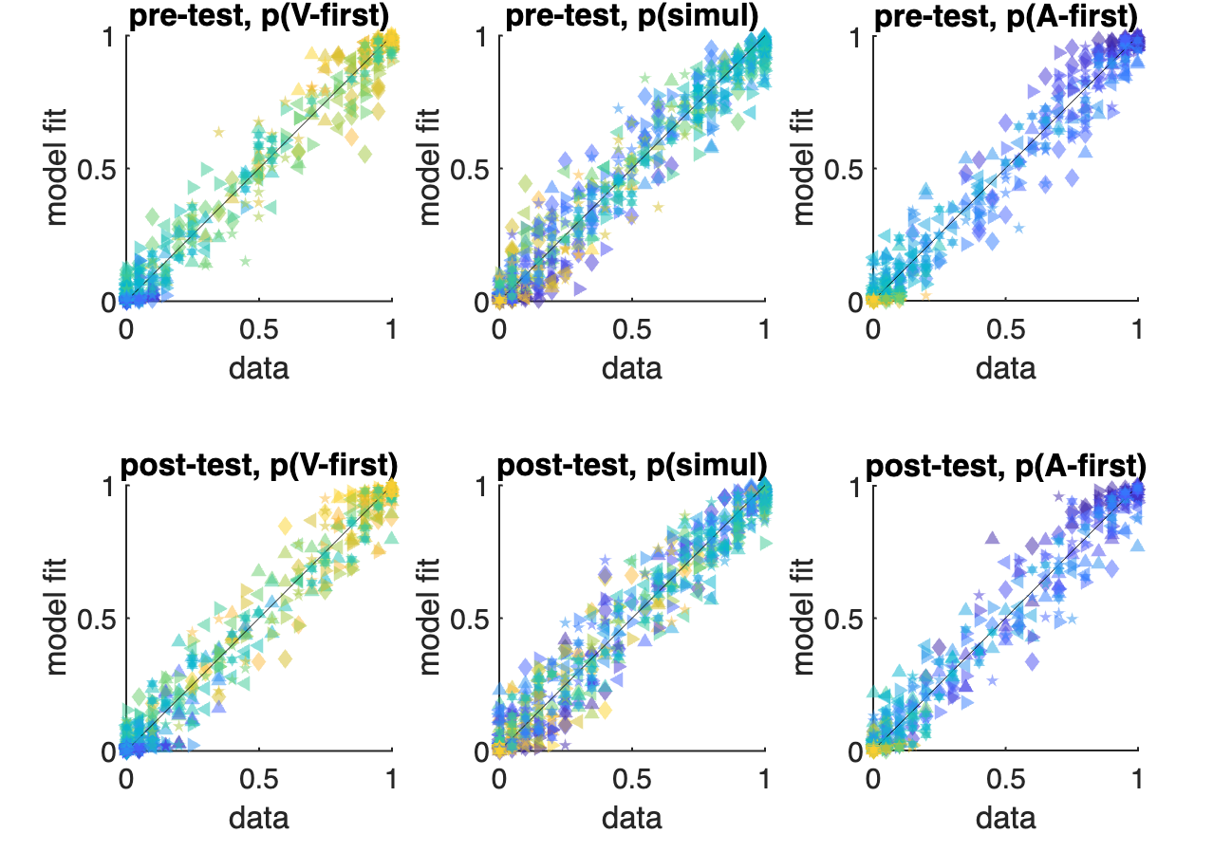
Model prediction of M1(72 parameters)
Notes:
Colorcode: test SOA
Marker: subject

Slide 8
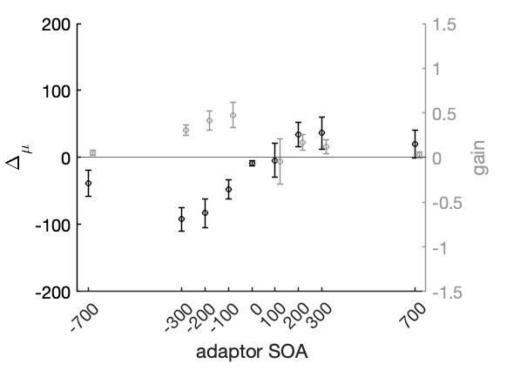
Model the exposure phase
Can we model cumulative and immediate recalibration effects together? Is this the same problem of modeling sequential dependence? Kalman filter?

Slide 9

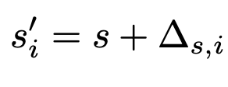

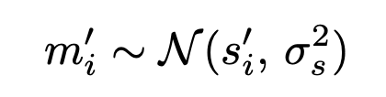
Bayesian causal inference model
1. SOA measurement
SOA
Remap SOA with a bias in the internal space,
where reflects the default bias of SOA mapping
Make a noisy measurement

Slide 10
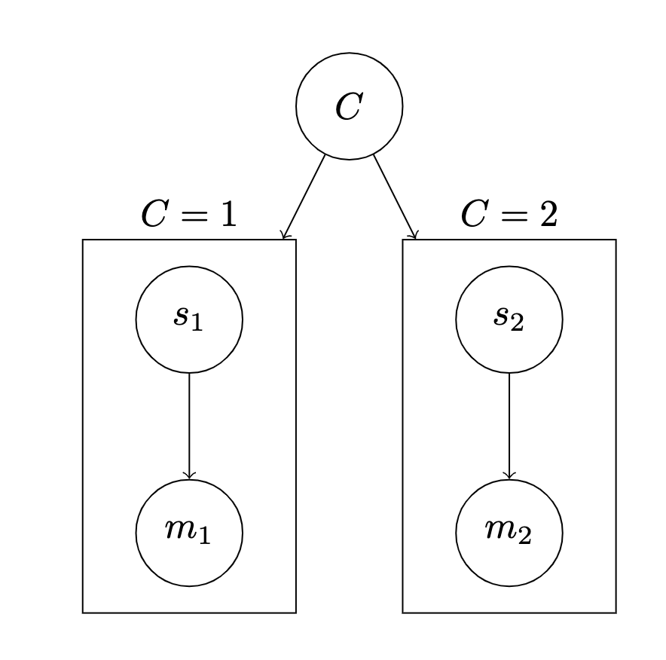
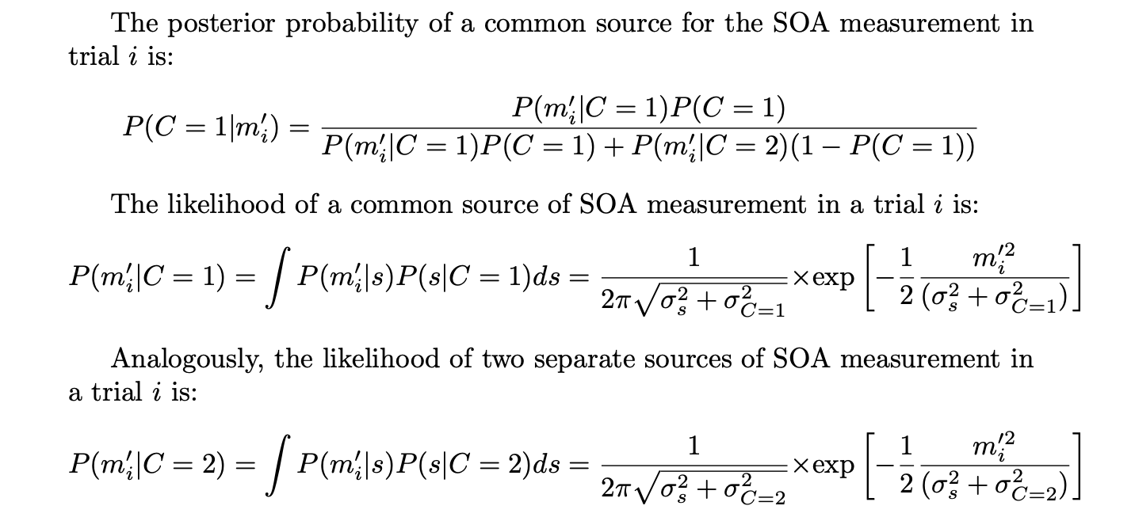


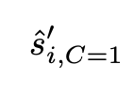

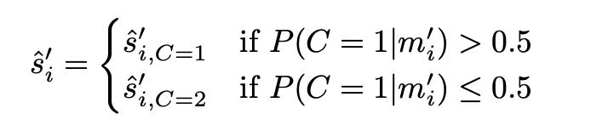
Bayesian causal inference model
2. SOA estimate
Model averaging
Model selection

Slide 11


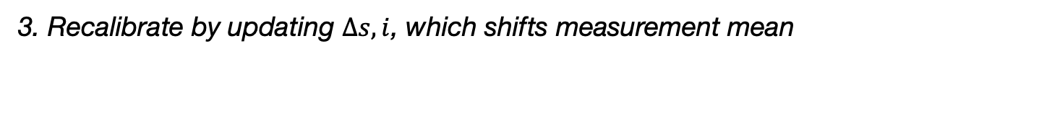
Bayesian causal inference model
3. Recalibrate by updating $∆s,i$, which shifts measurement mean
Free parameters:

