Slide 1
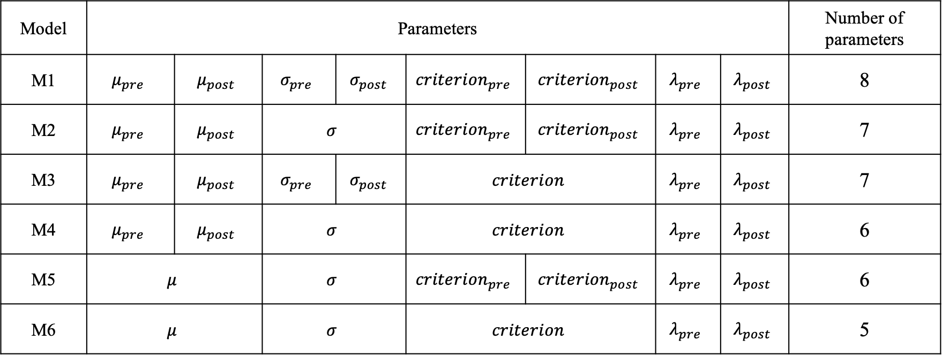
Models
Model | Parameters |  |  |  |  |  |  |  | Number of parameters
M1 | $$μ_{pre}$$ | $$μ_{post}$$ | $$σ_{pre}$$ | $$σ_{post}$$ | $${criterion}_{pre}$$ | $${criterion}_{post}$$ | $$λ_{pre}$$ | $$λ_{post}$$ | 8
M2 | $$μ_{pre}$$ | $$μ_{post}$$ | $$σ$$ |  | $${criterion}_{pre}$$ | $${criterion}_{post}$$ | $$λ_{pre}$$ | $$λ_{post}$$ | 7
M3 | $$μ_{pre}$$ | $$μ_{post}$$ | $$σ_{pre}$$ | $$σ_{post}$$ | $$criterion$$ |  | $$λ_{pre}$$ | $$λ_{post}$$ | 7
M4 | $$μ_{pre}$$ | $$μ_{post}$$ | $$σ$$ |  | $$criterion$$ |  | $$λ_{pre}$$ | $$λ_{post}$$ | 6
M5 | $$μ$$ |  | $$σ$$ |  | $${criterion}_{pre}$$ | $${criterion}_{post}$$ | $$λ_{pre}$$ | $$λ_{post}$$ | 6
M6 | $$μ$$ |  | $$σ$$ |  | $$criterion$$ |  | $$λ_{pre}$$ | $$λ_{post}$$ | 5

Slide 2
Models

