Slide 1
Personal Finance manager
Aleksejs Beloglazovs
Igors Rjabcevs
Nikita Rozenbergs-Trautmans
Sergejs Luhmirins

Slide 2
Goals:
Wanted to learn demanded technologies
Wanted to create really working system with these technologies

Slide 3
Functional requirements
Register new user
Login to system
CRUD Account (place where you keep money)
CRUD Expense Category
CRUD Income Source
CRD Expense
CRD Income
CRD Transfer
Calculate balance of all user’s accounts
Journal of user’s expenses/incomes/transfers

Slide 4
Non-functional requirements
Has web and mobile clients for convenient use
All business logic should be implemented on server side

Slide 5
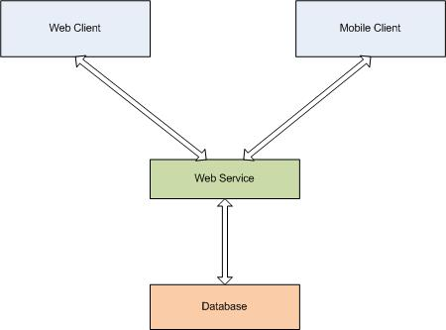
Conceptual architecture

Slide 6
Used technologies
Database
  MySQL
Server
  Glassfish Application Server
  JAX-RS
  Java Persistence Api
Web client
  GWT
Mobile client
  Android

Slide 7
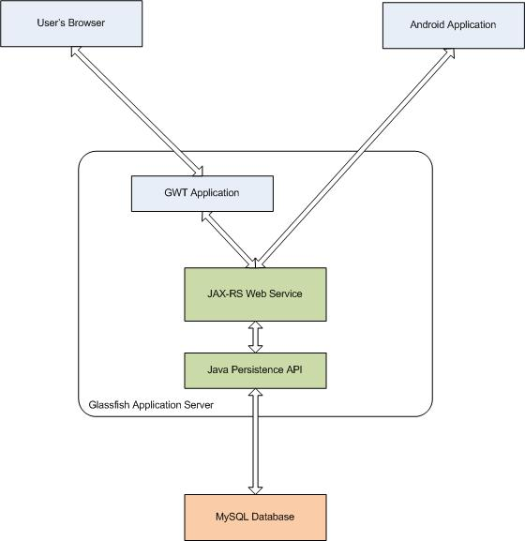
Real architecture

Slide 8
Server

