Slide 2
Brick-Assistant
AI-powered tool designed to help you query and interact with your building datasources
Luca Pasquarelli
15.09.2025

Slide 3
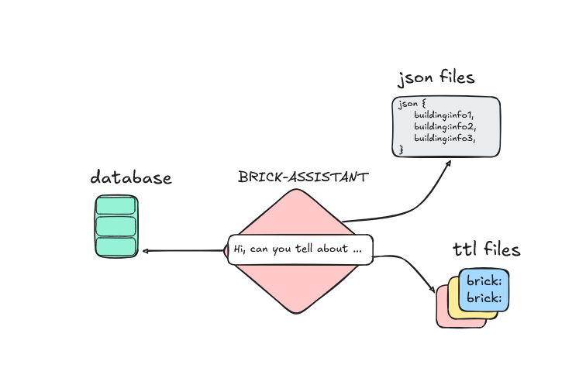
Core Idea:
Multiple datasources:
RDF files
Timeseries SQL data
Json data
One assistant for all

Slide 4
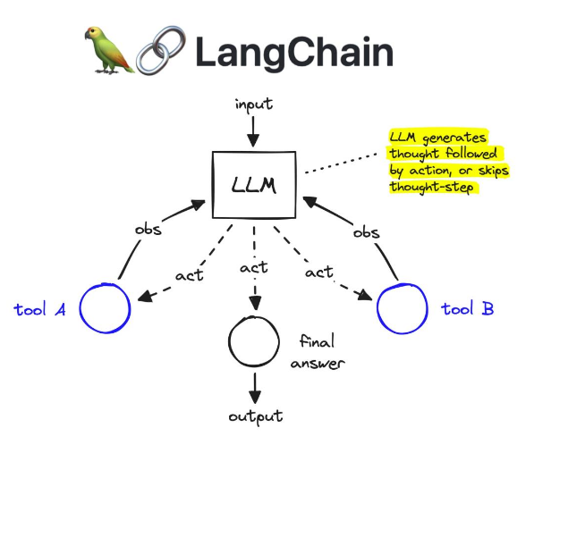




Tech Stack:

Slide 5
Main Challenges:
Avoid hallucinations
2. Might confuse what information each data source contains
3. Wrong sparql query generation
4. Risk of loops in case queries go wrong or information is not found
5. What if the user asks for something that doesn’t exist?
6. Token usage might explode for complex queries

Slide 6
Solutions:
1. Carefully validate output
2. Prompt engineering to instruct the agent on what to look for in every resource
3. Orchestrate between pre-built queries in sparql
4. Limit max number of iterations and ask for further clarification in case gets lost
5. Evaluate whether user input makes sense
6. Efficient queries, pass only the results as context to the next node in the system

Slide 7
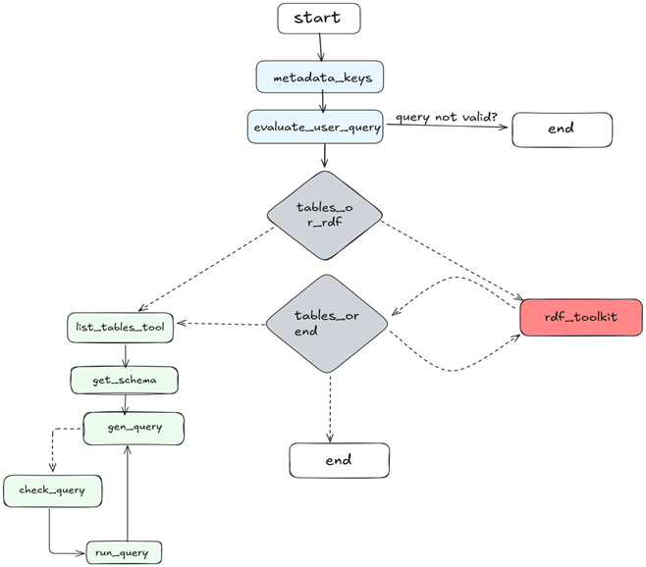
Architecture Diagram:

Slide 8
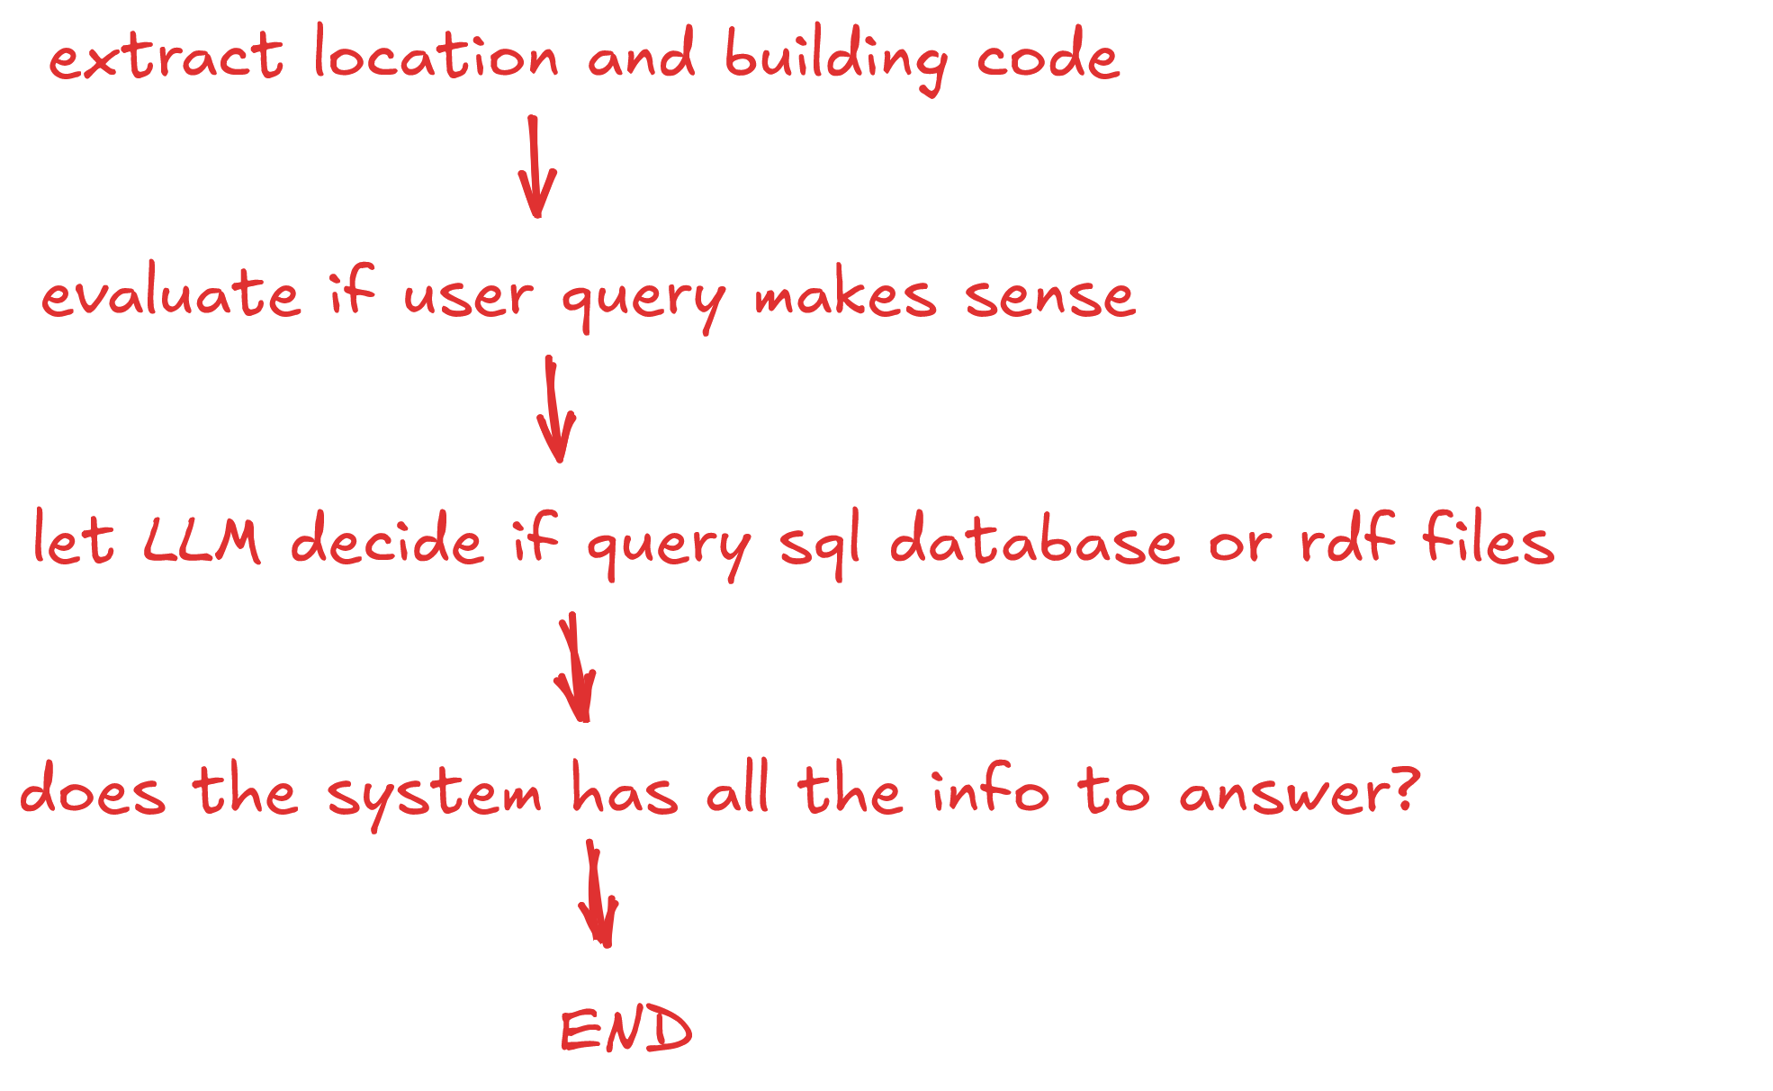
Workflow:

Slide 9
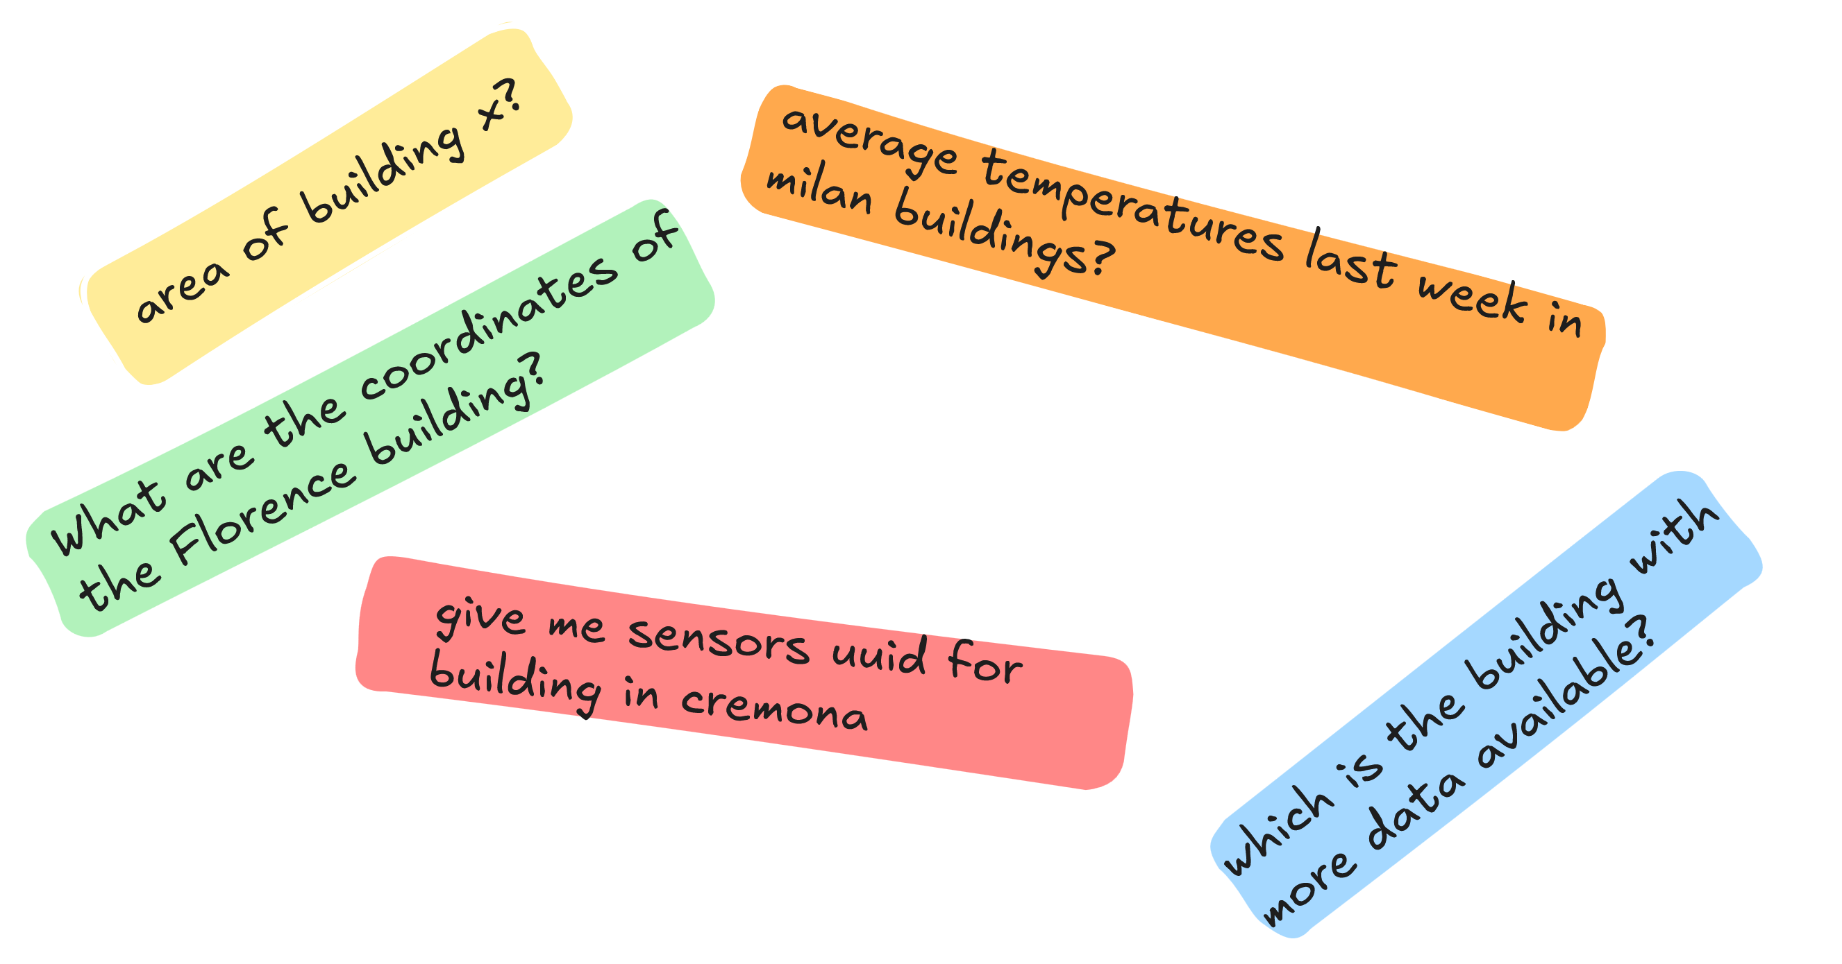
But what are you going to ask?

Slide 10


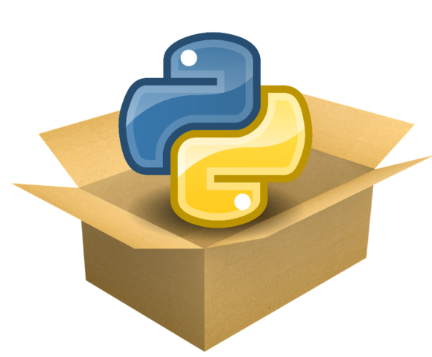
Project release:
Currently on
A
package

Slide 11

Contacts:
daniele.antonucci@eurac.edu
cristian.pozza@eurac.edu
olga.somova@eurac.edu
irene.bianconi@eurac.edu

