Slide 1
From Global to Local Quiescence:
Wait-Free Code Patching of Multi-Threaded Processes
Florian Rommel, Christian Dietrich, Daniel Friesel,
Marcel Köppen, Christoph Borchert, Michael Müller,
Olaf Spinczyk, Daniel Lohmann
Leibniz Universität Hannover
Universität Osnabrück

Slide 2


Dynamic Software Updating
Apply updates during the run time
High Availability service quality must not decrease
Expensive Reboot e.g., applications with large run-time state
Prime Example: Operating Systems
→ Linux Kernel (Ksplice, kGraft)
Userspace Applications?
→ DSU rarely used in practice

Slide 3
Example: OpenLDAP
OpenLDAP server
listener
dispatch
worker
compute
worker
compute
...
client
client
...

Slide 4
Example: OpenLDAP
do_work()
void worker_thread() {
while (1) {
wait_for_work();
do_work();
}
}
void worker_thread() {
while (1) {
wait_for_work();
do_work();
// quiescence point
if (patch_pending()) {
barrier();
wait_for_patch();
}
}
}
void rwm_op_rollback( Operation *op, SlapReply *rs, rwm_op_state *ros ) {
...
op->o_tmpfree( ros->mapped_attrs, op->o_tmpmemctx );
filter_free_x( op, op->ors_filter, 1 );
op->o_tmpfree( op->ors_filterstr.bv_val, op->o_tmpmemctx );
op->ors_attrs = ros->ors_attrs;
op->ors_filter = ros->ors_filter;
op->ors_filterstr = ros->ors_filterstr;
...
}
buggy
void rwm_op_rollback( Operation *op, SlapReply *rs, rwm_op_state *ros ) {
...
if ( op->ors_filter != ros->ors_filter ) {
filter_free_x( op, op->ors_filter, 1 );
op->ors_filter = ros->ors_filter;
}
if ( op->ors_filterstr.bv_val != ros->ors_filterstr.bv_val ) {
op->o_tmpfree( op->ors_filterstr.bv_val, op->o_tmpmemctx );
op->ors_filterstr = ros->ors_filterstr;
}
...
}
void patcher_thread() {
while (1) {
wait_for_patch_request();
set_patch_pending();
barrier();
apply_patch();
reset_patch_pending();
resume_workers();
}
}
patched
Global Quiescence:
All workers must be in
the barrier before patching

Slide 5
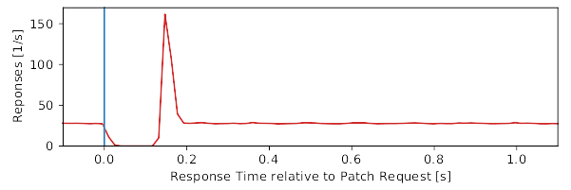
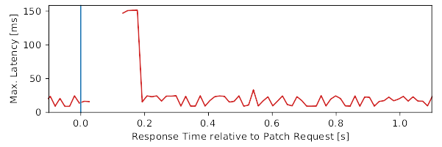
Global Quiescence
The to-be-patched code is not active in any thread
Problems
#1: Long Calculations
#2: I/O Operations
#3: Inter-Thread Dependencies

Slide 6
Global Quiescence
→ MariaDB: Transaction Locks
Problems
#1: Long Calculations
#2: I/O Operations
#3: Inter-Thread Dependencies
tx_lock()
barrier()
Thread 1
tx_lock()
Deadlock
Thread 2
time

Slide 7
Kernelspace
Ksplice: Probe for quiescence instead of waiting in a barrier
→ Patch may never get applied
kGraft, DynAMOS: Keep patched and unpatched functions in parallel
Decide on per-thread-basis which version to use
Global quiescence → local quiescence
→ Problems: kernel-specific, performance penalty

Slide 8
Local Quiescence
Basic Idea: Patching threads independently from each other.
Wait-Free Code Patching
via Address-Space Generations
OS extension for run-time modification in multi-threaded processes
  AS generations: Multiple views of an address-space
  Thread-local quiescence
  Thread-by-thread migration between AS generations
→ Implementation in the Linux Kernel

Slide 9
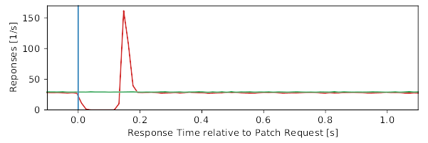

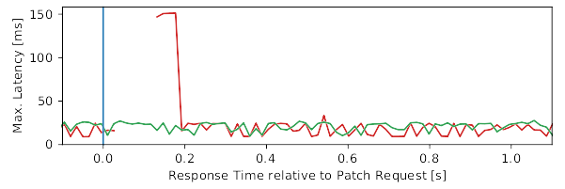
Local Quiescence
Inter-Thread Dependencies
→ No more deadlocks!

Slide 10
Address-Space Generations
address
space
Generation 0
Generation 1
wf_create()
text
Shared Mapping
text
Copy-On-Write Mapping
patched
wf_pin()
data
&
stack
data
&
stack
Shared Mapping

Slide 11
Address-Space Generations
mmview_delete()
address
space
Generation 0
Generation 1
mmview_create()
text
Copy-On-Write Mapping
text
patched
unshare()
data
&
stack
data
&
stack
Shared Mapping
threads
mmview_migrate()
th1
th2
th3
th1
th3

Slide 12

Example: OpenLDAP
do_work()
void worker_thread() {
while (1) {
wait_for_work();
do_work();
// quiescence point
if (patch_pending()) {
barrier();
wait_for_patch();
}
}
}
void worker_thread() {
while (1) {
wait_for_work();
do_work();
// quiescence point
if (migration_pending()) {
wf_migrate();
}
}
}
void rwm_op_rollback( Operation *op, SlapReply *rs, rwm_op_state *ros ) {
...
op->o_tmpfree( ros->mapped_attrs, op->o_tmpmemctx );
filter_free_x( op, op->ors_filter, 1 );
op->o_tmpfree( op->ors_filterstr.bv_val, op->o_tmpmemctx );
op->ors_attrs = ros->ors_attrs;
op->ors_filter = ros->ors_filter;
op->ors_filterstr = ros->ors_filterstr;
...
}
buggy
void rwm_op_rollback( Operation *op, SlapReply *rs, rwm_op_state *ros ) {
...
if ( op->ors_filter != ros->ors_filter ) {
filter_free_x( op, op->ors_filter, 1 );
op->ors_filter = ros->ors_filter;
}
if ( op->ors_filterstr.bv_val != ros->ors_filterstr.bv_val ) {
op->o_tmpfree( op->ors_filterstr.bv_val, op->o_tmpmemctx );
op->ors_filterstr = ros->ors_filterstr;
}
...
}
void patcher_thread() {
while (1) {
wait_for_patch_request();
set_patch_pending();
barrier();
apply_patch();
reset_patch_pending();
resume_workers();
}
}
void patcher_thread() {
while (1) {
wait_for_patch_request();
wf_create();
wf_migrate();
apply_patch();
set_migration_pending();
}
}
patched
4 – 18

Slide 13
Implementation in the Linux Kernel
wf_create
Memory Map (MM)
Cloned MM
wf_create
  Clones the memory map (MM) = AS generation
  like fork() but without COW
  However, pinned mappings use COW
wf_migrate
  Changes the thread’s MM pointer
  Context switch
wf_pin
text
text
COW
COW
data & bss
data & bss
heap
heap
file mapping
file mapping
file mapping
file mapping
stack
stack
Thread 1
Thread 2
Thread 3
*MM
*MM
*MM

Slide 14
Implementation in the Linux Kernel
wf_create
Memory Map (MM)
wf_create
  Clones the memory map (MM) = AS generation
  like fork() but without COW
  However, pinned mappings use COW
wf_migrate
  Changes the thread’s MM pointer
  Context switch
Mapping Changes
  Synchronized on all MMs
  Master MM:
  Lazy page initialization,
  Locking proxy
Master MM
Cloned MM
wf_pin
text
text
COW
COW
data & bss
data & bss
heap
heap
heap
heap
Page Fault
Page Fault
file mapping
file mapping
file mapping
file mapping
stack
stack
Thread 1
Thread 2
Thread 3
*MM
*MM
*MM

Slide 15
Evaluation: Patches
Debian 10.0 packages and Debian patches (except MariaDB)
 | OpenLDAP | Apache | Memcached | Samba | MariaDB | Node.js
Patches (CVE) | 13 (2) | 10 (10) | 1 (1) | 2 (2) | 74 (26) | 4 (0)
Restrict to code-only patches 87% (88%)
text-only | 9 (2) | 7 (7) | 1 (1) | 2 (2) | 67 (24) | 4 (0)
Generate patches via Kpatch 39% (47%)
kpatch’able | 9 (2) | 7 (7) | 1 (1) | 2 (2) | 16 (5) | 0 (0)

Slide 16
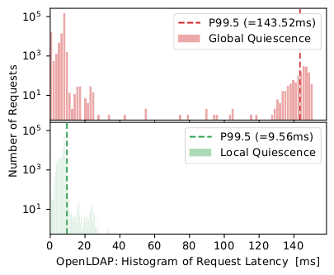
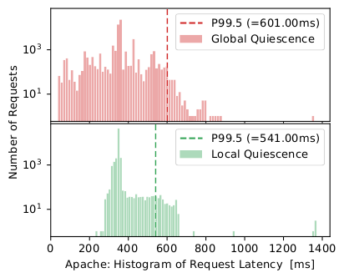
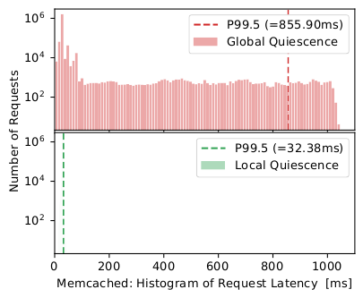
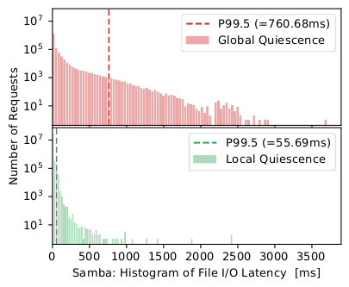
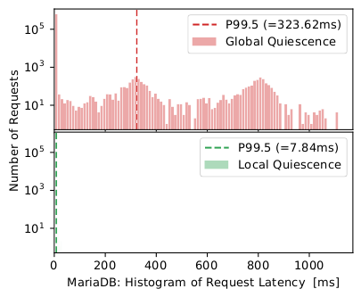
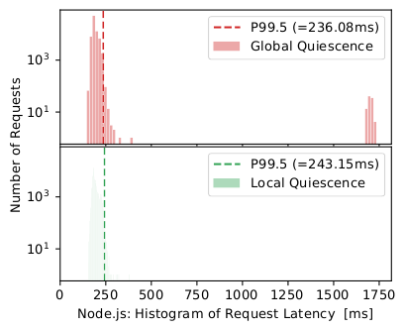
Evaluation: Request Latencies

Slide 17
Evaluation: Request Latencies

Slide 18
Evaluation: Request Latencies

Slide 19
Evaluation: Overhead
Run Time (microbenchmarks under load):
  wf_create
  88±23 µs (Memcached) to 2171±139 µs (Node.js)
  wf_migrate
  5±5 µs (Samba) to 8±7 µs (Node.js)
Memory (under load):
  132 KiB (Memcached) to 1808 KiB (Node.js)

Slide 20
Future Work
Basic mechanism
Synchronized address-space clones with partial differences
Possible applications
  Combination with JIT compiler
  Path-specific kernel modification (→ Synthesis)
  Implementation of dynamic variability (→ Multiverse)
  Address-space views for Data (thread isolation)

Slide 21
Conclusion
Wait-Free Code Patching
via Address-Space Generations
Goal: Reduce global quiescence to local quiescence
  Easier to establish
  Maintain quality of service
Approach: Synchronized address-space clones
Evaluation: 6 server applications
  Successful application of code-only patches
  Improved tail latencies during patching

Slide 22

Thank you for your attention.
Try it:
https://www.sra.uni-hannover.de/p/wfpatch
rommel@sra.uni-hannover.de

