Slide 1
甘赞栩 GAN ZAN XU 学号：2020131129
G→71→0x47 A →65 →0x41 N →78 →0x4E space →32 →0x20 Z →90 →0x5A A →65 →0x41 N →78 →0x4E space →32 →0x20 X →88 →0x58 U →85 →0x55
0 →48 →0x30 1 →49 →0x31 2 →50 →0x32 3 →51 →0x33 9 →57 →0x39
则明文为：0x47414E205A414E20 5855 0000 0000 0006
密文为：0x3230323031333131 3239 0000 0000 0006
47 | 5A | 58 | 00
41 | 41 | 55 | 00
4E | 4E | 00 | 00
20 | 20 | 00 | 06
32 | 31 | 32 | 00
30 | 33 | 39 | 00
32 | 31 | 00 | 00
30 | 31 | 00 | 06
明文
密文

Slide 2
1.轮密钥加
47 | 5A | 58 | 00
41 | 41 | 55 | 00
4E | 4E | 00 | 00
20 | 20 | 00 | 06
32 | 31 | 32 | 00
30 | 33 | 39 | 00
32 | 31 | 00 | 00
30 | 31 | 00 | 06
异或
75 | 6B | 6A | 00
71 | 72 | 6C | 00
7C | 7F | 00 | 00
10 | 11 | 00 | 00

Slide 3
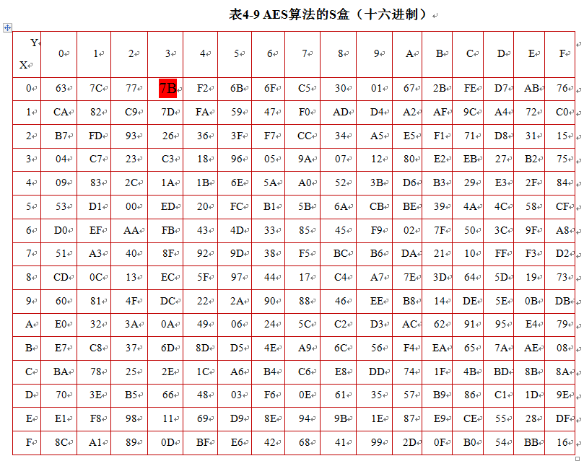
1.字节代替
75 | 6B | 6A | 00
71 | 72 | 6C | 00
7C | 7F | 00 | 00
10 | 11 | 00 | 00
字节代替
9D | 7F | 02 | 63
A3 | 40 | 50 | 63
15 | D2 | 63 | 63
A9 | 82 | 63 | 6F

Slide 4
2.行移位
9D | 7F | 02 | 63
A3 | 40 | 50 | 63
15 | D2 | 63 | 63
A9 | 82 | 63 | 6F
9D | 7F | 02 | 63
40 | 50 | 63 | A3
63 | 63 | 15 | D2
6F | A9 | 82 | 63
行移位

Slide 5
3.列混合
02 | 03 | 01 | 01
01 | 02 | 03 | 01
01 | 01 | 02 | 03
03 | 01 | 01 | 02
9D | 7F | 02 | 63
40 | 50 | 63 | A3
63 | 63 | 15 | D2
6F | A9 | 82 | 63
X
计算：
C4 | F4 | 46 | 2E
67 | 8A | DA | 57
75 | 4B | A2 | D2
E3 | 26 | 5B | A3

Slide 6
设初始密钥扩展之后下一轮子密钥（K₄、K₅、K₆、K₇）
4.轮密钥加
密钥扩展：
32 | 4A | B2 | 62
30 | 58 | 5C | 35
32 | 84 | 7B | 6E
36 | 3D | 1F | 33
k4 | k5 | k6 | K7
32 | 31 | 32 | 00 | 32 | 4A | B2 | 62
30 | 33 | 39 | 00 | 30 | 58 | 5C | 35
32 | 31 | 00 | 00 | 32 | 84 | 7B | 6E
30 | 31 | 00 | 06 | 36 | 3D | 1F | 33
k0 | k1 | k2 | k3 | k4 | k5 | k6 | K7

Slide 7
32 | 4A | B2 | 62
30 | 58 | 5C | 35
32 | 84 | 7B | 6E
36 | 3D | 1F | 33
C4 | F4 | 46 | 2E
67 | 8A | DA | 57
75 | 4B | A2 | D2
E3 | 26 | 5B | A3
轮密钥加
F6 | BE | F4 | 4C
57 | D2 | 86 | 36
47 | CC | D9 | A2
D5 | 1B | C2 | 90

