Slide 1
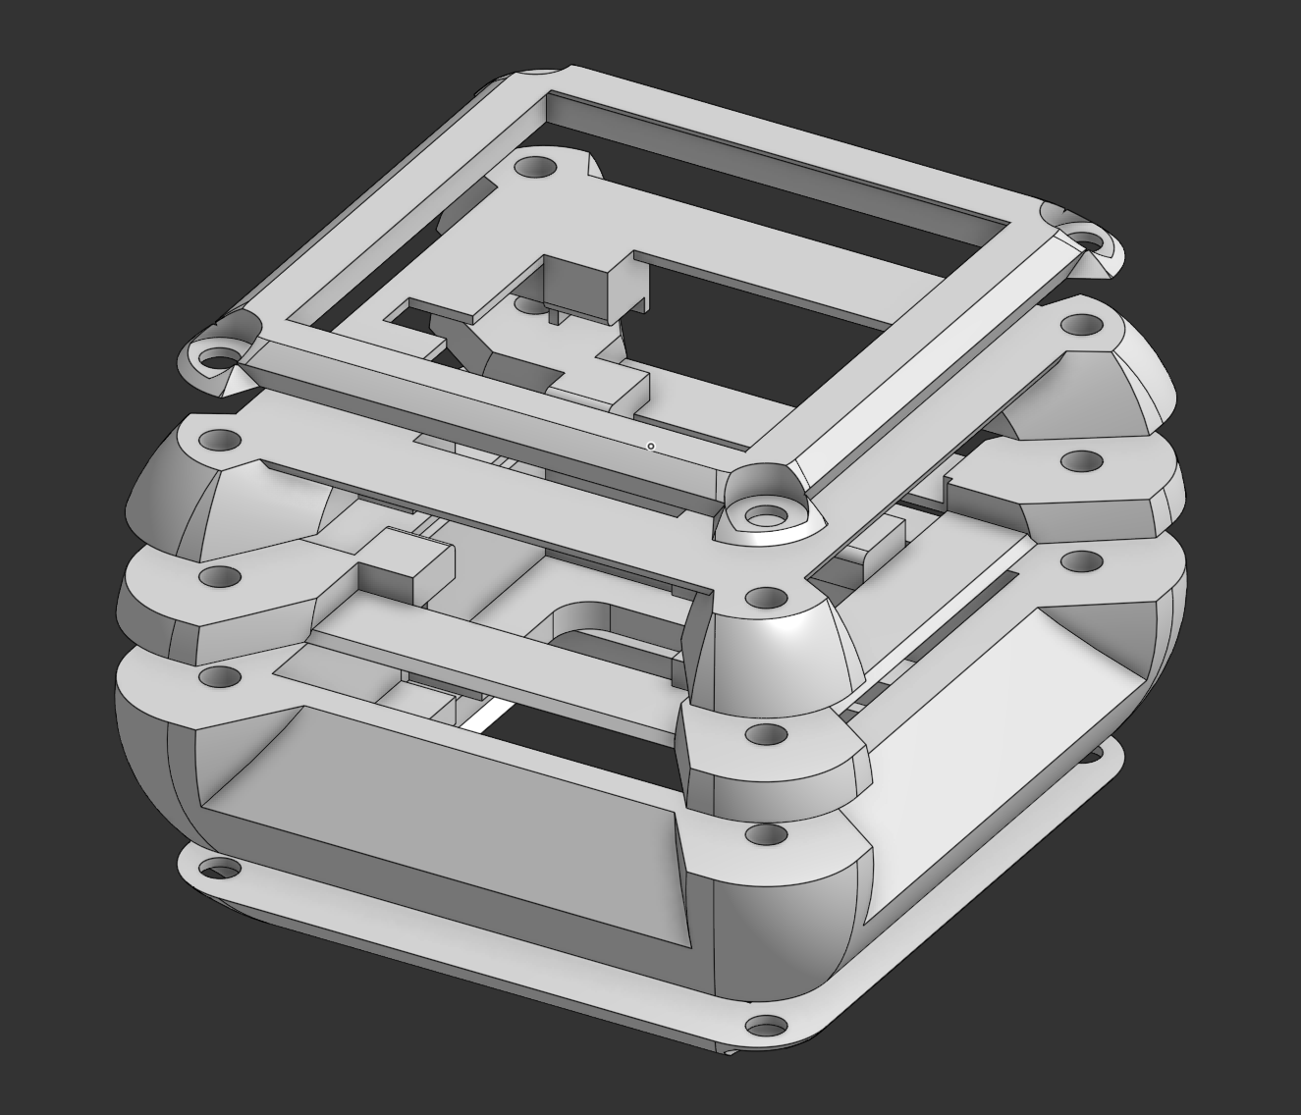
AMADEE-27
Tumbler
Design
Final semester meeting
Team: Tumbler Design
28 September 2026
Notes:
Open the final meeting with a clear frame: team, work package, and format. Keep this under 15–20 seconds.

Slide 2
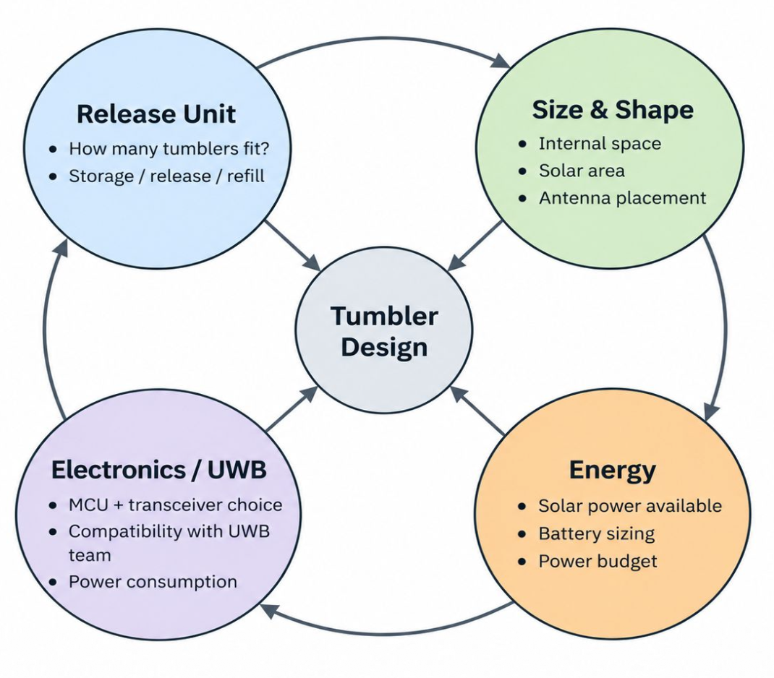
TUMBLER DESIGN
What was the problem?
Starting point
autonomous Tumbler
existing SKITH PCB
STM32F407 + DWM1000
RODOS-based UWB code
Release Unit still open
AMADEE-27 · Tumbler Design · Final Semester Meeting
2

Slide 3
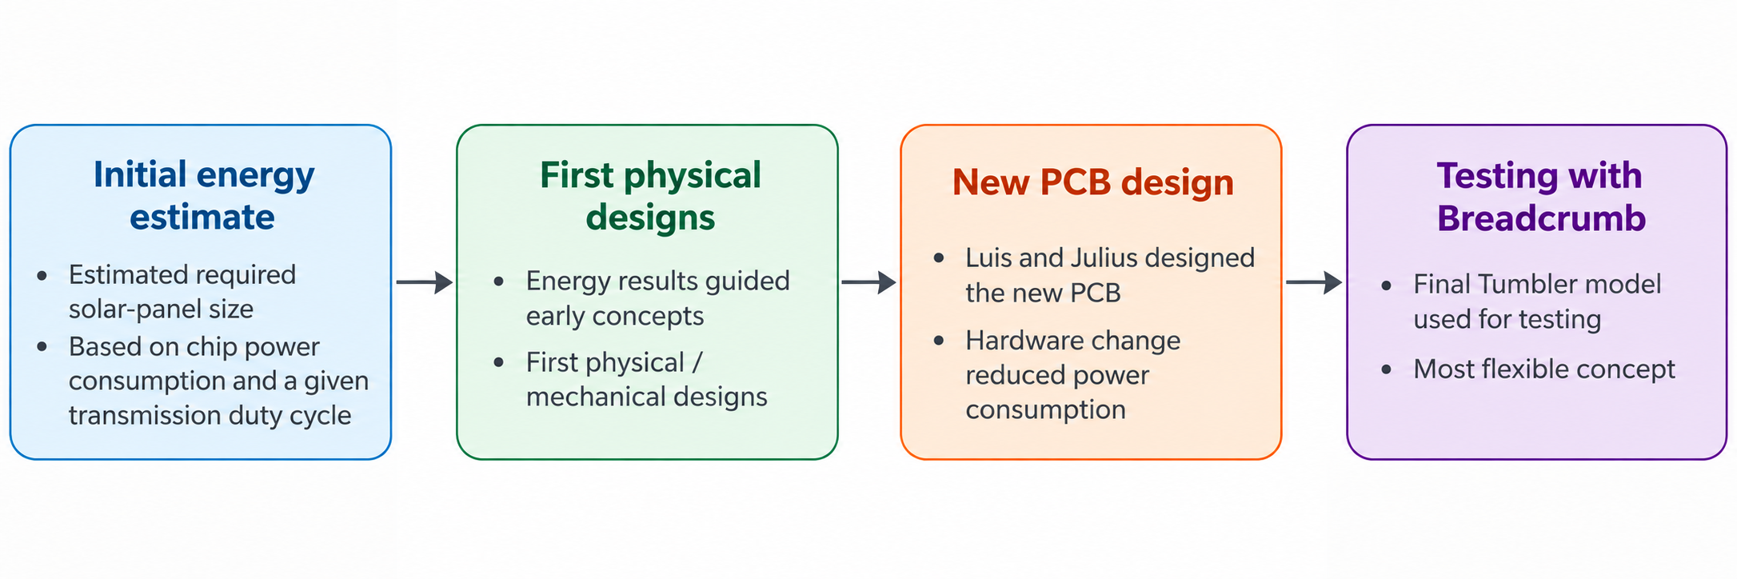
TUMBLER DESIGN
How did we structure the work?
AMADEE-27 · Tumbler Design · Final Semester Meeting
3

Slide 4
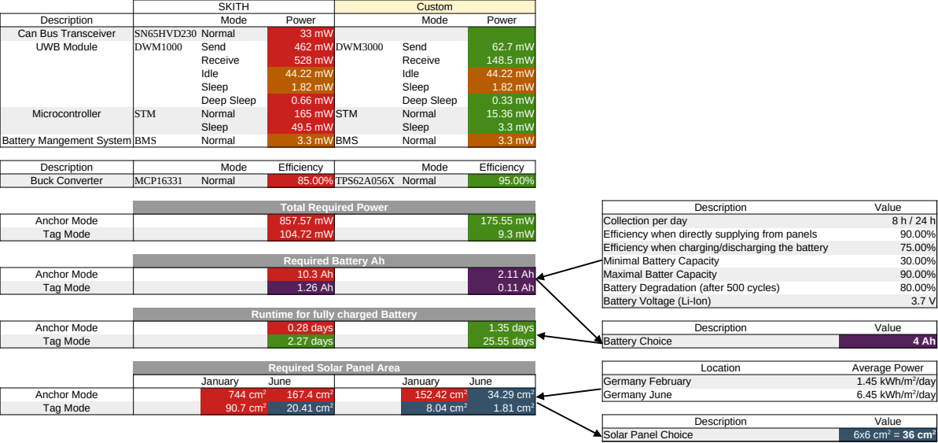
TUMBLER DESIGN
Power Requirement
AMADEE-27 · Tumbler Design · Final Semester Meeting
4
Notes:
Use this slide during the preparation call to decide the actual demo format.
For the final deck, either keep it as a short “Demonstration” slide or replace it with the actual demo material.
Assign responsibility: who brings the printed prototype, who opens CAD, who explains the test result.
Keep the demo short enough to leave time for Q&A.

Slide 5
TUMBLER DESIGN
Power Requirement
AMADEE-27 · Tumbler Design · Final Semester Meeting
4
Notes:
Use this slide during the preparation call to decide the actual demo format.
For the final deck, either keep it as a short “Demonstration” slide or replace it with the actual demo material.
Assign responsibility: who brings the printed prototype, who opens CAD, who explains the test result.
Keep the demo short enough to leave time for Q&A.

Slide 6


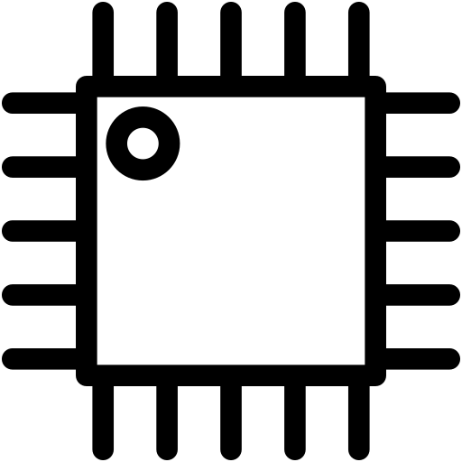


TUMBLER DESIGN
Tumbler Electronic Architecture
ETFE solar panel
Power Circuit
Microcontroller
UWB Chip
P124 1.2W 6V ~ 5400 mm²
P122 0.3W 6V ~ 2500 mm²
24.4% high-efficiency
Low friction, anti-dust surface
IPX7 waterproof rated
Up to 5 panels can be soldered to the PCB
(in parallel)
BQ25798 MPPT + Battery management
TPS62A056 High-Efficiency Buck Converter
4000mAh Lipo
Battery charging via USB-C interface
STM32L431CCT6
Ultra-low-power
Arm Cortex-M4 MCU 80 MHz
256 Kbytes of Flash memory
with FPU
I2C and SPI
standard ST-Link debugging
DWM3000
Pin and pitch compatible with the DWM1000
AMADEE-27 · Tumbler Design · Final Semester Meeting
5
Notes:
Use this slide to show that the design was not arbitrary.
Mention that early discussions included release constraints, solar panel placement, internal layout and UWB signal considerations.
Do not overpromise exact requirements unless the team has numbers. Keep it qualitative unless someone fills in confirmed values.

Slide 7
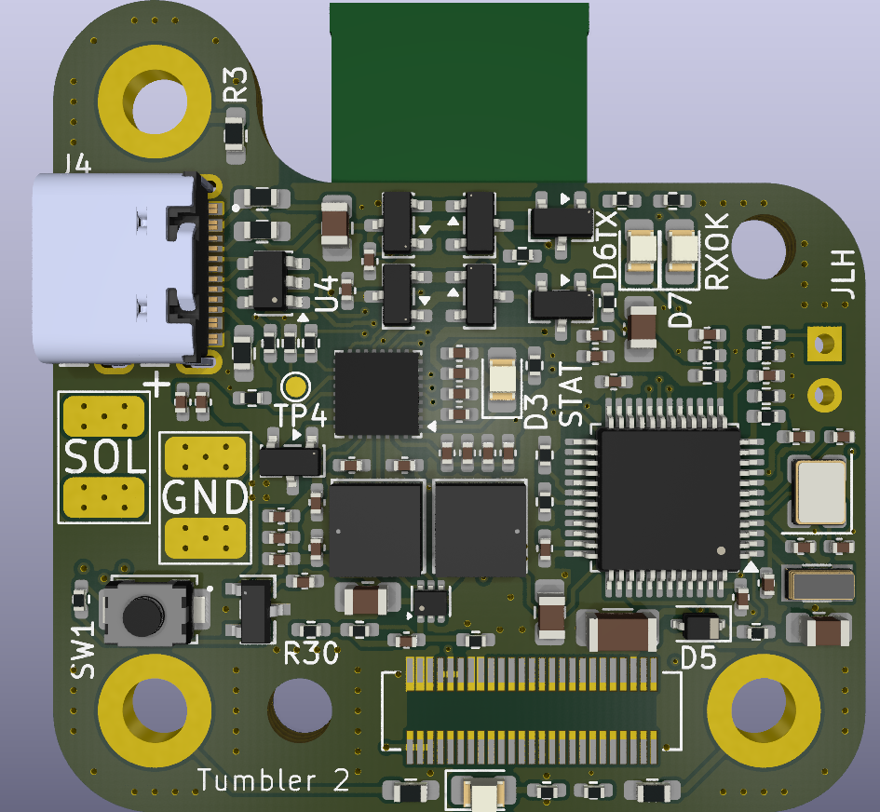
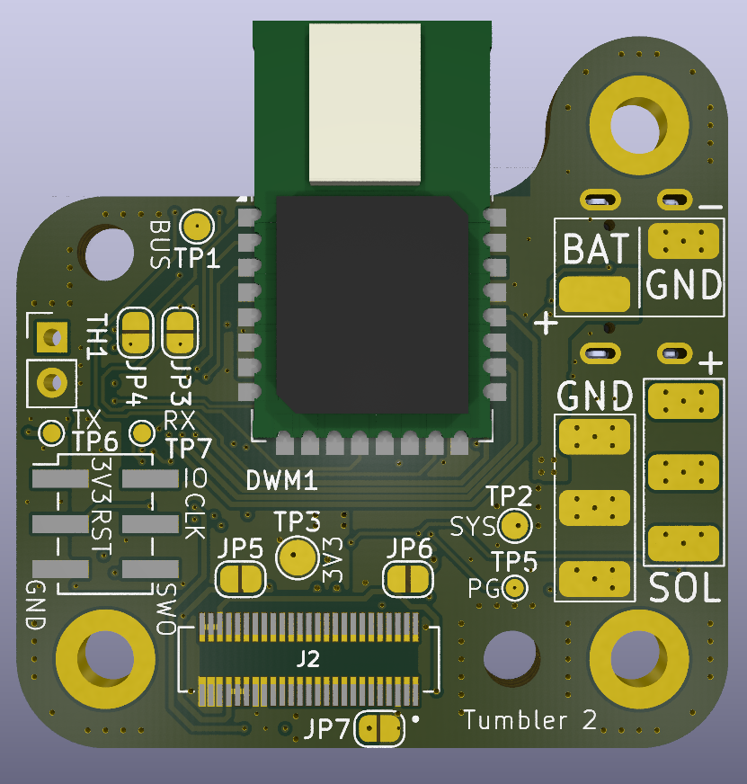
TUMBLER DESIGN
Tumbler PCB
AMADEE-27 · Tumbler Design · Final Semester Meeting
6
Notes:
Use this slide to show that the design was not arbitrary.
Mention that early discussions included release constraints, solar panel placement, internal layout and UWB signal considerations.
Do not overpromise exact requirements unless the team has numbers. Keep it qualitative unless someone fills in confirmed values.

Slide 8
TUMBLER DESIGN
Interface with the Release Unit
Release constraints
Design response
stacking / pushing
rigid alternatives
orientation-agnostic
release compatibility
AMADEE-27 · Tumbler Design · Final Semester Meeting
7
Notes:
Mention that the release mechanism influenced the outer shape and handling of the Tumbler.
In the Release Unit chat, the initial assumption was that a compressible/foldable Tumbler might need to be held compressed and released by a mechanism.
I clarified that our group had also discussed rigid alternatives where compression would not be necessary.
Important message: the Tumbler was treated as part of a deployable system, not only as an isolated housing.
“Because the Tumbler is not an isolated object, the release mechanism was one of the first external interfaces we had to align with.”
Early interface alignment changed the design discussion from “one isolated housing” to a deployable sytsme component.
The Tumber geometry was iterated together with external deployment contraints – not chosen only for appearance.

Slide 9
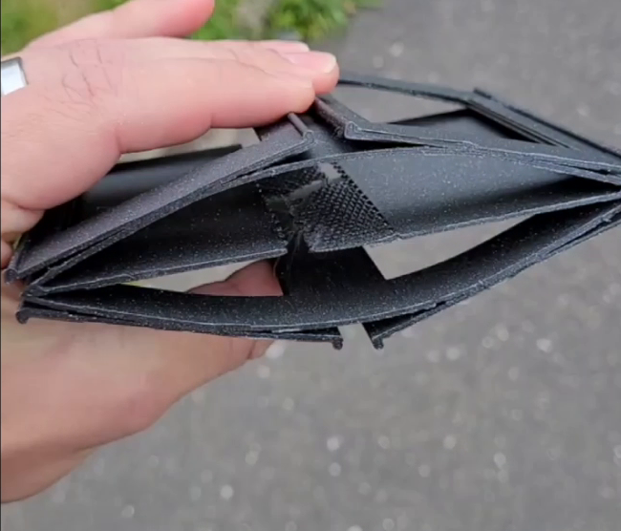
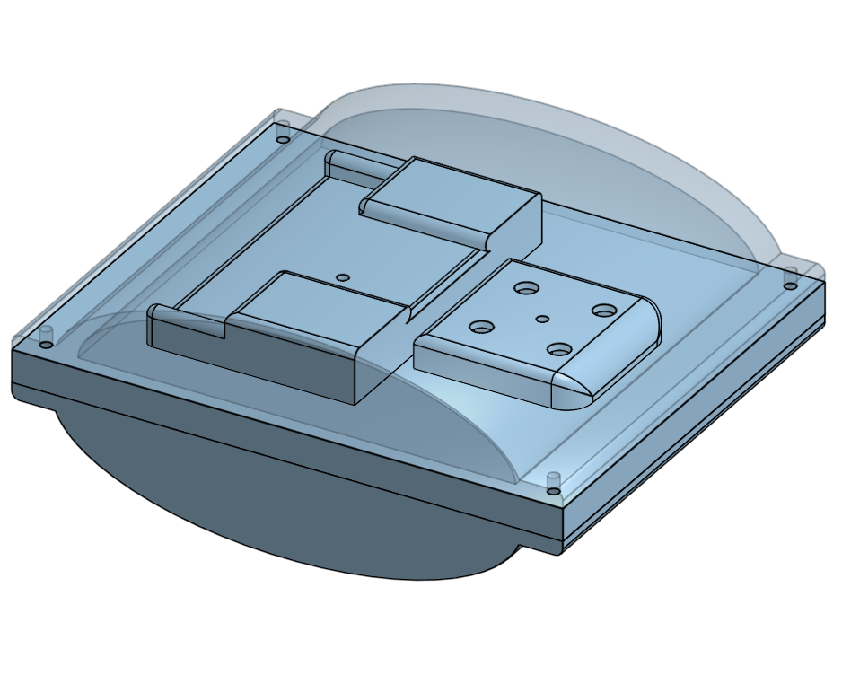
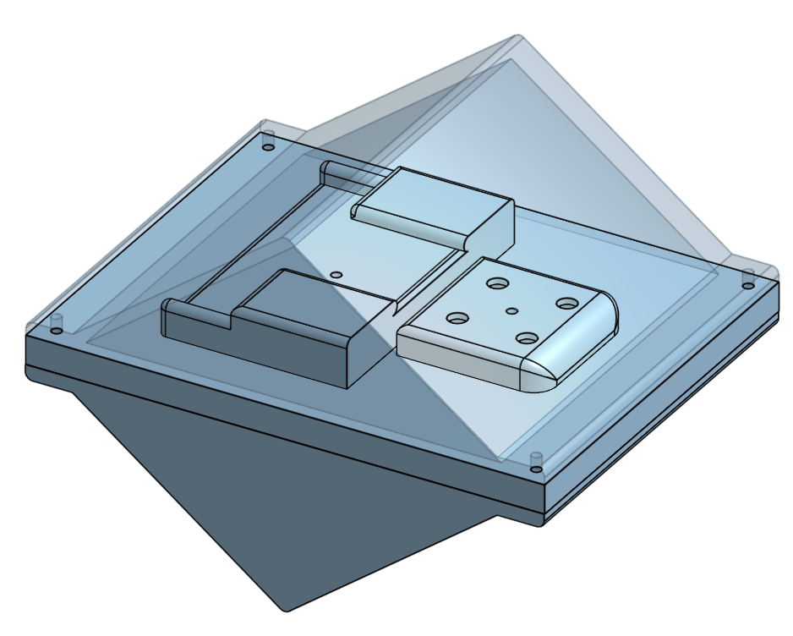
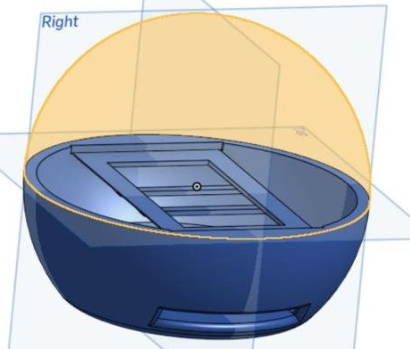
TUMBLER DESIGN
Concept comparison
Flex / folded
Oval
Prism
Sphere
AMADEE-27 · Tumbler Design · Final Semester Meeting
8
Notes:
The designs developed in parallel and were compared as different solution directions, not as a competition between people.
Flex/folded: compact storage and compression idea, but more mechanically complex.
Oval/prism: rigid alternatives that avoided compression and were easier to reason about for release.
Spherical design: later became the basis for the current Breadcrumb direction.
The main selection dimensions were release compatibility, storage, solar-panel placement, internal volume, robustness and feasibility.
“We did not want to decide immediately on one perfect shape. Instead, we compared multiple concepts against the main constraints.”
Mention that the early rigid concepts helped clarify that a non-compressed, orientation-agnostic Tumbler would be easier for release.
The early phase intentionally kept several geometries open so the team could evaluate trade.offs before converging on the current Breadcrumb design.
The final direction was not a single first idea”; it results from the comparing deployment, panel area, internal layout, robustness and testability.
Nicht Sphere to breadcrumb, sondern Trends bei dem Prototyping die dann in Richtung Breadcrumb gingen.
Üvbergang zu dem Finalen Design:
Several issues were investigated during the semester; some became part of the final design, others were resolved through later geometry updates.
The design evolved through prototype-driven decisions. The geometry issue noticed during print preparation was trace to a wrong prat/revision selection and is fixed ion the current revision.
This slide should explain the real evolution: we did not start by picking one final design.
First, the group continued to work on all four directions in parallel.
Then the team focused on an improved spherical design because it combined strengths from the other approaches.
The sphere was flattened to improve storage in the Release Unit and make the geometry more space-efficient. This led to the Breadcrumb concept.

Slide 10
TUMBLER DESIGN
Final mechanical design
Requirements:
Compatible with the designs of the Tumbler release Unit..
Ease of assembly in large numbers.
Capable of good message reception and transmission.
AMADEE-27 · Tumbler Design · Final Semester Meeting
9
Notes:
Likely owner: CAD/mechanical design owners.
Visible slide is intentionally clean: add final CAD images only.
Suggested content: what are the final parts, how are they assembled, how do solar panels sit in the housing, what changes were made after previous iterations.
If seals are no longer needed, explain calmly: “The updated geometry reduces/removes the sealing need that we had previously considered.”

Slide 11
TUMBLER DESIGN
Status and next steps
completed / ready
before next semester
before shipment
Tumbler geometry final
mass print: requested quantity
final assembly
PCB revision ordered
order missing parts
handover
mass-print ready
stock check
storage preparation
AMADEE-27 · Tumbler Design · Final Semester Meeting
10
Notes:
The Tumbler design is finalized and can be mass-printed depending on the desired quantity.
The new PCBs have been ordered.
Before the next semester, the team should finish printing the required number of Tumbler parts, order any components that are not yet available in the required quantity, and store everything properly: Tumbler parts, batteries, solar panels and PCBs.
Before the hardware is shipped for the mission or later integration phase, the Tumblers can either be assembled by us, or if desired, an assembly guide could be provided so that assembly can happen later.
Avoid overclaiming: say the design work package is largely complete; the remaining tasks are procurement, production/storage and later assembly/integration.
The design work package is largely complete; the remaining work is focused on printing, procurement, storage and later assembly/integration.
The main design phase is finished; the next phase is turning the finalized parts into stroed, ready-to-assemble hardware for later AMADEE integration stage.
Mention the updated status: new PCBs are ordered and the Tumblers are finalized, so they can be printed in quantity.
Next concrete steps before the semester starts: final print, final orders, store components (Tumbler parts, batteries, solar panels, PCBs).
Later assembly is expected around November/December when the parts are actually needed.

