Slide 1
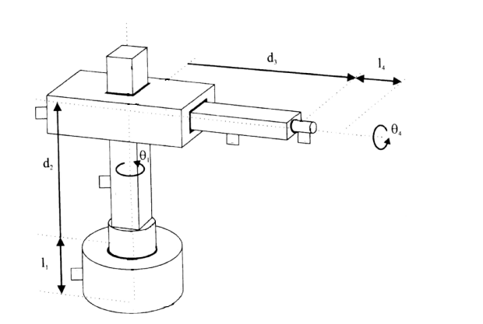
A step by step example
Tip1: to solve it at your computer (avoid printing, easy to undo, easy to share, you can make as many copies as you want of this slide to write down all the steps…)
Tip2: Why don’t you solve it collaboratively with, e.g., Jaamboard and your colleagues?

Slide 2
Denavit-Hartenberg (D-H): Step-by-step
[DH1] To label links, starting with 1 (first mobile link) until n (last mobile link). Link 0 = the base (e.g., fixed for a robot arm)
[DH2] To associate numbers to joints, starting with joint 1 (first degree of freedom), and finishing in joint n.
[DH3] To establish the axis J_{i} for every joint. Rotational: its own rotation axis; prismatic: the axis in the direction in which the translational motion takes place.
[DH4] For i=0 .. n-1: to place z_{i} on J_{i+1}. E.g., z₀ on J₁… and finally, z_{n-1} on J_{n}.
[DH5] To place O₀ of the base reference frame at any position on z₀, and x₀, y₀ as desired (freedom, simplicity!).
[DH6] For i=1 .. n-1, to place O_{i} (origin of frame S_{i} link i-th) at the intersection of z_{i} with the perpendicular line common to z_{i-1} and z_{i} (i.e., axis J_{i}, J_{i+1}). If z_{i-1}, z_{i} intersect => at the intersection If z_{i-1}, z_{i} parallel => anywhere on z_{i}.
[DH7] To place x_{i} on the perpendicular line common to z_{i-1} and z_{i}. x_{i} goes in the direction from z_{i-1} and z_{i}.
[DH8] To place y_{i} so that it constitutes a reference frame (given z_{i} and x_{i} ).
[DH9] Finally, to place the last ref. frame (z_{n},x_{n},y_{n}). Origin at the end-effector, axis z_{n} parallel to z_{n-1}, and freedom for the other axis.

Slide 3
When we are done, did everything go fine?
Check at the same time as you obtain parameters
To place a ref. frame at the (i-1)-th frame + manipulate it to make it equal to the i-th frame:
Rotation around z_{i-1} to make x_{i-1} and x_{i} parallel
Translation on z_{i-1}
Translation on the current x_{i-1} (that, due the previous steps, is parallel to x_{i}). After these two translations, the origin should match O_{i}, and x_{i-1} and x_{i} should be already equal.
Final rotation on the current x_{i-1} to make the current reference frame equal to the i-th frame
Not equal? … Something went wrong!

Slide 4
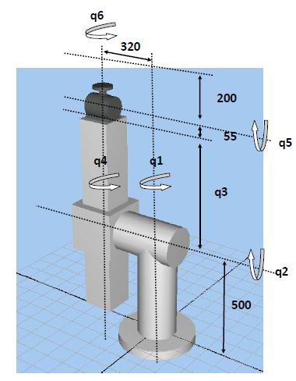
Some additional solved examples later

Slide 6
Denavit-Hartenberg (D-H): Step-by-step
[DH1] To label links, starting with 1 (first mobile link) until n (last mobile link). Link 0 = the base (e.g., fixed for a robot arm)
2
3
4
1
0

Slide 7
Denavit-Hartenberg (D-H): Step-by-step
[DH2] To associate numbers to joints, starting with joint 1 (first degree of freedom), and finishing in joint n.
[DH3] To establish the axis J_{i} for every joint. Rotational: its own rotation axis; prismatic: the axis in the direction in which the translational motion takes place.
Joint 3: prismatic
2
3
4
J3, J4
1
Joint 2: prismatic
Joint 4: rotary
Joint 1: rotary
0
J1, J2

Slide 8
Denavit-Hartenberg (D-H): Step-by-step
[DH4] For i=0 .. n-1: to place z_{i} on J_{i+1}. E.g., z₀ on J₁… and finally, z_{n-1} on J_{n}.
[DH5] To place O₀ of the base reference frame at any position on z₀, and x₀, y₀ as desired (freedom, simplicity!).
z2, z3
2
3
4
J3, J4
1
y0
0
z0, z1
O0
x0
J1, J2

Slide 9
Denavit-Hartenberg (D-H): Step-by-step
[DH6] For i=1 .. n-1, to place O_{i} (origin of frame S_{i} link i-th) at the intersection of z_{i} with the perpendicular line common to z_{i-1} and z_{i} (i.e., axis J_{i}, J_{i+1}). If z_{i-1}, z_{i} intersect => at the intersection If z_{i-1}, z_{i} parallel => anywhere on z_{i}.
z2, z3
2
3
4
J3, J4
1
z1
i=1: O1
z0,z1 paralel
O1
y0
Freedom!
0
z0, z1
Simplicity!
x0
J1, J2

Slide 10
Denavit-Hartenberg (D-H): Step-by-step
[DH6] For i=1 .. n-1, to place O_{i} (origin of frame S_{i} link i-th) at the intersection of z_{i} with the perpendicular line common to z_{i-1} and z_{i} (i.e., axis J_{i}, J_{i+1}). If z_{i-1}, z_{i} intersect => at the intersection If z_{i-1}, z_{i} parallel => anywhere on z_{i}.
z2, z3
2
O2
3
4
J3, J4
1
z1
i=2: O2
z1,z2 intersect
O1
y0
0
z0
x0
J1, J2

Slide 11
Denavit-Hartenberg (D-H): Step-by-step
[DH6] For i=1 .. n-1, to place O_{i} (origin of frame S_{i} link i-th) at the intersection of z_{i} with the perpendicular line common to z_{i-1} and z_{i} (i.e., axis J_{i}, J_{i+1}). If z_{i-1}, z_{i} intersect => at the intersection If z_{i-1}, z_{i} parallel => anywhere on z_{i}.
z2, z3
O3
2
O2
z3
3
4
J3, J4
1
z1
i=2: O3
z2,z3 parallel
O1
y0
Freedom!
0
z0
x0
J1, J2

Slide 12
Denavit-Hartenberg (D-H): Step-by-step
[DH7] To place x_{i} on the perpendicular line common to z_{i-1} and z_{i}. x_{i} goes in the direction from z_{i-1} and z_{i}.
z2
2
z3
3
4
J3, J4
1
z1
i=1: x1
z0,z1 parallel
y0
x1
Freedom!
0
z0
x0
J1, J2

Slide 13
Denavit-Hartenberg (D-H): Step-by-step
[DH7] To place x_{i} on the perpendicular line common to z_{i-1} and z_{i}. x_{i} goes in the direction from z_{i-1} and z_{i}.
x2
z2
2
z3
3
4
J3, J4
1
z1
i=2: x2
z1,z2
y0
x1
Common perpendicular
0
z0
x0
J1, J2

Slide 14
Denavit-Hartenberg (D-H): Step-by-step
[DH7] To place x_{i} on the perpendicular line common to z_{i-1} and z_{i}. x_{i} goes in the direction from z_{i-1} and z_{i}.
x2
x3
z2
2
z3
3
4
J3, J4
1
z1
i=3: x3
z2,z3
y0
x1
Freedom!
0
z0
x0
J1, J2

Slide 15
Denavit-Hartenberg (D-H): Step-by-step
[DH8] To place y_{i} so that it constitutes a reference frame (given z_{i} and x_{i} ).
x2
x3
y2
y3
z2
2
z3
3
4
J3, J4
1
y1
z1
y0
x1
0
z0
x0
J1, J2

Slide 16
Denavit-Hartenberg (D-H): Step-by-step
[DH9] Finally, to place the last ref. frame (z_{n},x_{n},y_{n}). Origin at the end-effector, axis z_{n} parallel to z_{n-1}, and freedom for the other axis.
x4
y4
x2
x3
y2
y3
z4
z2
2
z3
3
4
J3, J4
1
y1
z1
y0
x1
Freedom!
0
z0
x0
J1, J2

Slide 17
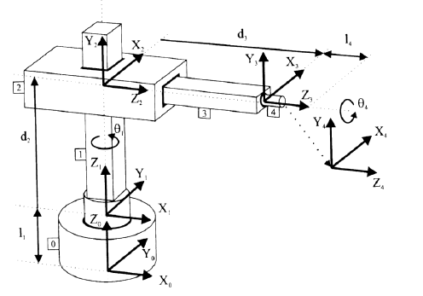

Reference frames
>> D-H Table
Did everything go fine?
S_{i-1} … S_{i} sequence (relative frames)
4 parameters. Overall in 3D rototranslations? (6!)

Slide 18
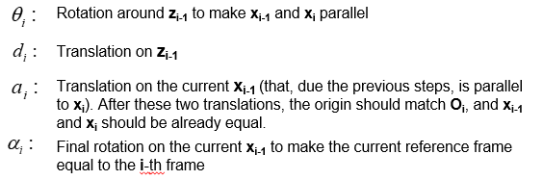
Reference frames
>> D-H Table
 | θi | di | ai | αi
1
2
3
4

Slide 19
Reference frames
>> D-H Table
 | θi | di | ai | αi
1
2
3
4
q1
l1
0
0

Slide 20
Reference frames
>> D-H Table
 | θi | di | ai | αi
1 | q1 | l1 | 0 | 0
2
3
4
90º
q2
0
90º

Slide 21
Reference frames
>> D-H Table
 | θi | di | ai | αi
1 | q1 | l1 | 0 | 0
2 | 90º | q2 | 0 | 90º
3
4
0
q3
0
0

Slide 22
Reference frames
>> D-H Table
 | θi | di | ai | αi
1 | q1 | l1 | 0 | 0
2 | 90º | q2 | 0 | 90º
3 | 0 | q3 | 0 | 0
4
q4
l4
0
0

Slide 23
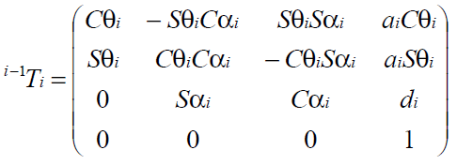
Reference frames
>> D-H Table
>> Transform matrices
 | θi | di | ai | αi
1 | q1 | l1 | 0 | 0
2 | 90º | q2 | 0 | 90º
3 | 0 | q3 | 0 | 0
4 | q4 | l4 | 0 | 0

Slide 24
Reference frames
>> D-H Table
>> Transform matrices
 | θi | di | ai | αi
1 | q1 | l1 | 0 | 0
2 | 90º | q2 | 0 | 90º
3 | 0 | q3 | 0 | 0
4 | q4 | l4 | 0 | 0

Slide 25
Reference frames
>> D-H Table
>> Transform matrices
 | θi | di | ai | αi
1 | q1 | l1 | 0 | 0
2 | 90º | q2 | 0 | 90º
3 | 0 | q3 | 0 | 0
4 | q4 | l4 | 0 | 0

Slide 26
Reference frames
>> D-H Table
>> Transform matrices
 | θi | di | ai | αi
1 | q1 | l1 | 0 | 0
2 | 90º | q2 | 0 | 90º
3 | 0 | q3 | 0 | 0
4 | q4 | l4 | 0 | 0

Slide 27
Other training examples (solved, not detailed)

Slide 28
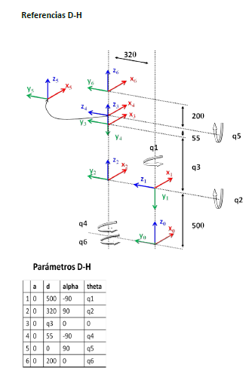
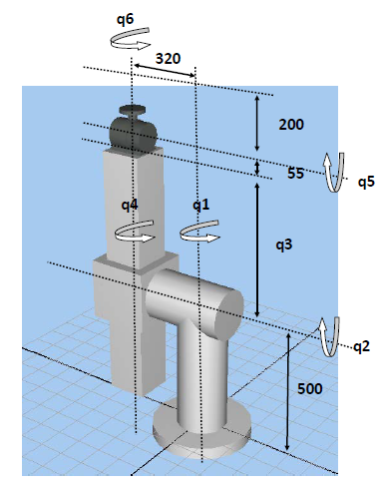
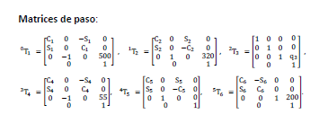

Slide 29
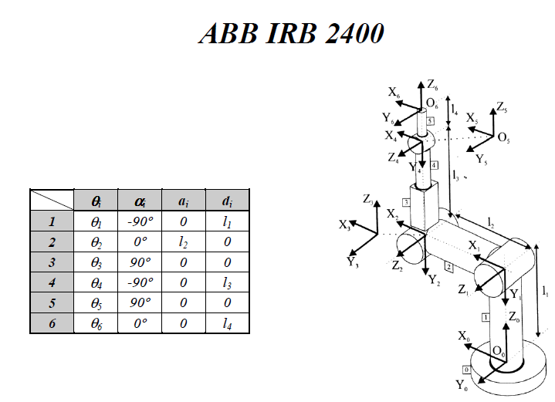

Slide 30
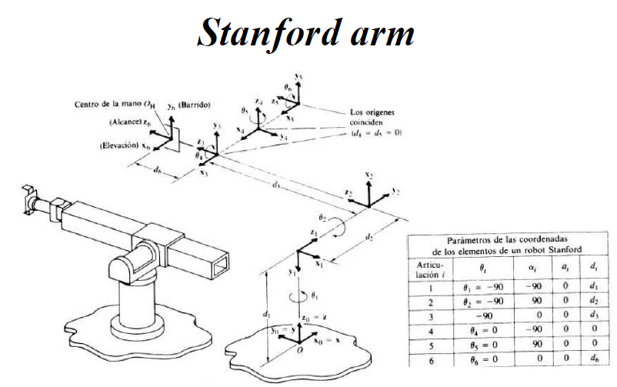

Slide 31
