Slide 1
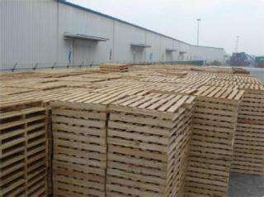
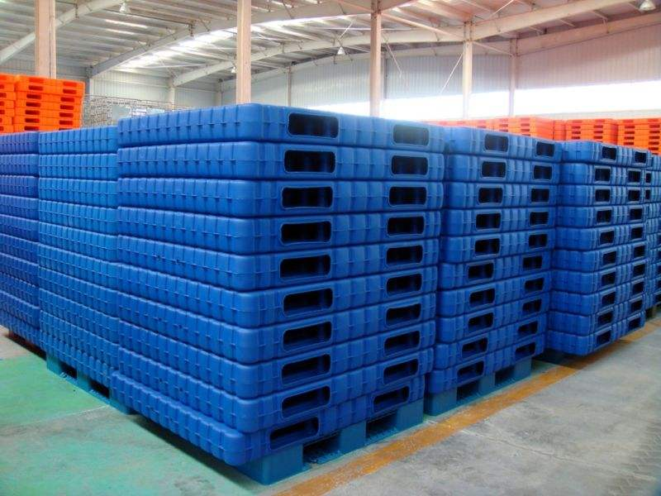
Pallets
Pallets are flat and portable structures used to ensure goods are efficiently transported and stored in warehouses for nearly a century. It has been called “the single most important object in the global economy.” While it can be made of plastic, metal, paper or recycled materials, most of pallets today are still made of wood. Depending on its type and usage, each material would have its own advantages and disadvantages, and to ensure health safety across national borders, pallets are subjected to international standards with specific dimensions and production protocols.
It is essential for carrying out nearly 80% of all commerce in the US alone, and its importance in the supply chain and logistics sector after the industrial revolution is unparalleled. Yet there are still key challenges to overcome. For instance, Johnson & Johnson recalled and stopped production of their known Tylenol medicine after several customer complaints about its odor. Thousands of wooden pallets on its supply chain received fungicide treatment that affected the product, resulting in a cost of nearly $900 million for the company.
With the development of IoT connected products, pallets can play a critical role to solve some of the challenges faced by the logistics and manufacturing industries, such as avoiding waste and potentially generating whole new business models. Information about location, weight, temperature, humidity levels, position and tracking time are essential for improving efficiency and profitability.
In 2017, the annual production of pallets was about 250 million pieces in China, with the total number of pallets reaching 1.23 billion.
Currently most pallets are still not tracked/positioned, resulting in an expensive loss of assets, i.e. it becomes a cost of transportation. Given that every pallet costs about RMB 100~200 (US$ 15~30), the overall spending on pallets can be RMB 25~50 billion (US$ 3.75~7.5 billion) annually as transportation costs in China.

Slide 2
Smart Pallet Challenge Developing a low-cost solution to track pallets across the logistics chain
Develop a business around tracking pallets to lower the overall transportation costs and as well to reduce environment impact due to manufacturing of new pallets. Think how you can transform the industry solving some of these pain points:
Cost: low cost solution (below RMB 30/US$5 per unit)
Traceability: precise outdoor and indoor positioning
Durability & longevity: low energy consumption and long working period (months/years)
Asset management: cloud based, easy-to-use, and scalable asset management system/platform
Safety across the logistics chain: anti-theft
Pallet and transported product damage: find a robust solution
Solve issues related to size and type, specifically for automated systems usage
Modularized data collection unit for adding functions (such as weight, temperature, humidity levels, position, etc.)

Slide 3
Smart Pallet Challenge Developing a low-cost solution to track pallets across the logistics chain
Develop a low-cost solution to track pallets across the logistics chain
Since the cost of pallet is not high, it is necessary to find a low-cost (below RMB 30/US$5) technology solution to track and position pallets during transportation
Most of existing solutions are RFID based. Disadvantage of the solution can be find in following article: https://kontakt.io/blog/better-pallet-tracking-logistics-needs-new-technology

Slide 4
Further Readings
Standard Pallet Sizes & Dimensions
https://www.1001pallets.com/standard-pallet-sizes-and-dimensions/
In English
http://www.thinkrace.in/pallet-tracker/
https://www.trackersense.com/
https://www.tracks360.com/asset-tracking-solutions/gps-rfid-tracking-industries/pallet-tracking/
In Chinese
http://www.sohu.com/a/233412281_100085523
http://news.baobei360.com/research/2018-08-02/10008252.html
http://blog.sina.com.cn/s/blog_139e0d71a0102woj2.html
https://www.st.com/zh/applications/factory-automation/pallets-and-container-tracking.html

Slide 5
Poor quality or missing bottom boards resulting in jams or faults
Missing or damaged components resulting in improper placement of unit loads
Excessive pallet deflection resulting in difficulty while removing loads from racks
Inconsistent pallet dimensions resulted in improper placement of unit loads
Missing or damaged components resulting in increased unit load speeds in gravity flow racks, which causes unit load instability or pallets leaving the equipment
Incapability of incoming pallets with the current storage system required to re-stack products on new pallets or to place unit load (product and pallet) on a pallet board
The low coefficient of friction in pallets results in greater unit load acceleration in gravity flow racks and creates unit load instability
Source: Peerless Research Group

Slide 6
Loose or broken pallet components got caught in between rollers resulting in jams or faults
Incorrect placement of bottom deck boards resulting in pallets being split or damaged during pallet jack handling
Poor quality or missing bottom boards resulting in jams or faults
Missing or damaged components resulting in improper placement of unit loads
Inconsistent pallet dimensions resulting in improper placement of unit loads
Inadequately designed pallets causing increased unit load vibration on conveyors
Small pallet sizes (half, quarter and Euro) causing stability issues and product damage when handled with standard fork tines
Wood splinters jammed the conveyors that had tightly spaced rollers
Pallet bottom deck boards wider than their blocks resulting in pallets being split or damaged during pallet jack handling
Missing or damaged components resulting in improper placement of unit loads
Missing or damaged components causing AGV handling issues
Source: Peerless Research Group

Slide 7
