Slide 1

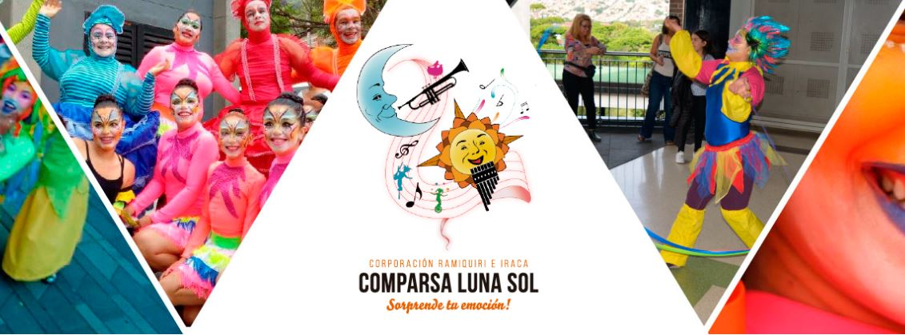
https://comparsalunasolcrei.com/ofertas-y-servicios/
PBX: (57) (4) 584 2121
CELULAR: (+57) 312 830 9616
CORREO: info@comparsalunasolcrei.com

Slide 2
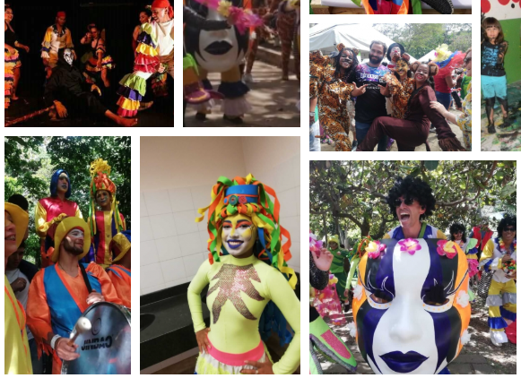

Ramiquiri and Iraca Corporation

Slide 3
What do they do?

Slide 4
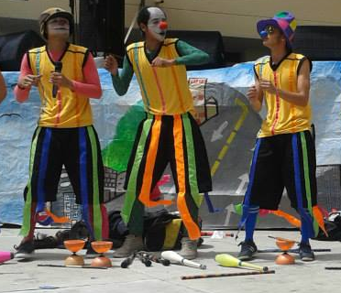
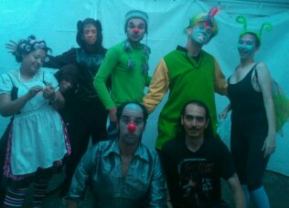
Theater

Slide 5

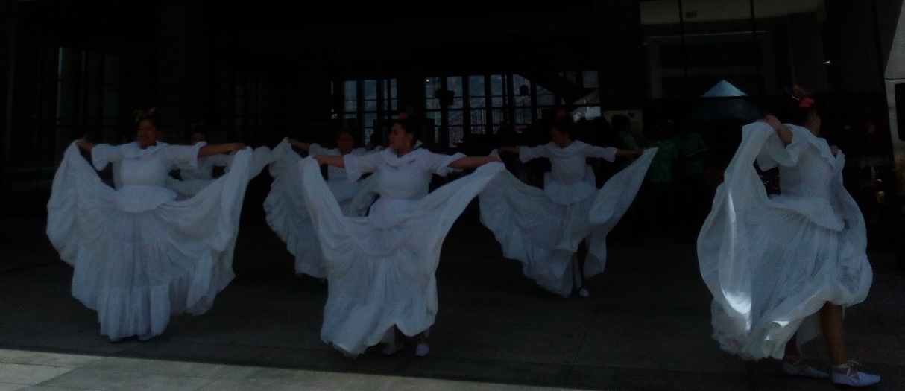
Folk dance

Slide 6
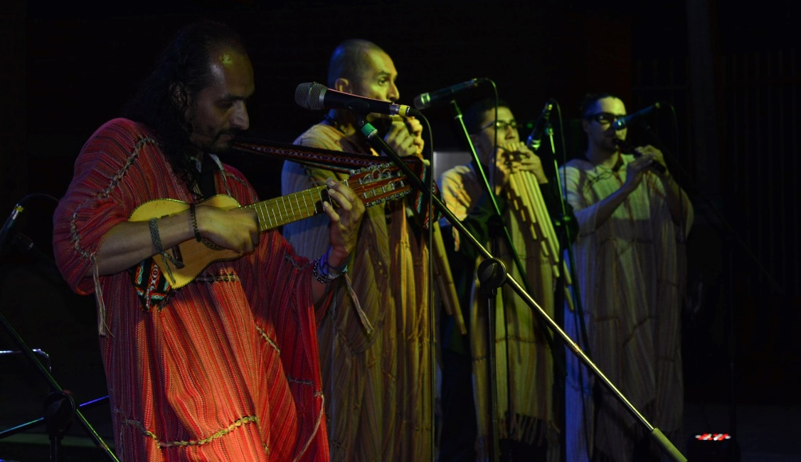
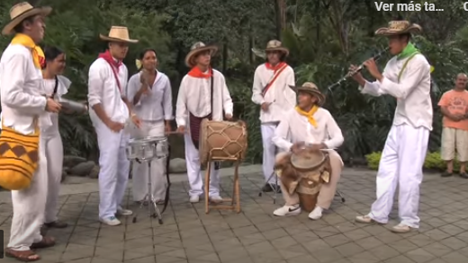
Music

