Slide 1
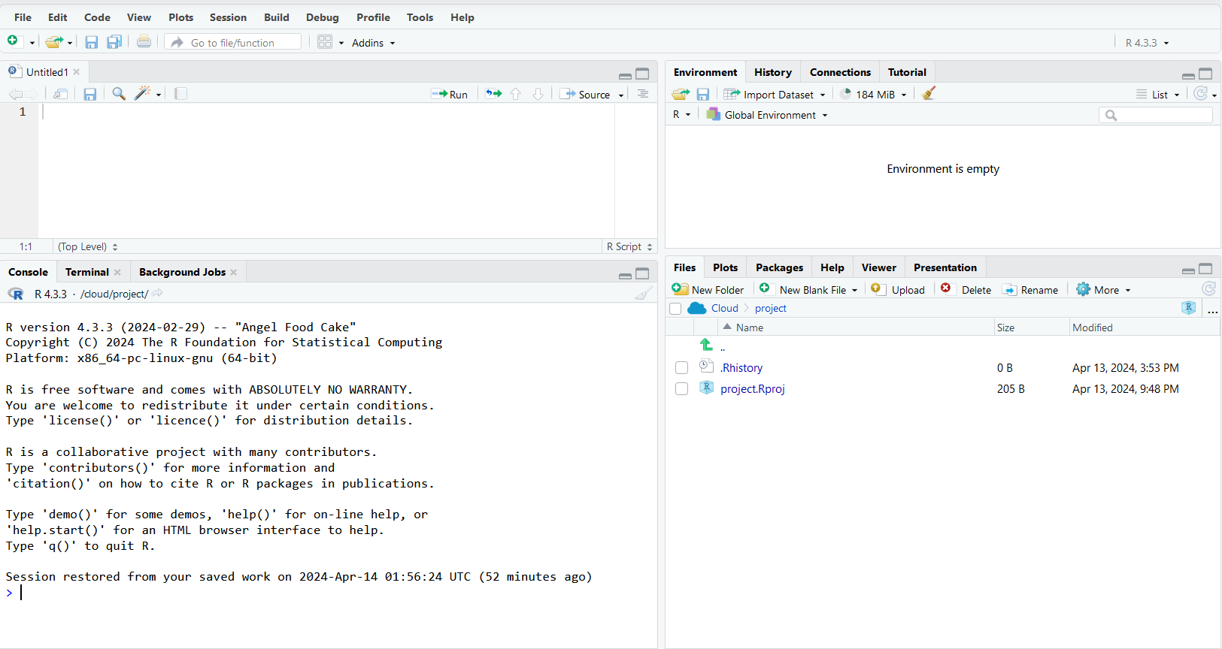
Painel 1
Painel 3
Painel 2
Painel 4

Slide 2
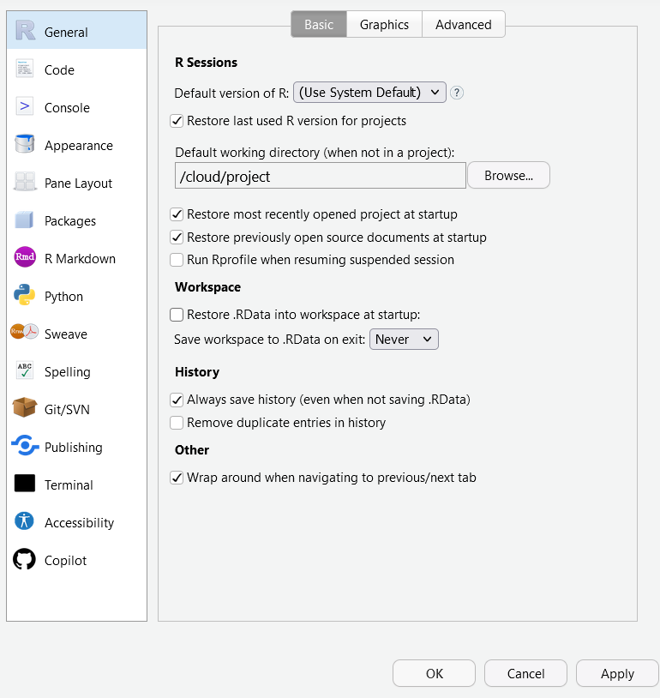

Slide 3
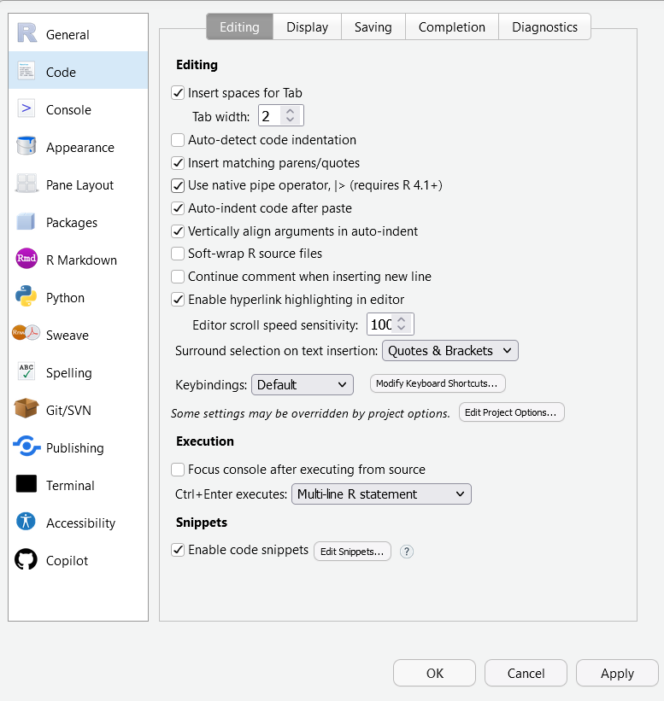

Slide 4
