Slide 1
ML4NP: Meeting 21.05.2020

Slide 2
Outline
Ar39 Pileups:
  PE Spectrum,
  Spatial Spread
Questions

Slide 3
Ar39 Pileups
Aim: see energy spectrum and spatial distribution of Ar39 Pileups’ depositions in Lar.
Events: aggregation of K Ar39 decays over the same time window, K=1,…,7.
Why? >7 Ar39s in ~10us present negligible probability (e.g. P(8Ar39s)=7.8e-17).
How:
  Aggregate K consecutive events in CJ simulations.
  Convert in sliced format (OP+sampling). Nr Slices=72
  Note: Using OP Map on Pure Argon (Old one)

Slide 4
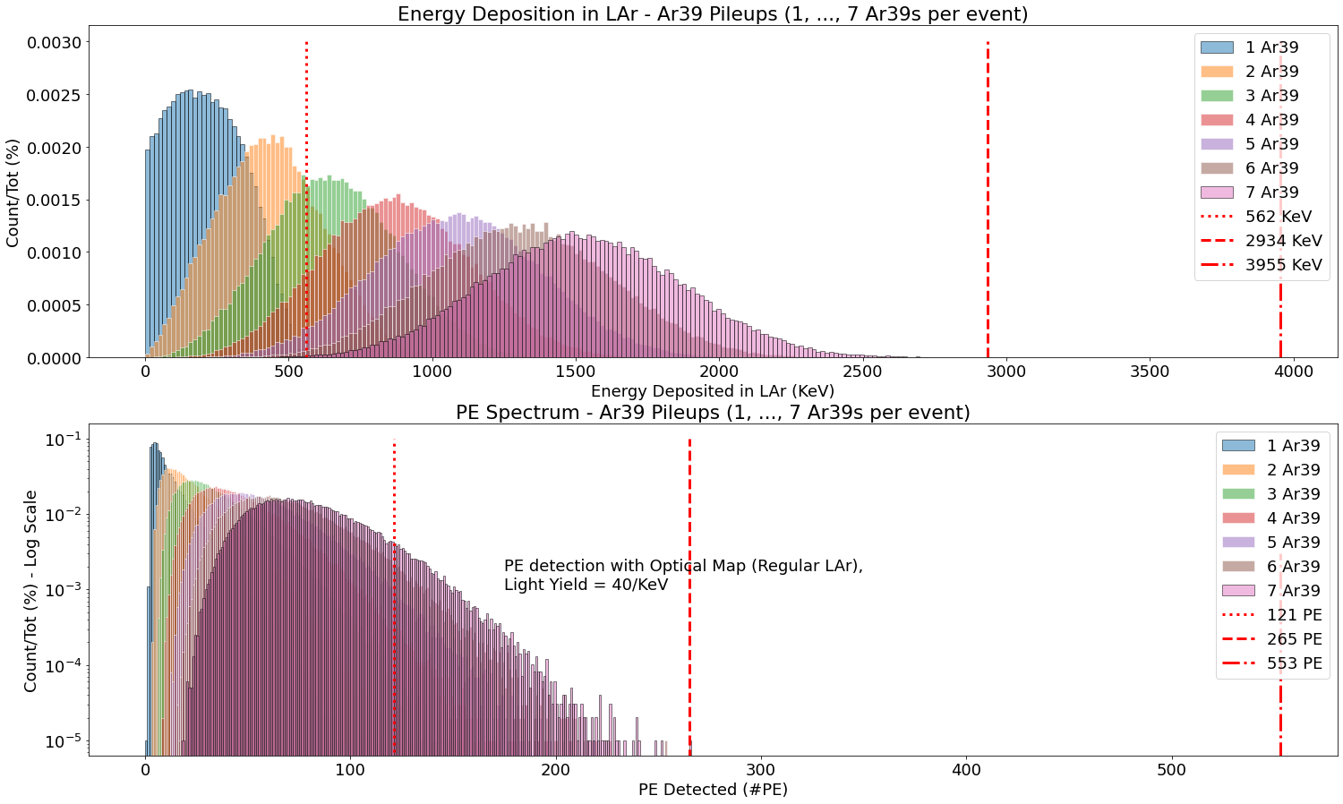
Ar39 Pileups – Energy
Energy and PE spectra for a population of 100 000 Pileups, for each K=1,…,7.
Thresholds Energy:
  562 KeV: 1 Ar39 max energy simulated
  2935 KeV: 7 Ar39s max energy simulated
  3955 KeV: ideal max energy
  (7 Ar39s with max energy)
Thresholds PE:
  121 PE: 1 Ar39 max PE simulated
  265 PE: max simulated energy
  553 PE: ideal max PE
  (7 Ar39s with max energy and best eff. 0.0035)

Slide 5
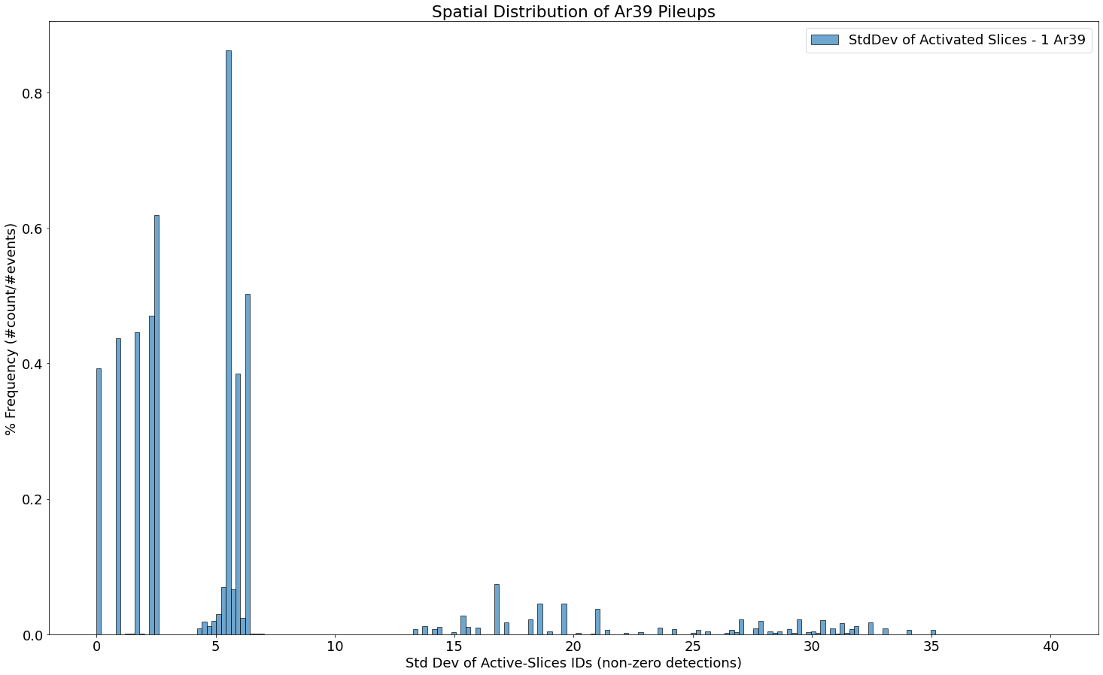
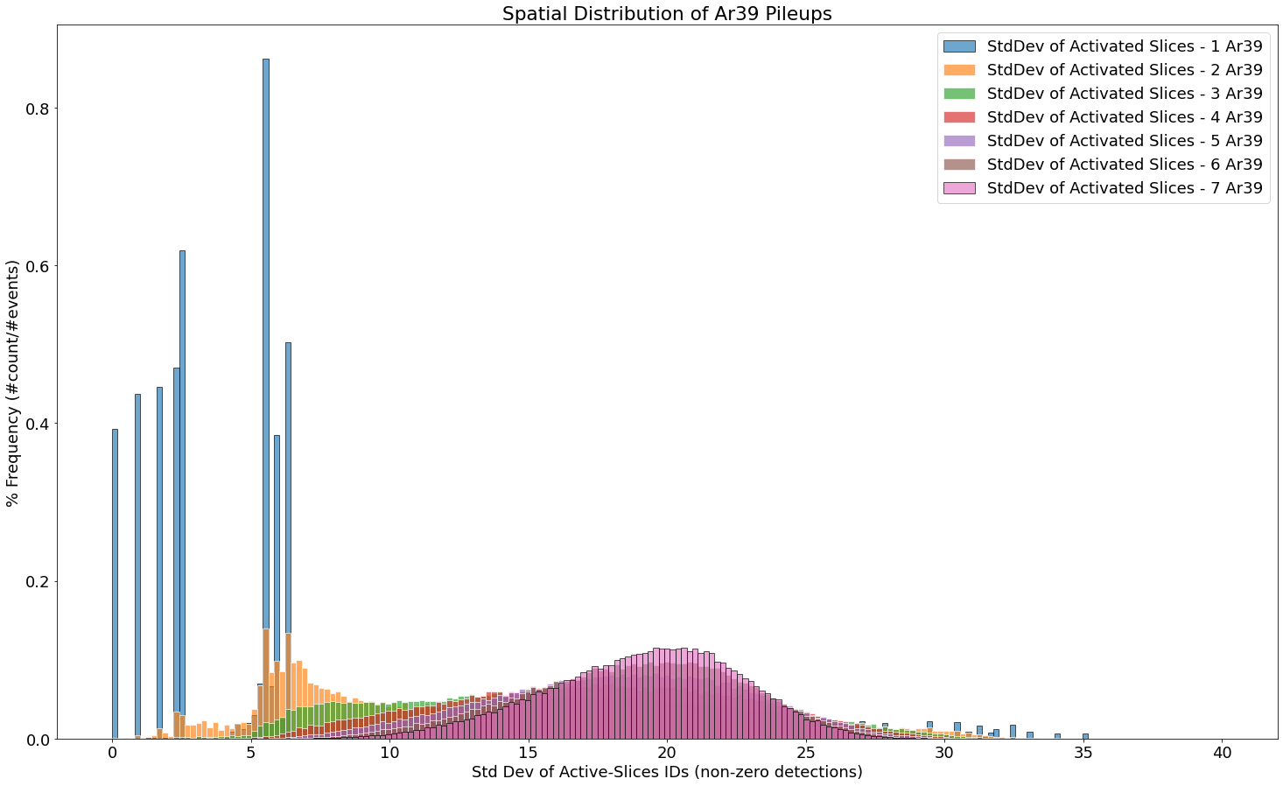
Ar39 Pileups – Spatial Spread
Spatial spread for a population of 100 000 Pileups, for each K=1,…,7.
How measure the spread? Std Dev!
  For each pileup event: consider indices of active slices (PE>1).
  Compute the std dev of these “active” indices.
Single Ar39 are localized
(small stddev)
stddev>30 because of cylinder
(0 and 71 are close, stddev is high)
as K grows,
stddev shifts to the right
As K grows: mean ~20
(isotropic spread for 72 slices)
Isotropic spread on 72 slices: Std({10,20,30,40,50,60,70})=20

Slide 6
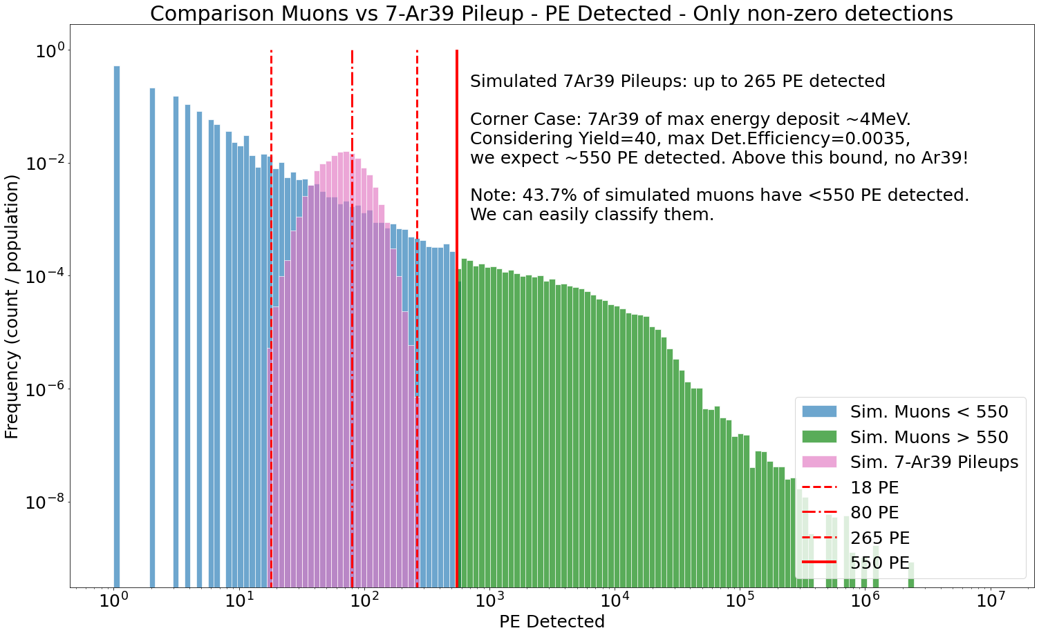
*Muon vs Ar39 Pileups – PE Spectrum
Aim: define a cut on energy to discard “easy” muons from Ar39.
Using Optical Map on Pure Lar (Det.Efficiency ranges in [0, 0.0035])
Consider Corner Case: 7 Ar39s with max Energy and best Det.Eff.
Place a threshold at 550 PE

Slide 7
Questions
Problem: muon data are not enough (~8K marginal muons wt PE<550).
We should think on how focus the simulation on interesting muons.
  Proposal: ask CJ to resume branches with starting condition of muons, run again 2e6 muons (few hours).
  Compare info of muons in ROI with MUSUN input → restrict input
Concerning the simulation of gammas on fibers:
  Assuming to know where gammas cross fiber surface
  Gammas deposit all their energy on the fiber surface
  Can we use OP Map for them? Like a deposit on the fibers
  (high energy + high det.eff → high PE detection)
  In that case, use always the sampling trick but with smaller StdDev.

Slide 8
BACKUP SLIDES

Slide 9
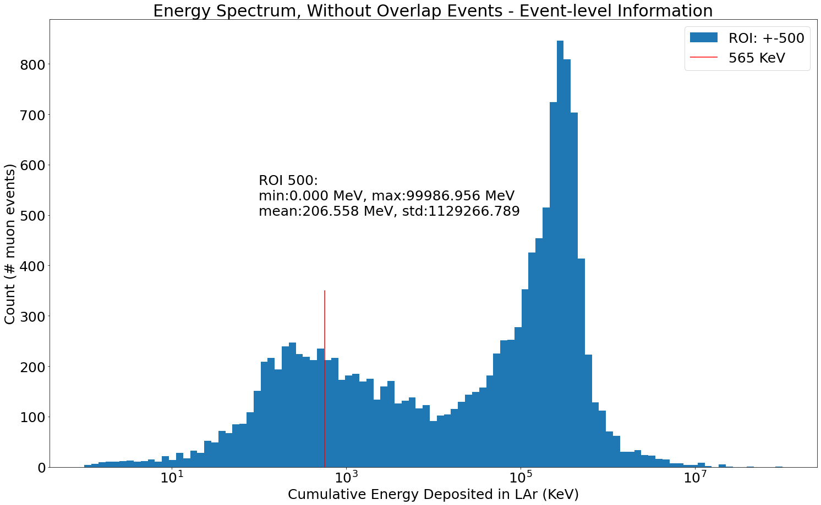
Error in processing simulation data
Issue: overlap of event number from different files
Solution: the files must be re-processed
Since the files must be re-processed…
Consideration 1: no news from Neil about new maps
  Proposal: use the old map with Pure Lar (no Xe-doping).
  We can eventually change it later.
Consideration 2:
  Map limits: x, y in +-700, z in +-845
  Our ROI: x, y in +-500, z in +-1000
  Proposal: consider larger ROI, like map limits
  TODO: eventually ask CJ Ar39 in larger ROI.
Good News: the cumulative energy is lower,
but the general trend is still valid!

Slide 10
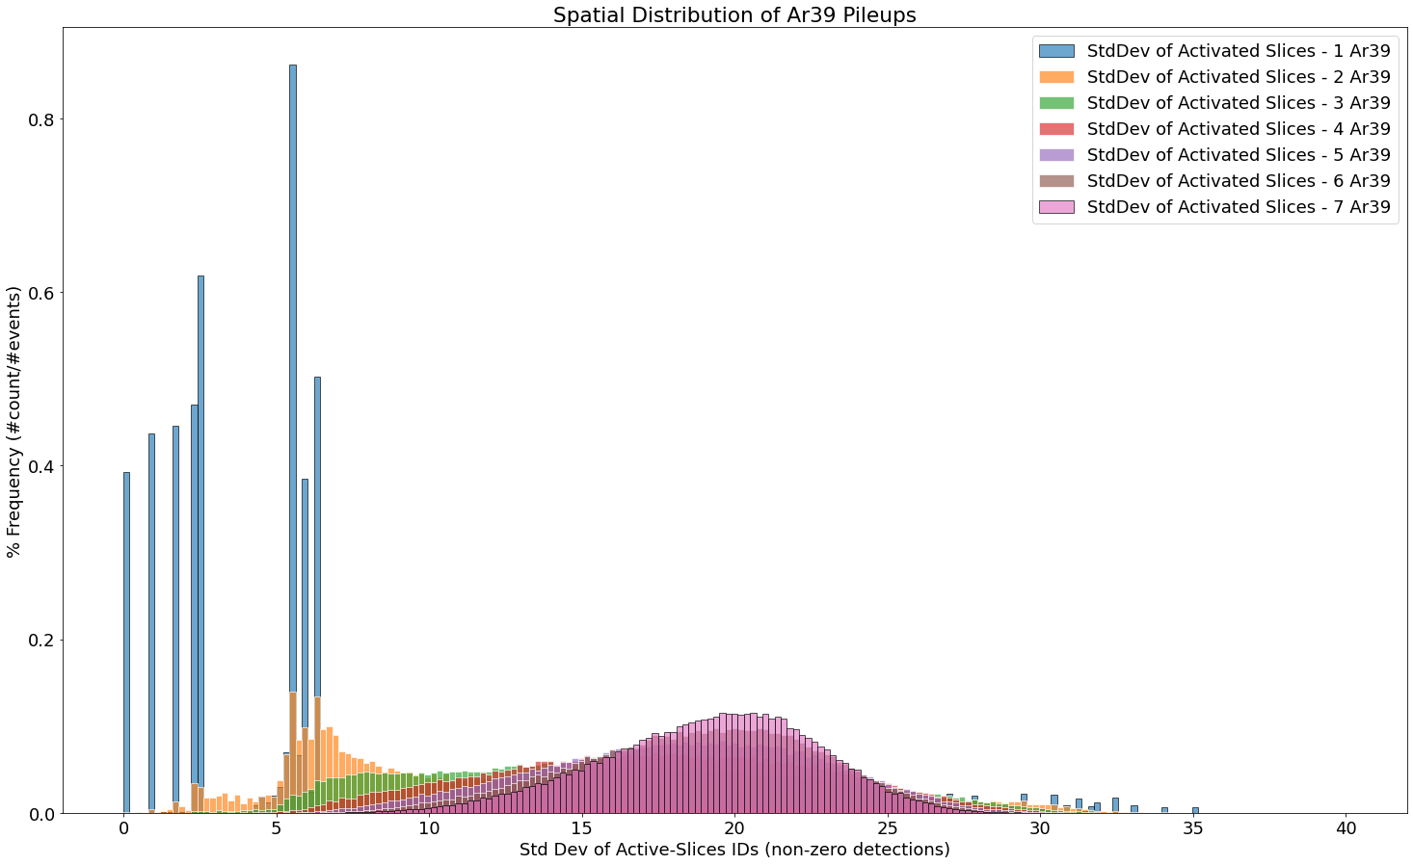
Ar39 Pileups – Spatial Spread

Slide 11
Muon Energy Spectrum, after re-proc.
Comparison with old analysis:
Before (wrong):
  Ranges 0, 142GeV
  Mean 328MeV
Now (right):
  Ranges 0, 99GeV
  Mean 206MeV
...different values but general trend is still valid!

Slide 12
Some data from new processing
Simulation Data: 2e6 Muons (CJ) with MUSUN input
Simulation-Data Processing includes 2 steps:
  Cut ROI: consider only entries in ROI, includes 0 depositions
    Why? Because we can analyze specific process (e.g. gammas Ar41 de-excitation)
    20 751 events (1% 2e6 muons) survive to ROI cut (ROI +-700, +-845)
    Remark: These events present at least 1 entry in ROI
  Convert in Sliced Detections: consider only detected entries,
  exclude Edep=0 or DetEff=0
    16 274 events survive
    Remark: They present at least 1 non-zero detection in ROI
What we can do now? From 16 274 events we can produce snapshots
  First: discard easy detections (energy deposition >> energy ar39 pileups)
  Analyze spatial distribution of detections (general, not specific process)

Slide 13
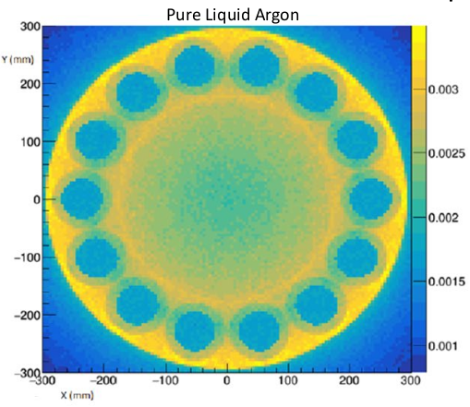
BACKUP
Optical Map on Pure Liquid Argon
Max ~ 0.0035
Min = 0.000
From Neil’s Presentation on 07/05/2020.

