Slide 1
ML4NP: Meeting 11.05.2020

Slide 2
Outline
Snapshot dataset for ML
  Status
  Data augmentation
  Dataset composition
Status of maps
Issues
TODO list

Slide 3
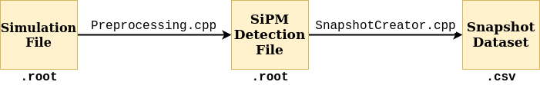
Status Snapshot Dataset
Recap of this work:
  Simulation File → SiPM Detection File (locality)
  SiPM Detection File → Snapshot Dataset (time)
Point 1) discussed in last meeting (Neil’s map + sampling trick)
Point 2) just mentioned in last meeting. A snapshot is:
  Sequence of N successive acquisitions
  of EP detected over integration time Dt.
  Then, a snapshot cover a time window of N*Dt

Slide 4
Dataset Composition
How should be composed Train/Dev/Test sets?
Ar39:
  E[Ar39 | V=2.6m3, T=1s] = 3666
  Example: T=100us interval: E[Ar39|V, T=100us] = 3666e-6
  Number of Ar39 in V over interval T ~ Poisson(E[Ar39|T,V]
k | p=Poisson(k, 3666e-6) | E[X~Bin(p)] (#snapshots) | ns*T (time)
0 | 0.996 | 1.004
1 | 3.37e-3 | 296.736
2 | 6.69e-6 | 149476.831
3 | 8.18e-9 | 122249388.753
4 | 7.50e-12 | 133333333333.333
5 | 5.50e-15 | 181818181818181.818

Slide 5
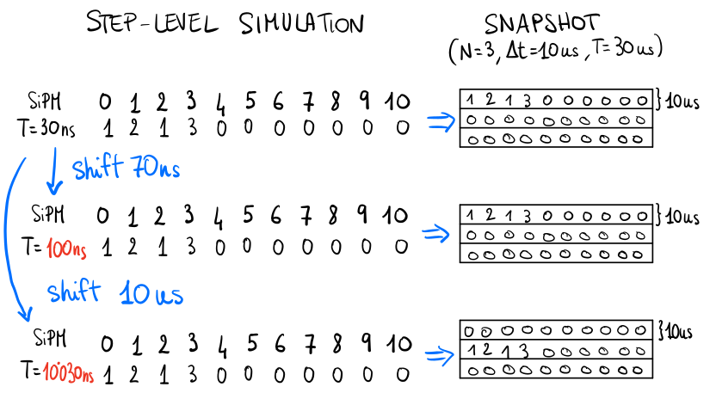
Data augmentation (1)
One single simulated event (e.g. Ar39, muon..)
can produce multiple snapshots
through shiftings in time.
Issue: small shiftings (O(ns)) produce duplicates
rather than different instances.
Example below: Consider a simulated event with a single deposition (common in Ar39) at time=30.0 ns. Assume 10 SiPM modules from which acquire 3 successive integrations of 10 us.

Slide 6
Data augmentation (2)
First solution:
  Assume 1st deposit at time=0.0
  Perform N shifting of Dt’s multiple
  [0, Dt, 2Dt, 3Dt, …, (N-1)Dt]
Issue: we loose events that occur between two integrations
Solution:
  Compute event_len = time_last – time_first ~O(ns)
  Add other (N-1) shiftings
  [Dt – event_len/2 , 2Dt – event_len/2, …,
  (N-1)Dt - event_len/s]

Slide 7
Data augmentation (3)
Example of application of this idea:
  Having 1500 muon events (current number of marginal muons)
  Assuming Dt=10us and N=10
  For each event, we obtain 2N-1 snapshots → 28500 snapshots

Slide 9
Status of maps
Current version of Neil’s map: Xenon-doped Ar
  Higher light production → Higher EP detection
  Issue: InteriorMap ok, ExteriorMap bugged
  Waiting for new map (this week)
All statistics about EP detected up to know are not reliable because depositions in exterior region are never detected

Slide 10
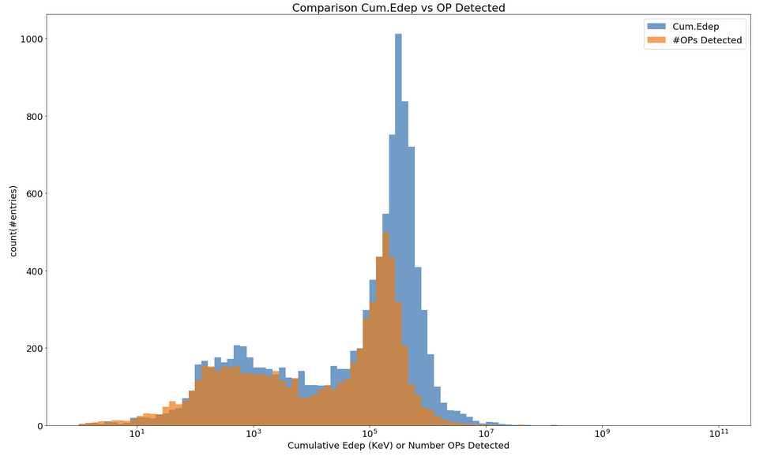
Muon simulations
CJ has uploaded the simulation of 2e6 muons (~20GB)
ROI cut: x, y in [-50,+50] cm, z in [-100,+100] cm
  Events in ROI: 10 594, Events detected: 6 670
  Data reduction: 20GB → 783MB, we don’t need further cut
OP detection
Neil’s map wt
OP yield=40 OP/KeV
Question:
OP map is not symm. in Z.
Should we consider simmetry?
Complete Notebook:
https://github.com/luigiberducci/ML4NP/blob/master/Notebooks/html/analysis_2e6muons.html

Slide 11
Background simulations
Matt Green simulations:
  No info output scheme (e.g. units)
  output scheme stores all Edep?
CJ should simulate Bg in the next weeks
Meanwhile, Ar39 activity:
  we need Edep over the time
  Mario Schwarz toy MC?

Slide 12
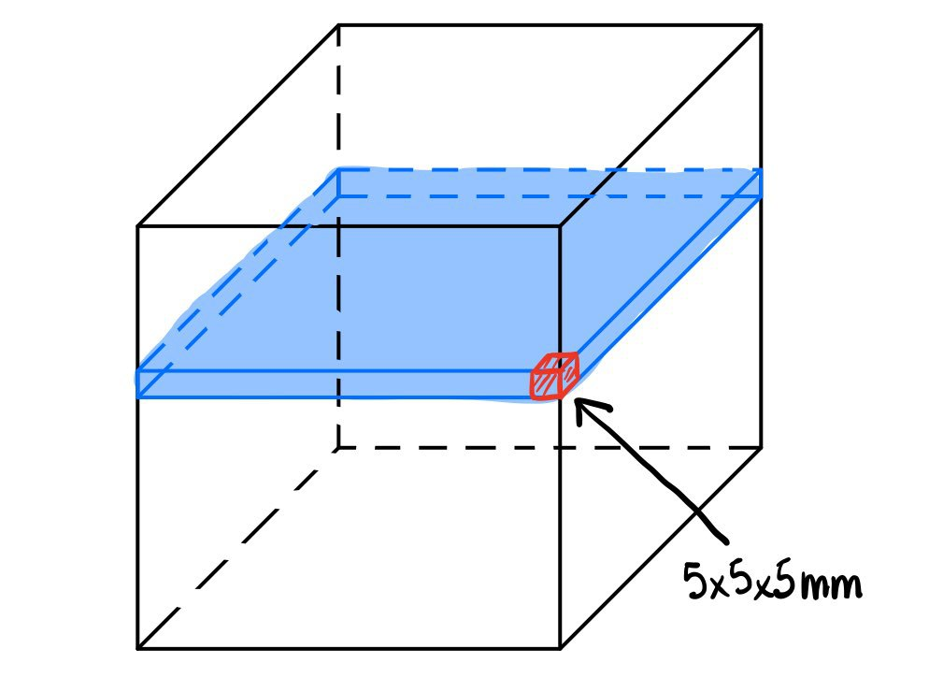
Dataset generation
We need to map Edep to OP counters of SiPMs
We could work on two phases:
  Artificial mapping x,y,z→distr. over N SIPMs
    (next slide)
  Mapping from simulations: like OP map
    Neil sent us: Generator and MAC file
    Running Generator on a single Z-slice
    Simulating 1 OP in each bin (5x5x5mm)
    Elapsed time ~17 minutes on RM3 cluster
    Back of envelope calc: simulation 500 Ops ~142 hours

Slide 13
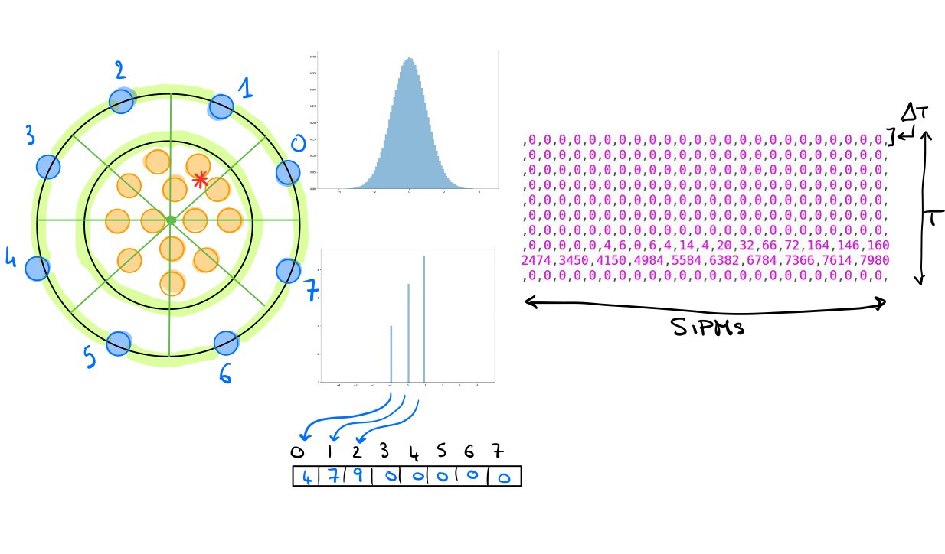
Dataset generation (2):
Artificial mapping
Not reflective of real spatial distribution of OPs
Artificial “segmentation” to proceed with first-phase ML:
  Divide ROI in N segments (left)
  Sample OP detected ~Norm (middle)
  Integrate OP count in time: window T, integration Dt (right)

Slide 14
Questions
OP map simmetry in Z?
Edep in MaGe output: unit is KeV or MeV?
Window T and Dt? Talk with DAQ about it?
Integration in O(microsec), <1 Ar39 decay
Why we need ML? Simple cut on OP counter?
SiPM with no OP detected are 0 in reality?
Should we add noise?

