Slide 1
ML4NP: Meeting 21.05.2020

Slide 2
Ar39 Pileups
Aim: see energy spectrum and spatial distribution of Ar39 Pileups’ depositions in Lar.
Events: aggregation of K Ar39 decays over the same time window, K=1,…,7.
Why? >7 Ar39s in ~10us present negligible probability (e.g. P(8Ar39s)=7.8e-17).
How:
  Aggregate K consecutive events in CJ simulations.
  Convert in sliced format (OP+sampling). Nr Slices=72
  Note: Using OP Map on Pure Argon (Old one)

Slide 3
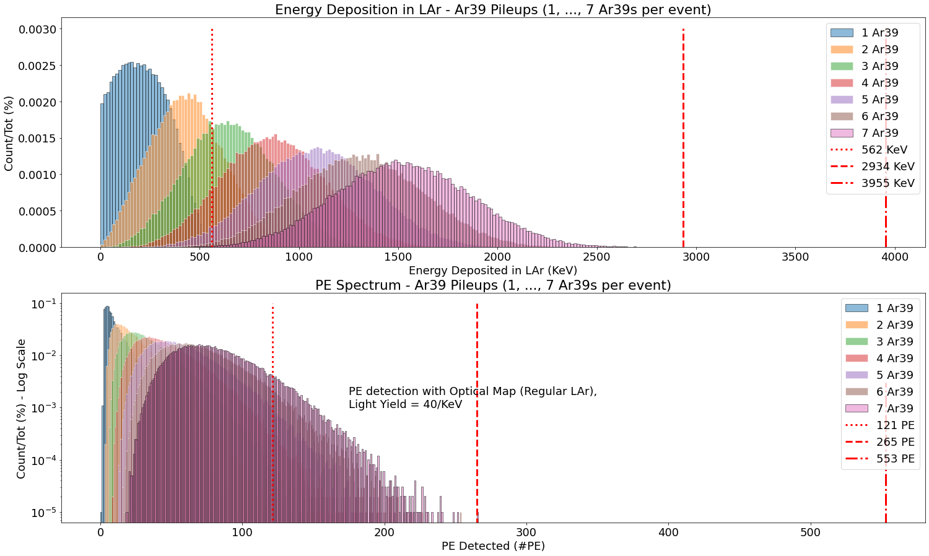
Ar39 Pileups – Energy
Energy and PE spectra for a population of 100 000 Pileups, for each K=1,…,7.
Thresholds Energy:
  562 KeV: 1 Ar39 max energy simulated
  2935 KeV: 7 Ar39s max energy simulated
  3955 KeV: ideal max energy
  (7 Ar39s with max energy)
Thresholds PE:
  121 PE: 1 Ar39 max PE simulated
  265 PE: max simulated energy
  553 PE: ideal max PE
  (7 Ar39s with max energy and best eff. 0.0035)

Slide 4
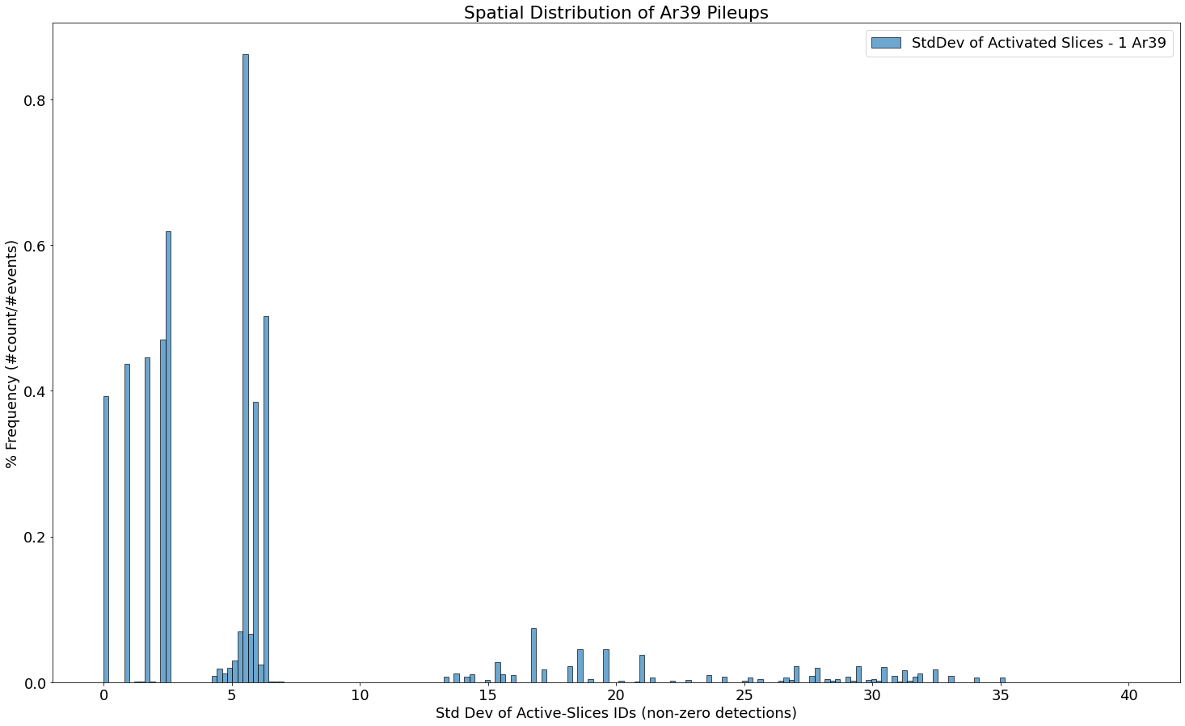
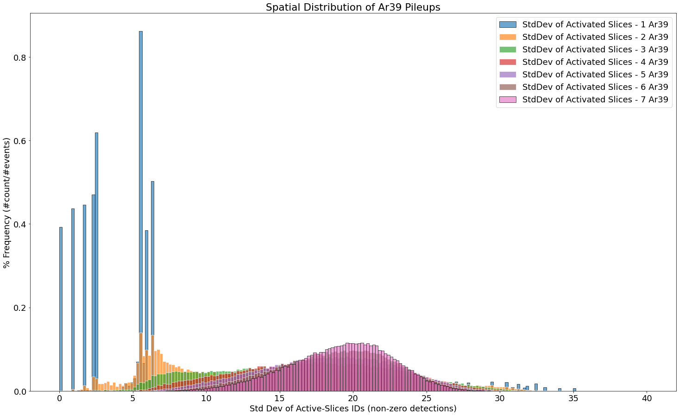
Ar39 Pileups – Spatial Spread
Spatial spread for a population of 100 000 Pileups, for each K=1,…,7.
How measure the spread? Std Dev!
  For each pileup event: consider indices of active slices (PE>1).
  Compute the std dev of these “active” indices.
Single Ar39 are localized
(small stddev)
stddev>30 because of cylinder
(0 and 71 are close, stddev is high)
as K grows,
stddev shifts to the right
As K grows: mean ~20
(isotropic spread for 72 slices)
Isotropic spread on 72 slices: Std({10,20,30,40,50,60,70})=20

Slide 5
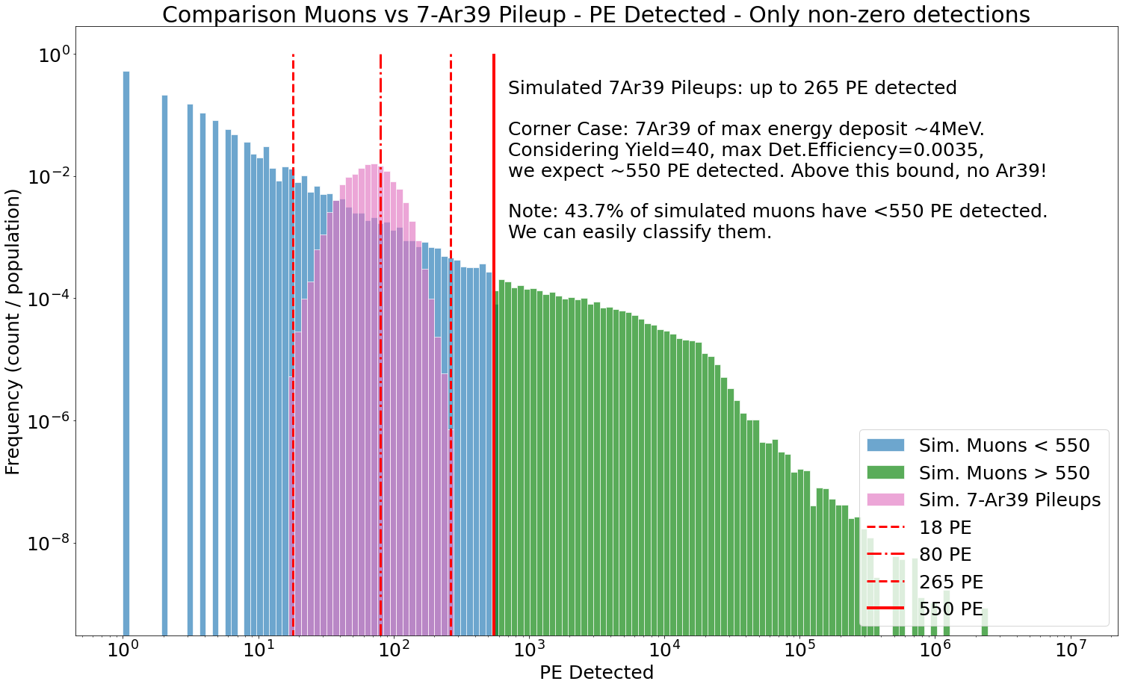
*Muon vs Ar39 Pileups – PE Spectrum
Aim: define a cut on energy to discard “easy” muons from Ar39.
Using Optical Map on Pure Lar (Det.Efficiency ranges in [0, 0.0035])
Consider Corner Case: 7 Ar39s with max Energy and best Det.Eff.
Place a threshold at 550 PE

Slide 6
Questions
Problem: muon data are not enough (~8K marginal muons wt PE<550).
We should think on how focus the simulation on interesting muons.
  Proposal: ask CJ to resume branches with starting condition of muons, run again 2e6 muons (few hours).
  Compare info of muons in ROI with MUSUN input → restrict input
Concerning the simulation of gammas on fibers:
  Assuming to know where gammas cross fiber surface
  Gammas deposit all their energy on the fiber surface
  Can we use OP Map for them? Like a deposit on the fibers
  (high energy + high det.eff → high PE detection)
  In that case, use always the sampling trick but with smaller StdDev.

