Slide 1
ML4NP: Meeting 03.07.2020

Slide 2
Summary
Spatial Map:
  recap
  updates: inner/outer maps
  questions
Features for ML
Classification wt DTree

Slide 3
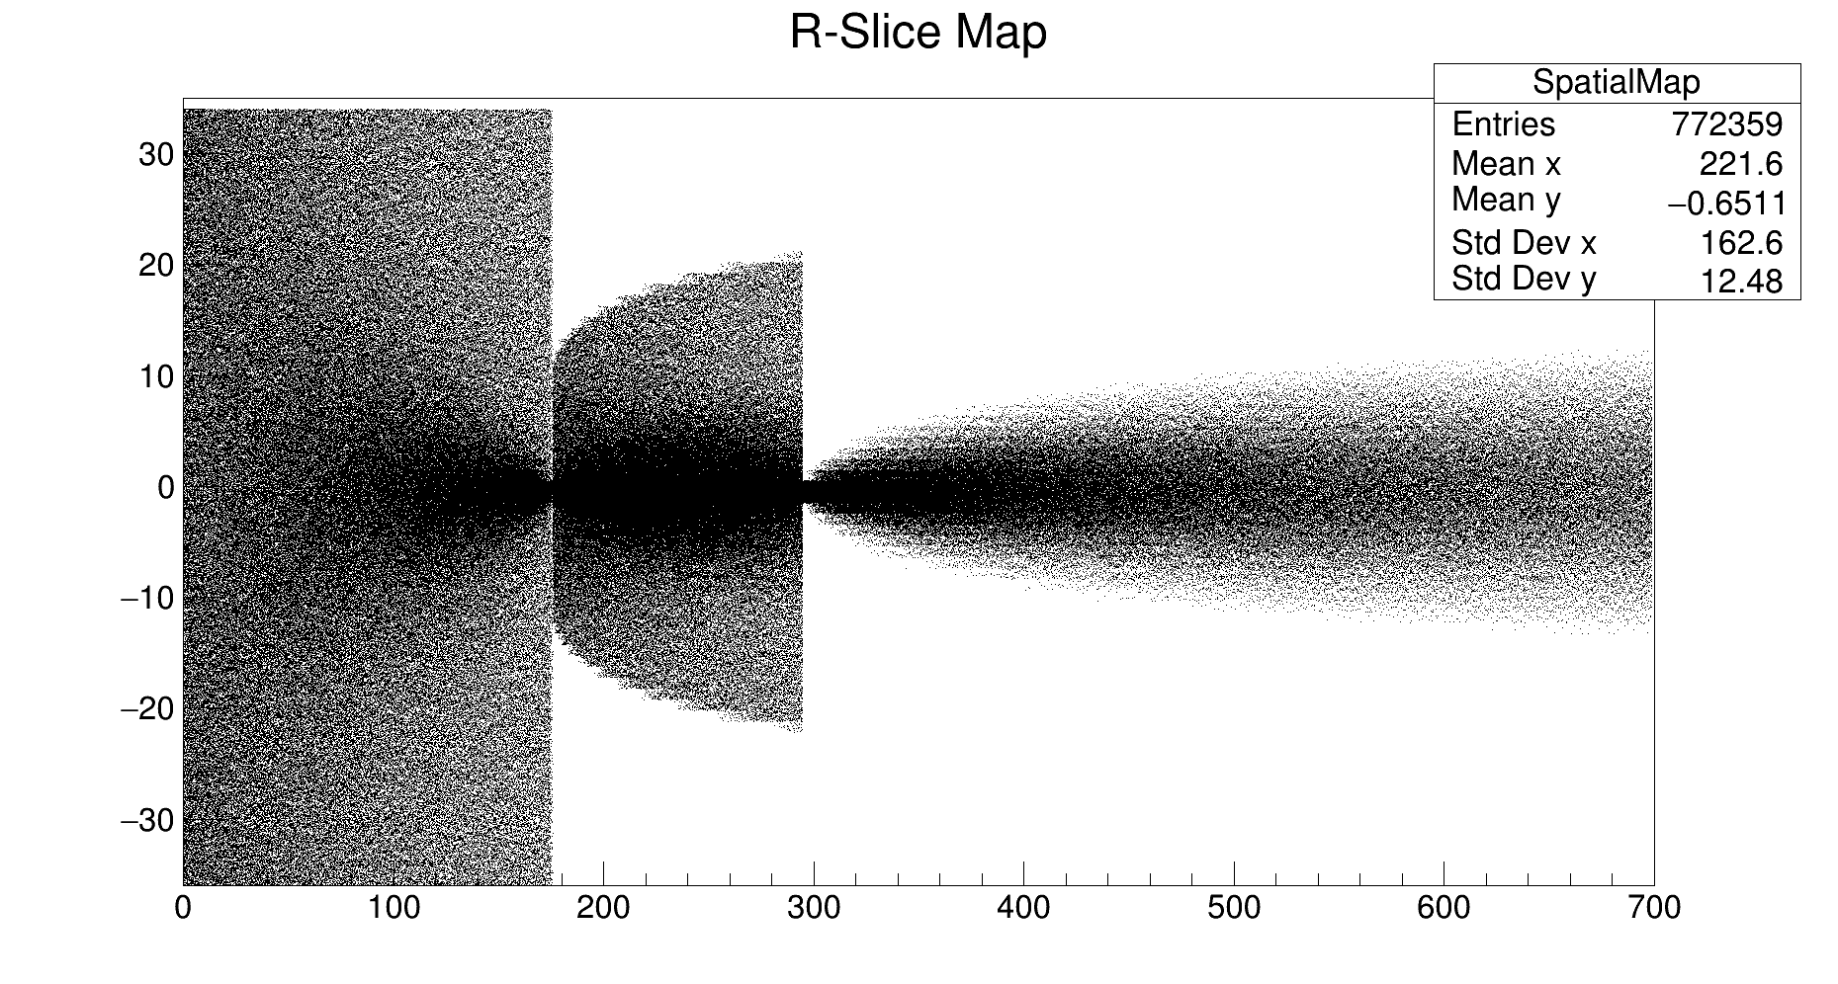
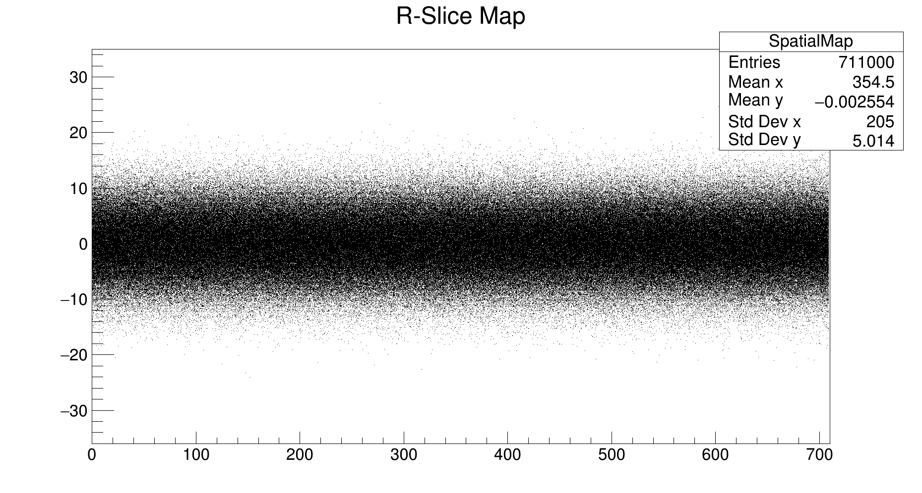
Spatial Map (recap)
Sampling the PE hit wt Gaussian does not reflect the real setup.
Problem: it doesn’t take into account the radius!
Idea: with a bit of geometry and patience, we can compute the intersection of OP trajectories (straight line) with the shrouds (circle in X-Y)
Is it real now? NO! Real Map should consider R, Z, angle.
But it should be more realistic.
This is how the Gaussian hit-space distribution would look like as map
Only Inner
Inner/Outer
Only Outer

Slide 4
Spatial Map (updates)
Last meeting’s observation: LGND200 has 2 shrouds. We should have Inner and Outer Detections!
Updates:
  Creation of 3 Maps:
  PrInnerDet, InnerMap, OuterMap
  Why 3? See next slide.
  Integration of other scenarios:
    Photon from outer region not captured by the outer shroud and detected by the inner one,
    and viceversa
    How? Approximate with probability!
Ge
Ge
Ge
Ge
Ge
Ge
Ge
Ge
Ge
Ge
Ge
Ge
I don’t know how to treat the spread between Inner and Outer Shrouds

Slide 6
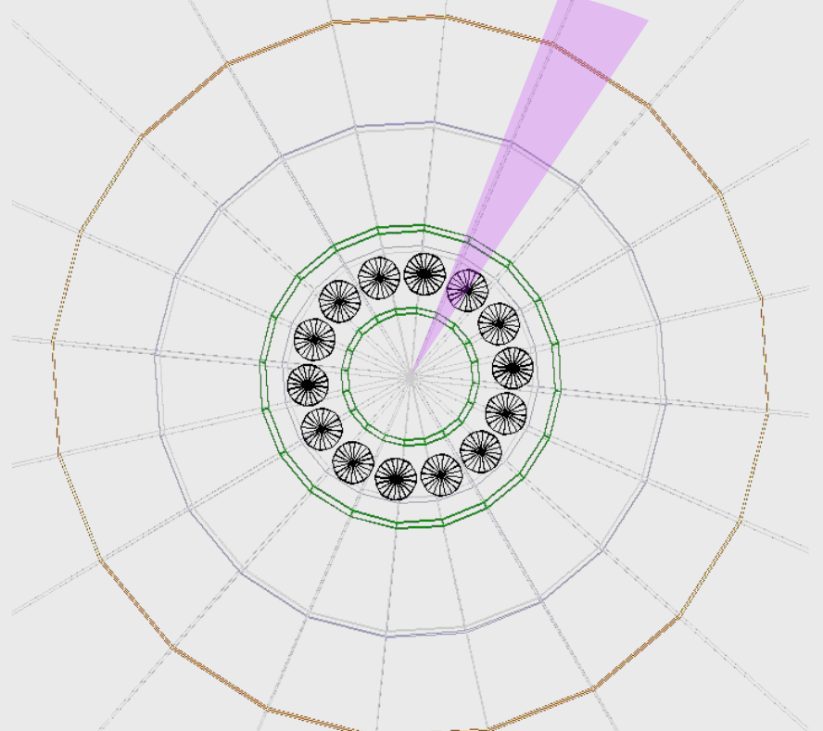
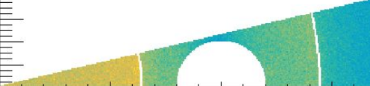
Spatial Map (updates)
Fibers don’t cover the whole cylinder surface.
Only the 54% is covered (CJ email).
Ge Arrays could reflect the photons.
I guess only 10% photons pass Ge,
90% are reflected.
Could we refine these values?
1)
2)
I assume two scenarios for a photons starting in the outer region:
Pr(Hit Outer Shroud | Start in Outer Region) =
= Pr(captured by OuterShroud) + Pr(reflected by Ge) * Pr(captured by OuterShroud) = .54 + (1-.54) * .90 * .54 = .76356
Pr(Hit Inner Shroud | Start in Outer Region) =
= Pr(not captured by OuterShroud) * Pr(pass Ge) * Pr(captured by InnerShroud)
= (1-.54) * .10 * .54 = .02484
Since, we aim to distribute the detection, we normalize these probabilities:
1) 0.03151 2) 0.96849
...and use these two value as weights to fill the Spatial Map!

Slide 7
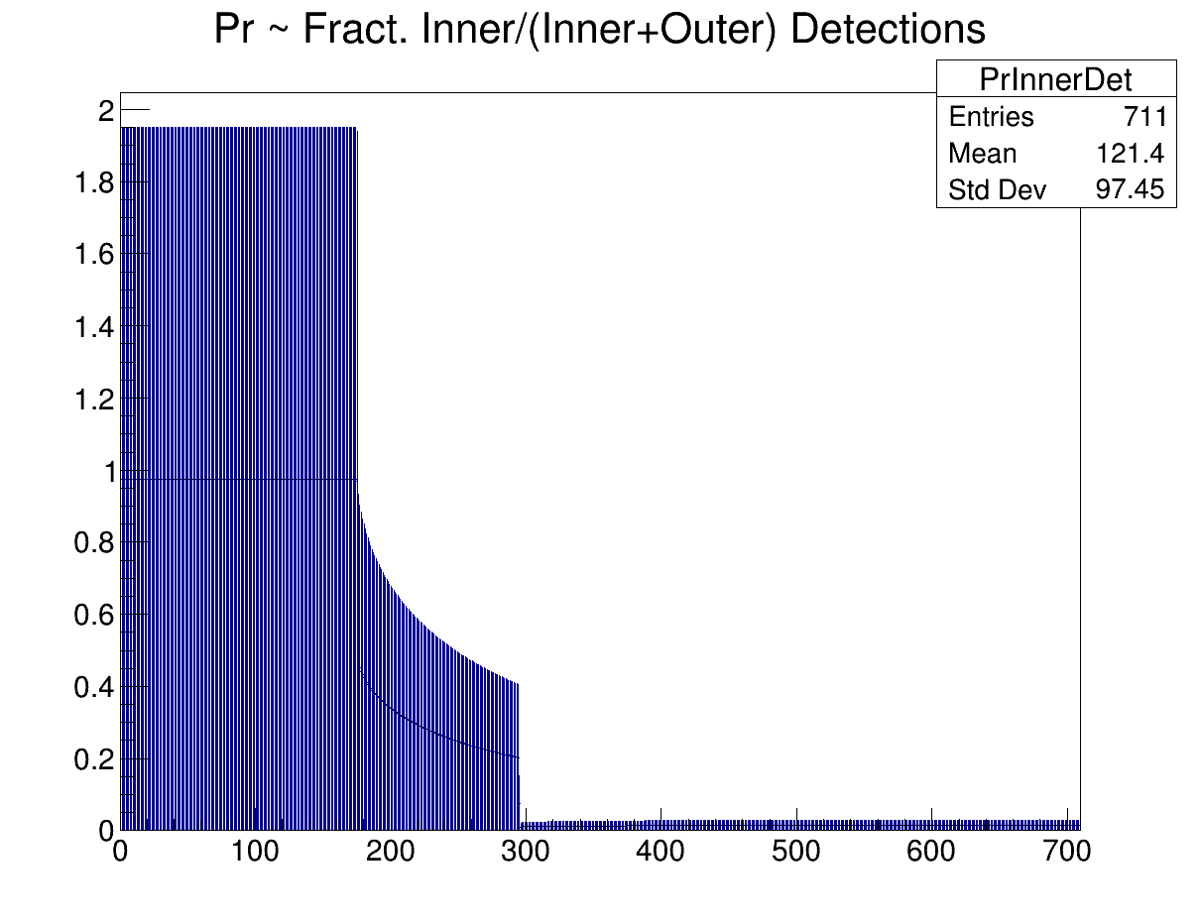
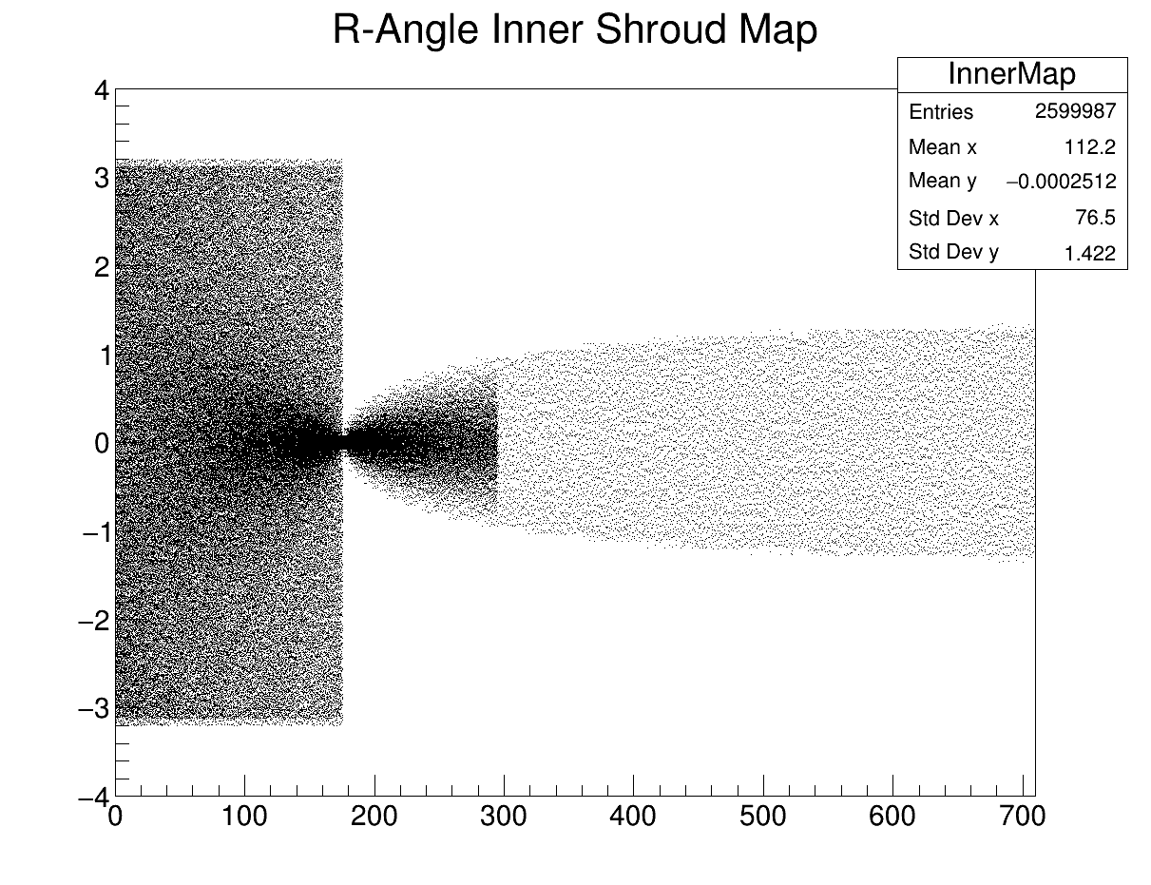
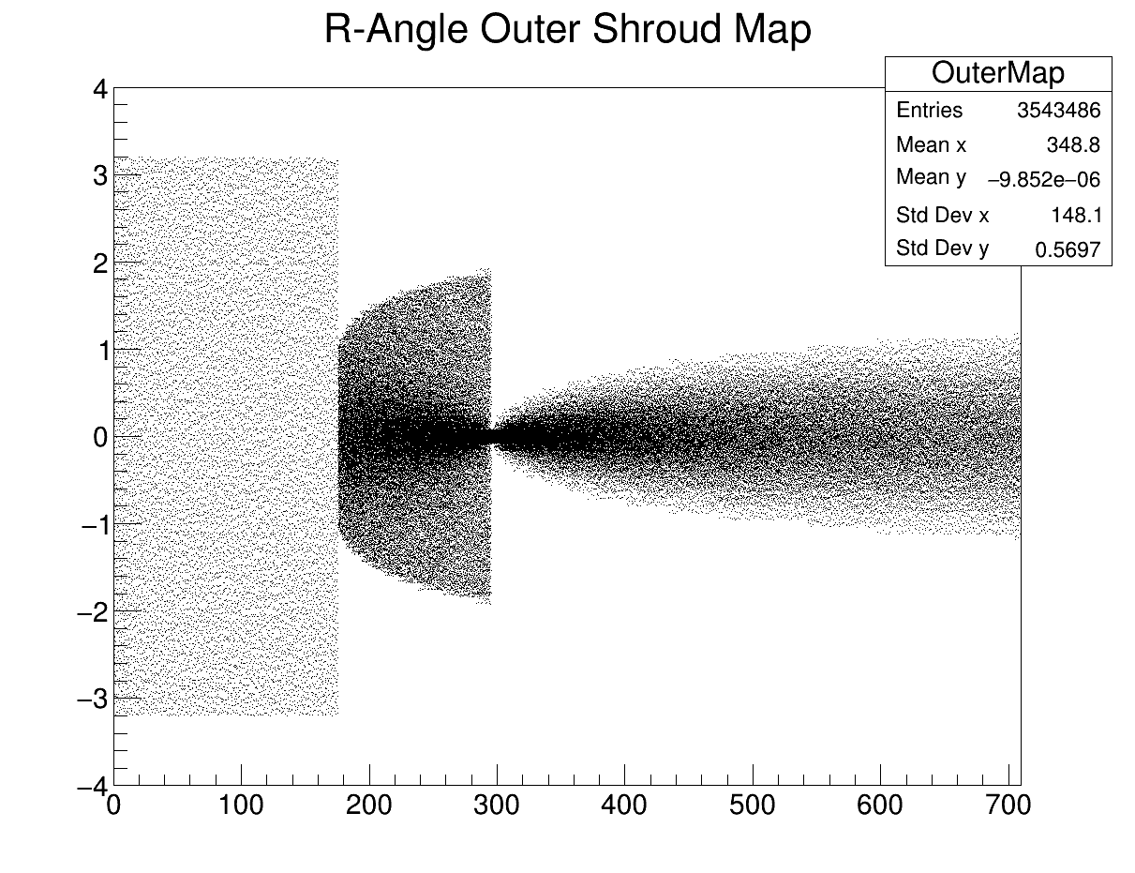
Spatial Map (updates)
PrInnerDet
How to combine 2 maps?
We have NPE = OPMap(Edep)
  Use PrInnerDet to compute NPE_in that hit the InnerShroud and NPE_out that hit the OuterShroud
  Spread NPE_in in InnerShroud wt InnerMap
  Spread NPE_out in OuterShroud wt OuterMap
InnerMap
Outer Map

Slide 8
Spatial Map (questions)
All the features about Spatial Spread of detections depends on the map
If the reality != simulation, the resulting “rejection strategy” would be uneffective
Toy Spatial Map: how to deal with Ge? Tips?
To have more realistic Spatial Map:
It’s time to talk wt Patrick and Mario (TUM).
  They already produce data wt symmetry
  If their simulator is open, we can use it
  Otherwise, we can ask them for raw data
  We have to think to a map: R, Z, deposit-angle→(shroud, hit-angle)

Slide 9
… change to ML!
The first problem we faced is single Ar39 decays:
  Single decays constitute the 98% of Ar39 background (Poisson)
  The trigger rate of 2.4kHz is mainly because of single Ar39,
We should first define a strategy to reject them, and then move to more sophisticated classification.
At the beginning, we thought we can simply perform a cut on NPE to reject all of them. Simulation of Single Ar39 has NPE in [0, 60].
Also ~30% of simulated muons deposit <=60PE.
Requirements:
  Reject single Ar39 decays as much as possible,
  Save very low-energy muons (PE<=60), if possible.

Slide 10
Features
Instance format by using 2 Spatial Maps:
InnerSlice0, …, InnerSlice11, OuterSlice0, …, OuterSlice19
32 int values, each is the nr of photons that are detected in that slice
Features for each shroud:
  PEDetected: sum PE detected in the shroud
  NactiveSlices: number of slices of the shroud wt >=1PE
  MeanNPE: PEDetected / NSlices
  StdNPE: std({PE | for PE>0 in shroud})
  SpatialRange: difference max - min active slice
  SpatialVar: var({ID**PE | ID of slice wt PE})
  SpatialStd: std({ID**PE | ID of slice wt PE})
7 inner features, 7 outer features (tot. 14 features)

Slide 11
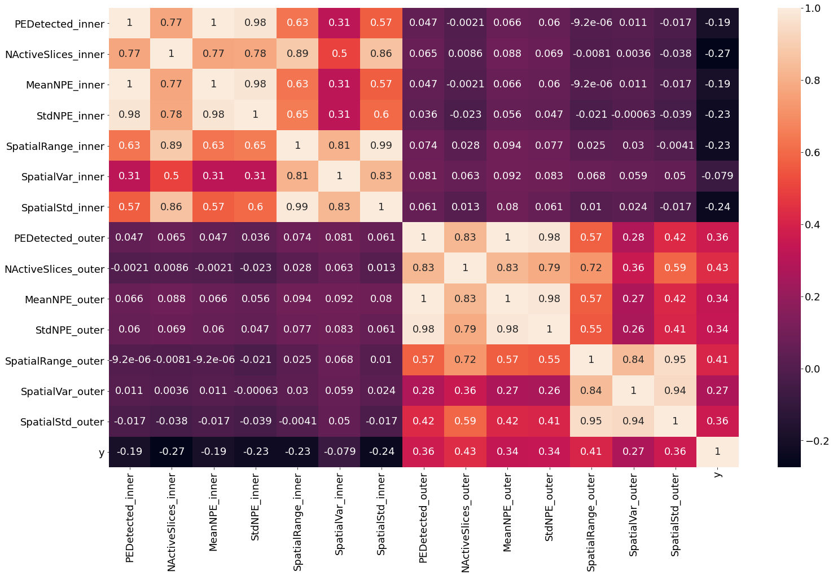
Feature Selection (1)
Correlation Matrix

Slide 12
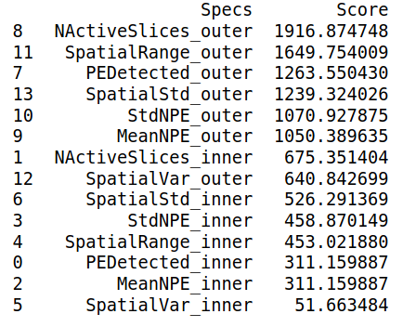
Feature Selection (2)
F-Score: “correlation” with label y
Observation: the first features are all “outer” features.

Slide 13
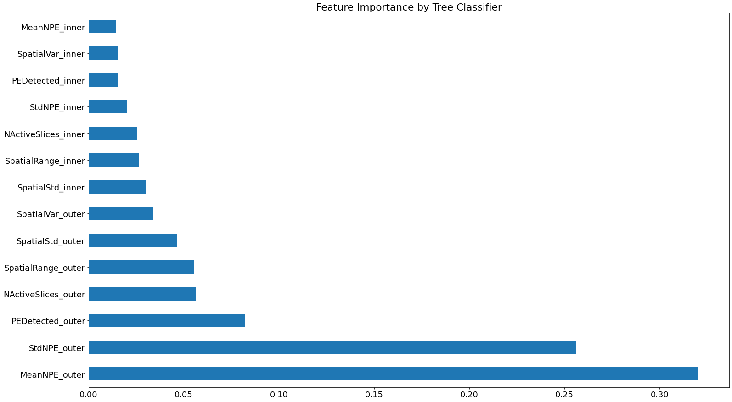
Feature Selection (3)
Train a Dtree and see what features are selected first
All of them
measure Spread
in Outer Shroud
All of them
measure NPE
in Outer Shroud
First attempt: remove all features wt correlation>.95. 8 Selected Features:
NActiveSlices_inner, StdNPE_inner, SpatialVar_inner, SpatialStd_inner,
NActiveSlices_outer, StdNPE_outer, SpatialVar_outer, SpatialStd_outer

Slide 14
DTree – Training
8 Features:
  NActiveSlices_inner, StdNPE_inner, SpatialVar_inner, SpatialStd_inner,
  NActiveSlices_outer, StdNPE_outer, SpatialVar_outer, SpatialStd_outer
Training data: 4000 LE Muons, 4257 Ar39
Hyperparameters:
  Criterion
  Max Depth
  Min Sample Leaf
Aim: “Reject as much 1Ar39 as possible, saving muons if possible”
Score for training: “purity”, it takes care of TP and FP!

Slide 15
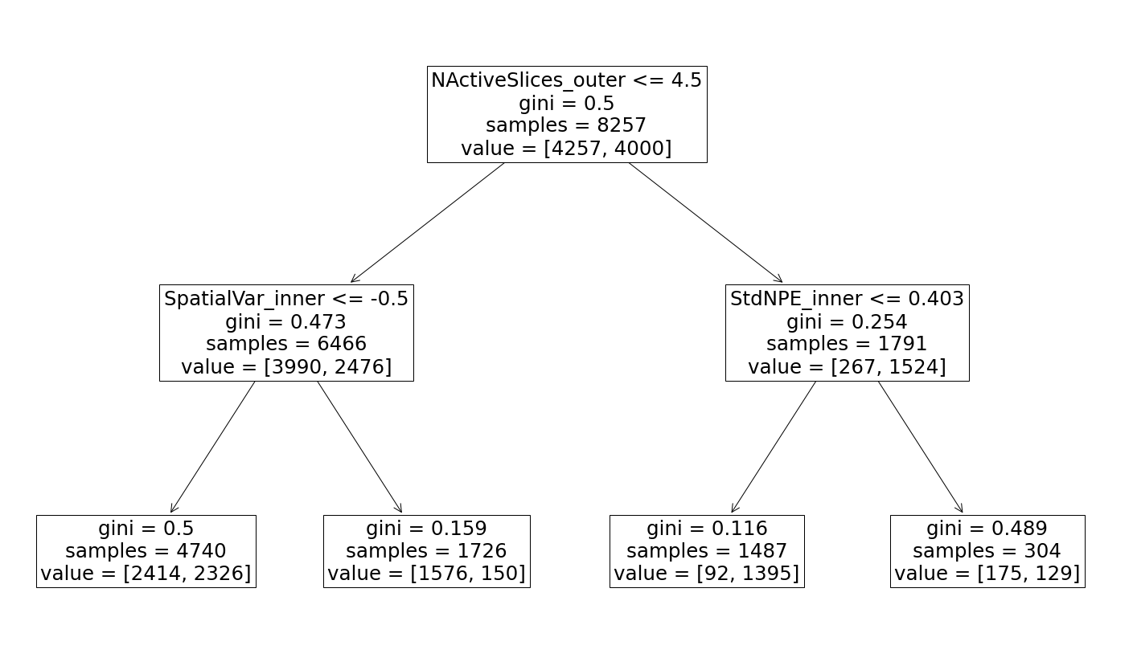
Trained Model
Spread of Outer Detections
Inner Detected Energy
(It can be retrained wt
PEDetected_inner,
it is an easier feature)
Useless, always Ar39
AR39
AR39
LE-Mu
AR39

Slide 16
DTree – Test on unbalanced data
Test Set: 626 LE Muons, 2M Ar39 (unseen data)
Evaluation of LE Classification (<=60PE):
  TPR (efficiency) = 38.5% (241 / 626)
  FPR = 3.48% (69601 / 2M)
Consideration FPR:
This is a first-level classification (we are not considering Pileups),
we will extend it with other classifiers!
Assuming this FPR, the Ar39 Background:
0.9883(1Ar39) + .0117(+Ar39) would be
< 0.9883*0.0348 + 0.0117 = 4.61%
Original Trigger Rate: 2353 Hz, Reduced Trigger Rate: 109 Hz

Slide 17
The big picture
NPE<=60
ML Part II
(Mu vs Pileups,
Delayed Ar41)

