Slide 1
ML4NP: Meeting 16.06.2020

Slide 2
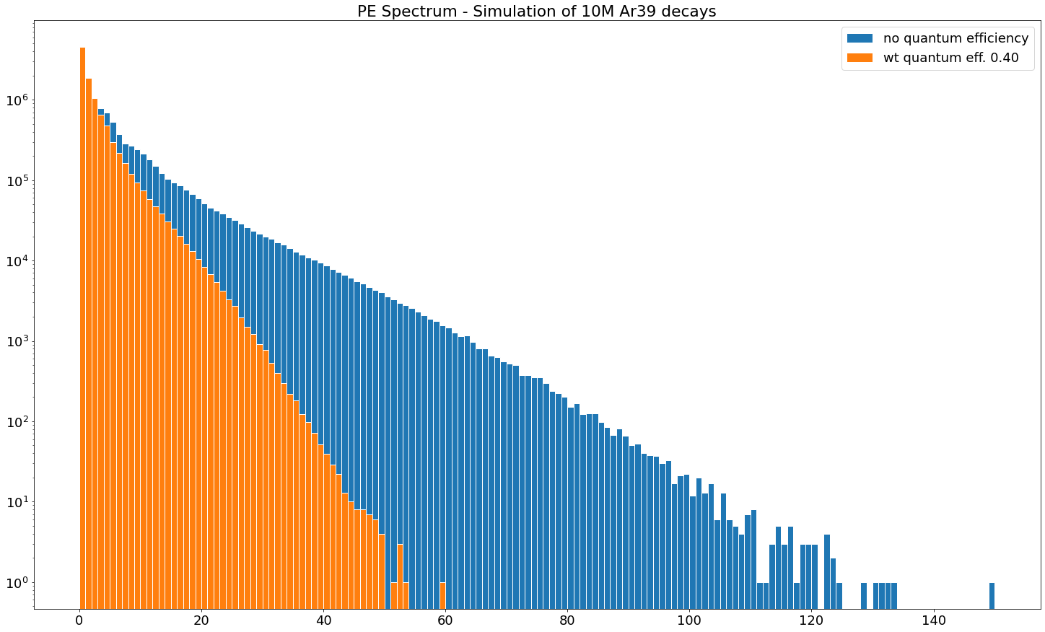
10M Ar39 Simulation
Regenerate PE Spectrum on new data (10M Ar39 in +-700, +-845)
Scale NPE with Quantum Efficiency = 0.40
M.S. Toy MC doesn’t include Quantum Efficiency
Q: he says “Unfortunately, I cannot give a multiplicity, because I do not have the necessary optical maps currently.” What is multiplicity?
In 10M simulations:
P(NPE>0|Q.E.=1) = 0.6985
P(NPE>0|Q.E.=0.4) = 0.6417

Slide 3
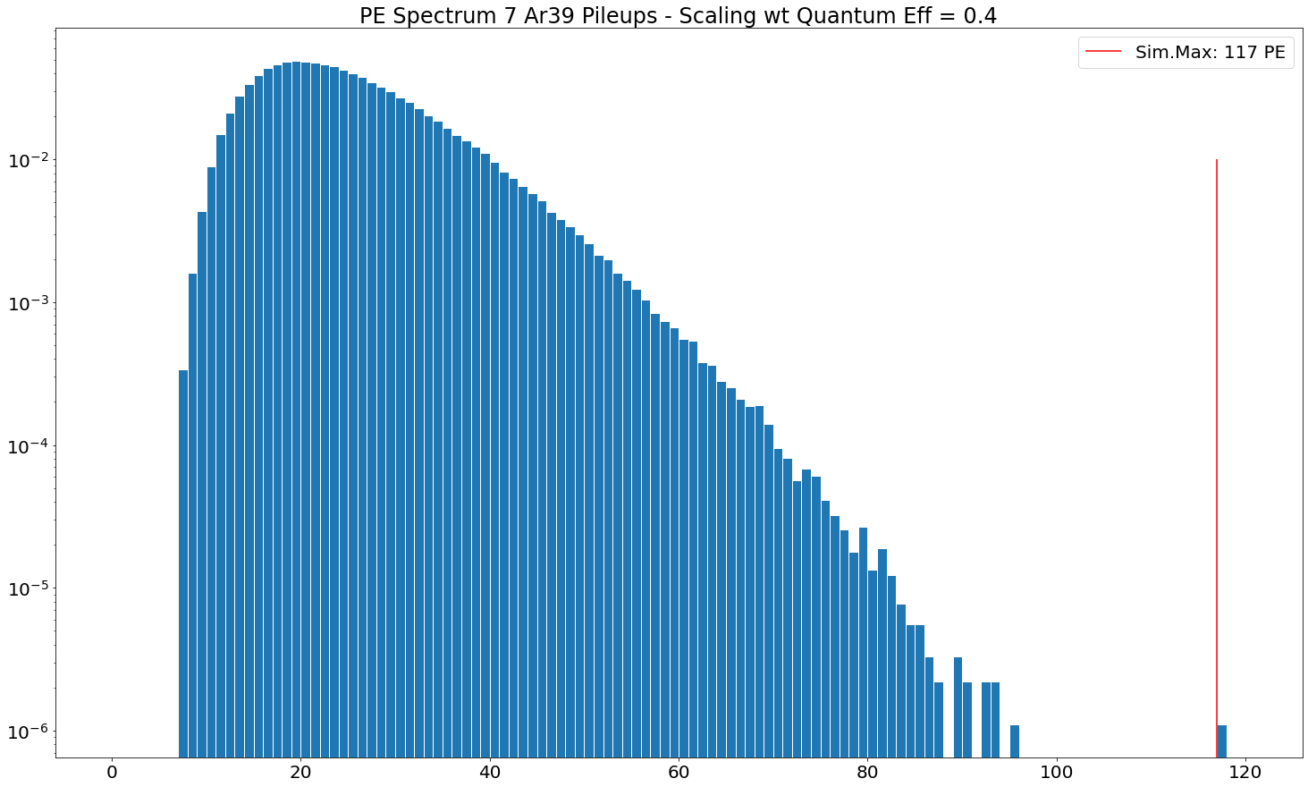
7 Ar39 Pileups
Consider only events wt NPE>0 to create Pileups
Previously, Max NPE for 7 Ar39s: 265 PE (wto Q.E.)

Slide 4
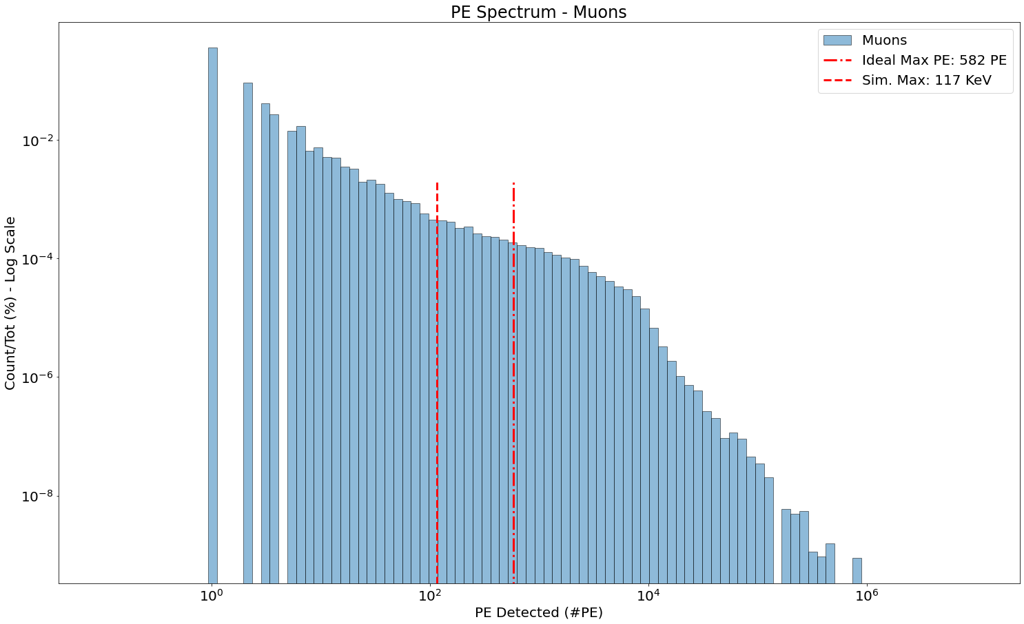
Muons wt Quantum Eff.
2M simulations, 85K in ROI, 14K NPE>0
Ideal Max: 7 * 565 * 40 * 0.0092 * 0.4 = 582 PE
Simulated Max: 117 PE (see prev. slide)
NPE<=117:
5176 events (34.89%)

Slide 5
Features
Decompose aquisition per quadrant
See notes

Slide 6
My questions
Simulation of re-emitted particles (offline)
If optical=false, propagation on fibers is simulated? Fibercore?
If optical=false, re-emission of gammas?
Real-setup aquisition are not a balanced dataset
Evaluation on a balanced dataset is certainly fair w.r.t. the predective power of classifier
But it is not reflective of its skills in real-setup
When Giuseppe said .95 efficiency, .90 purity refers to the application in the real-setup?

Slide 7
To improve purity, we should take care of 1 Ar39
P(NPE>0) = 0.6417 (from 10M simulations)
Rate: 3666*0.6417 = 2353
P(0 Ar39 | T=10us) = 0.9767
P(>=1 Ar39 | T=10us) = 0.0233
P(1 Ar39|T=10us, >=1 Ar39) = 0.9883
P(2 Ar39|T=10us, >=1 Ar39) = 0.0116
P(>=3 Ar39|T=10us, >=1 Ar39) = 0.0001

