Slide 1
ML4NP: Meeting 12.05.2020

Slide 2
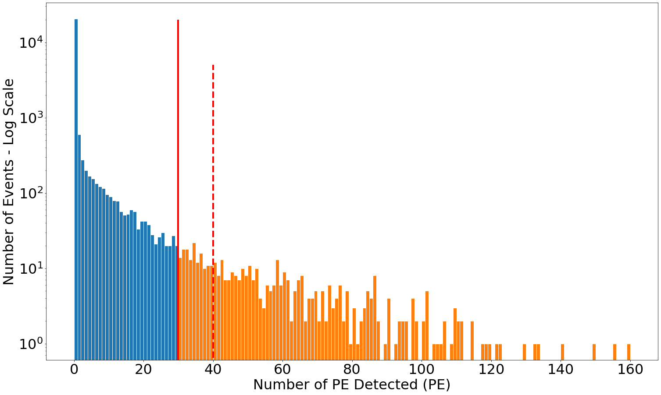
Neutron Simulation
First Run of Neutrons:
  Number of events: 2M
  Neutron Position Sampling: cylinder h=4m, r=2m
  Neutron Energy Sampling: spectrum 0-7 MeV
  Sensitive Volumes: LAr, FiberCore
Result:
  Output file size: 34 GB
  Number of events wt Ar41: 23 554
Problem:
  Number of PE detected is rather low (max=160 PE)
  A lot of events wt 0 PE => 20 346 (86 %)
  Why? Ar41 production point is far from fibers?
PE Spectrum from Post-processing
(LY=40 OP/KeV, Q.E.=0.20, Att.L.=50cm)
30 PE – Max Detection in 1 Ar39 Simulations
40 PE – Max Ideal Detection in 1 Ar39
(max Edep * best map det.eff. * LY * QE = 545 * .0092 * 40 * .20 = 40)
The orange area is only 1.95% (460 events)

Slide 3
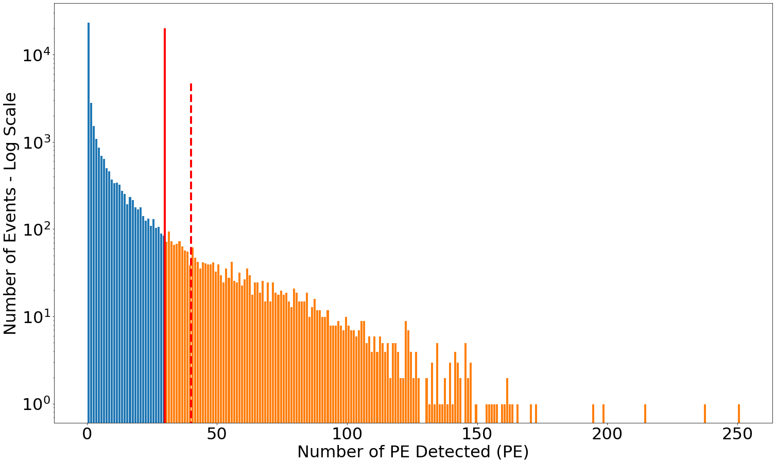
Neutron Simulation
Idea: Sampling in a restricted area to increase the number of Ar41 production close to the fibers
New Run of Neutrons:
  Number of events: 2M
  Neutron Position Sampling: cylinder h=1.69m, r=0.7m (ROI)
  Neutron Energy Sampling: spectrum 0-20 MeV
  Sensitive Volumes: Only LAr
Result:
  Output file size: 11 GB
  Number of events wt Ar41: 38 549
  PE Spectrum ranges in [0, 251] PE
  Undetected events: 23441 (61%)
Questions and my answers (?):
  Why higher Ar41 production? Maybe because we have less neutrons that go outside the LAr volume.
  Why higher detections? Ar41 produced closer to the fibers.
PE Spectrum from Post-processing
(LY=40 OP/KeV, Q.E.=0.20, Att.L.=50cm)
30 PE – Max Detection in 1 Ar39 Simulations
40 PE – Max Ideal Detection in 1 Ar39
(max Edep * best map det.eff. * LY * QE = 545 * .0092 * 40 * .20 = 40)
The orange area is 5.71% (2203 events)

Slide 4
TODO List
Can we classify Ar41 de-excitation vs 1 Ar39 decay?
Probably not, because both of them should be extremely localized.
Check the spread of Ar41 and compare it wt 1-2 Ar39s.
If 1. is true, we obtain only 2K Ar41 events wt >30 PE (even less >40). How can we produce more data?

