Slide 1
ML4NP: Meeting 14.07.2020

Slide 2
Summary
Spatial Map:
ML Part I: Rejection of single Ar39 decay
ML Part II: Classification Muons vs Ar39 Pileups

Slide 3
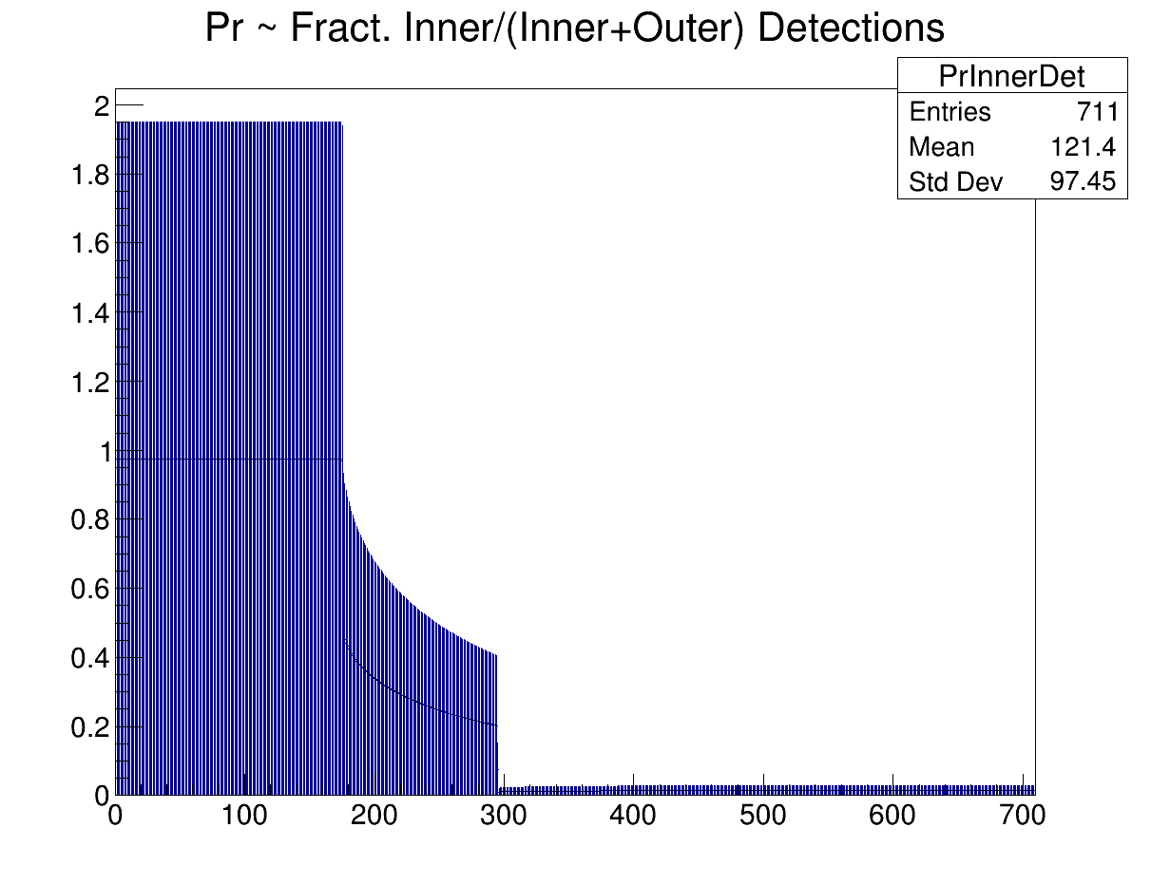
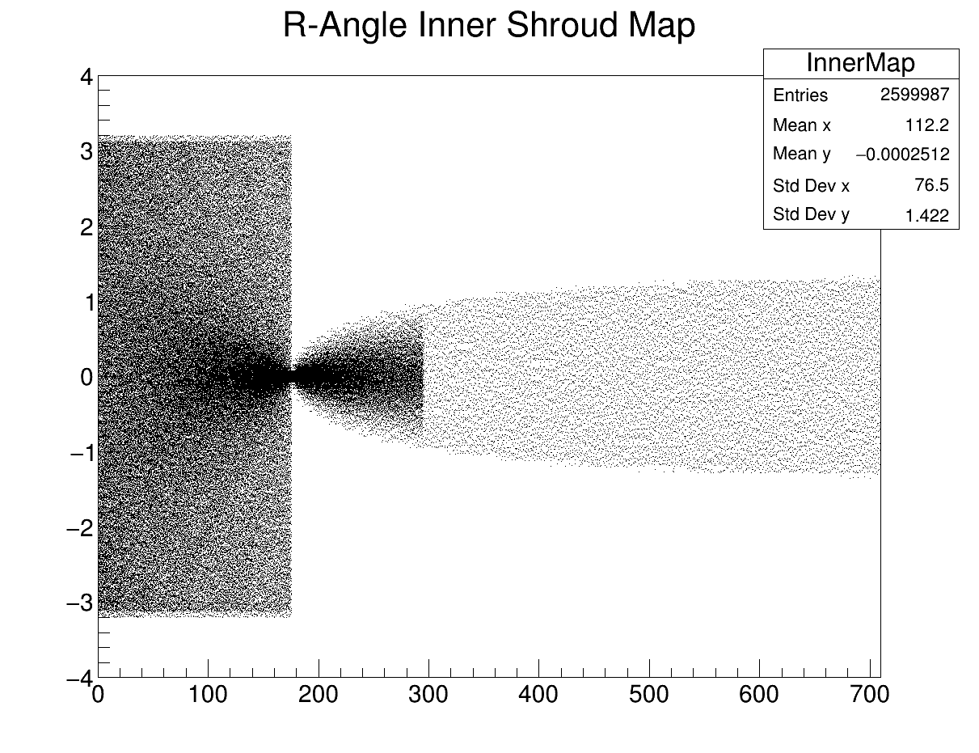
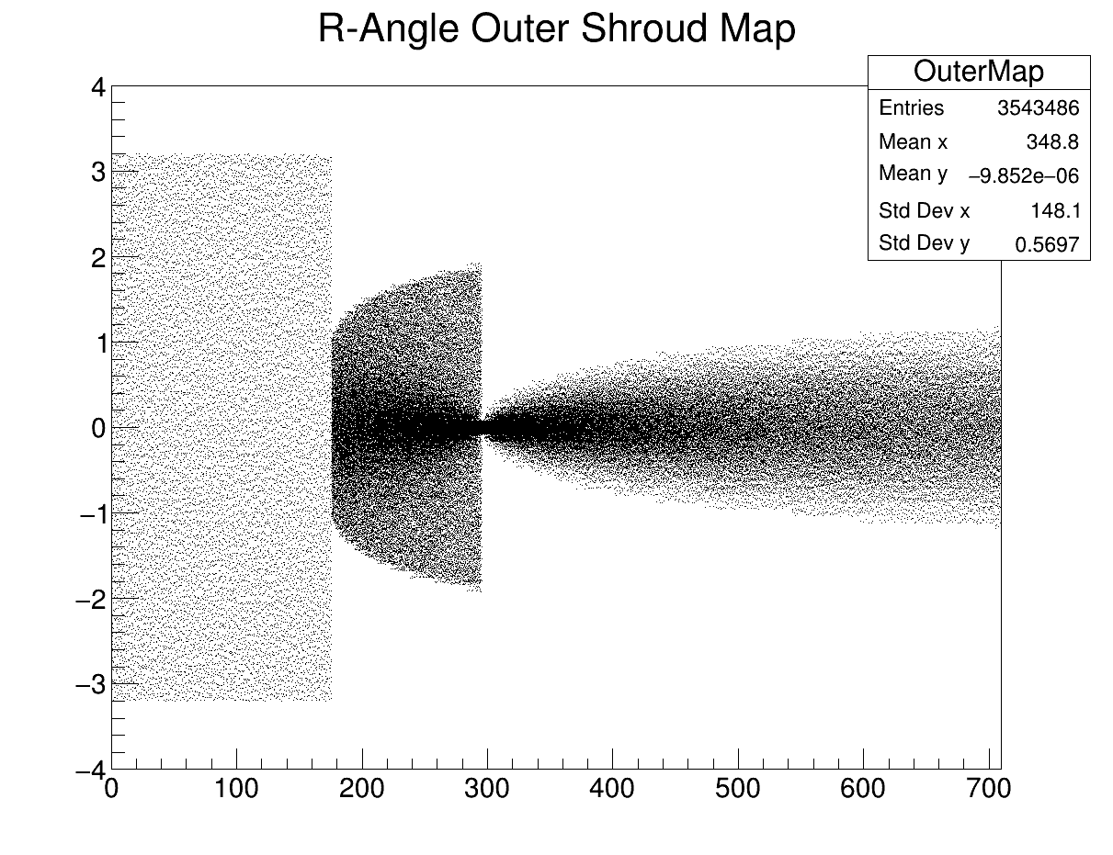
Spatial Map (last week)
PrInnerDet
Production of 3 maps:
  PrInnerDet: given NPE, it computes NPE_in that hit the InnerShroud and NPE_out that hit the OuterShroud
  Spread NPE_in in InnerShroud wt InnerMap
  Spread NPE_out in OuterShroud wt OuterMap
InnerMap
Outer Map

Slide 4
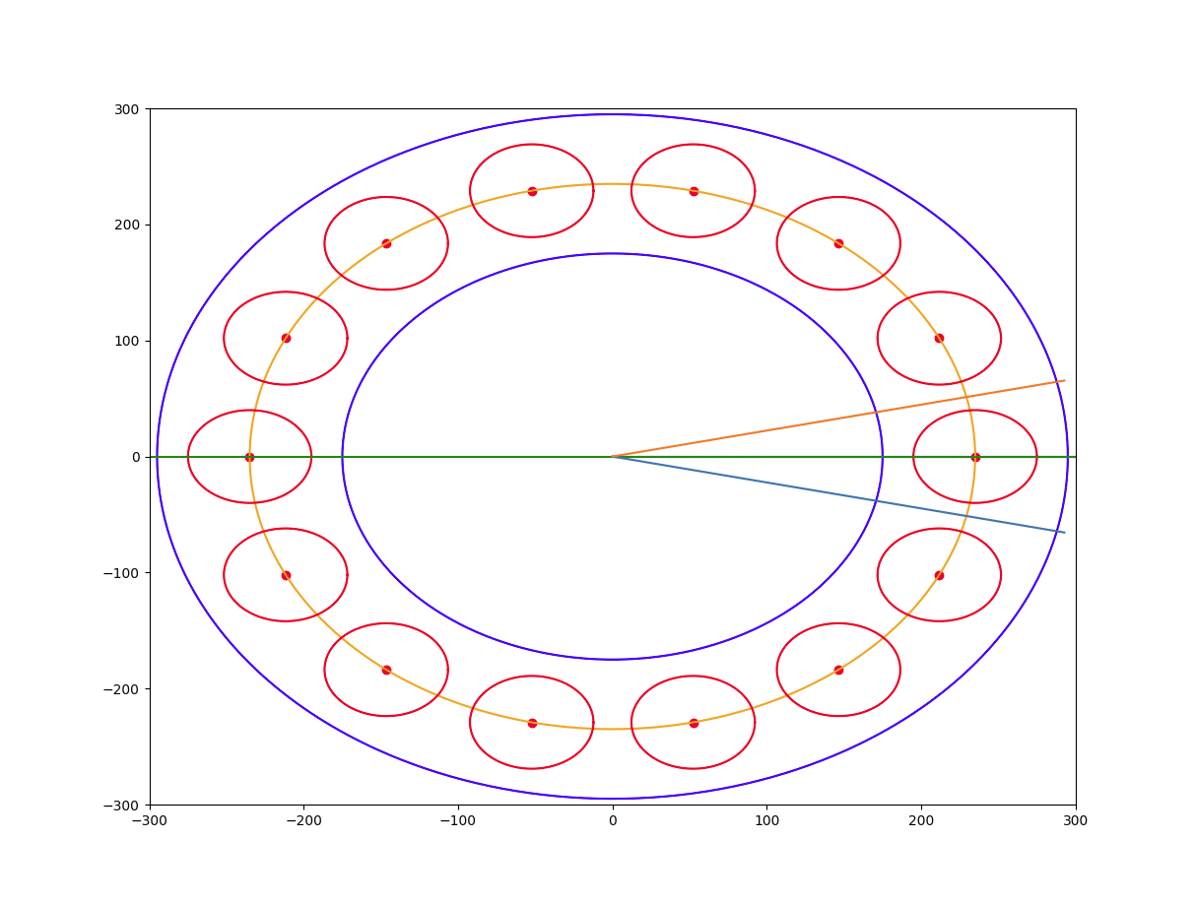
Spatial Map (updates)
Inclusion of Ge crystals
(14 strings in geometry = 14 circles in 2D)
We always sampled in point along a line, extend with sampling in a range +-0.22 rad.
The chance to hit Ge crystals depends on:
  Starting z
  OP emission angle
By sampling z, OP phi and OP theta, we compute where the OP trajectory cross the Ge surface (cylinder 23.5+40mm).
  If the crossing point has z in +-445mm, enable Ge (green arrows).
  Otherwise, disable Ge (red arrows).
The OP trajectories ends when they go outside the roi. We cut a 2D trajectory based on where the 3D trajectory cross +-845mm.

Slide 5
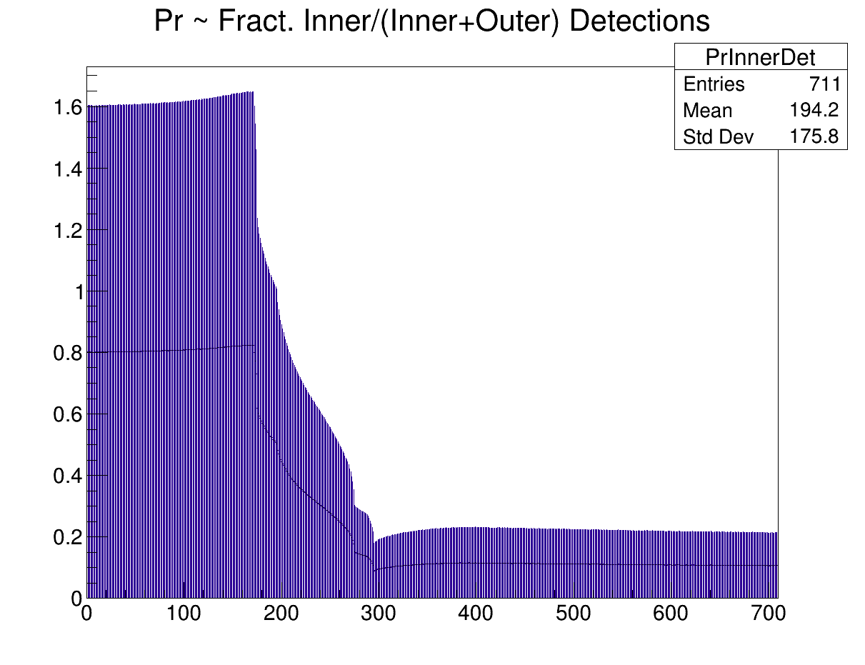
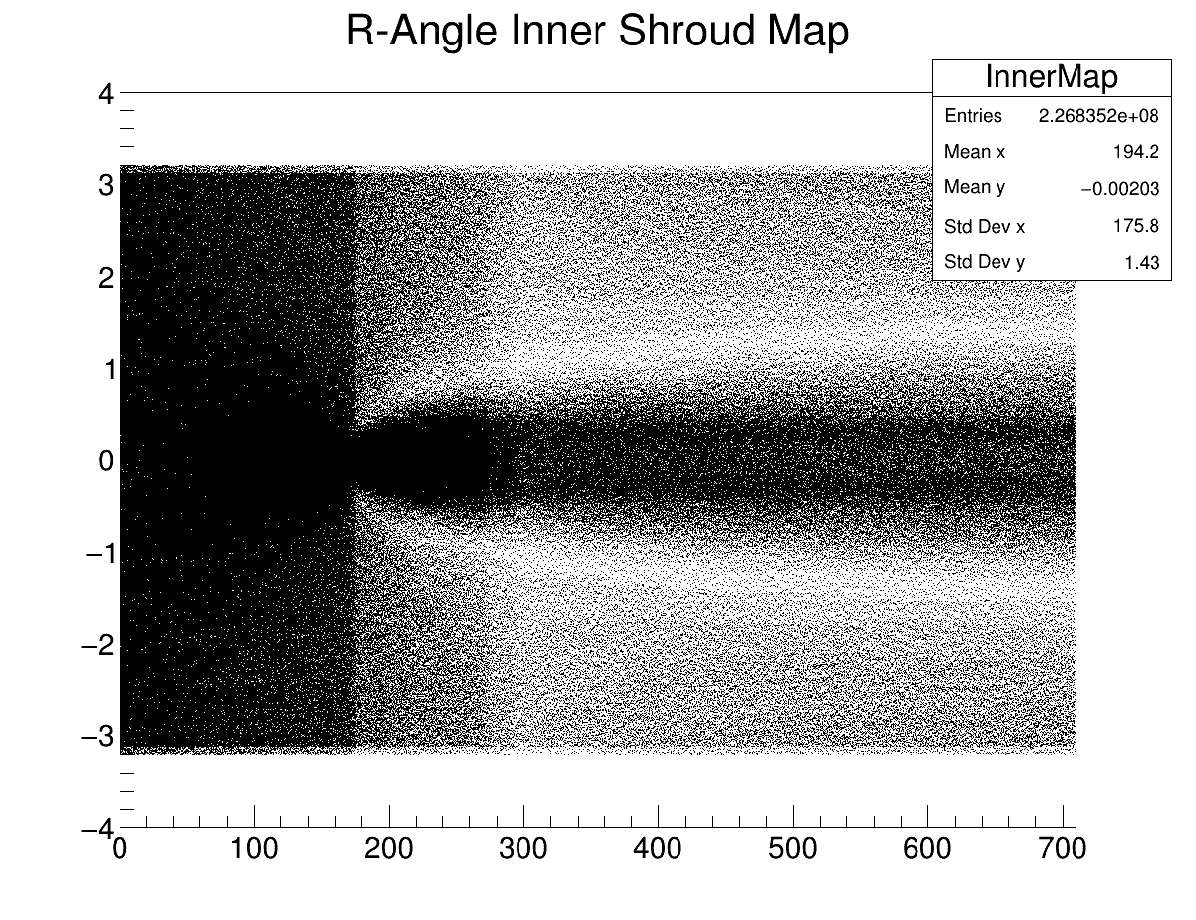
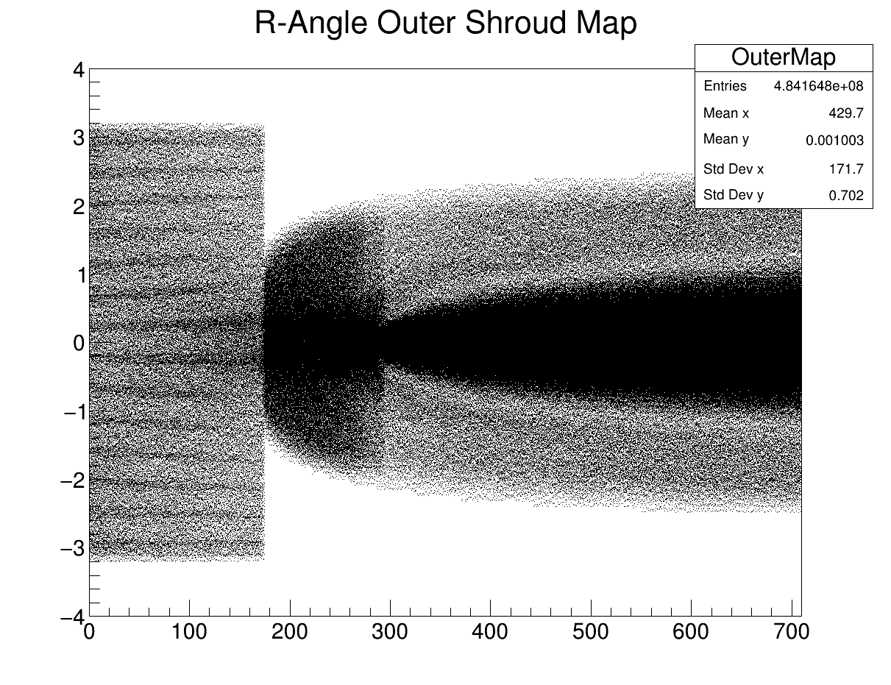
Spatial Map (updates)
The new maps include:
  sampling of shifting angle and z,
  sampling of OP orientations,
  enabling/disabling Ge crystals,
  early cutting of OP trajectories.

Slide 6
ML Part 1: Rejection of Ar39
Context:
  Very low-energy events: detections up to 60 PE
  Level 0 Tagging: specialized in 1 Ar39 to suppress its high-activity
Requirements:
  Reject single Ar39 decays as much as possible (high TNR),
  Save very low-energy muons (PE<=60), if possible.

Slide 7
ML Part 1: Rejection of Ar39
Available Data: 5 834 261 Ar39, 26 881 Mu (old data + new 1M muons by CJ)
Preliminary cut at 5 PE to discard most of the single Ar39 decays (avg 3 PE):
  5 110 Muons, 1 474 688 Ar39
Training Data (balanced): 4 500 Muons, 4672 Ar39s (undersampling)
Test Data (unbalanced): 610 Muons, 1M Ar39s
Trained model:
  Evaluation on Test Data:
    Accuracy: 0.880, Purity: 0.004, Efficiency: 0.852, F1: 0.009
  Conf. Matrix:
  TN: 879742, FP: 120258,
  FN: 90, TP: 520
  TPR: 85.25%, FPR: 12.03% (without considering preliminary cut)

Slide 8
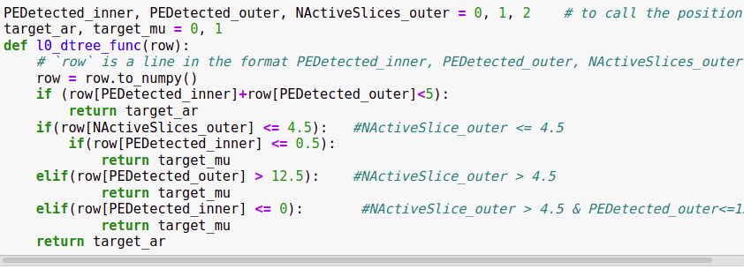
From model to code...

Slide 9
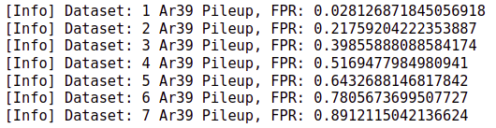
ML Part 1: Rejection of Ar39
Passing the various Ar39 classes through this selection strategy.

Slide 10
ML Part 2: Mu vs Ar39 Pileups
Context:
  Low-energy events: detections up to 115 PE
  Level 1 Tagging: wide classification 1, 2, …, 7 Ar39 decays vs Muons
Requirements:
  Prompt tagging of muons, suppression of Ar39 (single or pileup)
  Good metrics: Efficiency/Purity
First attempt:
  CNN model: slower inference but no cost for feature creation
  (at least on my pc, e.g. 701000 instances in 16 seconds)
  The previous Dtree has faster inference
  (e.g. 901235 instances in 8 seconds) but requires feature creation

