Slide 1
ML4NP: Meeting 28.05.2020

Slide 2
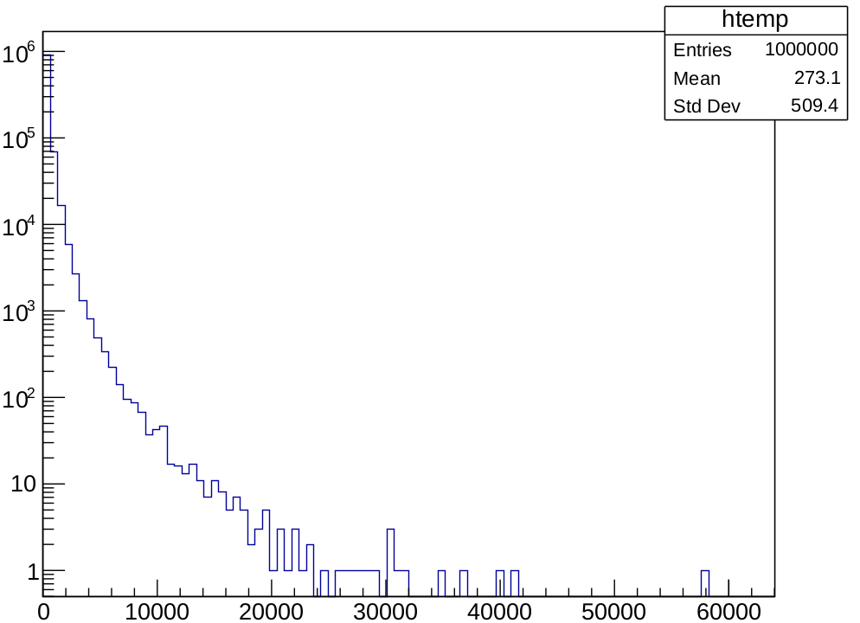
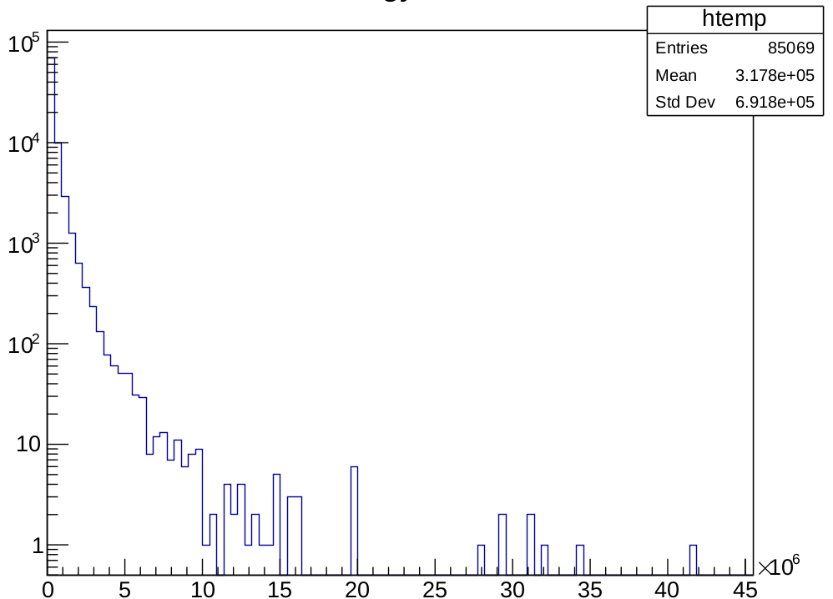
Starting Muons
Aim: Extract initial condition of muons in ROI to restrict the MUSUN input for CJ simulations
Problem: muonenergy branch is not consistent with MUSUN file
Either muonenergy doesn’t contain what we expect or CJ hasn’t used MUSUN input
MUSUN - energy
2e6 CJ - muonenergy/1000
Max: 58238 MeV
Max: 41433393 MeV

Slide 3
Few words on time...
Considering ML for “general” muon classification
Most of the muons deposit energy in very short time: few ns
Why not perform a first cut on short time-window? (e.g. T=100 or 200ns)
  Benefits: less data → faster learning
Consider longer sequences will lead to:
  Sparsity of depositions over time
  Slow writing of data (most of them are 0s),
  Input size of the model would be unnecessarly large
    Example: consider a muon (event=5) with large deposit in 5-6 ns
    72 SiPMs, T=10us, Dt=4ns (FADC) → 180000 values
    Only 95 values are non-zero!
    ...for Ar39 even worst (less energy, multiple localized deposits)

Slide 4
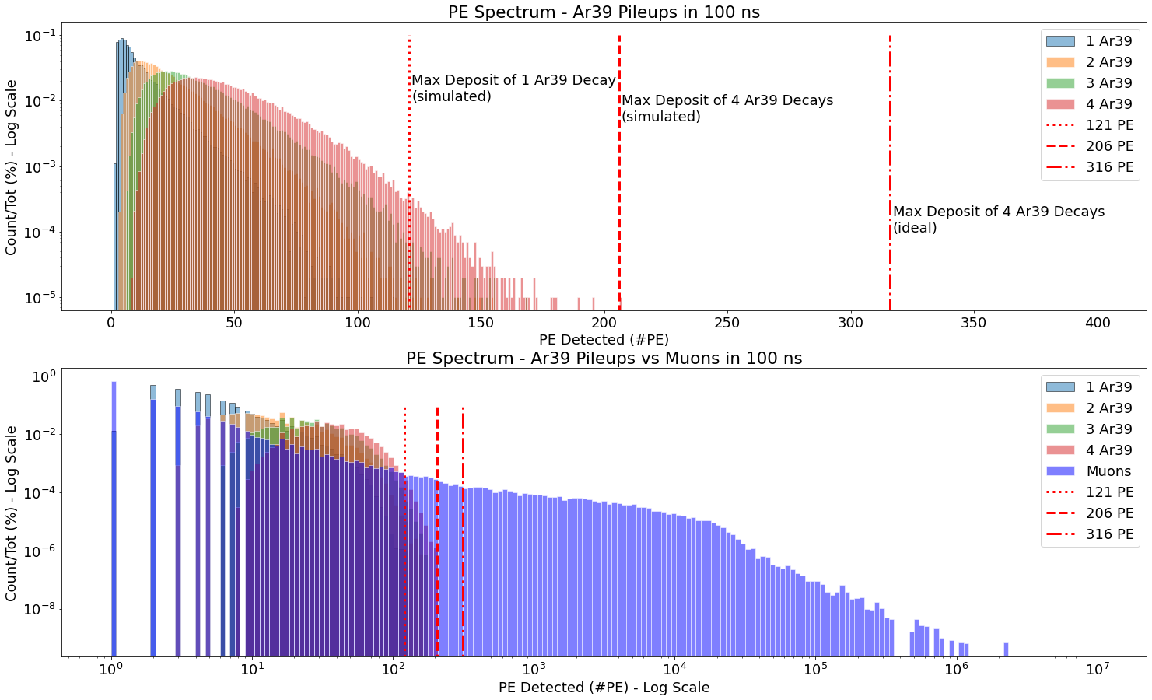
PE Spectrum
Like last week plot, but: if T=100ns, makes sense to consider 1...4 Ar39 decays (5 Ar39s have p=5.52e-20). Then, I redefined the thresholds.
The events in the plot are: Ar39s: Pileups from 1, …, 4 decays (population 100K for each class), and Muons: 16087 events
~99%

Slide 5
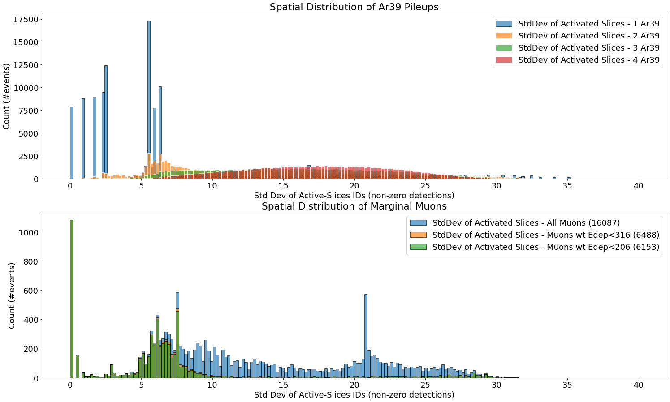
Spatial Distribution
Ar39 Pileups: from 1...4 decays, considering T=500ns
Muon wt 1 deposit in ROI.
Probably indistiguishable from Ar39.
Here, anticoincidence on Ar41* makes sense!
Marginal Muons
are localized!
High-energy Muons
deposit more energy
in a larger area!

Slide 6
G4Gun Neutrons
Sample 5000 neutrons: fraction of events wt Ar41 from nCapture is ~0.30 → Nice!
  Note: I simply extracted fields of CJ format for all the step entries
  (MG output is more complex, prestep/poststep info → double counting is a problem?)
Questions & TODO:
  Geometry “LGND_200_14Strings” includes fibers? SiPM are sensitive volumes?
  Understanding what exactly is simulated?
  e.g. /generator/volumearrayadd “DetectorArray_001_StringAssembly_001_DetUnit_007_ActiveDet_001”
  Can we isolate OP on fibers or directly detections?
    Physical volume name?
    Process?
    'primaryParticle', 'neutronInelastic', 'compt', 'phot', 'msc', 'eIoni', 'hadElastic', 'ionIoni', 'annihil', 'nCapture', 'RadioactiveDecay', 'eBrem', 'conv', 'Transportation', 'hIoni'

