Slide 1


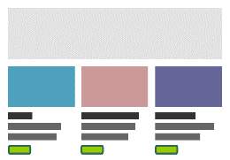









Serer-side rendering

Slide 2


Serer-side rendering
SLAVE
MASTER
SLAVE

Slide 3



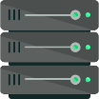

Serer-side rendering
BFF smartphone
BFF tablet
BFF desktop
Microservice X
Microservice Y
Microservice Z
MS/MM cluster
MS/MM cluster
MS/MM cluster

Slide 4
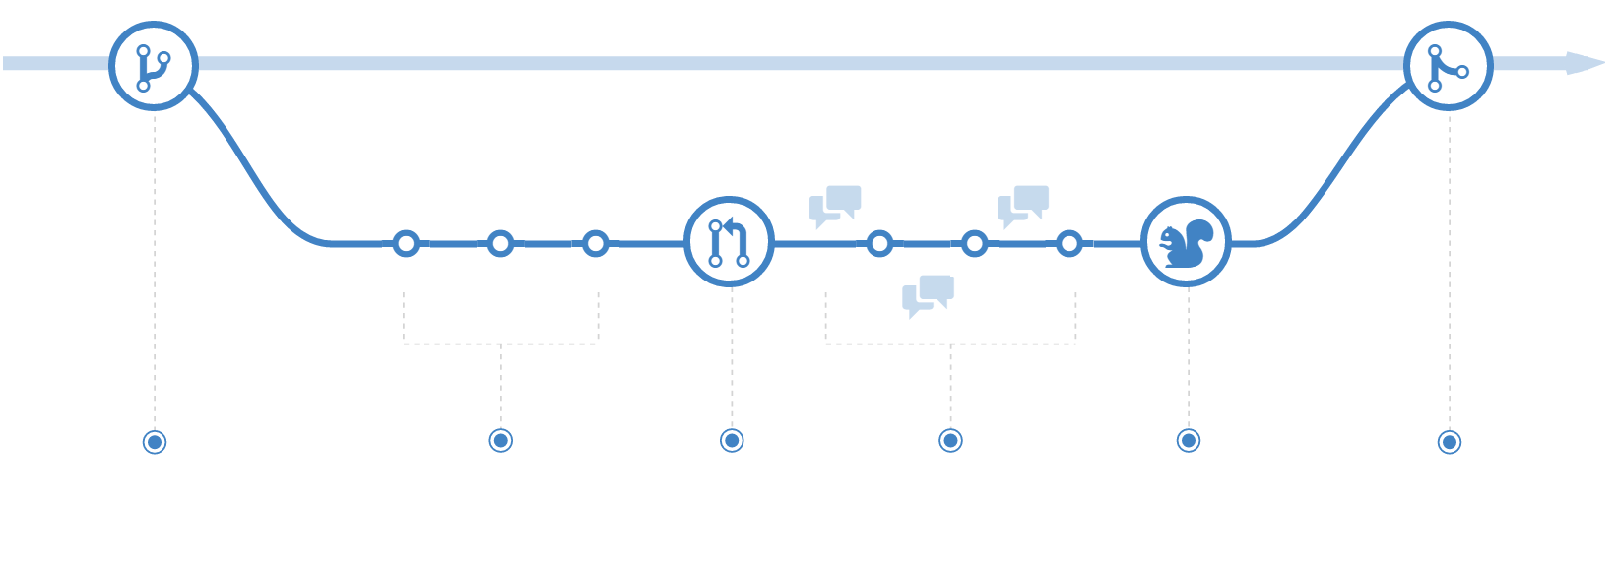
CREATE A BRANCH
ADD COMMITS TO THE BRANCH
OPEN A PULL REQUEST
DISCUSS AND REVIEW YOUR CODE
DEPLOY TO ALL ENVS UP TO PROD
MERGE TO THE MASTER BRANCH

Slide 5




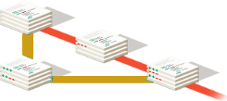

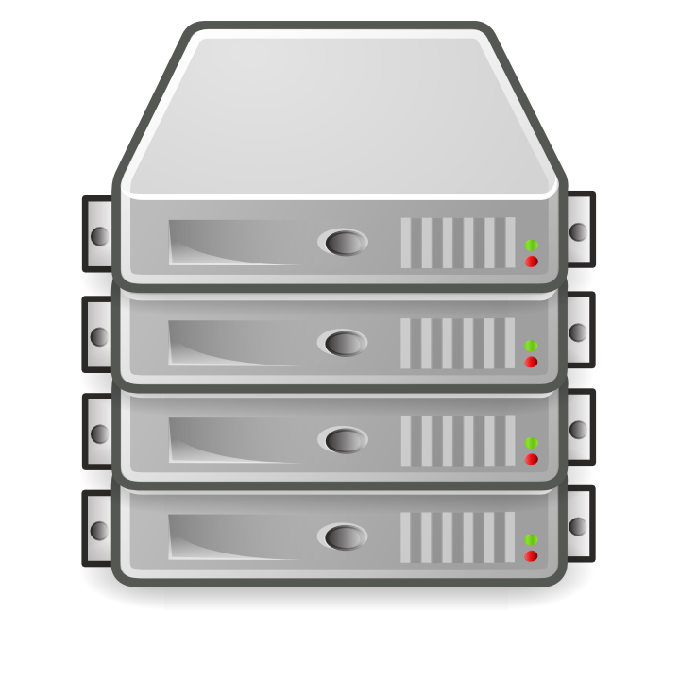



LOCAL
LOCAL
VCS REPOSITORY
TEST
INTEG
PERF
CI SERVER
MANDATORY DEPLOY OPTIONAL GATE
MANDATORY DEPLOY OPTIONAL GATE
BINARY REPOSITORY MANAGER
ON-DEMAND
SUPPORT
STAGING
CANARY
PROD
ON-DEMAND
MANDATORY DEPLOY OPTIONAL GATE
RELEASE
MANAGEMENT
TOOL
DEV
SHOWCASE
ALPHA ‒ PRIVATE AND SAFE
BETA ‒ SHARED AND SAFE
RTM ‒ SHARED AND DANGEROUS

Slide 6
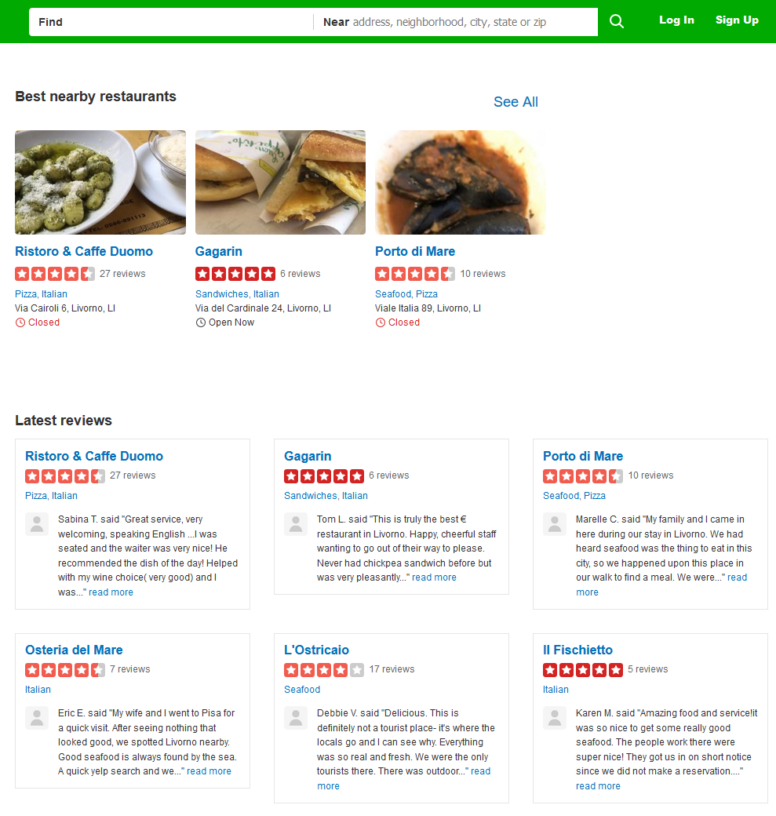
RECOMMENDATIONS
REVIEWS

Slide 7
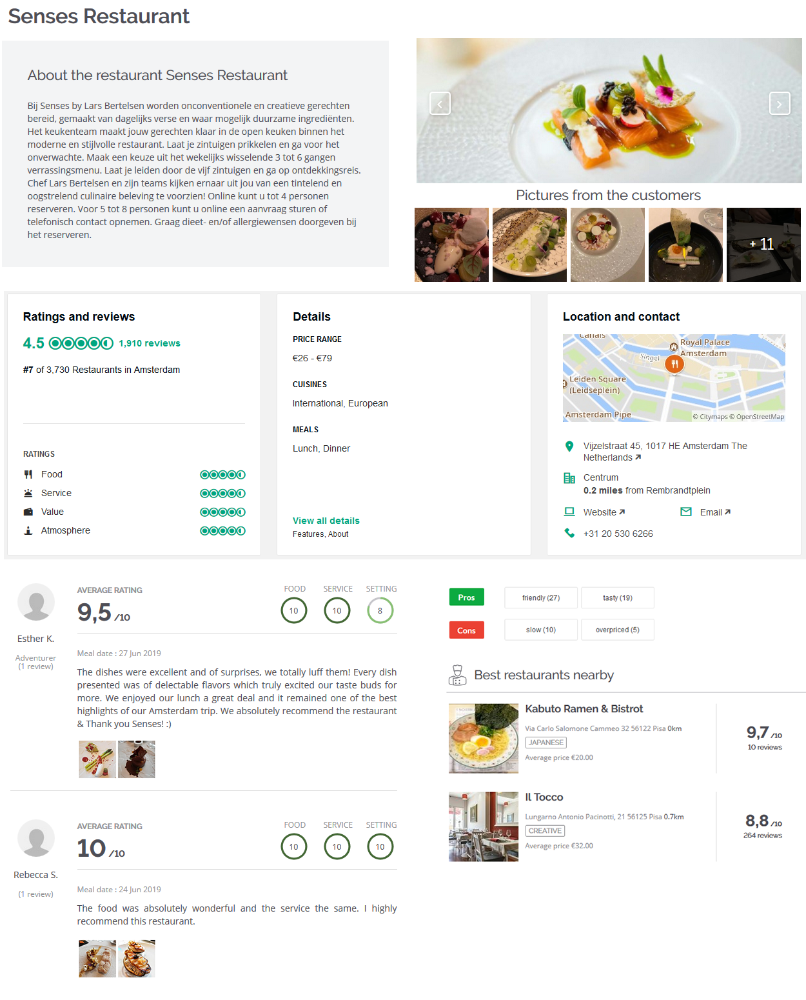
VENUES
RATINGS
RATINGS
RECOMMENDATIONS
REVIEWS

Slide 8
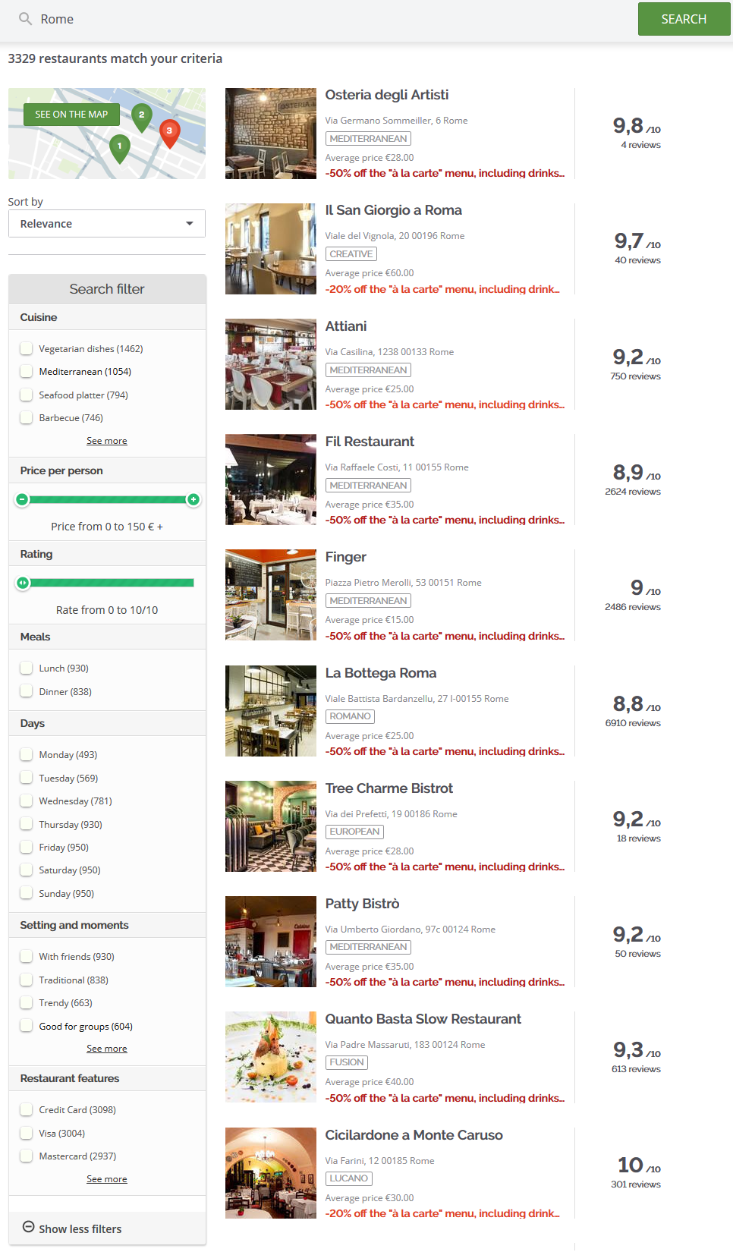
SEARCH

Slide 9
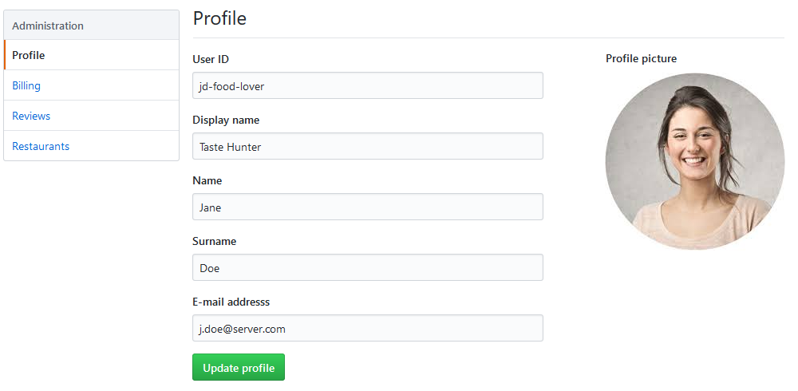
ACCOUNTS

Slide 10
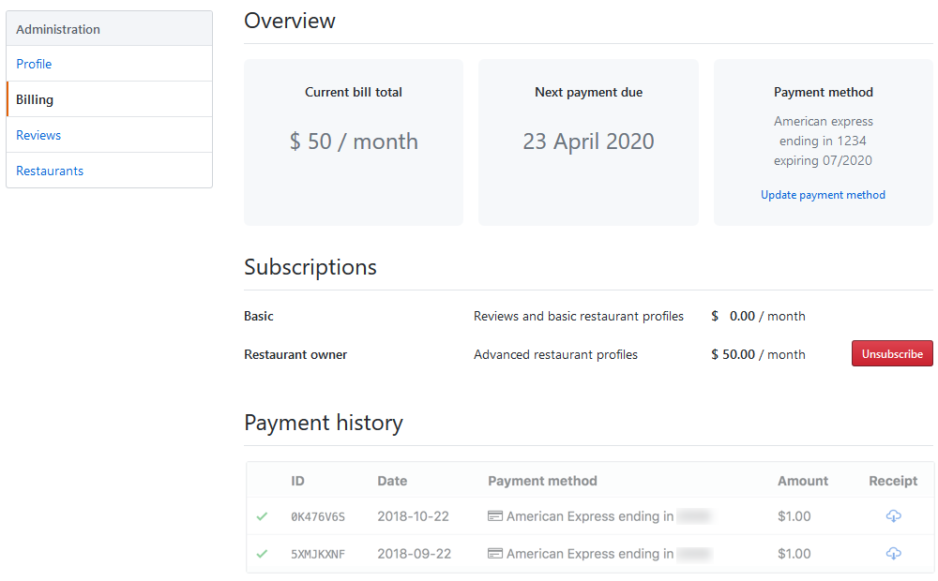
PAYMENTS
SUBSCRIPTIONS
PAYMENTS

Slide 11
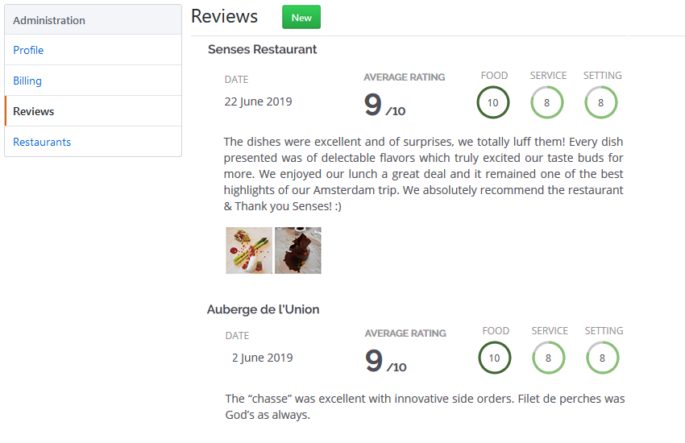
REVIEWS

Slide 12
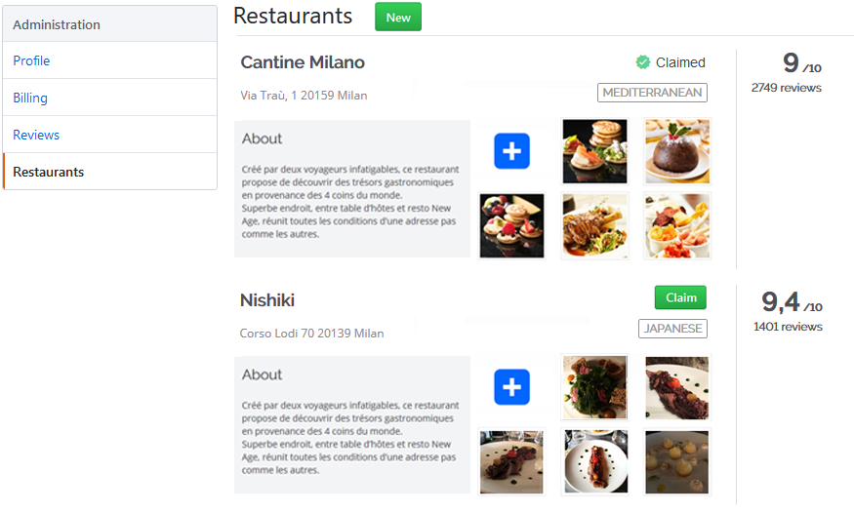
VENUES
RATINGS

Slide 13
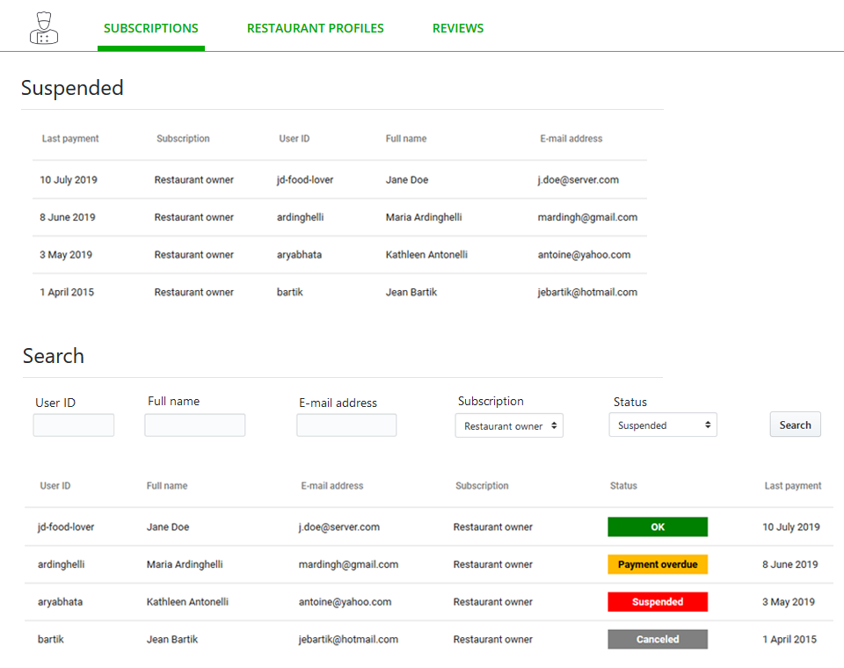
SUBSCRIPTIONS
SUBSCRIPTIONS

Slide 14
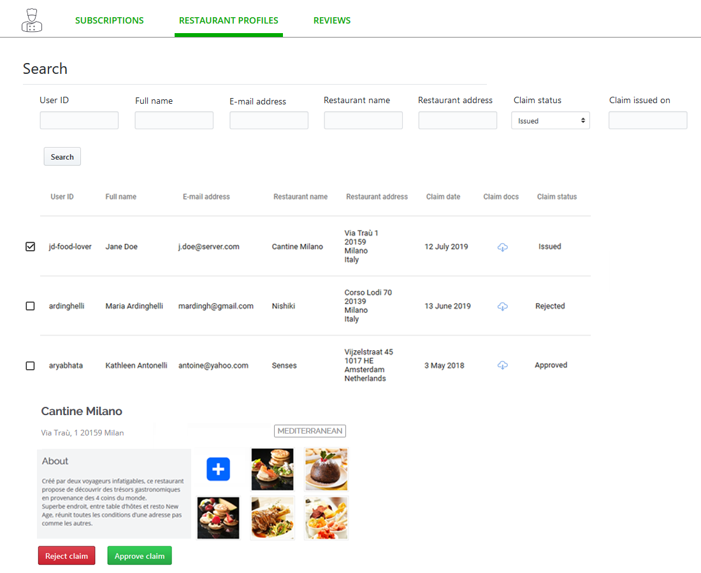
VENUES

Slide 15
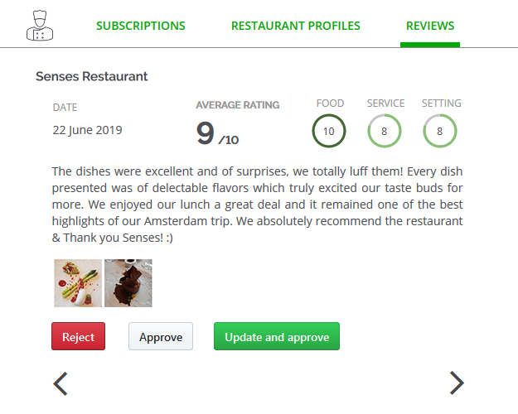
REVIEWS

