Slide 1

Inspecting code metrics. Analyzing Google Guava
Boc Patricia-Simina
Bolovan Luigi-Ionuț

Slide 2

Case study
Google Guava is an open-source set of common libraries for Java, mainly developed by Google engineers.

Slide 3
Guava
3000+ files
250+ contributors
5400+ commits
10 years

Slide 4
Summary
Data Cleanup and Organization
System Overview
Exploring the System
Exploring the Team
Exploring the Tasks
Exploring Relations
Exploring the Quality Model
Code metrics

Slide 5

1. Data Cleanup and Organization

Slide 6
FILES MODIFIED DURING THE PANDEMIC
639
file: lastChanged before 2020

Slide 7
FILES MODIFIED BEFORE THE PANDEMIC
344
file: lastChanged after 2020 OR lastChanged before 2019

Slide 8
Merging developer aliases
Before: 427
After: 405

Slide 9
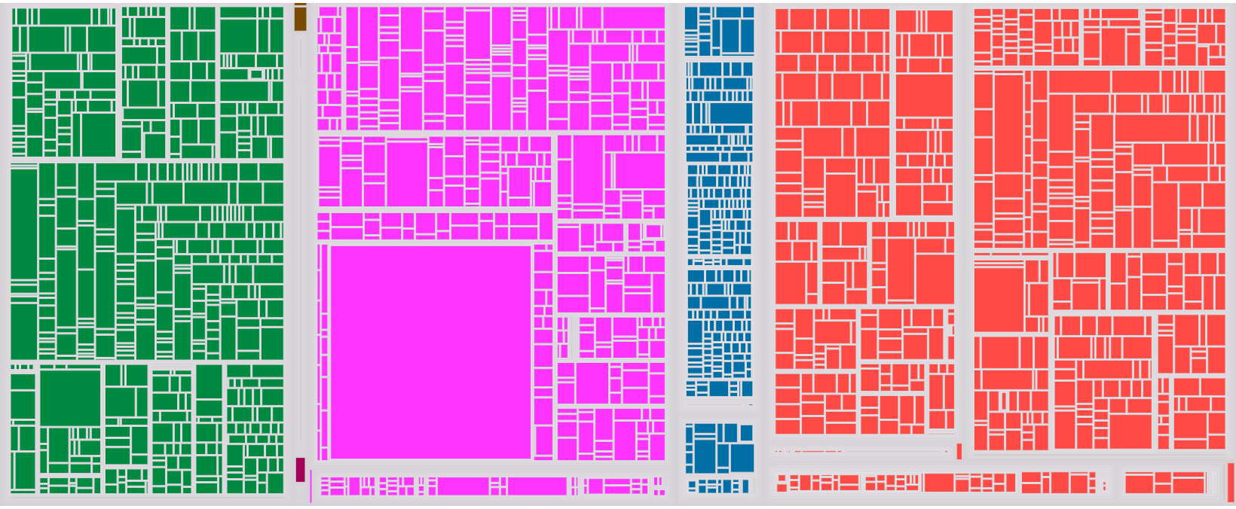
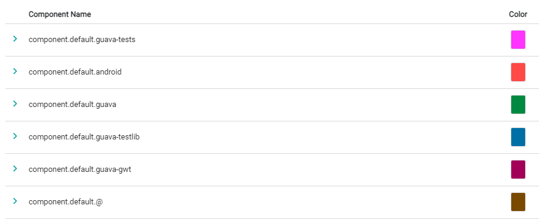
Defining components

Slide 10

2. System overview

Slide 11
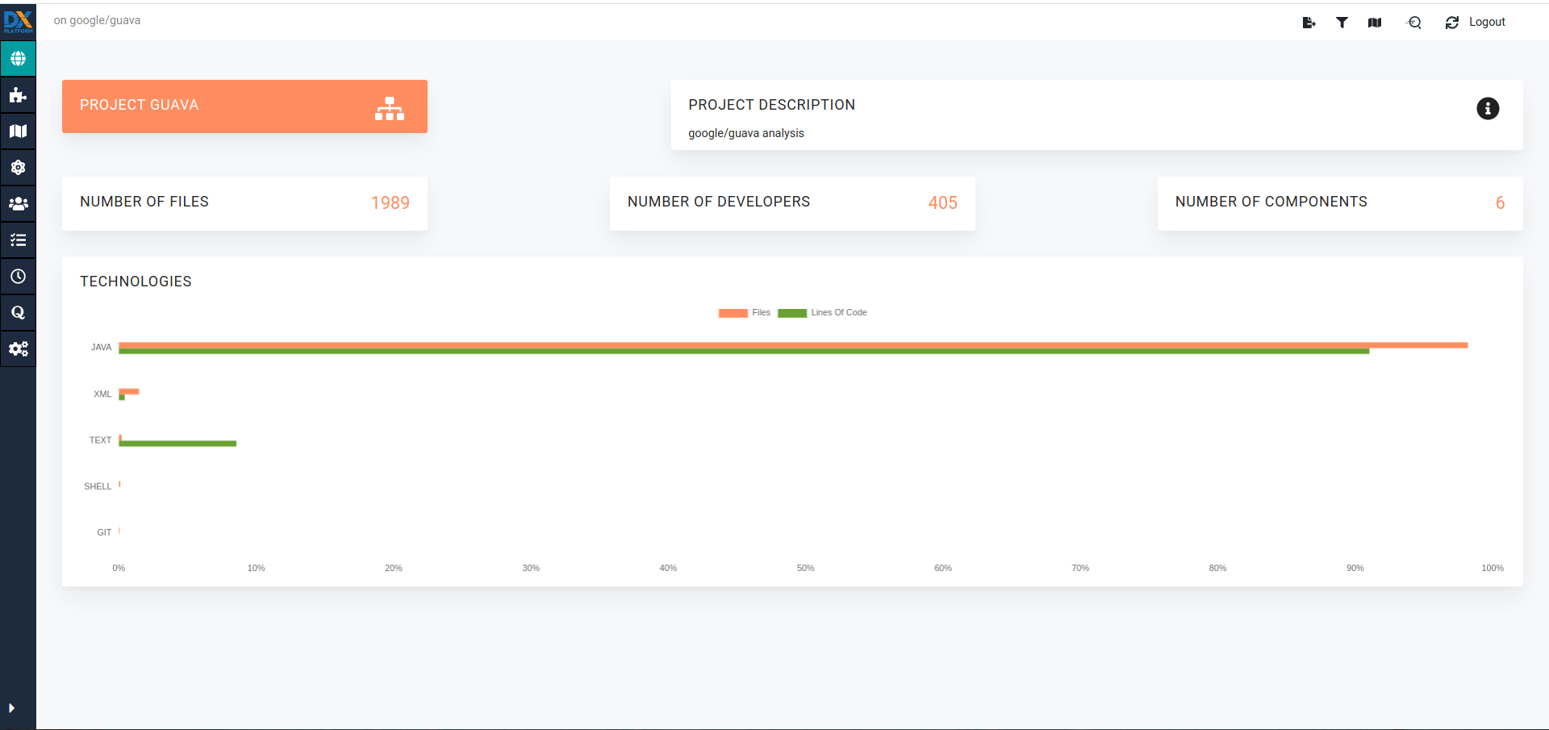
System overview
The most used programming language is Java since it provides numerous Java libraries.
There are also a few huge text files used for testing purposes.

Slide 12

3. Exploring The System

Slide 13
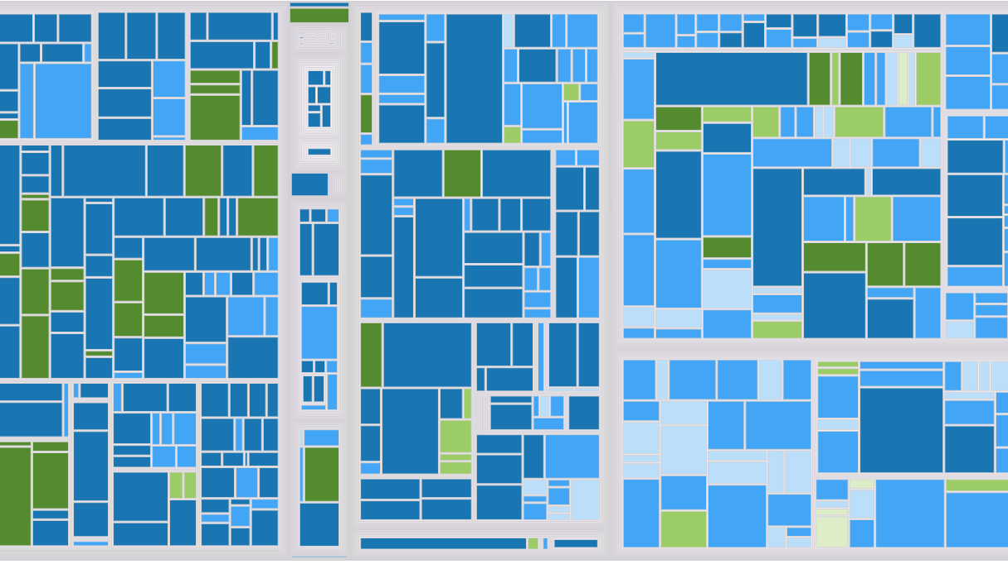
FILES MODIFIED DURING THE PANDEMIC
The developers focused on modifying the core functionalities of the project.
The most worked on components were the guava and the Android ones.

Slide 14
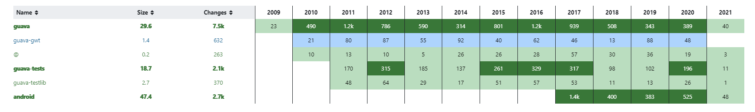
Components evolution
In 2020 developers worked more on the components associated with tests.
It is also visible that they put a lot of effort in Android development.

Slide 15

4. Exploring The Team

Slide 16
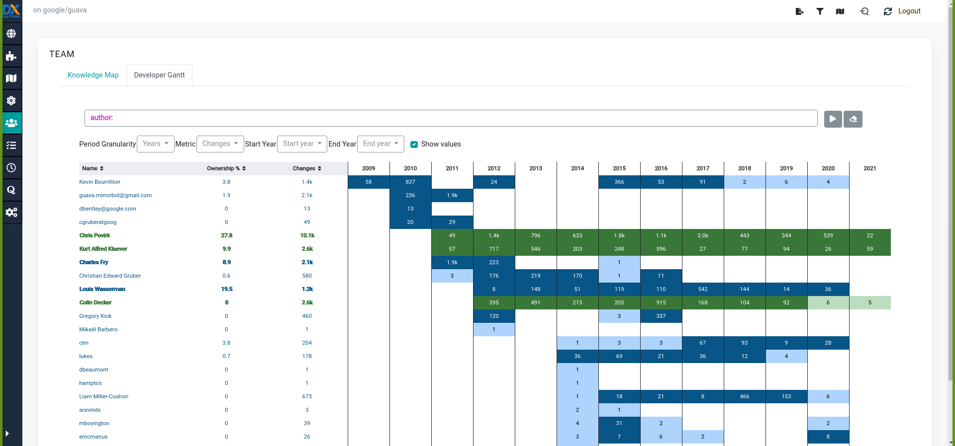
Evolution of team
The early developers are mostly retired. However, in 2011-2012 new members came into the team and they are now the most active ones.

Slide 17
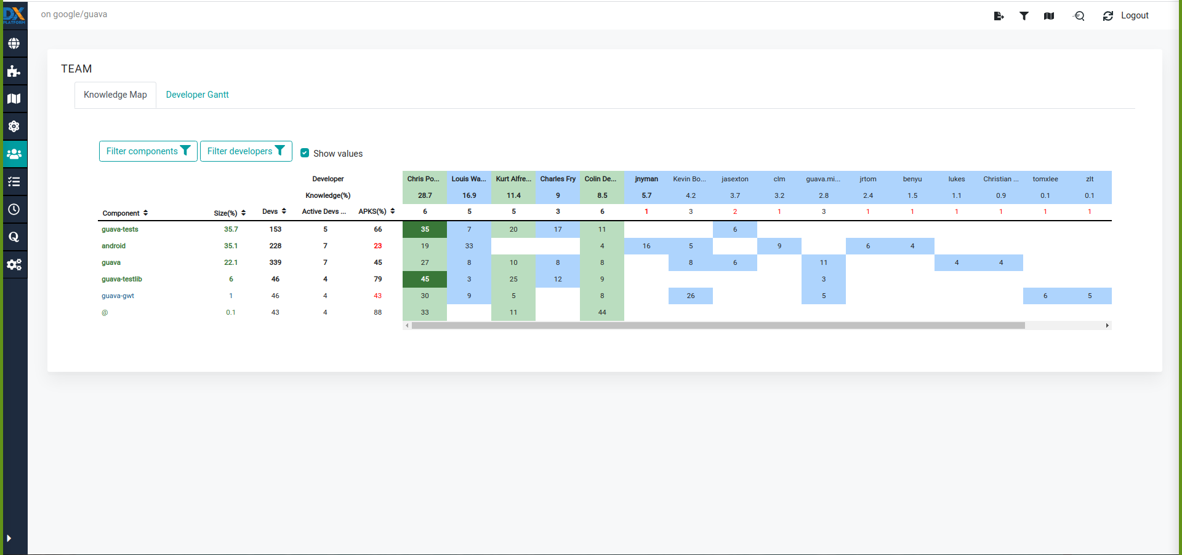
Knowledge of team
As we can see, Chris Povirk, one of the few active ones, has the most knowledge of the system. However, the other active ones have pretty good insight of the system too.

Slide 18
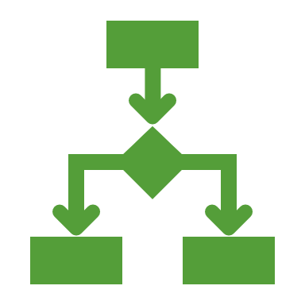
5. Exploring The Tasks

Slide 19
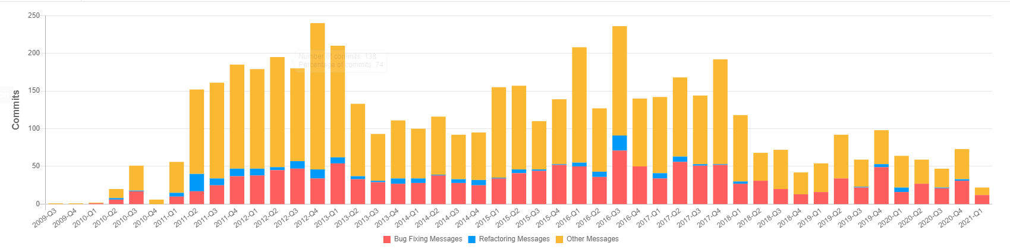
Tasks overview
The system reached its maturity level.
The number of new features has decreased drastically and developers are now focusing on bug fixing.
As it can be seen from the graph, the overall number of tasks has decreased.

Slide 20

6. Exploring Relations

Slide 21
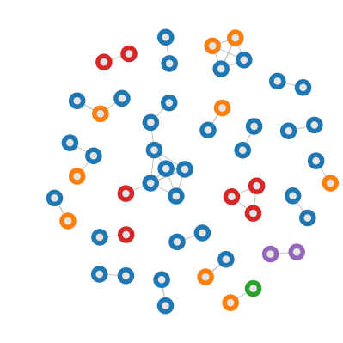
Relations between files
As it can be seen from the graph, the files are coupled mostly in groups of 2. However, there are some exceptions. There is one big group of files from the collect subcomponent of the guava component. The weak connections between files can be a good thing because the files are not so dependent upon each other.

Slide 22

7. Exploring The Quality Model

Slide 23
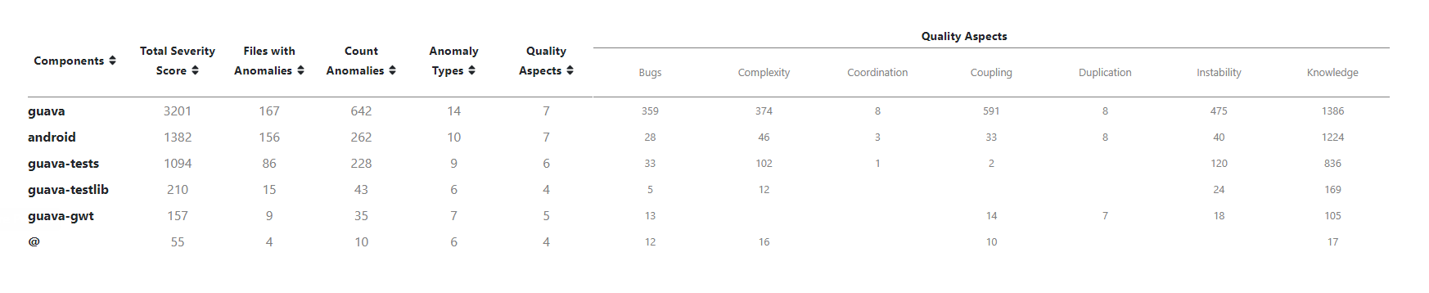
Quality Model Table
The biggest component is also the one that has the most problems.
For example, the count anomalies for ‘guava’ alone is bigger than the sum of the count anomalies for the other components.
The duplication is not such a big problem since it is present in only 3 components and the duplication factor for them is low.

Slide 24
Comparison between components
The ‘guava-tests’ component has almost half the files with anomalies the ‘android’ component has. However, the instability value for ‘guava-tests’ is three times higher.

Slide 25

8. Code metrics

Slide 26
SCC wrapper for DX-platform
SCC-wrapper is a plugin that uses the SCC static analysis tool and converts its output into a DX-platform accepted format.
SCC provides several metrics about files within a given project. We focused just on 3 types of results:
No. of blank lines
No. of code lines
No. of comment lines

Slide 27
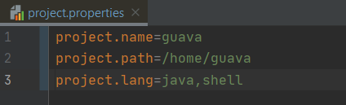
SCC wrapper - Configuration
The project generates a DX-platform accepted json file based on the information provided in the project.properties configuration file.

Slide 28
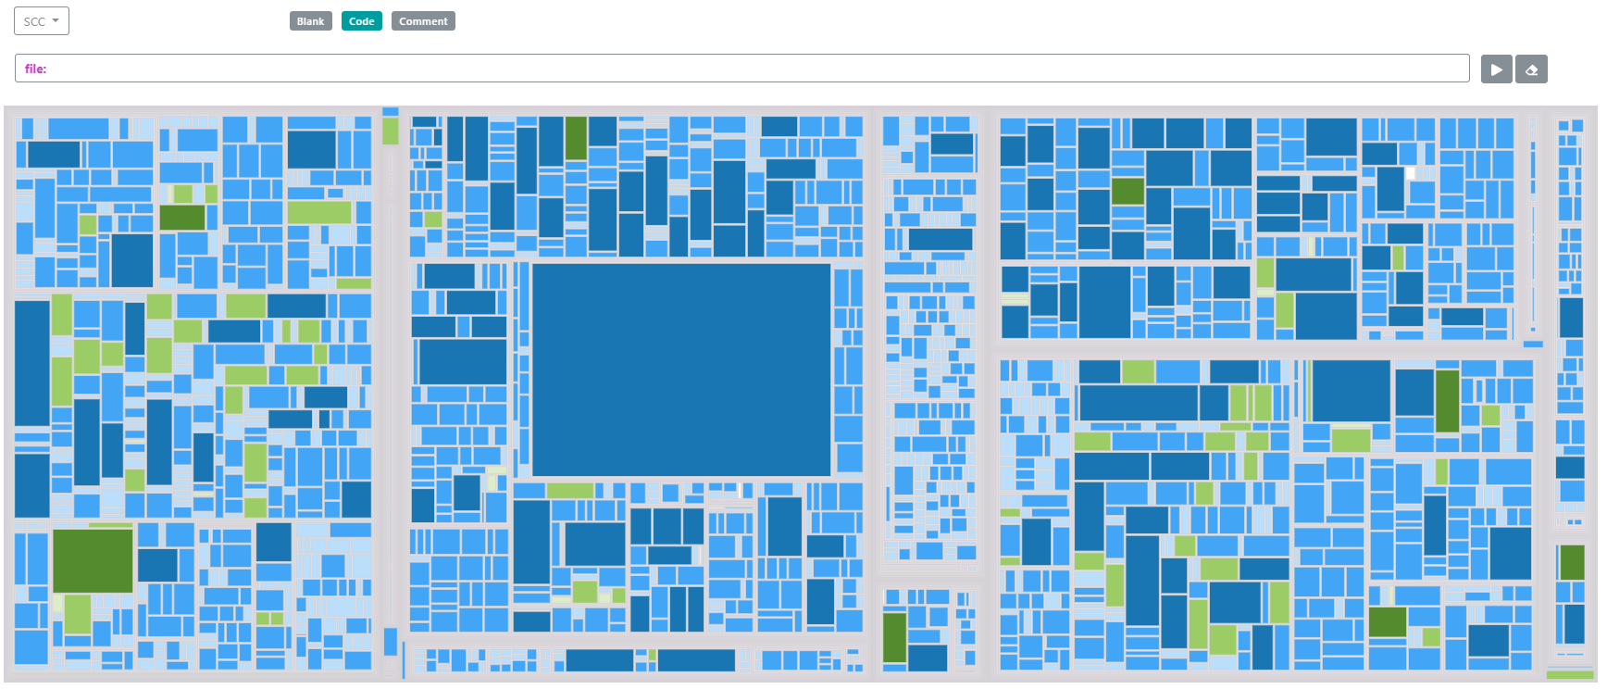
SCC wrapper – Results: Code
After uploading the json properties file, the results are displayed on the system map.
Judging by the number of lines of code, we can conclude that there is an agglomeration of files with many code lines inside the android component. We have considered the upper threshold limit to be 600.

Slide 29
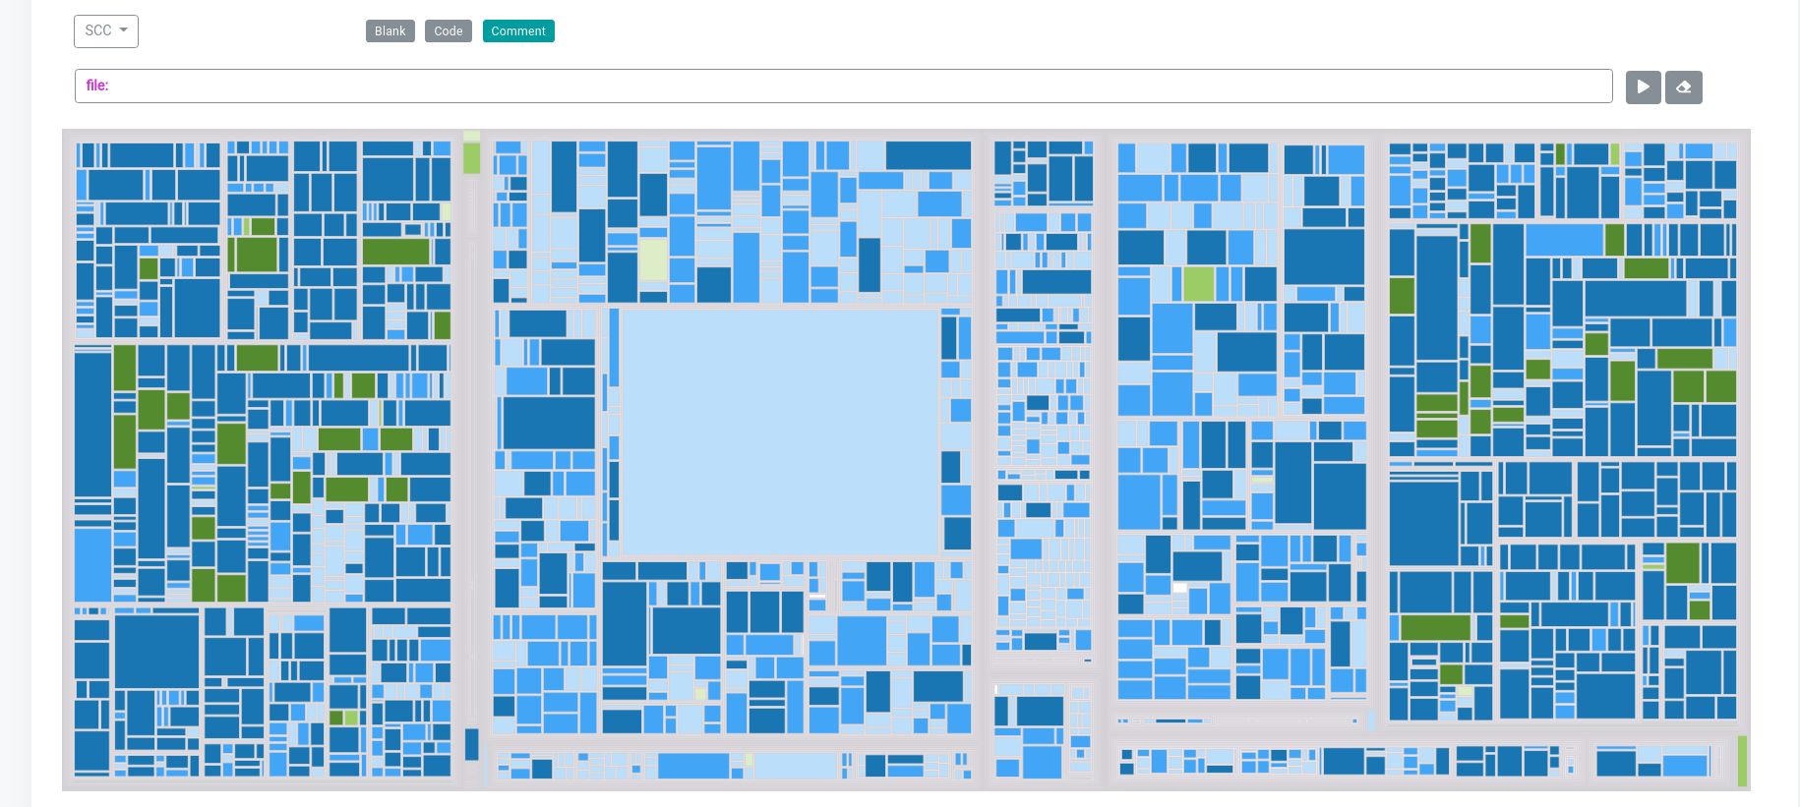
SCC wrapper – Results: Comment
There are many files with many lines of comments. This can point out the fact that the code is not explicit enough and thus needs further explanation.

