Slide 1






Course: Software Engineering
Pre-game phase presentation
Gruppo 17:
Luigi Corvino
ALexander De Santis
Alfonso Esposito
a.a 2021/2022

Slide 2


Tools
GitHub repo: https://github.com/luigicorvino/ProgrammableCalculator
Trello: https://trello.com/b/tsxGBUc8/programmablecalculator
Programming language: Java 8
IDE: NetBeans 8.2
External Libraries: Apache Commons Math 3.6.1
https://commons.apache.org/proper/commons-math/

Slide 3
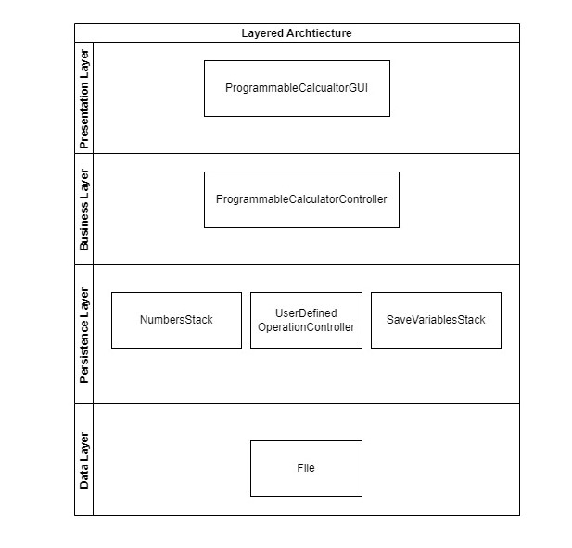
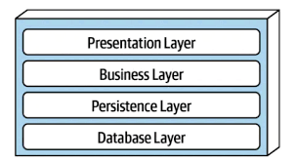
Software Architecture
Layered Style
Components communicate with the other components in the layers immediately above and below their layer

Slide 4
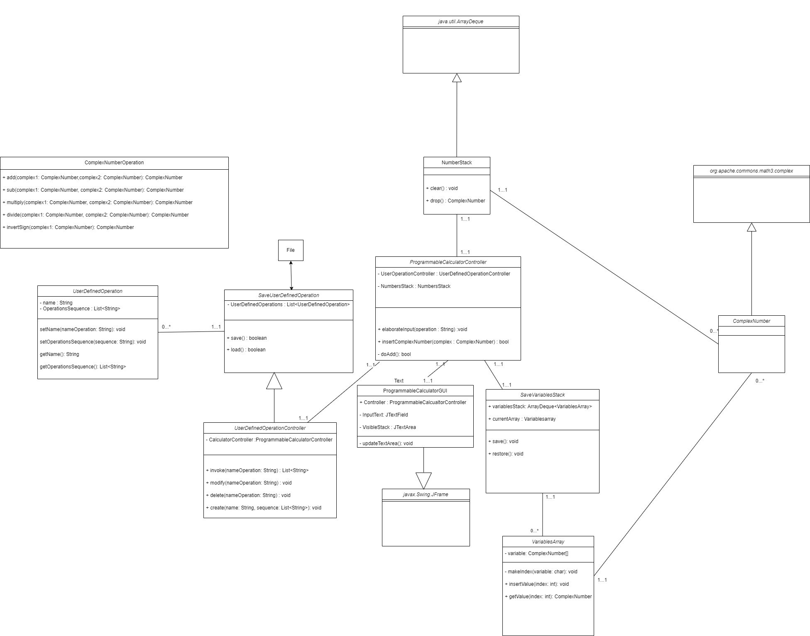

Slide 5
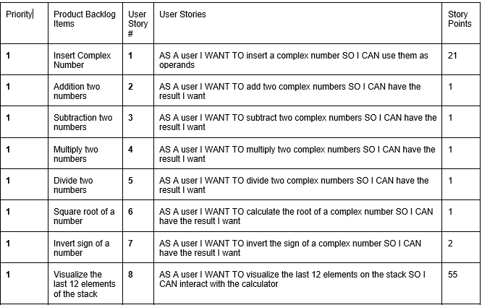
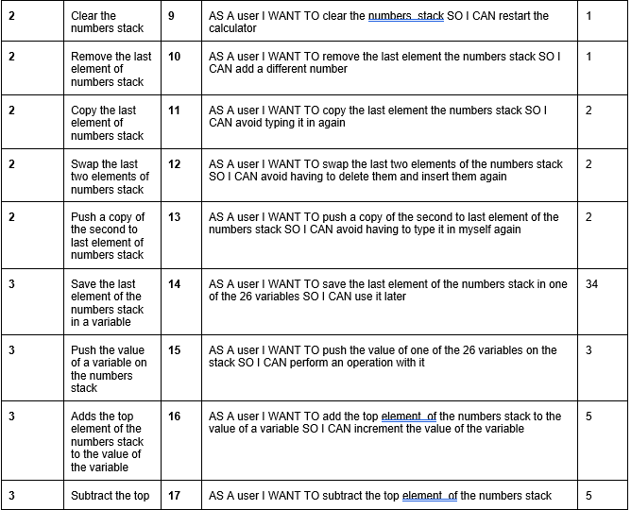
Product Backlog

Slide 6
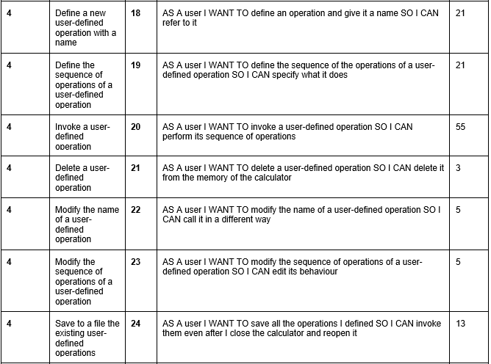
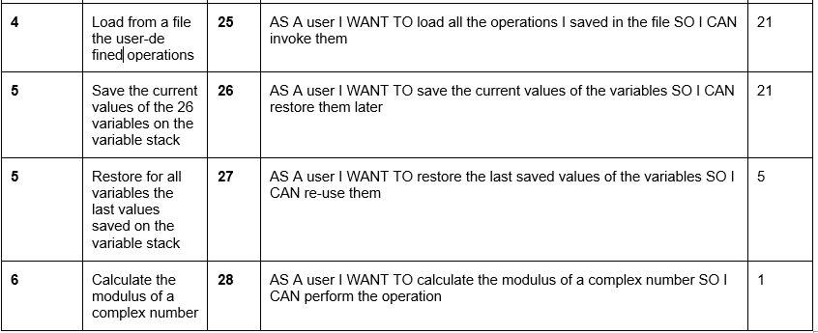

Slide 7


Estimated Velocity
Total Story Points: 309
Estimated Velocity for the first Sprint: 58 Story Points

Slide 8
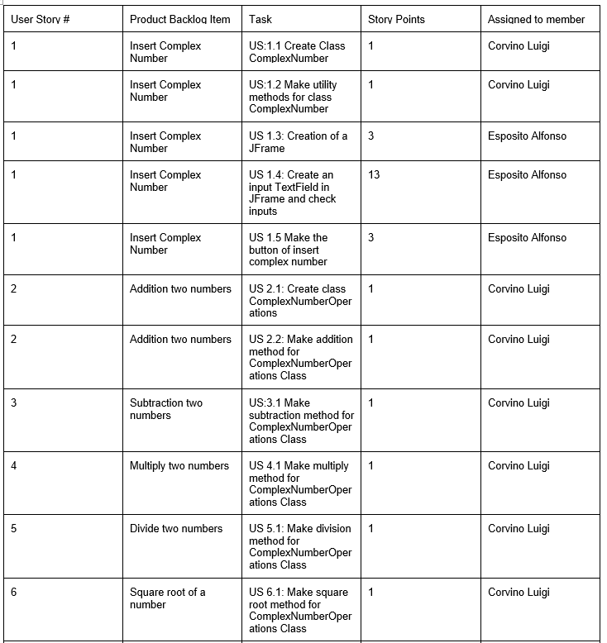
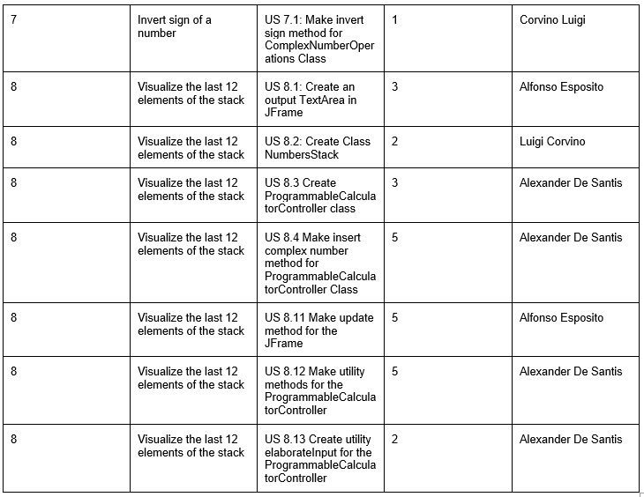
Sprint Backlog

