Slide 1
Predicting car accident severity using historical records
Luigi De Marco

Slide 2
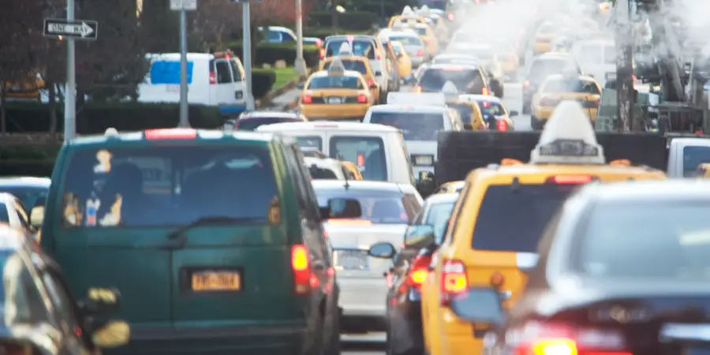
When do severe accidents happen?
Predicting car accident severity can have a critical impact on commuters and city planners alike
E.g. if severe accidents are likely then commuters can arrange for alternate transportation
When is an accident severe?
Injury
Loss of life
Getty Images

Slide 3
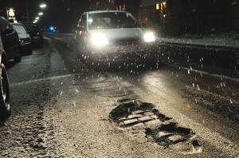
What factors affect accident severity?
There are a large number of factors that affect accident severity. For example:
Weather
Driver distraction
Light conditions
Road conditions
etc…
Some of these factors are predictive, while others cannot be accounted for
There is also significant randomness associated with the severity of collisions
Bad road conditions and inclement weather can contribute to accident severity (Google Images)

Slide 4

Building a warning system
The goal of this work is to build a warning system to alert drivers that severe accidents are more likely
Commuters can then make alternate arrangements to avoid unnecessary risk

Slide 5
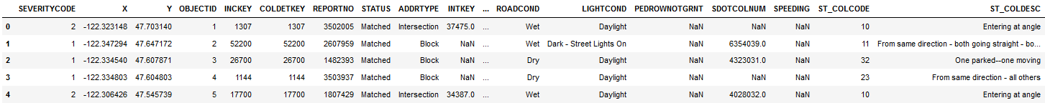
Car Accident Severity Data
Historical data from 2004 to present for accidents in the Seattle area
Each data point corresponds to an accident and is classified by whether it is severe
Each data point has a thorough description of the conditions under which the accident occurred
Use data provided by the Seattle Department of Transportation
https://s3.us.cloud-object-storage.appdomain.cloud/cf-courses-data/CognitiveClass/DP0701EN/version-2/Data-Collisions.csv
Example data

Slide 6
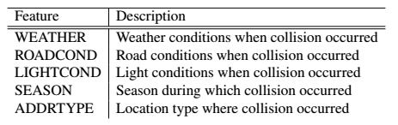
Feature Selection
In order to make a predictive model, we select features that have predictive value
That is, features that are known before a commute begins
Speeding or distraction may be highly correlated with accident severity, for example, but these are not predictive

Slide 7
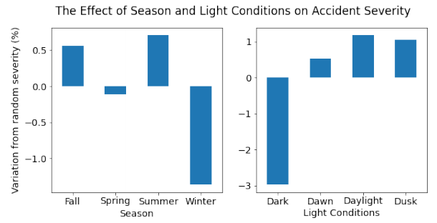
Single Feature Correlations
Analyzing the data, we see small correlations between accident severity and the chosen features
We notice some counterintuitive trends
Severe accidents less likely during winter or dark conditions (possibly due to more careful driving)

Slide 8
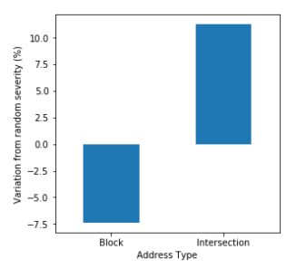
The problem with address type
Original inclusion of address type seemed useful for helping drivers avoid certain areas
However, data is highly biased since most severe accidents occur at intersections
Therefore remove address type as a predictive feature

Slide 9
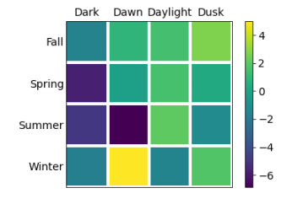
Two-Feature Correlations
Construct a pivot table to see how different features correlate with each other
We see stronger trends emerge than if looking at just the single feature correlations
E.g. Severe accidents are most likely at dawn during winter

Slide 10
Machine Learning Models
We have a supervised classification problem
Try various models to determine which is best
We want:
Accuracy
Ease of use
Intuitive
MODELS
K-Nearest Neighbors
Logistic Regression
State Vector Machine
Decision Tree

Slide 11
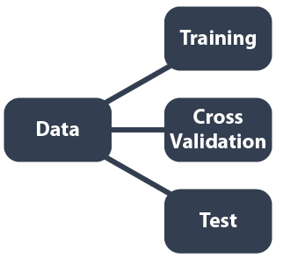
Splitting the data
The data is randomly split into three categories for training, hyperparameter tuning, and model testing
For each model, train using training data and choose hyperparameters using CV data
Split by 3:1:1
Train model by minimizing objective function
Hyperparameter tuning and feature selection
Test model performance and generalization to new data

Slide 12
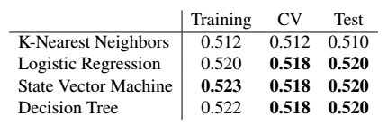
Model Performance Overview
Overview using the Jaccard index to score the accuracy for each model (after hyperparameter tuning)
We see all models have similar performance except for KNN which performs slightly worse

Slide 13
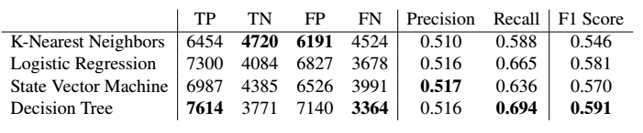
Model Performance Overview
A more in-depth look shows that the models do differ significantly when considering precision, recall, and F1 score
Generally we see that the decision tree has the best performance

Slide 14
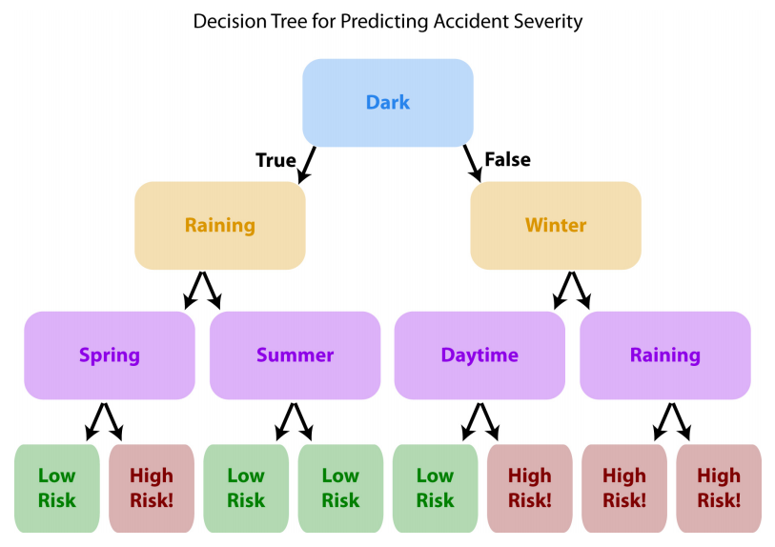
Decision Tree Model
Decision tree is most advantages because
Most accurate
Intuitive
Easy to use
Visual representation
Example: driving during the dark, while raining in summer carries a high risk of severe accidents

Slide 15
Conclusions and Outlook
Building a warning system using historical accident severity data
Decision tree model found to be most accurate, intuitive, and easy to use
Future improvements can be made using more features and collecting better data

