Slide 1
ARC 3133
ARCHITECTURAL
VISUALIZATION
METHODS 1
COMPUTATIONAL VISUALIZATION + DIGITAL FABRICATION
FALL 2026 | WEDNESDAY 9 AM | CHRISTINE KHOURI SADER HEAD COORDINATOR: LUIS PACHECO ALCALA
CSADER2015@FAU.EDU
Notes:
hello, welcome,
this is class 1 for arch viz,
we will meet at 9 am on wednesdays
im the gta and professor christine (INTRODUCE ME)
head coordinator is luigi (INTRODUCE LUIGI)
THIS CLASS WILL BE A COLLABORATIVE CLASS BETWEEN OUR SECTION AND LUIGI’S , WE WILL SHARE THE GROUP CHAT AND TUTORIALS AND POWERPOINTS AS MUCH AS POSSIBLE
I WILL MAKE A FOLDER FOR OUR SECTION TO UPLOAD WHEN ASSIGNMENTS ARE DUE. SHOW TEAMS AND UPLOADS AND ALL
my email is csader2015@fau.edu the best way to reach me is through email, you can also reach out to me on teams privately
or you can ask a general question/ about assignments on the main group chat, which is shared with luigis section.

Slide 2
ARC 3133
join our Microsoft Teams group using the following code: 796zq4x
COMPUTATIONAL VISUALIZATION + DIGITAL FABRICATION
FALL 2026 | WEDNESDAY 9 AM | CHRISTINE KHOURI SADER HEAD COORDINATOR: LUIS PACHECO ALCALA
CSADER2015@FAU.EDU
Notes:
SPEND A COUPLE MINUTES AND JOIN THE CHAT FOR BOTH SECTIONS.

Slide 3
ARCHITECTURAL VISUALIZATION
SYLLABUS
SIGN IN SHEET
CLASS SCHEDULE + ASSIGNMENTS
1
2
3
Notes:
FOR THIS CLASS
MAKE SURE U REview the syllabus
and make sure you sign in every class when you walk in
the class schedule and assignments are dependant on how the semester goes and how everyones progress is, and we will evaluate as necessary to modify
for now this is the schedule, look at syllabus

Slide 4
STRUCTURE OF CLASS
TUTORIAL WILL BE HANDED THE PRIOR CLASS
PIN UP OR 1-1 CRITIQUE
LECTURE/TUTORIAL TIME - QUESTIONS AND TROUBLESHOOT
PRESENT NEXT ASSIGNMENT IF APPLICABLE
WORK TIME
1
2
3
4
Notes:
EACH class will follow this structure:
we will hand you a tutorial FOR YOU TO REVIEW and attempt on your on time
you will come in with finished work for pin up and critique if it is due
or you will come in with progress of your work FOR A ONE ON ONE CRITIQUE
we will have a short lecture/ review of examples of what is expected
review any questions and troubleshoot any issues you have FROM THE PREVIOUS TUTORIAL
i will then present any upcoming assignment if applicable
and then you will have a designated working time

Slide 5
VISUAL SCRIPTING
BLENDER
GRASSHOPPER IN RHINO
Notes:
IN THIS CLASS
u will learn what we call
VISUAL SCRIPTING IN BOTH
blender and grasshopper in rhino
we will provide you the tutorials needed after each class, which as we discussed you should do before the next class. feel free to also model and explore beyond what the tutorial shows
my advice is for first few assignments to attempt both softwares, to see which you prefer and feel more comfortable in.
understanding of one system should apply to understanding to the other
they are both just tools, but as long as you begin to understand the way of thinking in visual scripting is the key

Slide 6
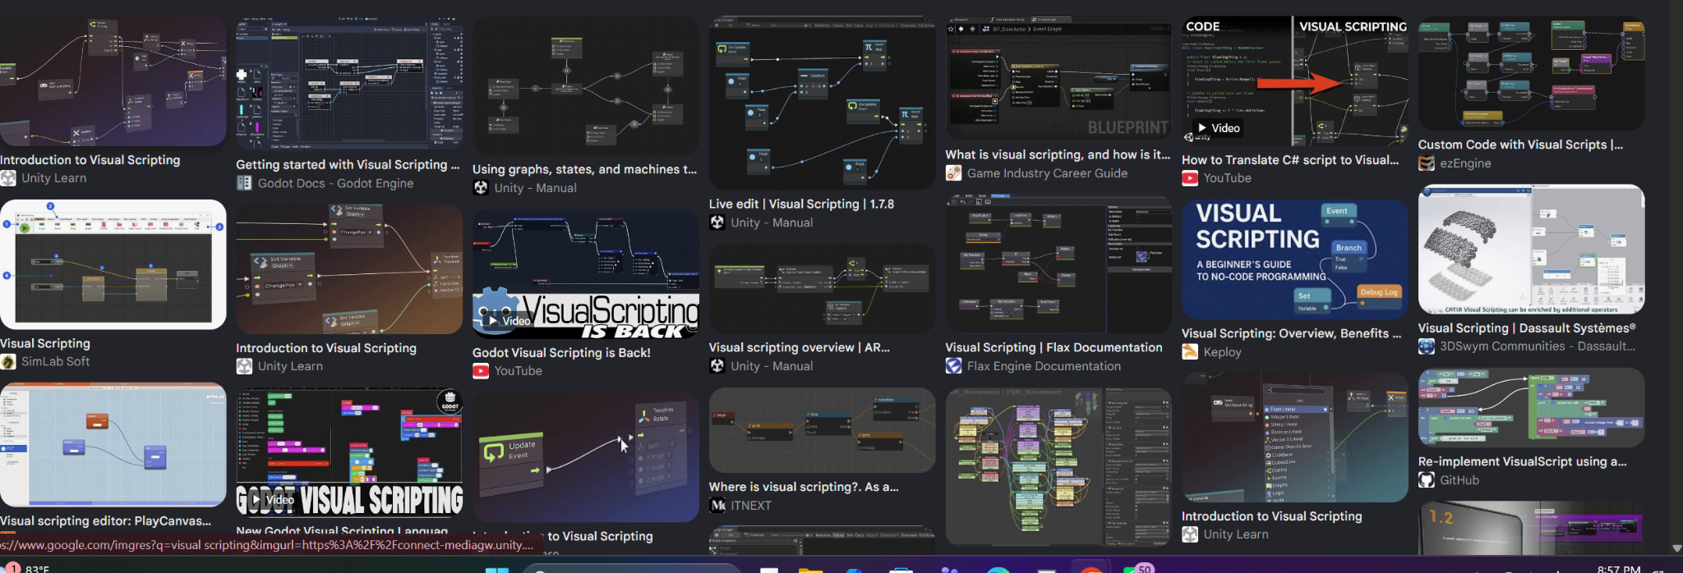
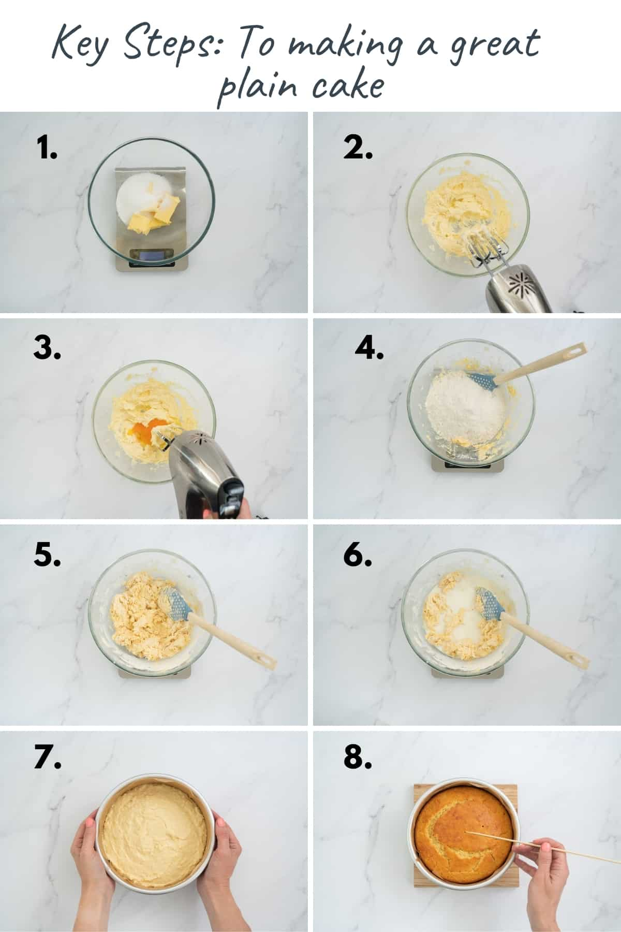
Notes:
visual scripting can be applied to multiple softwares or no software
it is a means of writing an ingredient list with a recipe of specific tasks

Slide 7
THE DESIGNER IS NO LONGER MAKING CHOICES ABOUT A SINGLE, FINAL OBJECT , BUT CREATING A MATRIX MAKING AN ENTIRE POPULATION OF POSSIBLE DESIGNS.
Notes:
WE R TEACHING U a tool that helps you iterate and test ideas with simple changes in parameters
your final output may not be what you start with , and that is something that comes from emergence of systems

Slide 8
INPUT
PROCESS
OUTPUT
parameters
data
variables
algorithm
procedure
operation tree
design
Notes:
every computational system and computational design is made of these few steps
this is something you touched on last semester and also will start to build on this semester if you are in D5
the idea of designing with parameters and rules, where output is not yet determined
but to be discovered
inputs could be xxx
process could bexxxx
output is the design / object / system

Slide 9
THREE PARADIGMS
01
PROCEDURAL
02
PARAMETRIC
03
GENERATIVE
PROCESS
PROCESS
PROCESS
A fixed sequence
of operations
Relationships between
inputs and form
A rule applied to its
own output, repeatedly
YOU DEFINE
YOU DEFINE
YOU DEFINE
THE STEPS
THE RULES OF
VARIATION
THE RULE + THE
STARTING STATE
OUTPUT IS
OUTPUT IS
OUTPUT IS
ONE EXPECTED
RESULT
A FAMILY OF RESULTS THAT YOU
KNOW THE RANGE,
NOT EACH MEMBER
UNKNOWN, WITHIN
A SPECTRUM YOU SET
We are interested primarily in instructions.
The same inputs always produce the same output.
Parameters are iterated by the algorithm itself.
MODULE 0
MODULES 1–3
FINAL
Notes:
one of the learning objectives of this class
is to understand the difference between
procedural parametric
generative ways of design and modelling
the goal is for you to be able to learn all these methods and also figure out which is the best way to model which one would u use to solve design problems efficiently
procedural modelling
does not even need a computer
think about the steps you took to build something from scratch (step by step) THINK ABOUT D3 OR D4
U TOOK a sequence of operations
result is one expected output
one expected thing to learn is you learn how to break a geometry you want to model into multiple steps SO U CAN IMPLEMENT IT IN GRASSHOPPER OR BLENDER GEOMETRY NOTES
parametric modelling
THE QUESTION IS what happens when we start changing the input
what defines the rules SHOW SCOTTY EXMAPLE
generative
we follow the two things
and then we feed the output we get as input
now we have a loop of iterations and a cycle of generating
biomimicry
recursive
fractal
design from nature
SOME OF THESE WILL MAKE MORE SENSE AS WE MOVE FORWARD IN SEMESTER

Slide 10
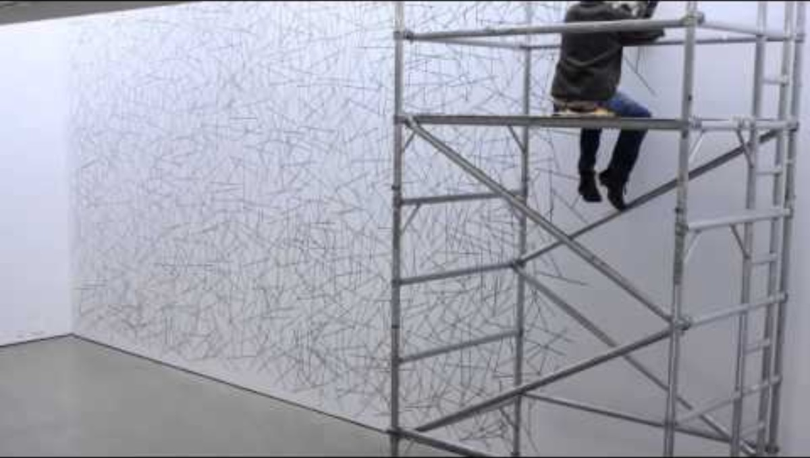
01 — PROCEDURAL
Form as a set of instructions. Output: expected.
AN INSTRUCTION
1. Place twenty points at random
on the sheet.
2. Connect each point to its two
nearest neighbours with a
straight line.
LEWITT WALL DRAWING
Add: a LeWitt wall drawing beside its written instruction.
The work IS the instruction. Someone else executes it — LeWitt often never touched the wall.
1. THE POINTS
2. THE LINES
Notes:
procedural modelling is as discussed steps and instructions broken down
in this example here we see sol le witt work, where he makes the steps and others implement this steps like a recipe
SHOW VIDEO EXAMPLE

Slide 11
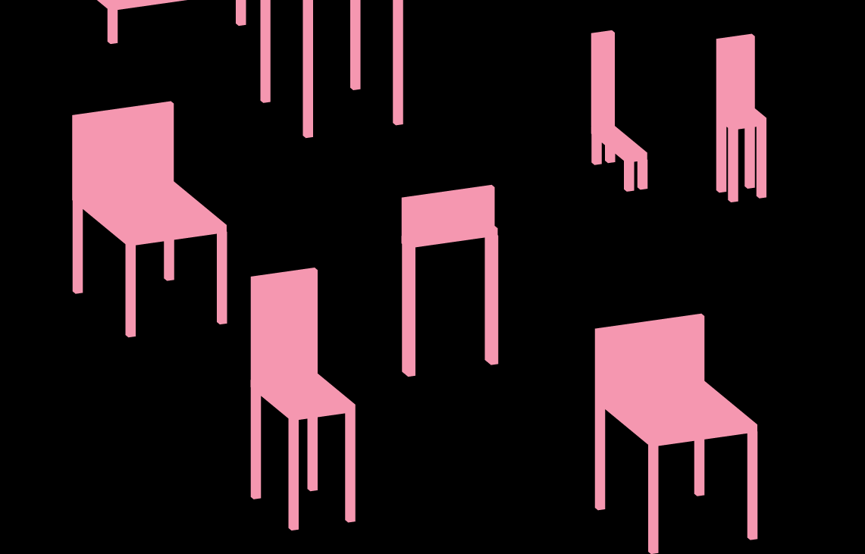
02 — PARAMETRIC
Parameters drive the form. Output: partially expected.
DECOMPOSE A FORM INTO VARIABLES
SAME INPUTS IN
same result out. Always.
CHANGE ONE INPUT
the whole system responds.
PARAMETRIC PRECEDENT
NON-DESTRUCTIVE
every step stays editable.
https://formandcode.com/code-examples/parameterize-chair
MODULES 1–3 / FIELDS + ATTRACTORS / SECTION + SEQUENCE / TESSELLATION
Notes:
parametric
we have parameters, another word for rules
output is partially expected but can still create new opportunities
SHOW EXAMPLE

Slide 12
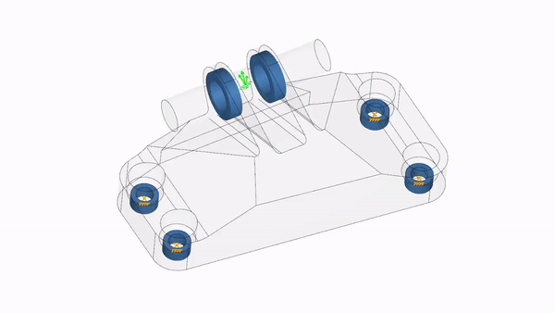
03 — GENERATIVE
The system feeds itself. Output: unknown, within a spectrum.
Every generative system is the same three-step loop, run over and over.
STATE
RULE
NEXT STATE
GENERATIVE PRECEDENT
THE OUTPUT BECOMES THE INPUT
Using FEA as a generative algorithm
GROWTH / AGENTS / CELLULAR AUTOMATA / RELAXATION + PACKING
Your final assignment. You will build one of these.
Notes:
generative design and modelling is a loop
this is what is described as bottom up design, you dont design the output, you design the system
in this example here, this is the fenete element analysis
you build the boxes
and that is the wasteful geometry
it is optimizing the model through generative algorithm, step by step, deleting material while keeping the core of the structure
Cellular automata (CA) in architecture are grid-based computational systems where simple local rules generate complex, emergent spatial forms and architectural layouts.
Each cell changes its state based on neighboring cells and predefined survival or growth rules.
SHOW EXAMPLE
Show Conway's Life running (copy.sh/life) — 20 seconds.
Four rules, no design, and it produces things nobody specified.
That's the last three weeks of this course.

Slide 13
HOW THIS RUNS
Watch before class. Class time is for your problems, not my demo.
01
TUTORIAL ARRIVES
Pre-recorded, sent after the class before. Grasshopper and Blender versions of each.
02
YOU WORK THROUGH IT
Before the session. This is the part that doesn't work if you skip it.
03
WE TROUBLESHOOT
First part of class: what broke. Bring the file, not the description.
04
ASSIGNMENT BRIEFING
Requirements, precedents, then supervised work and critique.
Notes:
if you come in with nothing
i dont have anything to discuss and review with you
WE ONLY HAVE 12 CLASSES TOGETHER, AND THIS CLASS IS IMPORTANT FOR YOU TO LEARN AND EXPERIMENT WITH, SKILLS U LEARN HERE WILL APPLY THROUGHOUT YOUR CAREER
Everything is in two versions , blender rhino

Slide 14
WHAT YOU'LL MAKE
Every module has a drawing and a physical thing.
MODULE 0
PROCEDURE
Massing diagram + written instructions
SMALL 3D PRINT
MODULE 1
FIELDS
Arrays and attractors, systematically
PLOTTER DEMO
MODULE 2
SECTION
Serial sections, contours, hierarchy
LASER-CUT ASSEMBLY
MODULE 3
TESSELLATION
A panelized surface as a filter
3D-PRINTED SYSTEM
FINAL
GENERATIVE
A tool that iterates
—

Slide 15
ISSUED TODAY
0.2 — VISUAL IDENTITY MANUAL
FOUR PAGES. NO MORE. DUE CLASS 4 — SEP 15
1
Typography — typefaces and hierarchy, with sizes
2
Palette with stated values · line weights with assigned uses
3
The 17" × 11" sheet template, grid shown explicitly
4
A sample sheet, using the system on real work
NO CANVA. NO EXPRESS. NO SLIDES. A template supplies the grid, the hierarchy and the palette — exactly what you're being asked to decide.
Notes:
YOUR FIRST ASSIGNMENT
1ST ITERATION OF THIS IS DUE NEXT CLASS
VISUAL CONSISTENCY
BETWEEN ALL YOUR PROJECTS PRESENTATIONS and booklet in the end FOR THIS CLASS
WORK ON THIS FOR NEXT WEEK BUT THIS IS DUE SEP 15
ALL YOUR PROJECTS WILL FOLLOW THIS COLORS TYPOGRAPHIES
SHOW EXAMPLES
u dont need to make a logo but if u want to feel free
NOTE : if you change your visual identity later, teh final booklet must match it, each assignment should follow the updated template

Slide 16
BEFORE NEXT CLASS
Tutorial 0.1 — Grasshopper / Geometry Nodes basics, transformations, Booleans, non-destructive modeling. Sent tonight.
MODEL
FabLab Safety Orientation on Canvas. Required before you touch any machine — due end of Class 2.
ENROL
visual identity - Look at how other people build identity systems before you build yours.
START
A building you find interesting. Orthogonal massing — no complex curves. You'll rebuild it as a procedure.
BRING
Notes:
we will send u the tutorials
luigi will send blender
and i will send grasshopper
MODEL THE TUTORIALS IN BOTH, I WANT TO SEE THE FILES AND UR THOUGHT PROCESS,
do the fab lab because you will need it for an upcoming assignment
now, look at other people visual identity, bring ideas, bring color template,
find a building, orthogonal simple shapes massing, because you will build THIS BUILDING using the tutorial we will send , bring 3 options of the 3 buildings
design operation sequence diagram big but now built with grasshopper, similar to d4 , show exmaple SHOW EXAMPLE

Slide 17
PROCEDURAL
PARAMETRIC
GENERATIVE
QUESTIONS.

