Slide 1
ARC 3133
ARCHITECTURAL
VISUALIZATION
METHODS 1
COMPUTATIONAL VISUALIZATION + DIGITAL FABRICATION
FALL 2026 / TUESDAYS 5:00–7:50 PM / LUIS PACHECO ALCALA
Notes:
Welcome. Today: what the course is, how it runs, the one big idea, and your first assignment.
Don't open software today — this is the framing class.

Slide 2
THE DESIGNER IS NO LONGER MAKING CHOICES ABOUT A SINGLE, FINAL OBJECT — BUT CREATING A MATRIX ENCOMPASSING AN ENTIRE POPULATION OF POSSIBLE DESIGNS.
THIS IS WHAT CHANGES WHEN YOU DESIGN WITH CODE.
Notes:
Ask: what do you hand in at the end of a studio? One building.
Here the deliverable is the system. The images are evidence of the system.
This sentence is the whole course.

Slide 3
EVERY COMPUTATIONAL SYSTEM
…has the same three parts. What changes is how much you control the third.
INPUT
PROCESS
OUTPUT
parameters
data
variables
algorithm
procedure
operation tree
design
Notes:
Draw this on the board too. Everything we build fits here.
The question that separates the three paradigms: how determined is the output?

Slide 4
THREE PARADIGMS
The whole course, in one table. Each one extends the last.
01
PROCEDURAL
02
PARAMETRIC
03
GENERATIVE
PROCESS
PROCESS
PROCESS
A fixed sequence
of operations
Relationships between
inputs and form
A rule applied to its
own output, repeatedly
YOU DEFINE
YOU DEFINE
YOU DEFINE
THE STEPS
THE RULES OF
VARIATION
THE RULE + THE
STARTING STATE
OUTPUT IS
OUTPUT IS
OUTPUT IS
ONE EXPECTED
RESULT
A FAMILY — YOU
KNOW THE RANGE,
NOT EACH MEMBER
UNKNOWN, WITHIN
A SPECTRUM YOU SET
We are interested primarily in instructions.
The same inputs always produce the same output.
Parameters are iterated by the algorithm itself.
MODULE 0
MODULES 1–3
FINAL
Notes:
Spend real time here — this table is the course outline.
The YOU DEFINE row is the ladder: steps → relationships → rules.
Watch for the obvious question: if parametric always gives the same output for the same input, why is it only PARTIALLY expected? Answer: because you are defining a SPACE, not a result. You know its range, not every member. That is the whole point.
Ask the room for an example of each before you give yours.

Slide 5
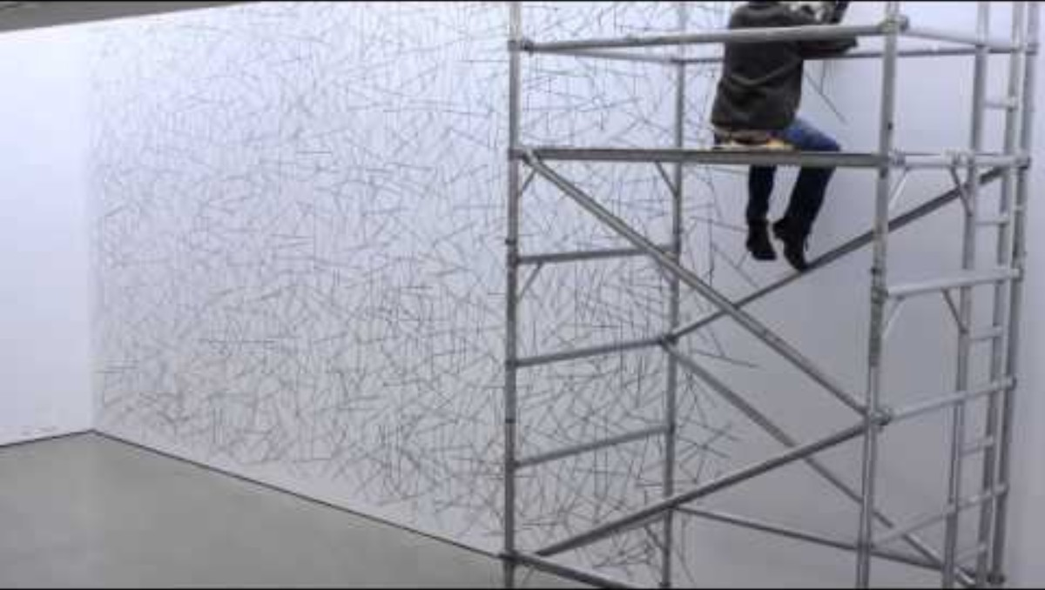
01 — PROCEDURAL
Form as a set of instructions. Output: expected.
AN INSTRUCTION
1. Place twenty points at random
on the sheet.
2. Connect each point to its two
nearest neighbours with a
straight line.
LEWITT WALL DRAWING
Add: a LeWitt wall drawing beside its written instruction.
The work IS the instruction. Someone else executes it — LeWitt often never touched the wall.
1. THE POINTS
2. THE LINES
Notes:
Read the instruction aloud. Two lines, and it produces a drawing nobody designed.
Then ask what is still undecided: how random is random? How big is the sheet? Do lines cross?
Every execution differs — that ambiguity was the point for LeWitt. In assignment 0.1 you must do the opposite and pin the outcome down.
Also flag forward: points, nearest neighbours, connecting lines — that is Module 1, and it is what the plotter draws.

Slide 6
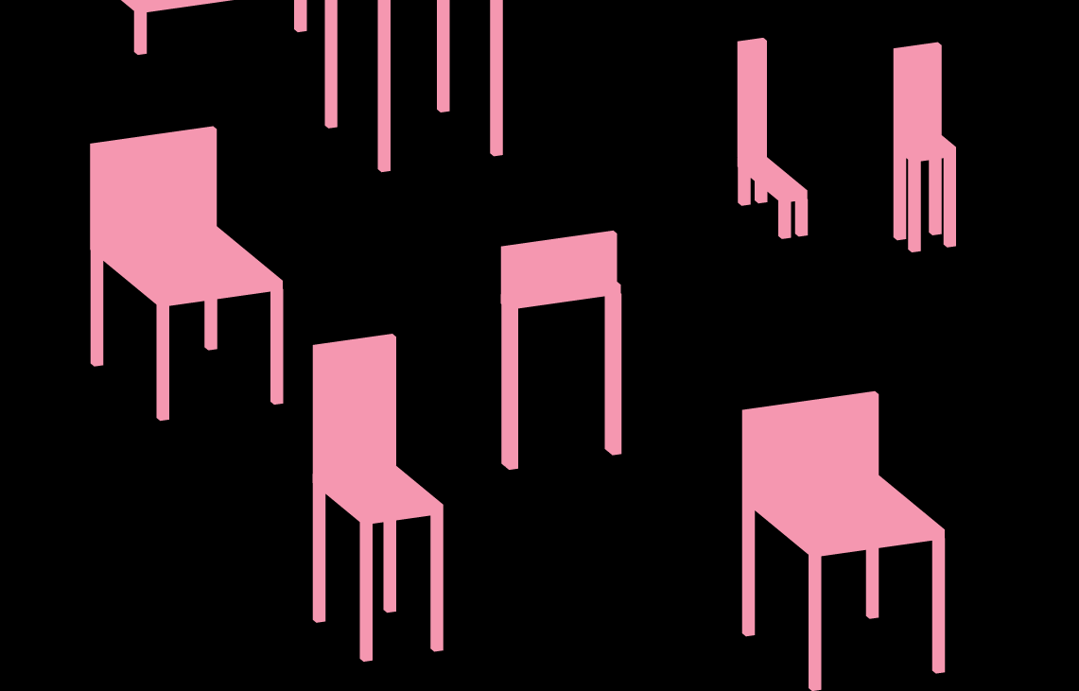
02 — PARAMETRIC
Parameters drive the form. Output: partially expected.
DECOMPOSE A FORM INTO VARIABLES
SAME INPUTS IN
same result out. Always.
CHANGE ONE INPUT
the whole system responds.
PARAMETRIC PRECEDENT
NON-DESTRUCTIVE
every step stays editable.
https://formandcode.com/code-examples/parameterize-chair
MODULES 1–3 / FIELDS + ATTRACTORS / SECTION + SEQUENCE / TESSELLATION
Notes:
Three quarters of the semester lives here.
Show a Grasshopper definition on screen — move one slider, let them watch everything update.
That visible cause-and-effect is why we work in graphs.

Slide 7
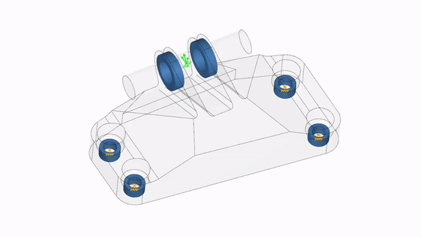
03 — GENERATIVE
The system feeds itself. Output: unknown, within a spectrum.
Every generative system is the same three-step loop, run over and over.
STATE
RULE
NEXT STATE
GENERATIVE PRECEDENT
THE OUTPUT BECOMES THE INPUT
Using FEA as a generative algorithm
GROWTH / AGENTS / CELLULAR AUTOMATA / RELAXATION + PACKING
Your final assignment. You will build one of these.
Notes:
Show Conway's Life running (copy.sh/life) — 20 seconds.
Four rules, no design, and it produces things nobody specified.
That's the last three weeks of this course.

Slide 8
HOW THIS RUNS
Watch before class. Class time is for your problems, not my demo.
01
TUTORIAL ARRIVES
Pre-recorded, sent after the class before. Grasshopper and Blender versions of each.
02
YOU WORK THROUGH IT
Before the session. This is the part that doesn't work if you skip it.
03
WE TROUBLESHOOT
First part of class: what broke. Bring the file, not the description.
04
ASSIGNMENT BRIEFING
Requirements, precedents, then supervised work and critique.
Notes:
Be blunt about step 2. A session spent watching what you could have watched at home is wasted.
Everything is in two versions — pick your environment and stay in it.

Slide 9
WHAT YOU'LL MAKE
Every module has a drawing and a physical thing.
MODULE 0
PROCEDURE
Massing diagram + written instructions
SMALL 3D PRINT
MODULE 1
FIELDS
Arrays and attractors, systematically
PLOTTER DEMO
MODULE 2
SECTION
Serial sections, contours, hierarchy
LASER-CUT ASSEMBLY
MODULE 3
TESSELLATION
A panelized surface as a filter
3D-PRINTED SYSTEM
FINAL
GENERATIVE
A tool that iterates + two sheets
—
Notes:
Point at the fabrication column. Everything you compute, you also make.
That's what makes this different from a software class.

Slide 10
ISSUED TODAY
0.2 — VISUAL IDENTITY MANUAL
FOUR PAGES. NO MORE. DUE CLASS 4 — SEP 15.
1
Typography — typefaces and hierarchy, with sizes
2
Palette with stated values · line weights with assigned uses
3
The 17" × 11" sheet template, grid shown explicitly
4
A sample sheet, using the system on real work
NO CANVA. NO EXPRESS. NO SLIDES. A template supplies the grid, the hierarchy and the palette — exactly what you're being asked to decide.
Notes:
Four pages is a constraint, not a minimum. A system you can't state in four pages isn't a system.
Due Class 4 — you'll have done 0.1 by then, so it gets tested against real work.
Every sheet for the rest of the semester uses this.

Slide 11
BEFORE NEXT CLASS
Tutorial 0.1 — Grasshopper / Geometry Nodes basics, transformations, Booleans, non-destructive modeling. Sent tonight.
WATCH
FabLab Safety Orientation on Canvas. Required before you touch any machine — due end of Class 2.
ENROL
Assignment 0.2. Look at how other people build identity systems before you build yours.
START
A building you find interesting. Orthogonal massing — no complex curves. You'll rebuild it as a procedure.
BRING
Notes:
The building matters — say the constraint clearly. Orthogonal massing, no complex curves.
If they pick Fallingwater they cannot describe it in five Booleans and the exercise fails.
Have a fallback list ready.

Slide 12
PROCEDURAL
EXPECTED
PARAMETRIC
PARTIALLY EXPECTED
GENERATIVE
UNKNOWN, WITHIN A
SPECTRUM YOU DEFINED
QUESTIONS.
Notes:
Leave this up while they ask. Repeat the three words — they'll hear them all semester.

