Slide 1
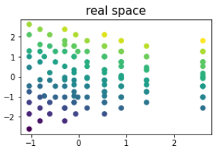
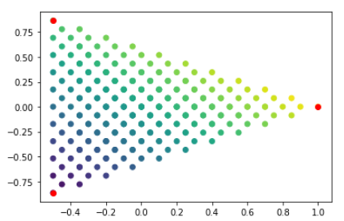
Data creation
- use points uniformly distributed in 2D ‚base-latent-space‘ with target = x+y
- apply any kind of function to x and y to create coords in real space
base-latent-space
X‘ = xfunc(x)
Y‘ = yfunc(y)

Slide 2
Implications of data creation
like this, for a perfectly working NN the derived latent space should be distributed uniformly, too
General usefullness of NN can be assessed by
  comparing distribution in derived latent space to uniform distribution
  MSE for features and target between real and reconstructed real space
for transformation functions of varying complexity:
  0: no transformation
  1: linear transformation
  2: monotonic non-linear (exp, ^3,^5,…)
  3: non-monotonic non-linear (Gaussian)
  4: periodic (cos,sin)
Calculations are started, waiting for result

Slide 3
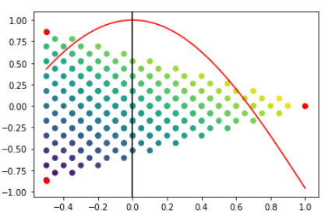
Do new points carry additional info?
Proof of concept
x‘ = cos(1.55*x), y‘ = y
Compare e.g. two cases:
  Random division: NN trained with rand1, tested with rand2
  Division at x=0: NN trained with divX<0, tested with divX>0
Former should work, latter should not
divX<0
divX>0

Slide 4
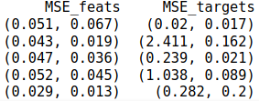
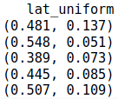


Results for Proof of Concept
- how much latent space distribution deviates from uniform distribution is calculated in
lat_uniform with Hellinger Distance, in [0,1] → turns 0 for perfect uniform distribution
Train
set
Test
set
(mean, std.dev.) for 20 calculations, with each #epochs=1000
- results: MSE_targets seems to be a reliable metric: it increases when
new data points carry new information and cannot be predicted well with old model.

Slide 5
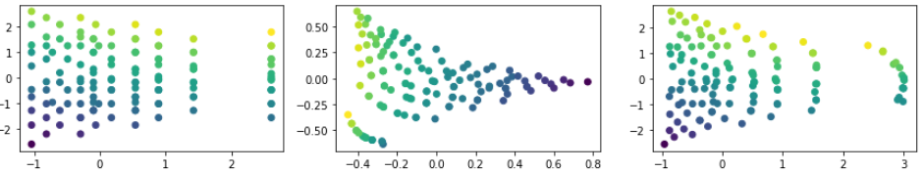
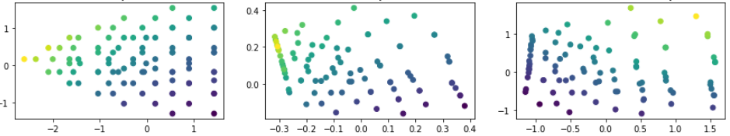
Results for Proof of Concept
Example calculations: Test points shown in all diagrams
div1div1
div1div2

Slide 6
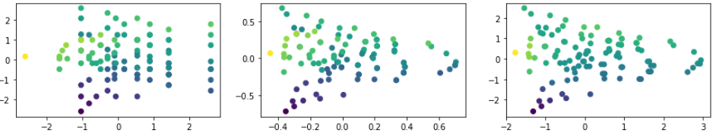
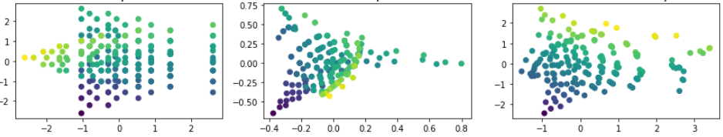
Results for Proof of Concept
Example calculations: Test points shown in all diagrams
rand1rand2
div1both

Slide 7
Result analysis & next steps
As was to be expected, data points that carry new information cannot be predicted well with old NN
New points are not displayed outside latent space, hypothesis: setup of NN does not allow for any point to be placed outside
If target values are unknown for new points, until now not clear if NN suitable for their prediction
Next step: Check if clustering of new-information carrying points occurs inside latent space

