Slide 1

Building Scalable Mobile Applications
Luigi Zuccarelli

Slide 2
Why nodejs
Footprint
Mature
Support
Modular
Easy
Leverage
Performance
Tooling

Slide 3
Why cordova
Support
Features
Easy installation
Write once
Skill set
Freedom of choice

Slide 4
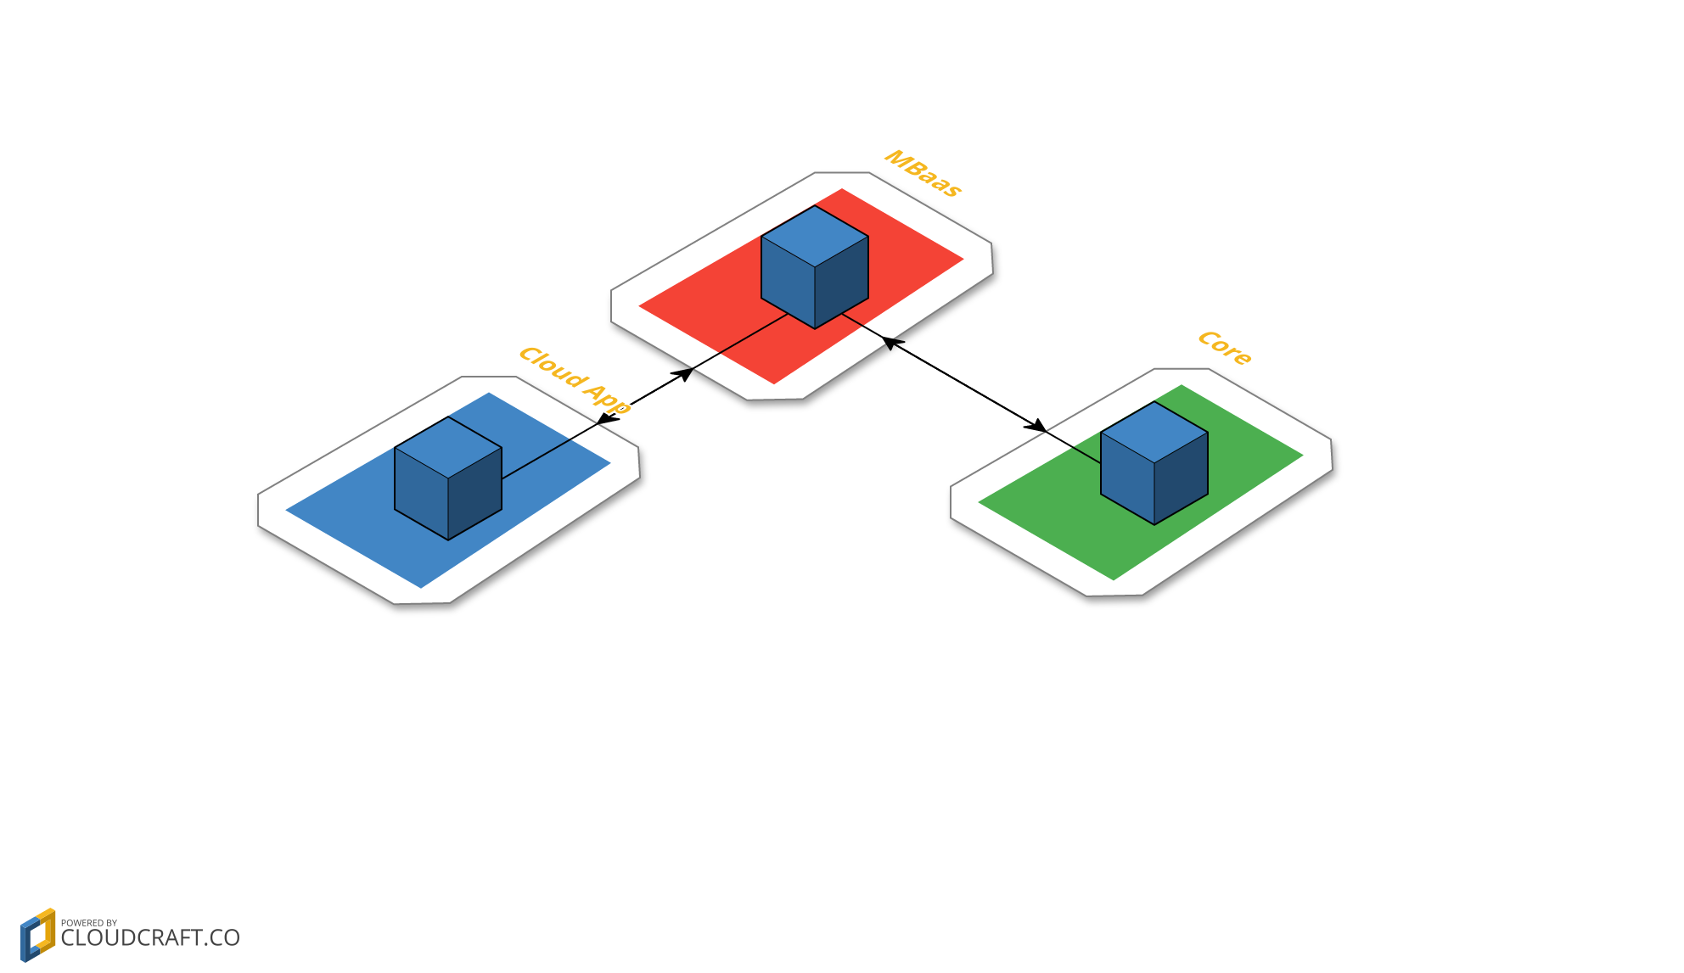
Current MAP Architecture

Slide 5
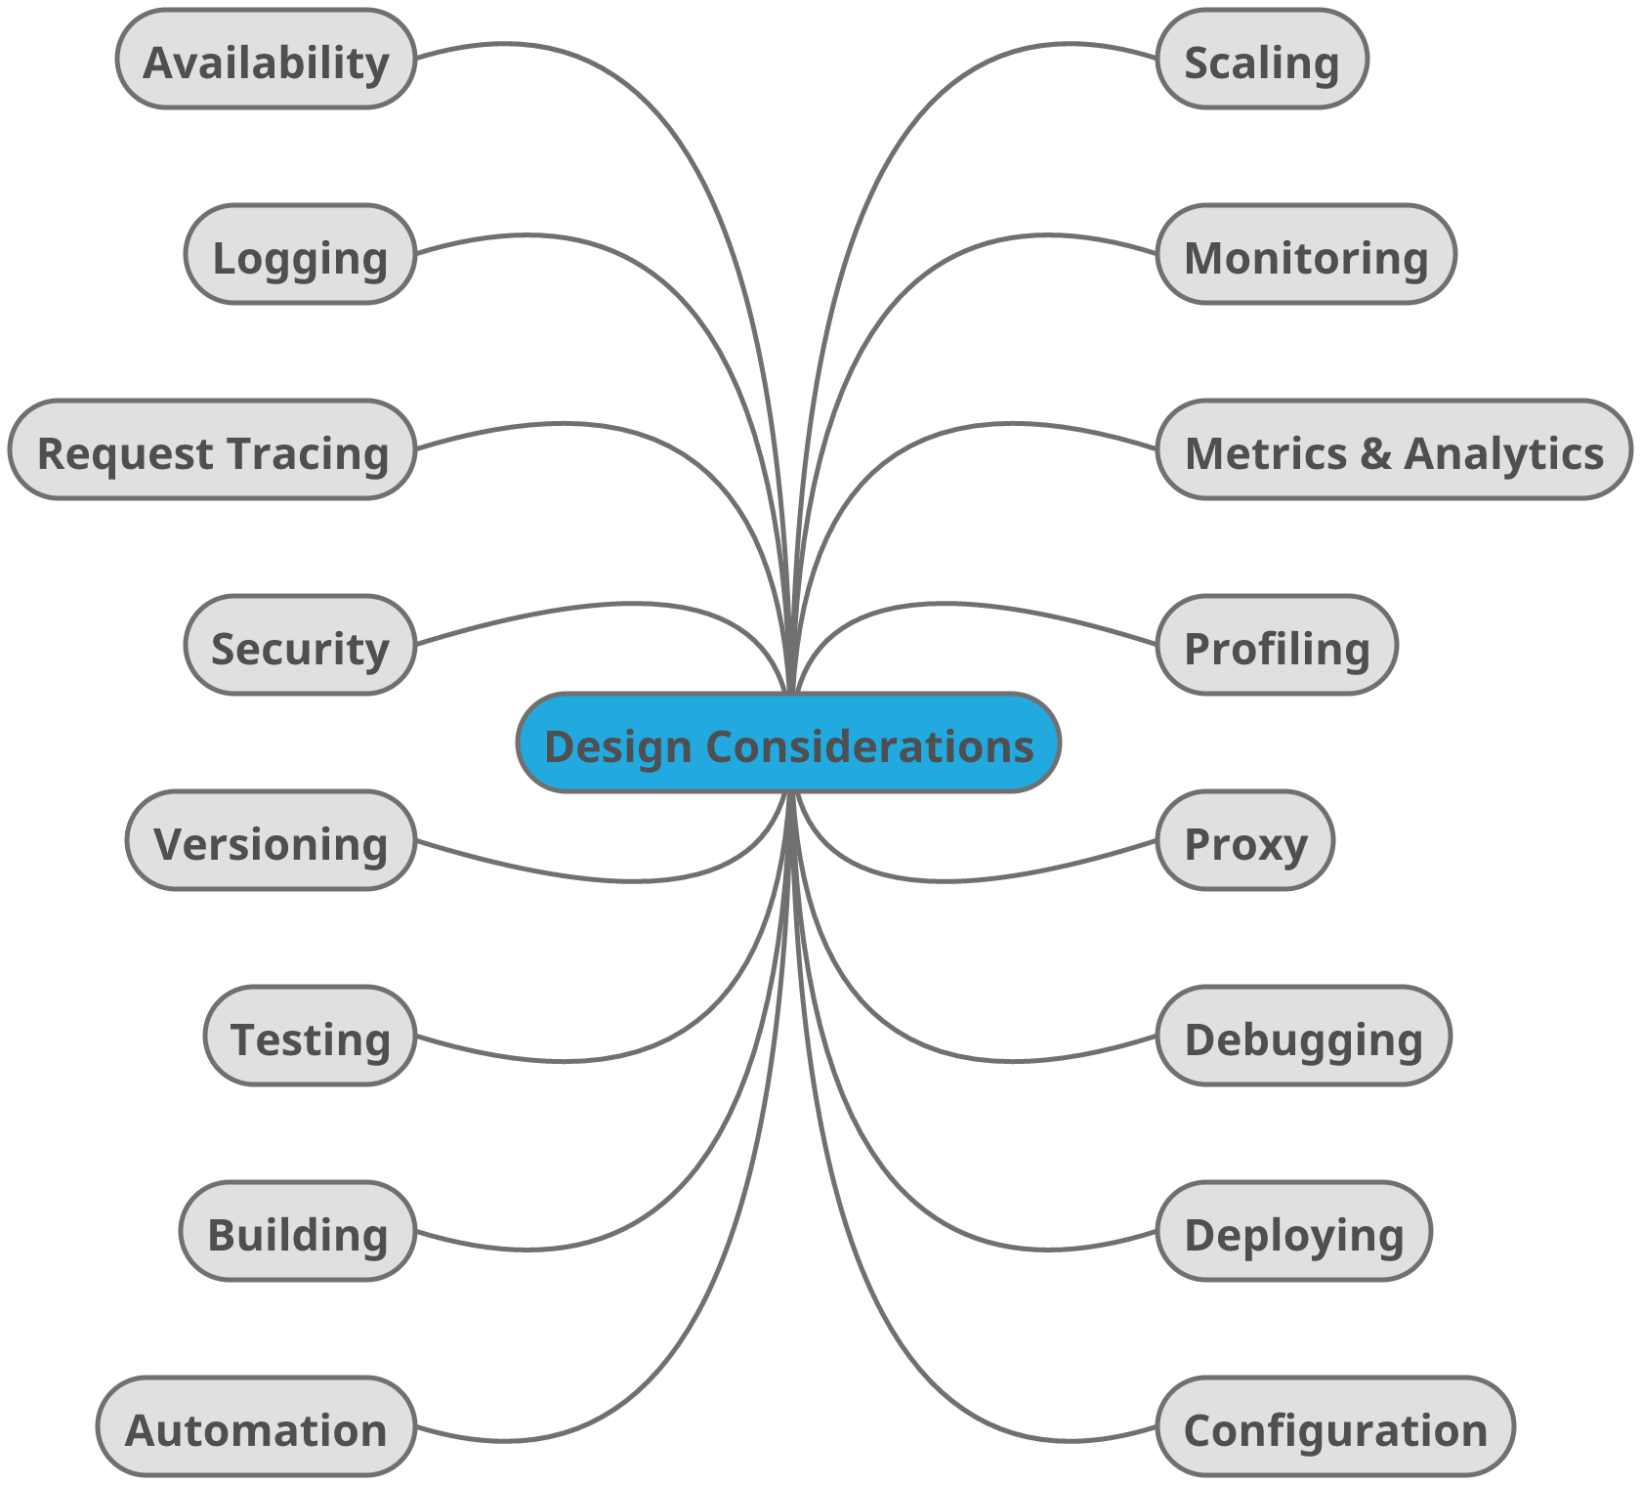
Design considerations

Slide 6
Scaling the enterprise
Checklist
Over engineer
Future optimization
Analysis paralysis
Do the simple well
Interfaces
TDD
Logging
Peer review
Tooling
Automate

Slide 7
?

Slide 8
Technologies
Docker
Kubernetes
OpenShift

Slide 9
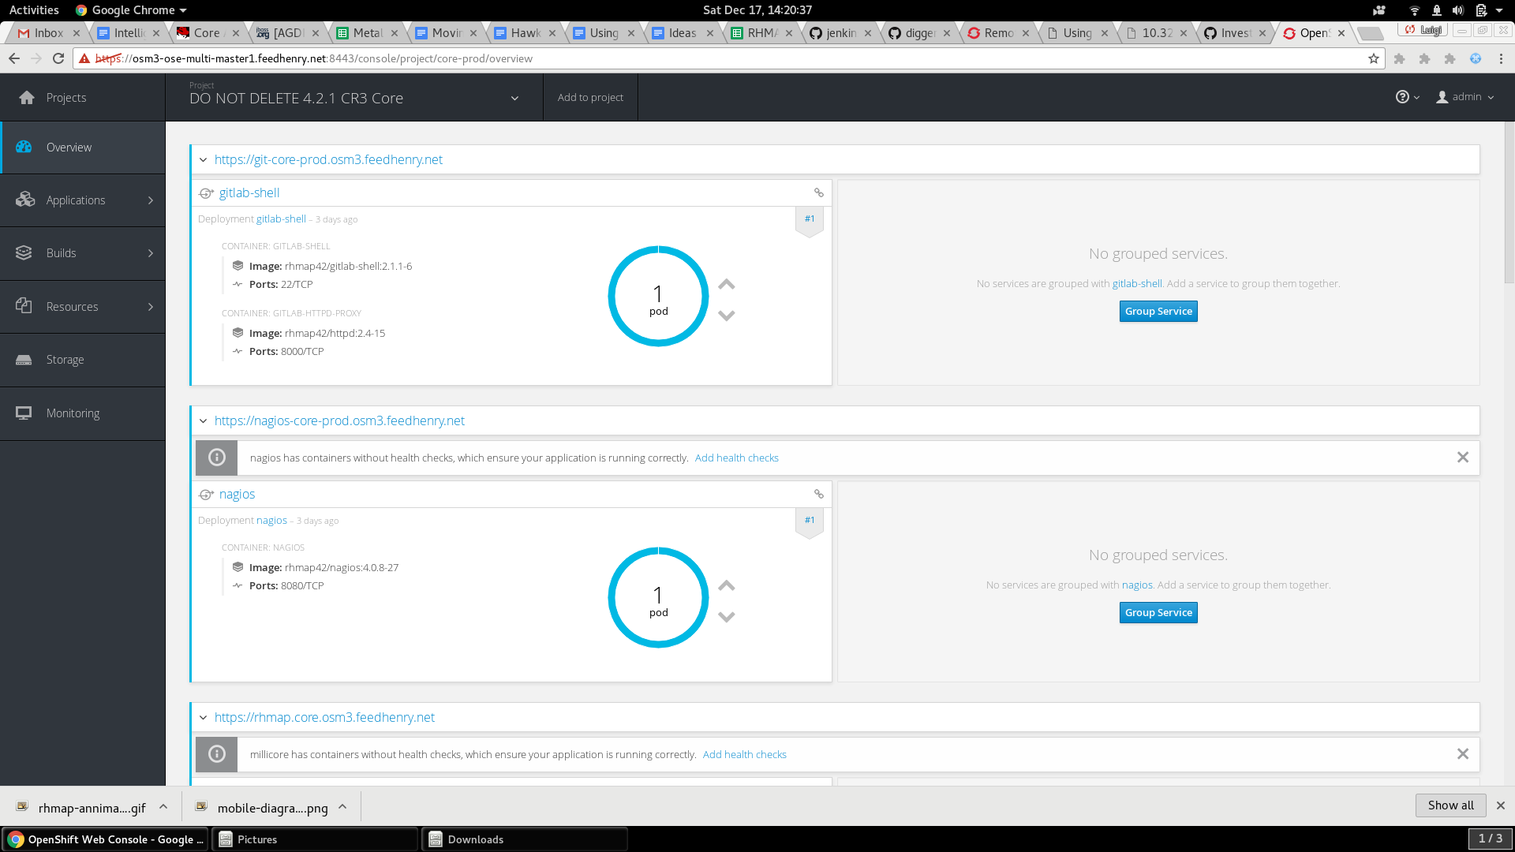
Container orchestration

Slide 10
Open Source
github.com/feedhenry
github.com/aerogear/digger-jenkins
github.com/openshift/origin
github.com/feedhenry-raincatcher
Luigi Zuccarelli

Slide 11
THANK YOU
lzuccare@redhat.com
github.com/luigizuccarelli
Luigi Zuccarelli

