Slide 1


Low-Dropout (LDO) Voltage Regulator in SKY130A
Simulation, Physical Verification & Post-Layout Validation
Silicluster v3 Analog Project Submission | VDD = 1.8 V | VOUT = 1.2 V | Iload = 0 – 5 mA
Luigy Amado Jeison Acevedo Daniel Castellanos
Integrated Circuit and Systems Research Group – OnChip
Universidad Industrial de Santander, Bucaramanga - Colombia
lduran2805@gmail.com | luigy2230397@correo.uis.edu.co

Slide 2
Outline
• 1. General Specifications & External Interface (LDO.v & Silicluster v3)
• 2. Top-Level LDO Regulator Schematic Architecture (LDO.sch)
• 3. VDD-Independent Self-Biased Current Reference Circuit (self_bias.sch)
• 4. Two-Stage Miller-Compensated Error Amplifier (OTA.sch)
• 5. Pre-Layout Simulation Results: AC Stability & PSRR (225 PVT Corners)
• 6. Pre-Layout Simulation Results: Transient Response & DC Regulations
• 7. Monte Carlo Statistical Analysis (Process & Mismatch Variability)
• 8. Physical Layout Design, Area (152.4 µm × 82.9 µm) & M4/M5 Power Grid (LDO.gds)
• 9. Physical Verification Evidence: Clean DRC & LVS in KLayout
• 10. Post-Layout (PEX) Validation: Response Curves Across PVT Corners
• 11. Final Comparison: Pre-Layout vs. Post-Layout (PEX)
2

Slide 3
1. Specifications & External Interface (Silicluster v3)
• PDK Technology: SkyWater 130 nm Open Source PDK (sky130A).
• Nominal Analog Supply: VDD = 1.8 V (range: 1.62 V – 1.98 V, VSS = 0 V).
• Input Voltage Range: VIN = 1.3-1.8 V nominal (mean Dropout ≈ 60.7 mV).
• Reference & Output: External Vref = 0.6 V → VOUT = 1.2 V (Iload = 0 to 5 mA).
• Total Physical Area: 152.43 µm × 82.91 µm (standard limit: 180 µm × 115 µm).
• Power Grid: Vertical tracks on Metal 4 (M4) and horizontal rails on Metal 5 (M5).
• Power Grid: Vertical tracks on Metal 4 (M4) and horizontal rails on Metal 5 (M5).
• Physical Verification: 0 DRC errors (sky130_drc.txt) and 100% clean LVS (LDO.lvsdb).
Pin Name | Direction | Layout Layer | Track Width | Requested Chip Assignment
VDD | inout | met4 (V) / met5 (H) | 1.0 μm / 2.0 μm | Power Grid VDD (1.8 V)
VSS | inout | met4 (V) / met5 (H) | 1.0 μm / 2.0 μm | Power Grid VSS (0 V)
VIN | input | met3 (70/20) | 2.0 μm | 1 Analog Input Pad (1.3–1.8 V)
Vref | input | met3 (70/20) | 0.30 μm | 1 Analog Reference Pad (0.6 V)
VOUT | output | met3 (70/20) | 2.0 μm (x2 branches) | 2 Analog Output Pins / Pads (connected to the two met3 branches)
External Verilog Interface (LDO.v):
module LDO (
inout VDD, inout VSS,
input VIN, input Vref,
output VOUT
);
endmodule
3

Slide 4
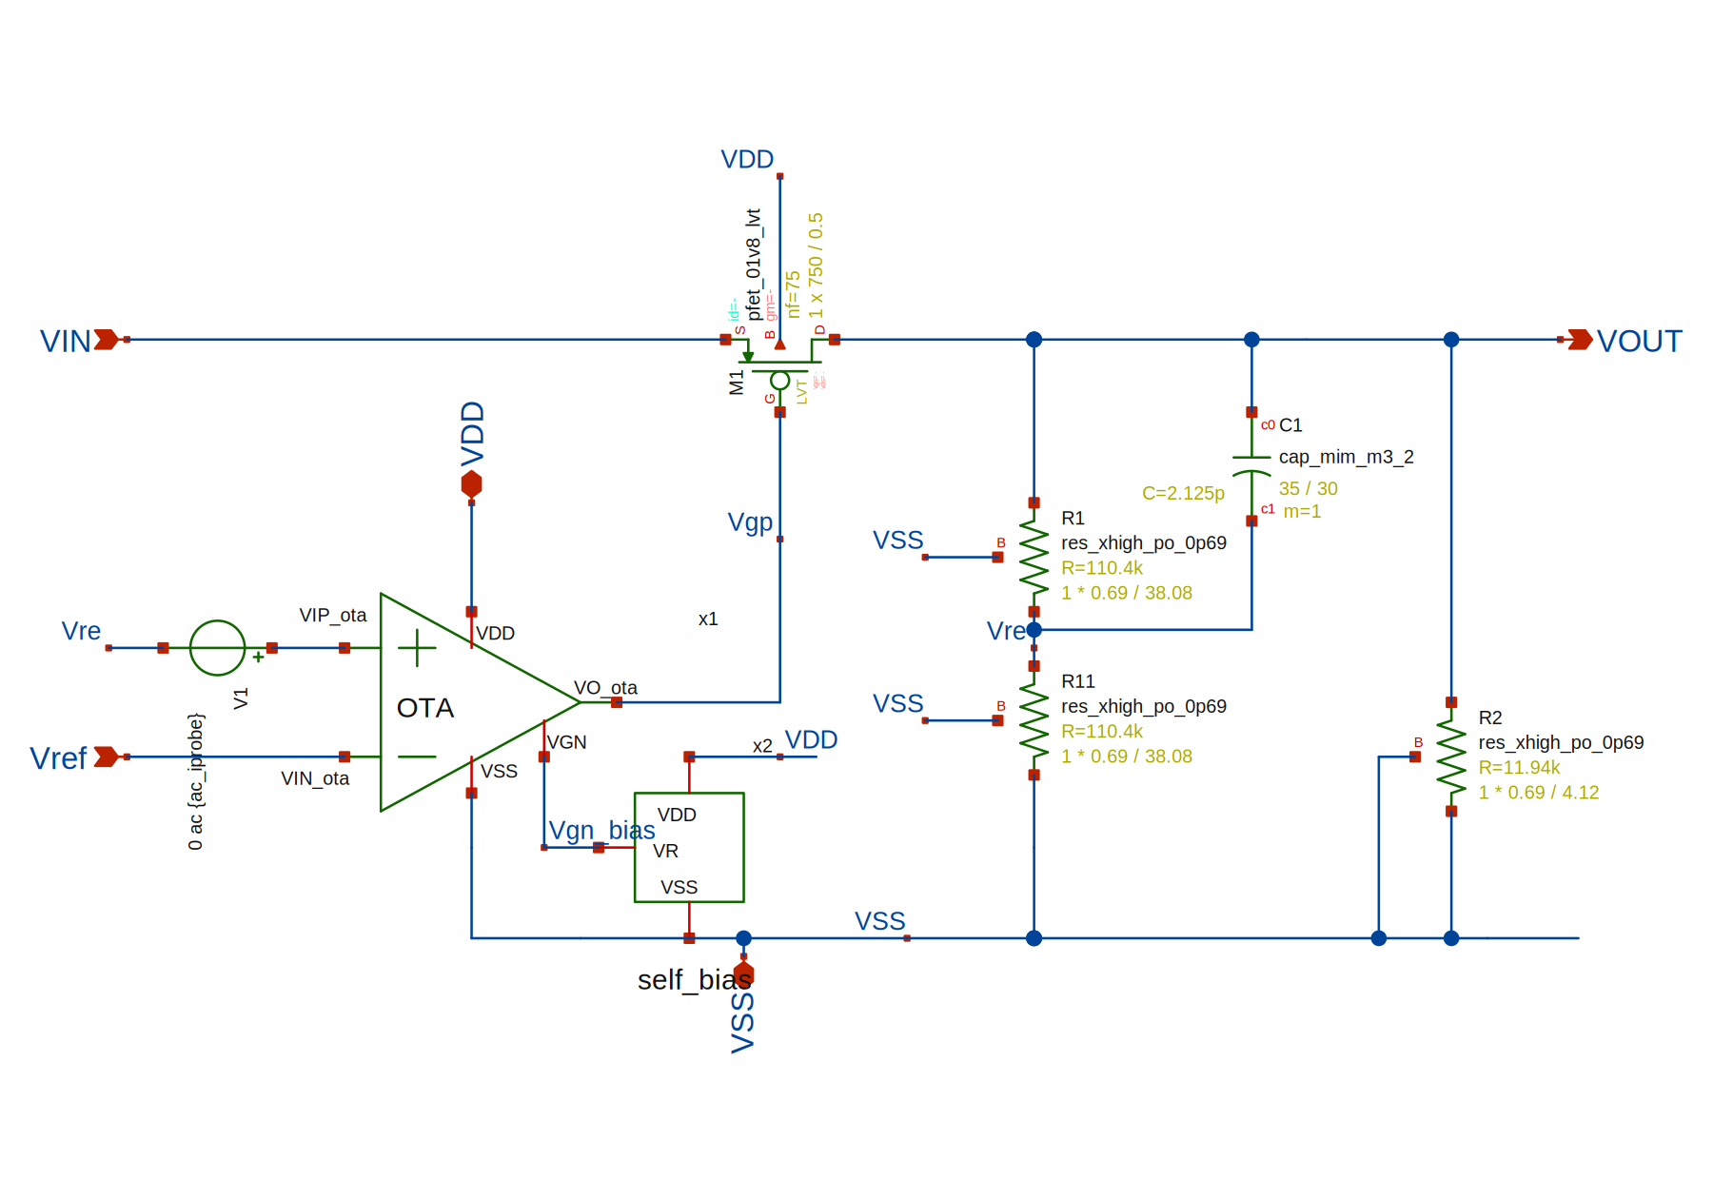
2. Top-Level LDO Schematic Architecture
• The LDO regulator integrates 3 core building blocks in closed loop:
• 1) Self-Bias Generator (x2): Provides bias voltage Vgn_bias (~0.71 V) to the OTA without external current sources.
• 2) OTA Error Amplifier (x1): Compares Vref (0.6 V) against feedback node Vre and drives pass transistor gate Vgp.
• 3) Power & Feedback Stage: PMOS LVT M1 (W=750 µm, L=0.5 µm), divider R1=R11=110.4 kΩ (VOUT=1.2 V), R2=11.94 kΩ, and MIM cap C1=2.1 pF.
Elem. | Sky130A Model | Dimensions | Function
M1 | pfet_01v8_lvt | W=750µm, L=0.5µm, nf=75 | PMOS pass transistor
R1, R11 | res_xhigh_po_0p69 | 0.69×38.08µm (110.4 kΩ) | Feedback divider (Vre = 0.5·VOUT)
R2 | res_xhigh_po_0p69 | 0.69×4.12µm (11.94 kΩ) | Minimum bleeder load (~100 µA)
C1 | cap_mim_m3_2 (M4) | 35µm × 30µm (2.10 pF) | Feedforward capacitor
4

Slide 5
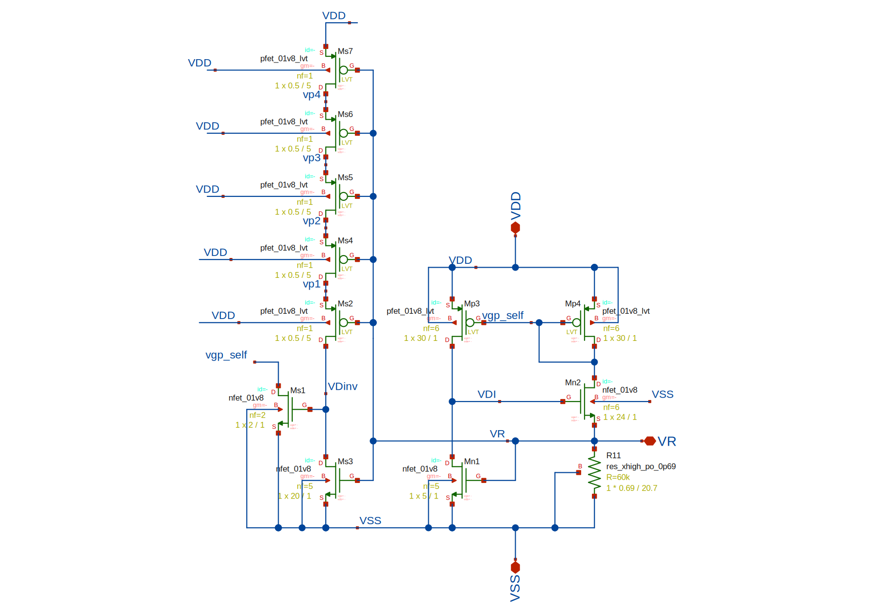
3. Self-Biased Current Reference Generator (Self-Bias)
• Beta-Multiplier topology with source resistive degeneration (R11 = 60 kΩ).
• Bias Core: 1:1 PMOS LVT current mirror (Mp3, Mp4 with W=30 µm, L=1 µm, nf=6) and NMOS pair (Mn1 with W=5 µm, Mn2 with W=24 µm).
• Nominal Operating Point (TT, 27 °C, 1.8 V): VR = 0.7138 V and Ibias = 11.82 µA.
• Start-Up Circuit: 5 series PMOS LVT devices (Ms2, Ms4–Ms7 with W=0.5 µm, L=5 µm) with Ms3 and Ms1 preventing the zero-current state at power-up.
Device | Sky130A Model | W [µm] | L [µm] | nf | Role in Circuit
Mp3, Mp4 | pfet_01v8_lvt | 30.0 | 1.0 | 6 | Upper PMOS mirror
Mn1 | nfet_01v8 | 5.0 | 1.0 | 5 | Left NMOS reference
Mn2 | nfet_01v8 | 24.0 | 1.0 | 6 | R11-degenerated NMOS
R11 | res_xhigh_po_0p69 | 0.69 | 20.7 | 1 | Ibias resistor (60 kΩ)
Ms3, Ms2 ,Ms4–7 | pfet_01v8_lvt | 0.5 | 5.0 | 1 | Start-up branch
Ms1 | nfet_01v8 | 2 / 20 | 1.0 | 2 / 5 | Start-up injection & cutoff
5

Slide 6
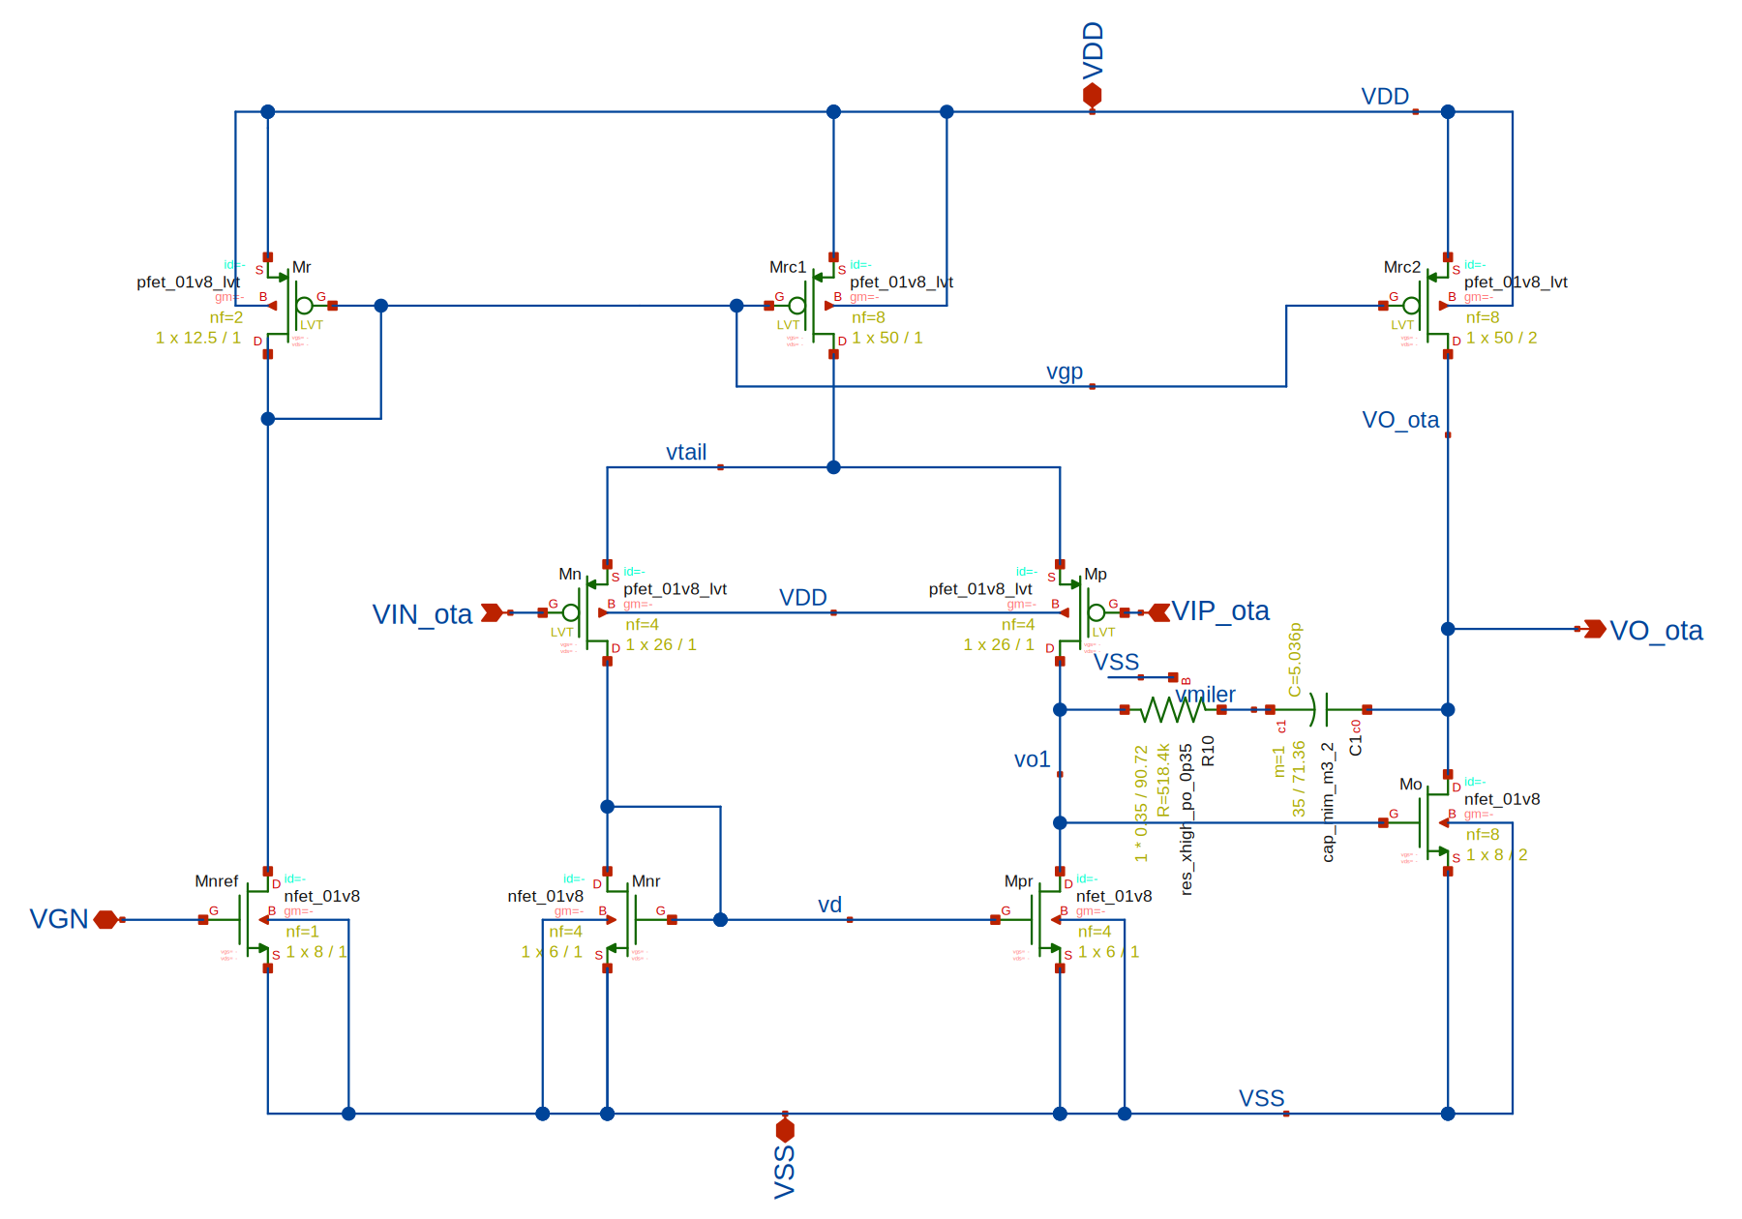
4. Two-Stage OTA Error Amplifier (OTA.sch)
• Two-stage operational transconductance amplifier driving pass transistor M1 gate.
• First Stage: PMOS LVT differential pair (Mn, Mp with W=26 µm, L=1 µm, nf=4) with NMOS active load mirror (Mnr, Mpr with W=6 µm, L=1 µm, nf=4).
• Second Stage: Common-source NMOS stage (Mo with W=8 µm, L=2 µm, nf=8) with PMOS active load (Mrc2 with W=50 µm, L=2 µm, nf=8).
• Miller Compensation: MIM capacitor C1 = 5.0 pF (44.6 µm × 56 µm) and nulling resistor R10 = 518.4 kΩ.
Device | Sky130A Model | W [µm] | L [µm] | nf | Function in OTA
Mn, Mp | pfet_01v8_lvt | 26.0 | 1.0 | 4 | Input differential pair
Mnr, Mpr | nfet_01v8 | 6.0 | 1.0 | 4 | Active load mirror
Mrc1 / Mr | pfet_01v8_lvt | 50 / 12.5 | 1.0 | 8 / 2 | Tail current source & mirror
Mrc2 / Mo | pfet_lvt / nfet | 50 / 8.0 | 2.0 | 8 / 8 | Second-stage output
Mnref | nfet_01v8 | 8.0 | 1.0 | 1 | VGN bias sink
C1 / R10 | cap_mim / res_po | 44.6×56 | - | 1 | Miller network (5pF + 518kΩ)
6

Slide 7
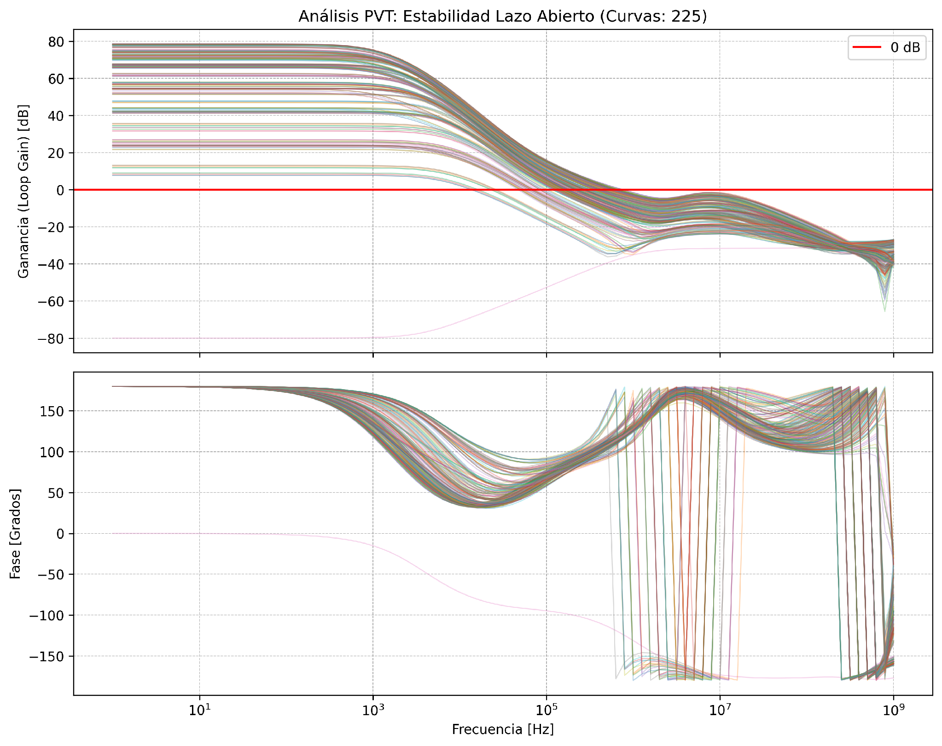
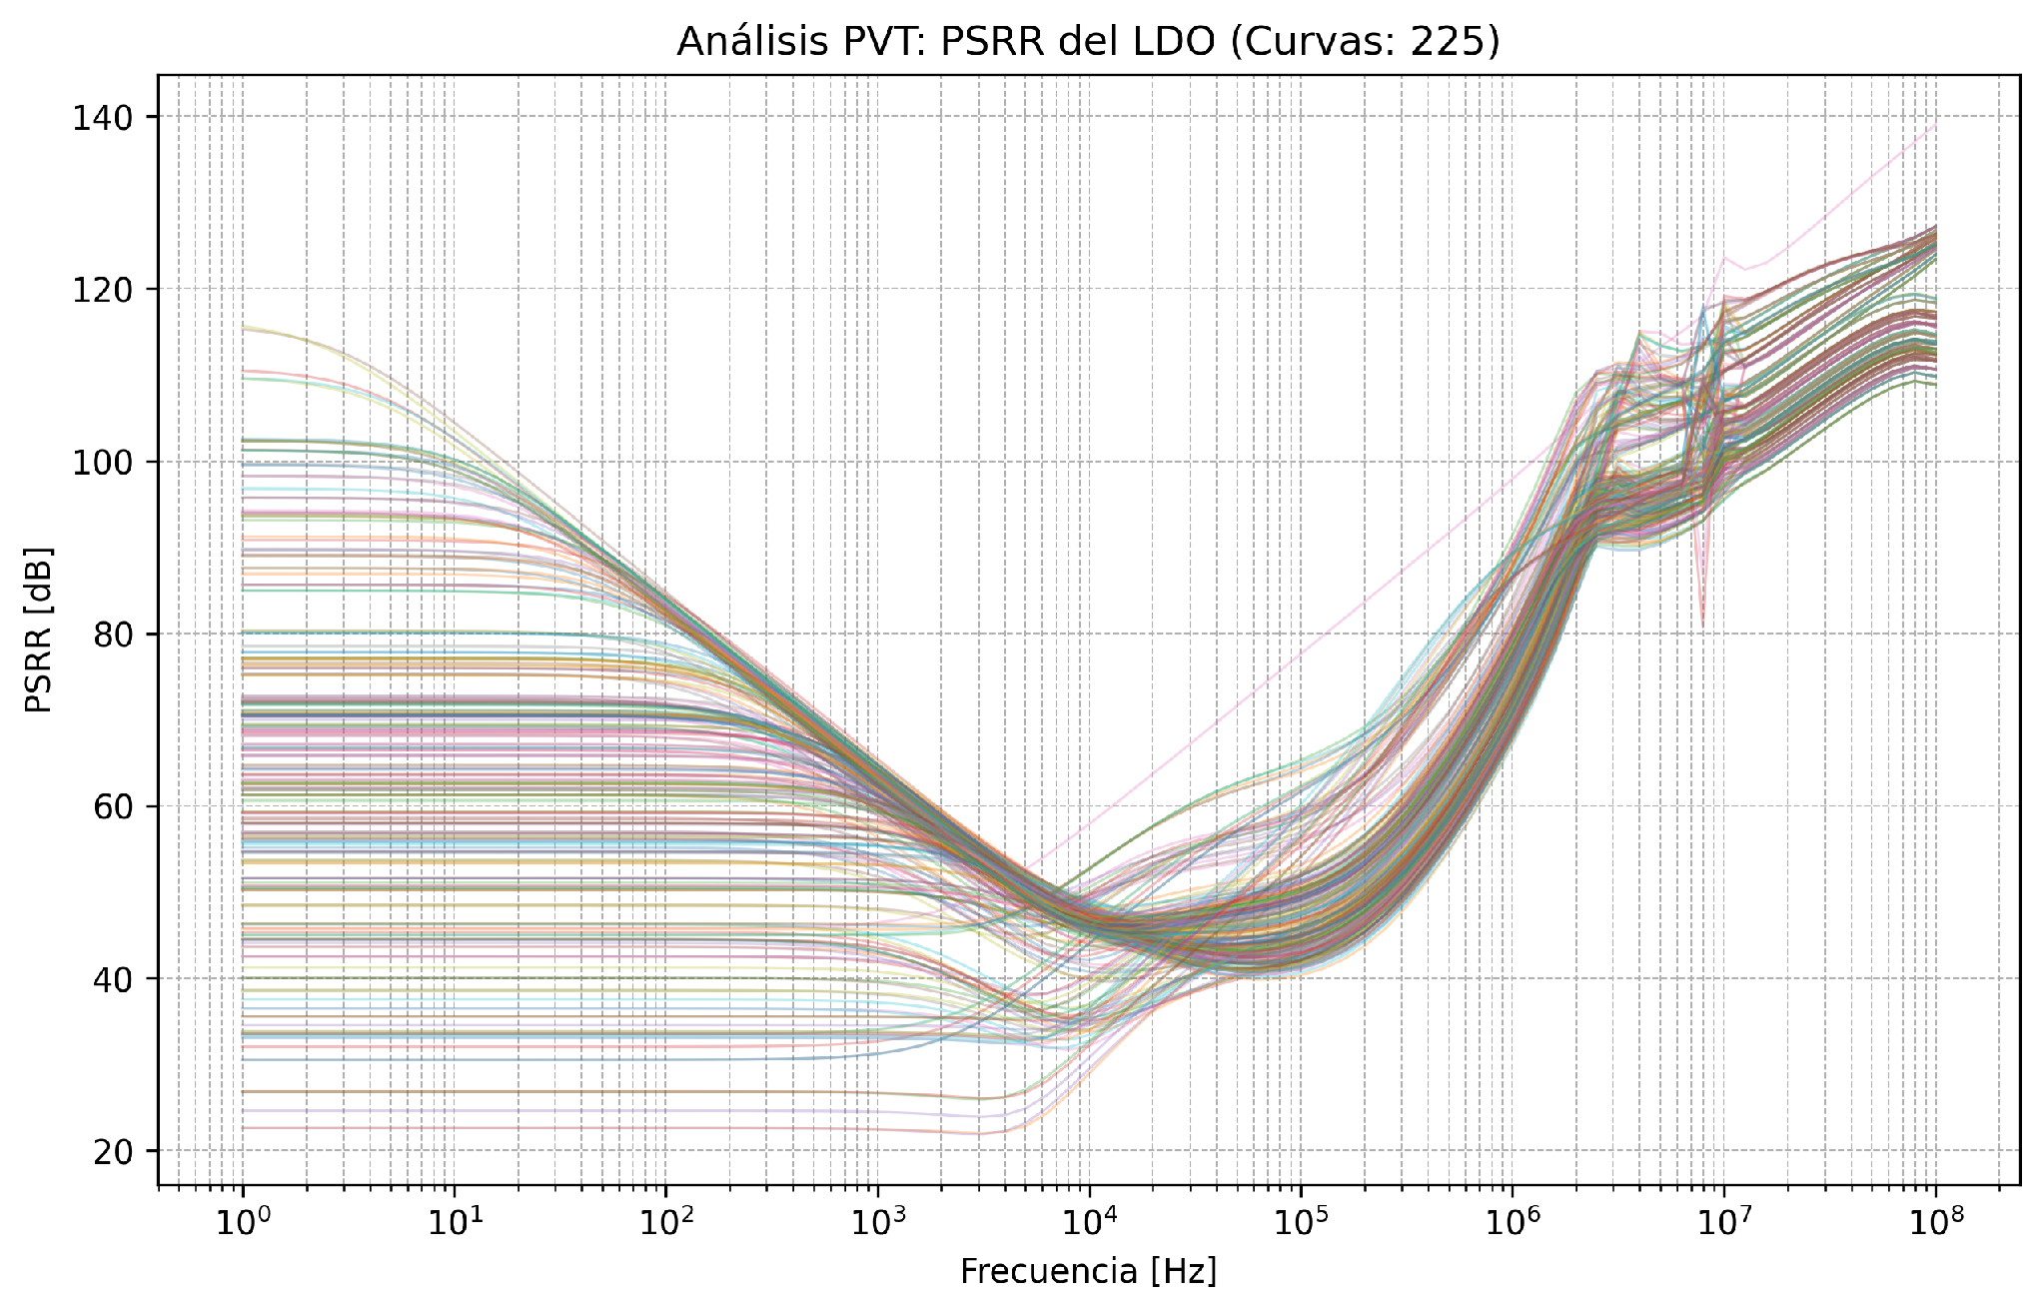
5. Pre-Layout Simulation: AC Stability & PSRR (PVT)
• Sweep across 225 PVT corners: T ∈ {-40 °C, 27 °C, 125 °C}, VDD ∈ {1.62 V, 1.80 V, 1.98 V}, and 25 Sky130 process corners.
• Open-Loop Stability (Iload = 5 mA): Mean Phase Margin = 92.69° (min = 64.18°, max = 123.50°); Mean UGB = 275.3 kHz.
• Power Supply Rejection Ratio (PSRR): Mean of 64.90 dB @ 10 Hz, 62.36 dB @ 1 kHz, 55.49 dB @ 10 kHz, and 48.46 dB @ 1 MHz.
7

Slide 8
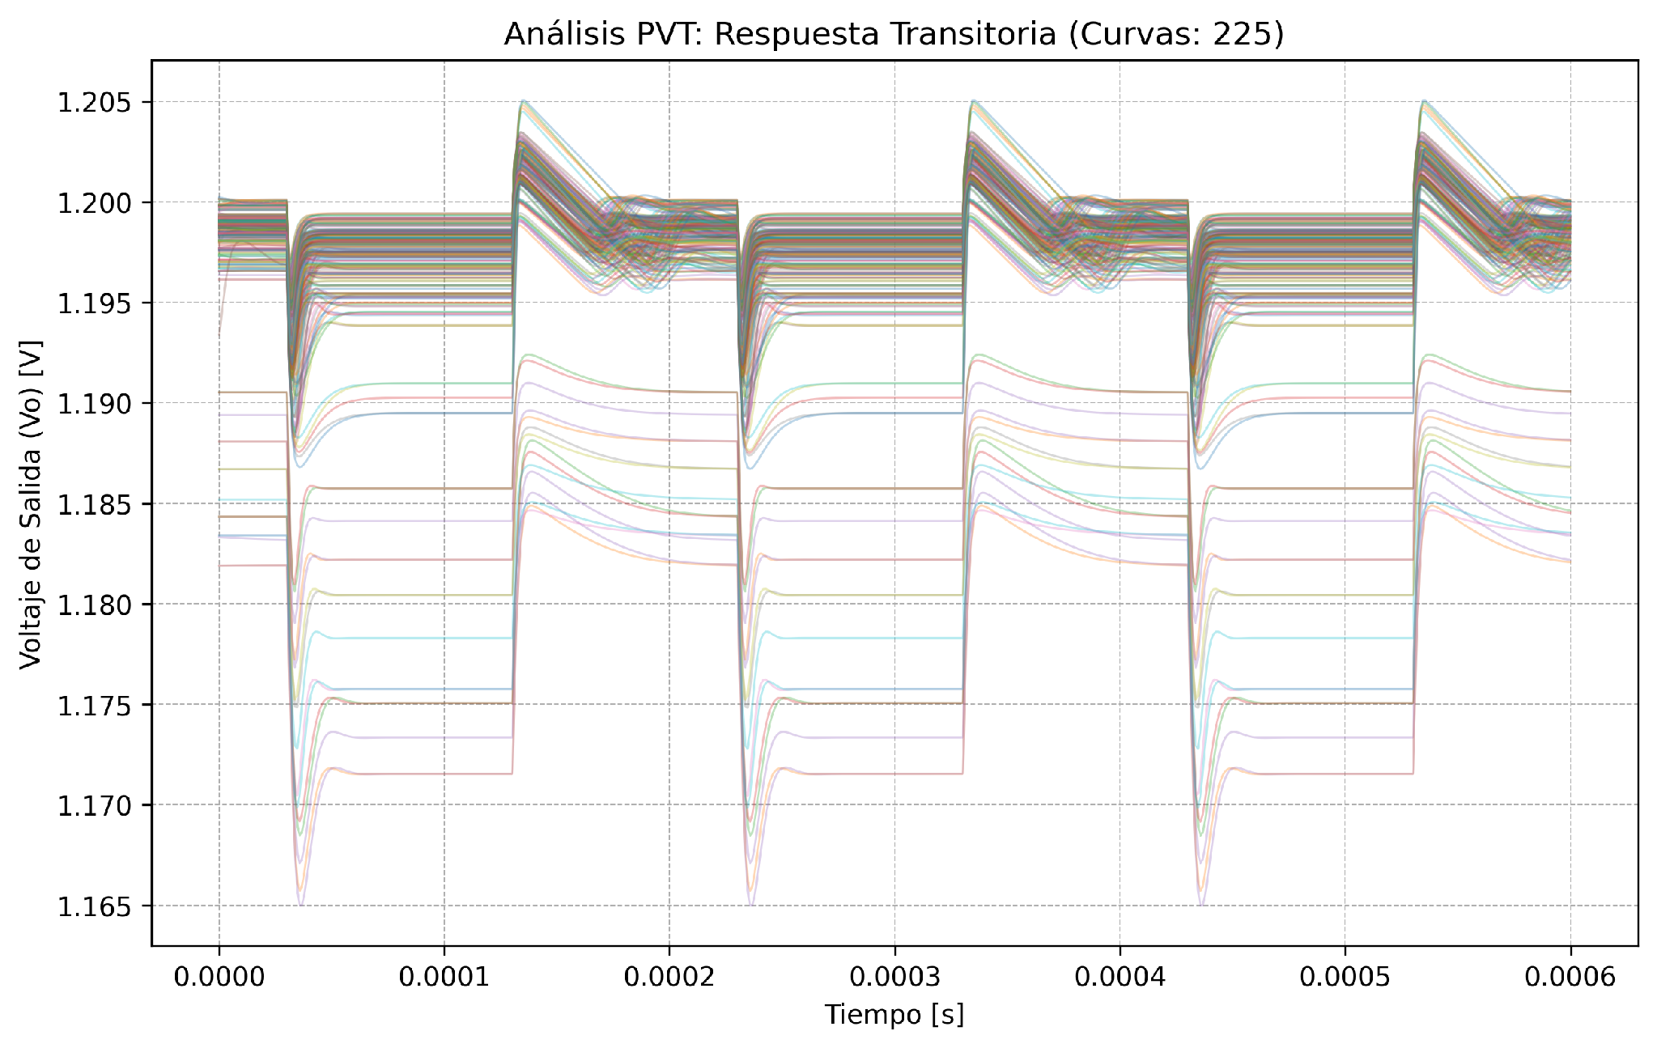
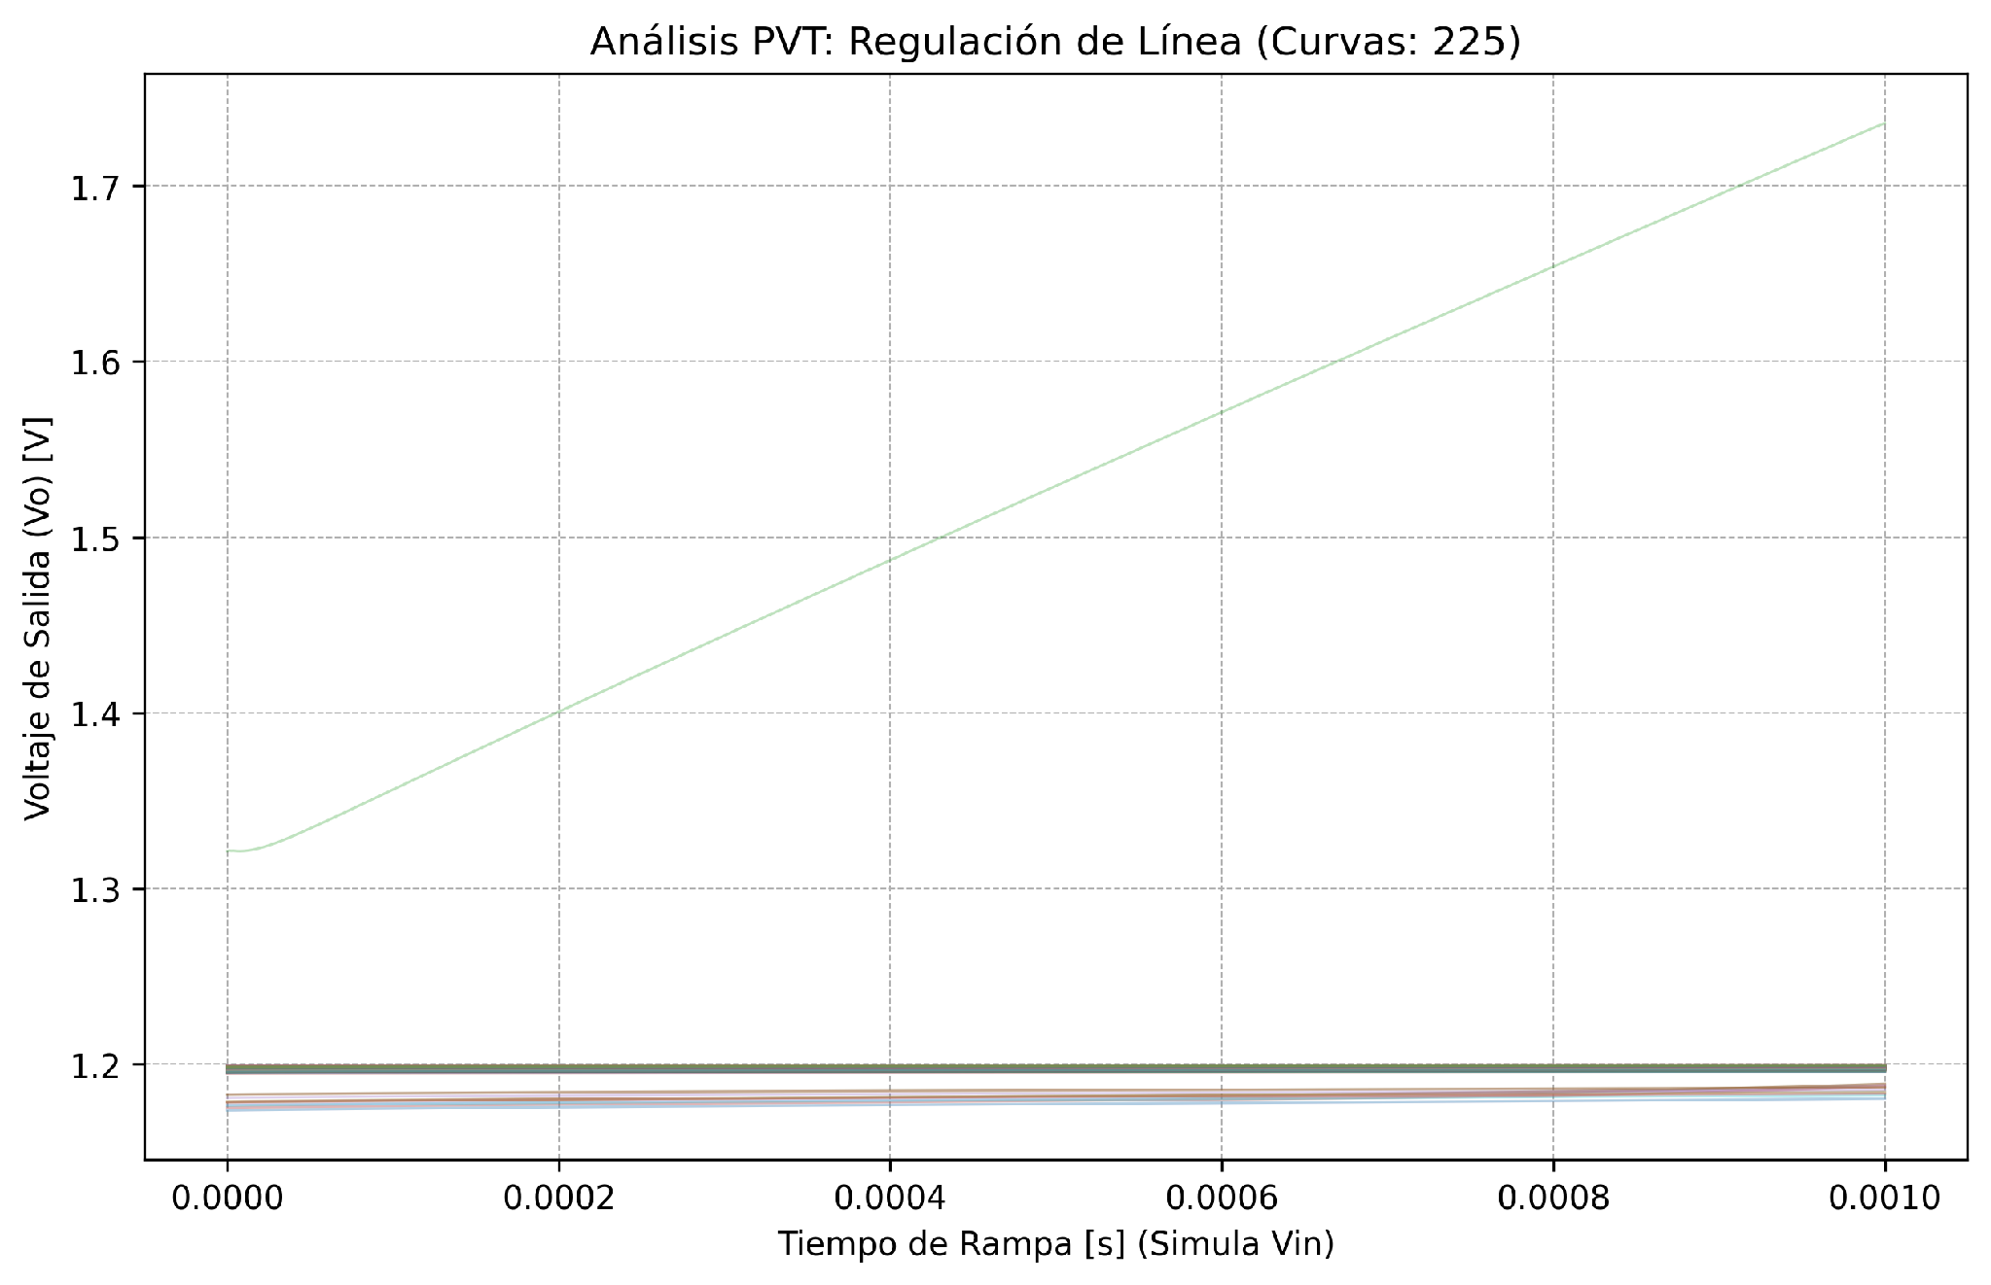
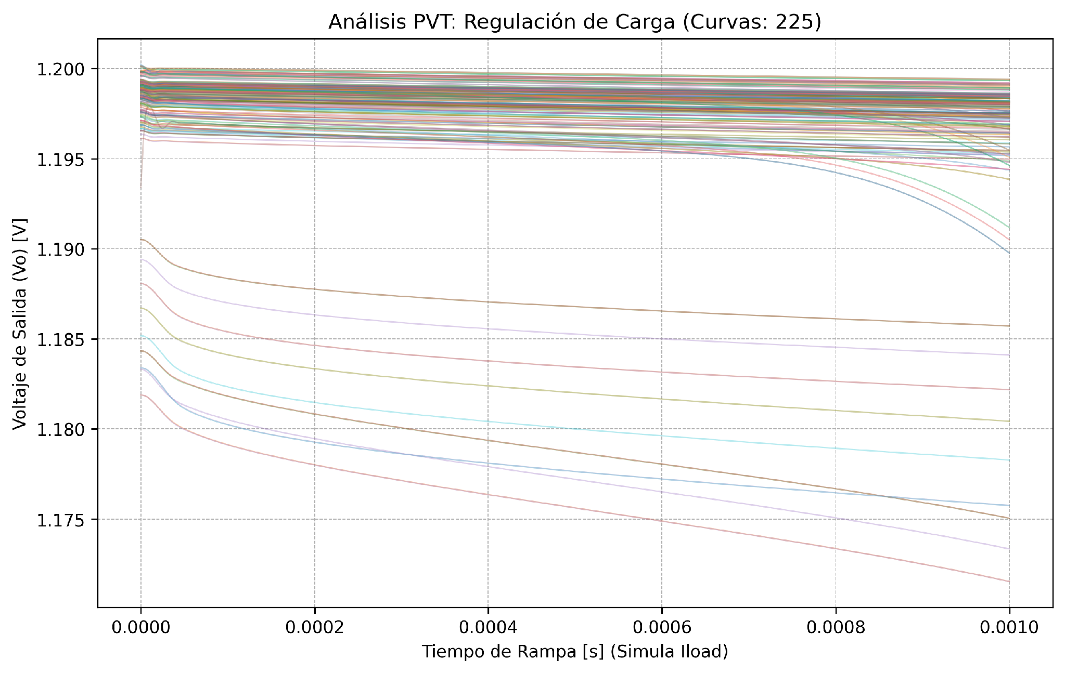
6. Pre-Layout Simulation: Transient & Regulations
Pre-Layout Metric (225 PVT Corners, Iload = 5 mA) | Minimum | Mean | Maximum | Unit
Transient Output Voltage (Vo_tran) | 1.1776 | 1.1972 | 1.1998 | V
Undershoot on 1 µA → 5 mA step (tr = 100 ns) | 2.072 | 3.883 | 6.669 | mV
Overshoot on 5 mA → 1 µA step (tf = 100 ns) | 1.000 | 3.132 | 5.616 | mV
Load Regulation (Iload from 1 µA to 5 mA) | 0.602 | 1.436 | 8.739 | mV
Line Regulation (VIN from 1.4 V to 1.8 V) | 0.286 | 2.631 | 11.50 | mV
Dropout Voltage (at 90% of Vo_nom) | 34.33 | 58.15 | 84.79 | mV
8

Slide 9
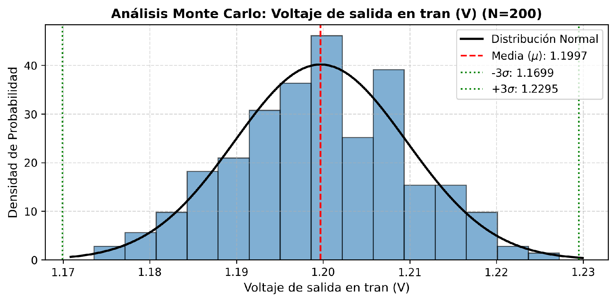
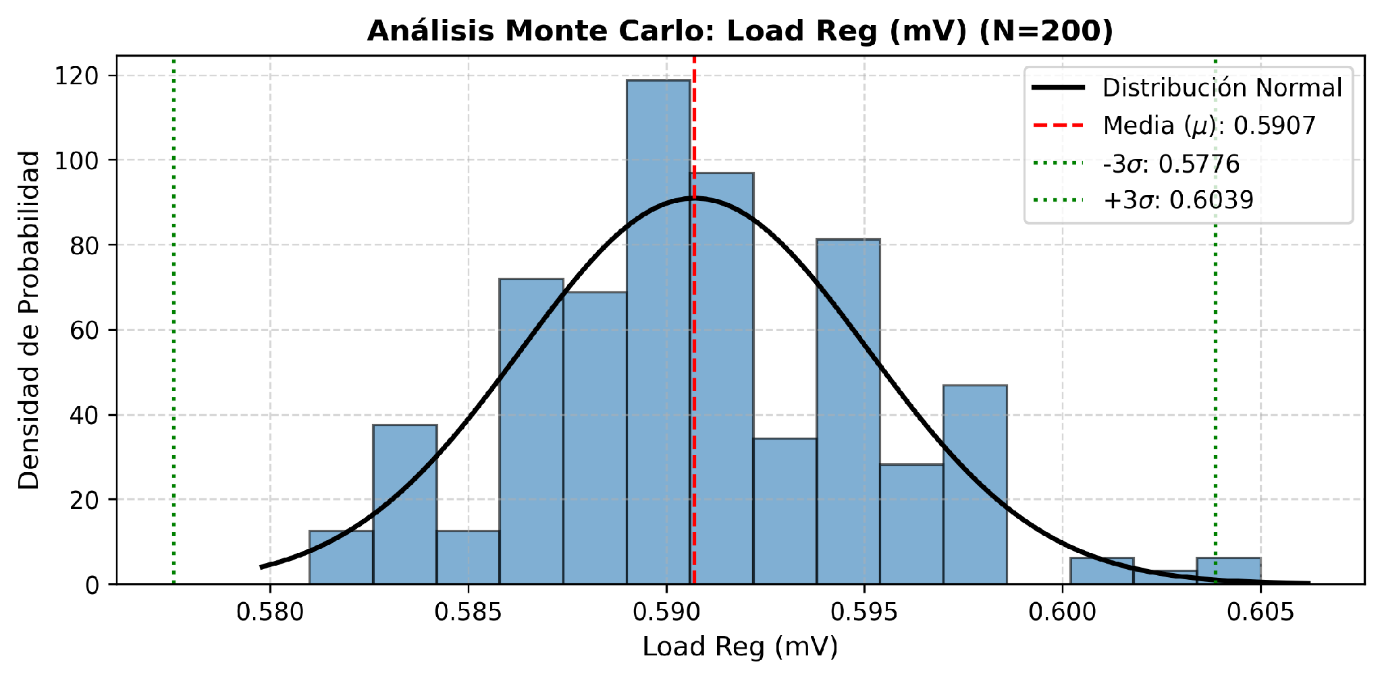
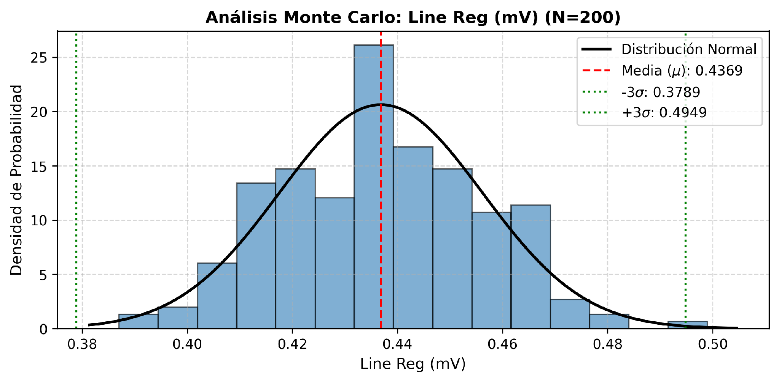
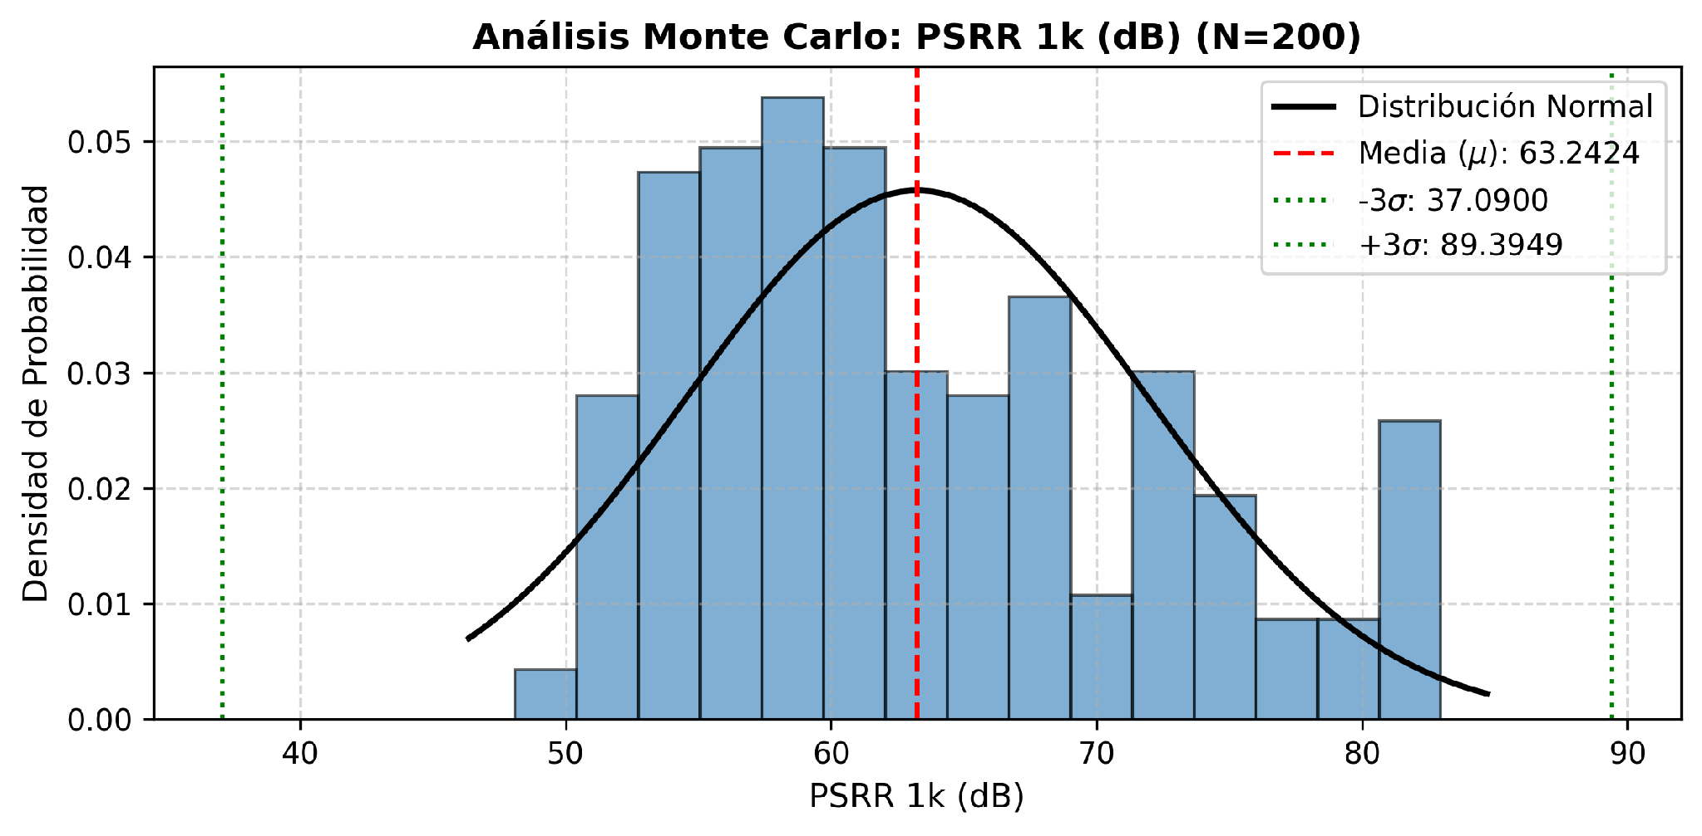
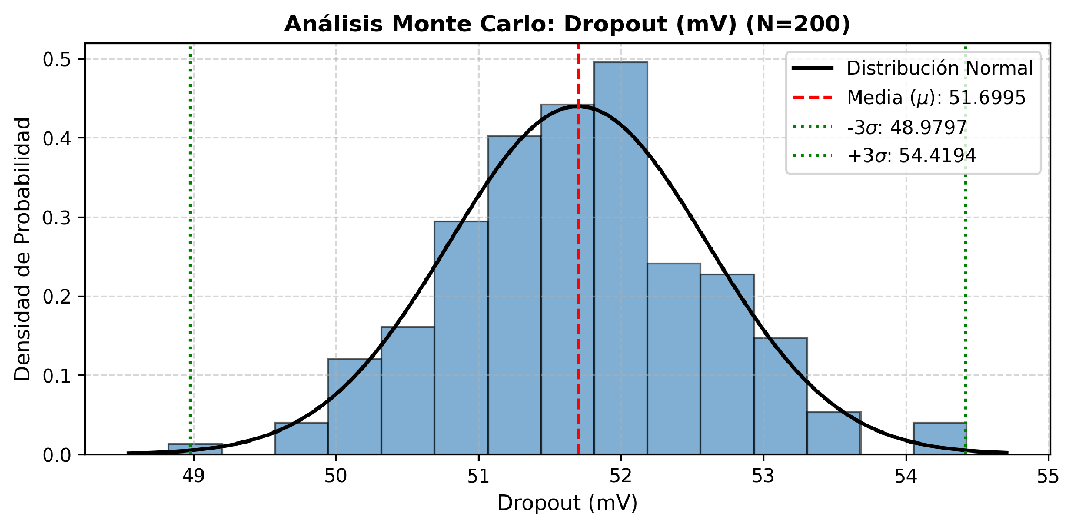
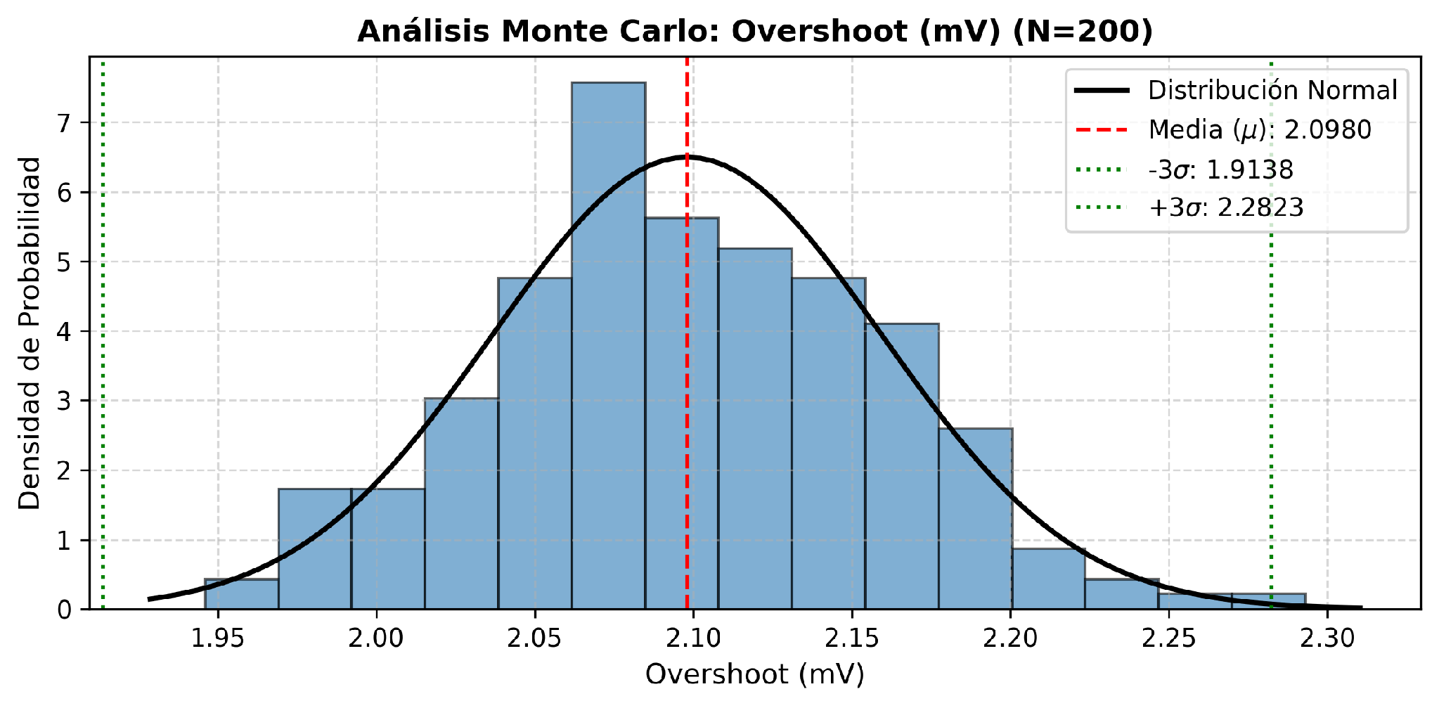
7. Monte Carlo Statistical Analysis (tt_mm, Iload = 5 mA)
9

Slide 10
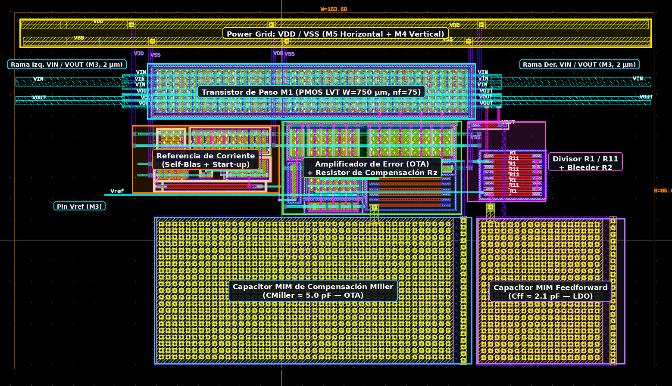
8. Physical Layout Design & M4/M5 Power Grid (LDO.gds)
• Total Dimensions: Width = 152.43 µm (≤ 180 µm), Height = 82.91 µm (≤ 115 µm), Area = 0.0126 mm².
• Power Grid Compliance (Section 11): Vertical distribution tracks on Metal 4 (M4) connected to horizontal main VDD and VSS rails on Metal 5 (M5).
• Matching & Symmetry: OTA differential pair and current mirrors surrounded by dedicated guard rings for latch-up and substrate noise immunity.
• Pass Transistor M1: 75-finger interdigitated array (Wtotal = 750 µm) in the upper region with dense M1–M3 vias to minimize IR drop and series resistance.
• MIM Capacitors (M3/M4): Placed in the lower region efficiently utilizing the area beneath top-level routing.
10

Slide 11
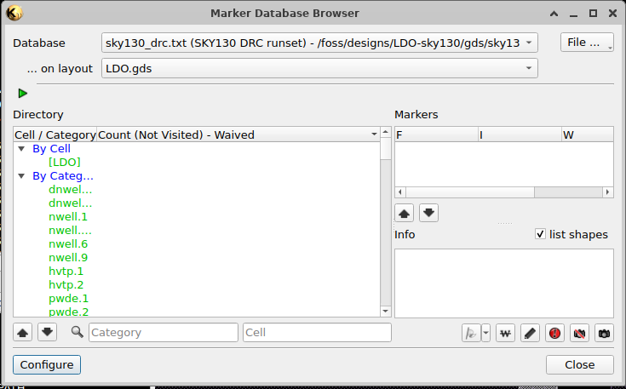
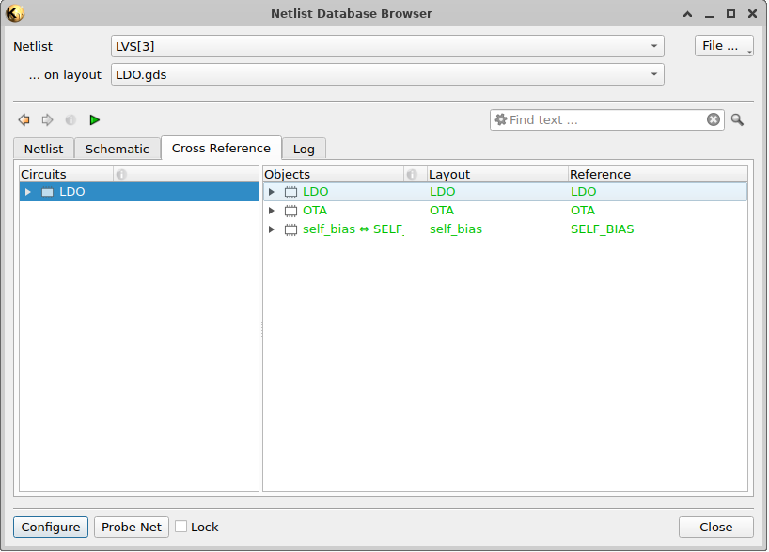
9. Physical Verification Evidence: Clean DRC & LVS
• DRC Verification: Executed in KLayout using the official SKY130 DRC runset on top cell 'LDO'. Result: 0 violations (100% clean).
• LVS Verification (Right - LDO.lvsdb): Executed in KLayout comparing hierarchical layout 'LDO.gds' against Xschem schematic. Result: Exact match (green) across all 3 hierarchical levels (LDO, OTA, and self_bias).
11

Slide 12
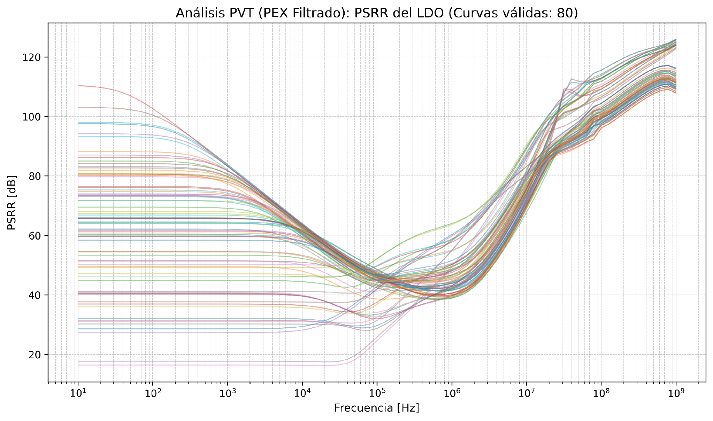
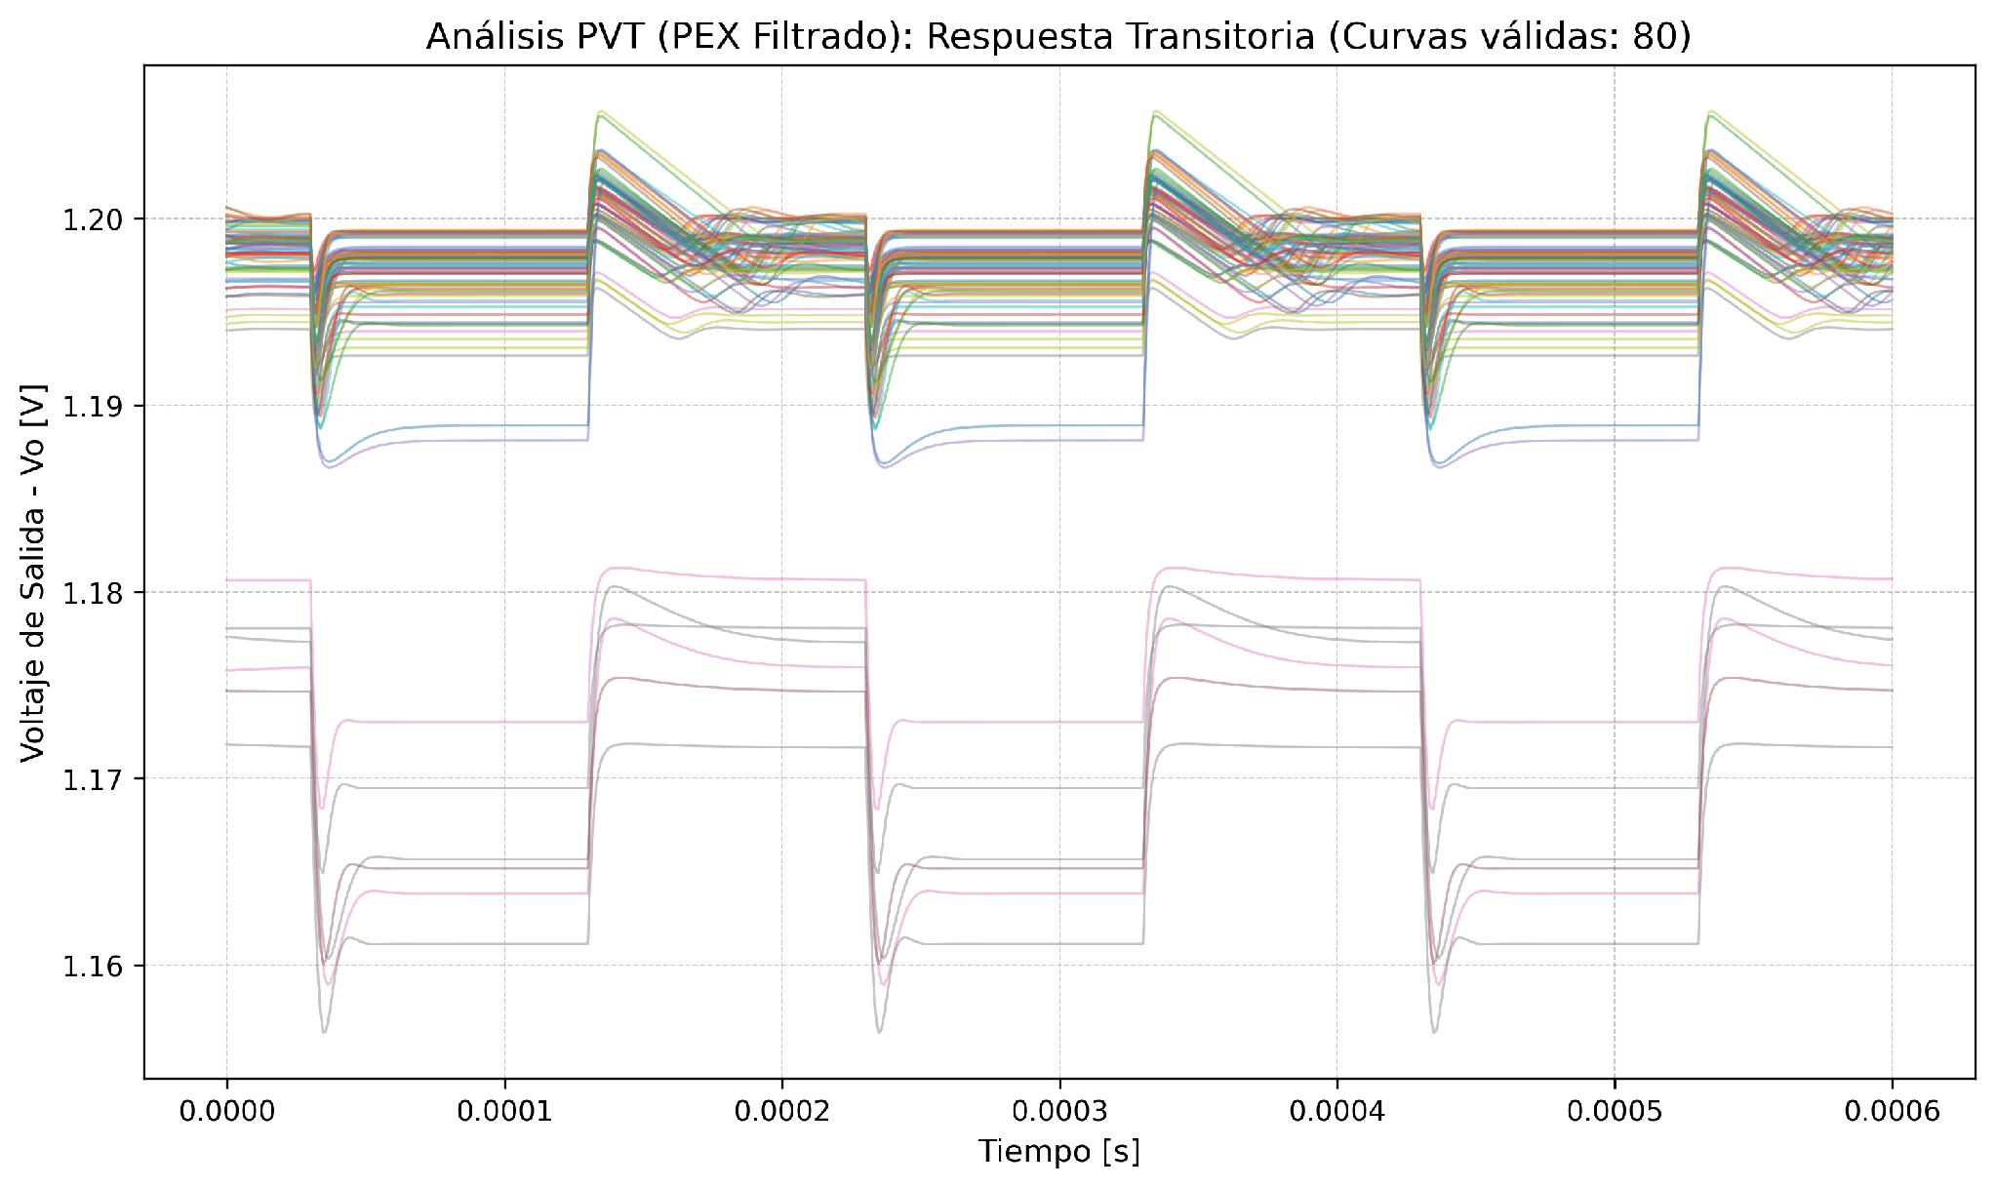
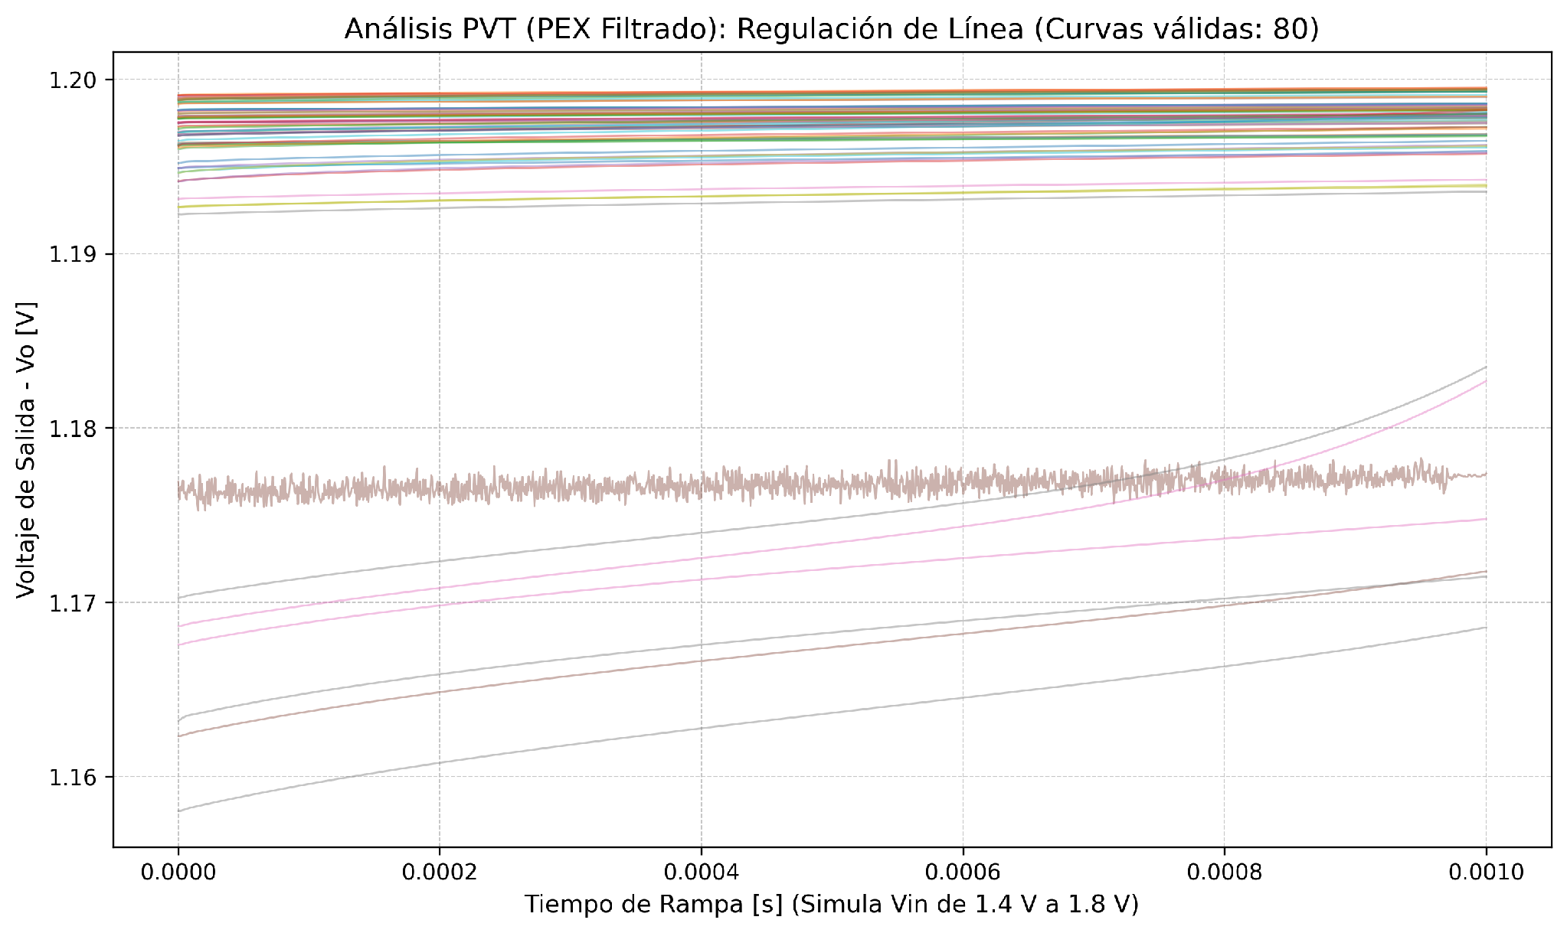
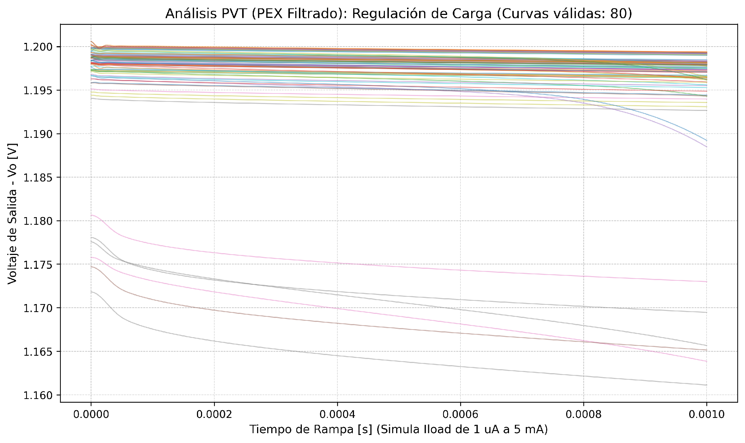
10. Post-Layout (PEX) Validation: PVT Corner Curves
12

Slide 13
11. Final Comparison: Pre-Layout vs. Post-Layout (PEX)
Parameter / Specification | Pre Min | Pre Mean | Pre Max | PEX Min | PEX Mean | PEX Max | Unit
Settled Output Voltage (Vo_tran) | 1.1776 | 1.1972 | 1.1998 | 1.1669 | 1.1959 | 1.1999 | V
Line Output Voltage (Vo_line) | 1.1773 | 1.1982 | 1.2000 | 1.1635 | 1.1953 | 1.1993 | V
PSRR @ 10 Hz | 22.61 | 64.90 | 115.65 | 16.44 | 63.05 | 110.32 | dB
PSRR @ 1 kHz | 22.61 | 62.36 | 84.81 | 16.43 | 61.15 | 83.80 | dB
PSRR @ 10 kHz | 22.45 | 55.49 | 65.44 | 16.37 | 53.90 | 64.04 | dB
PSRR @ 1 MHz | 40.34 | 48.46 | 77.63 | 38.89 | 46.64 | 64.00 | dB
Undershoot (1 µA → 5 mA) | 2.072 | 3.883 | 6.669 | 1.426 | 3.570 | 6.938 | mV
Overshoot (5 mA → 1 µA) | 1.000 | 3.132 | 5.616 | 0.128 | 2.936 | 5.451 | mV
Line Regulation (1.4 V – 1.8 V) | 0.286 | 2.631 | 11.50 | 0.295 | 1.226 | 11.60 | mV
Load Regulation (1 µA – 5 mA) | 0.602 | 1.436 | 8.739 | 0.602 | 1.673 | 10.48 | mV
Dropout Voltage (Iload = 5 mA) | 34.33 | 58.15 | 84.79 | 37.59 | 60.74 | 87.65 | mV
• Validation Conclusion: The full RC-extracted post-layout model (LDO_pex.spice, 35,359 lines) maintains accurate regulation at VOUT = 1.1959 V (< 1.3 mV deviation vs. schematic), mean PSRR > 61 dB up to 1 kHz, and mean Dropout of 60.74 mV.
13

Slide 14

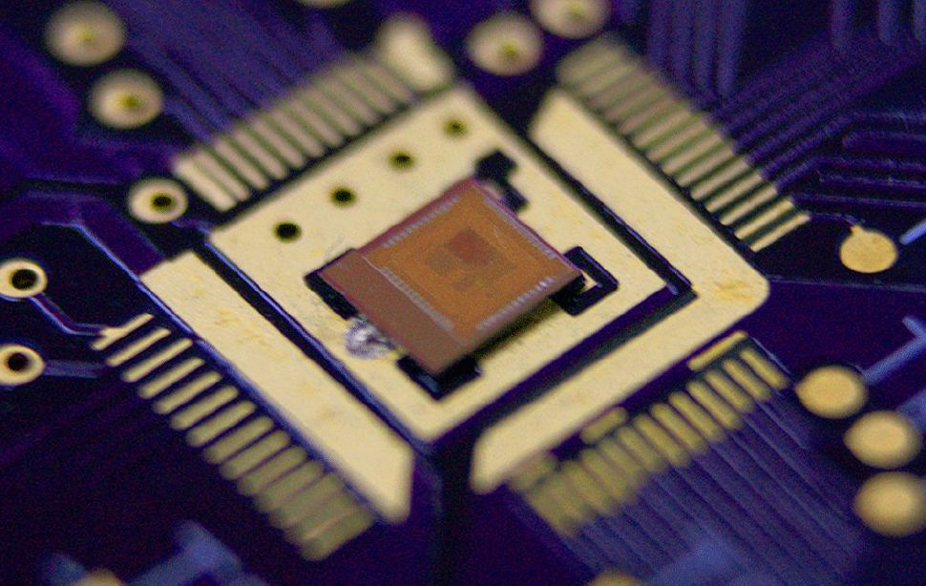
Thanks
lduran2805@gmail.com | luigy2230397@correo.uis.edu.co
14

