Slide 1
Target Tracking with Pan and Tilt
Optimal control – MEMec Spring semester 2017/2018, IST
Luis Miranda nº 81089
Diogo Catarino nº 81772
Reon Fujieda nº89120

Slide 2
Problem
Model and control an acquisition and tracking system in a mobile robot of a static target in an optimal way.
Tracking will be made by a combination of horizontal and vertical movements (Pan-Tilt) actuated by two servomotors through acquisition of data from na end-effector camera.
Main purpose is to fixate the target in the center of the camera

Slide 3
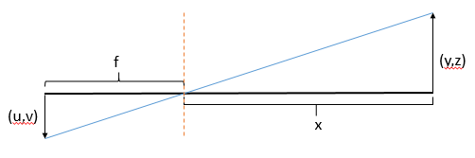
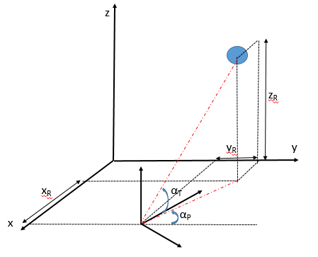

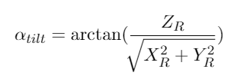
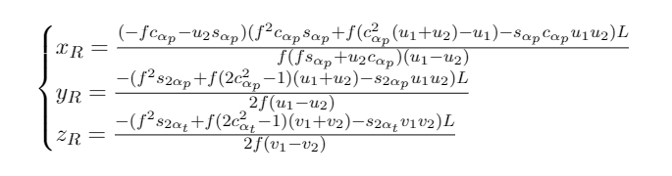
System Dynamics
Target and “rasteirinho” coordenates

Slide 4
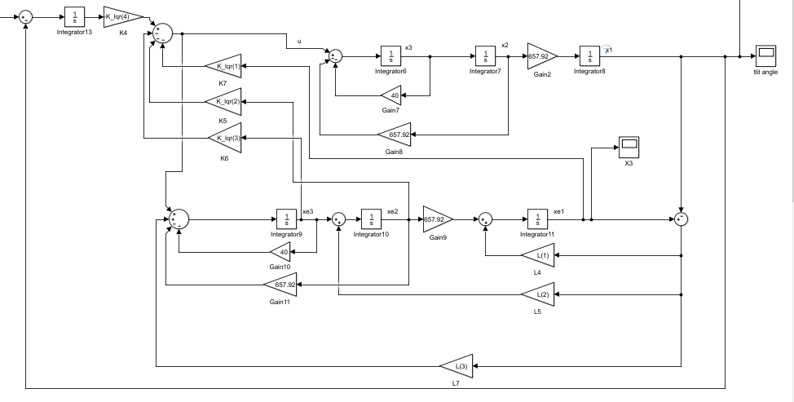
LQR with Observer design

Slide 5
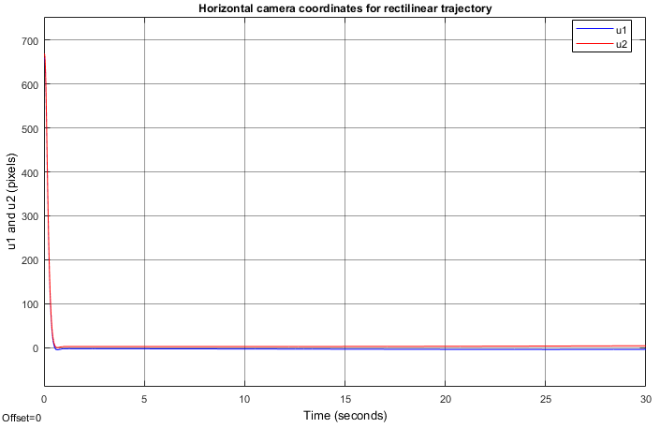
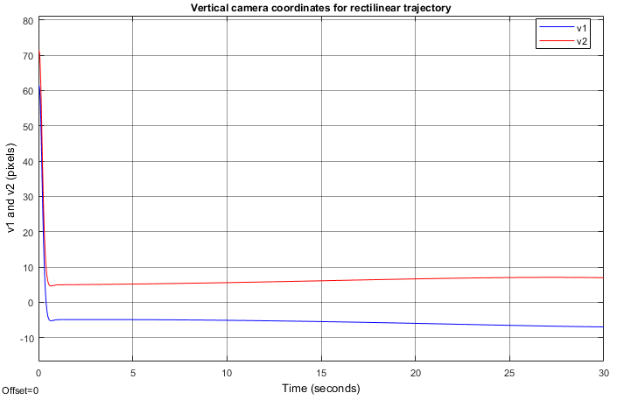
Continuous Time responses

Slide 6
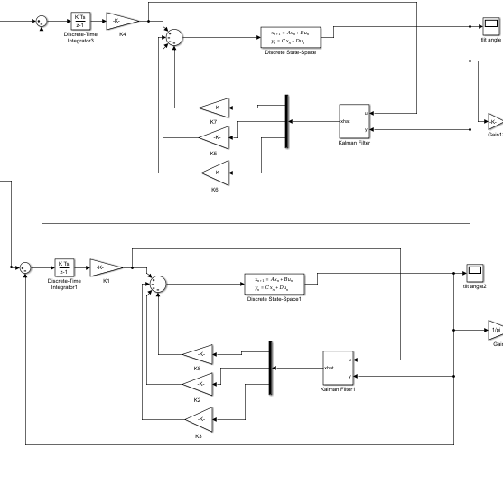
Discrete Model

Slide 7
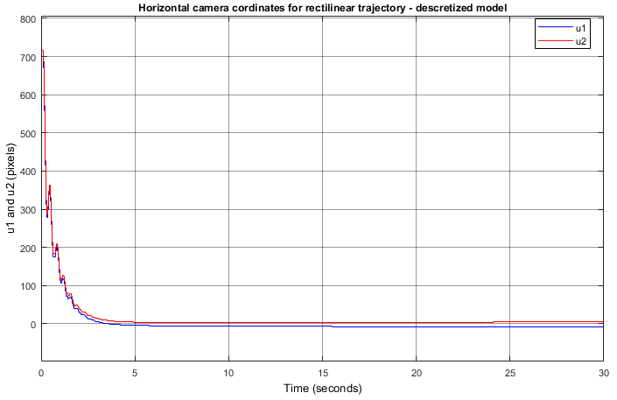
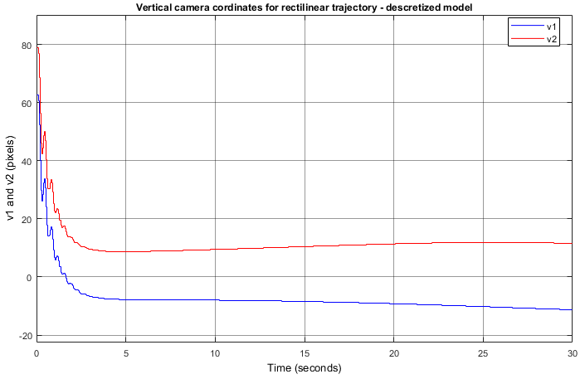
Discrete Time Response

Slide 8
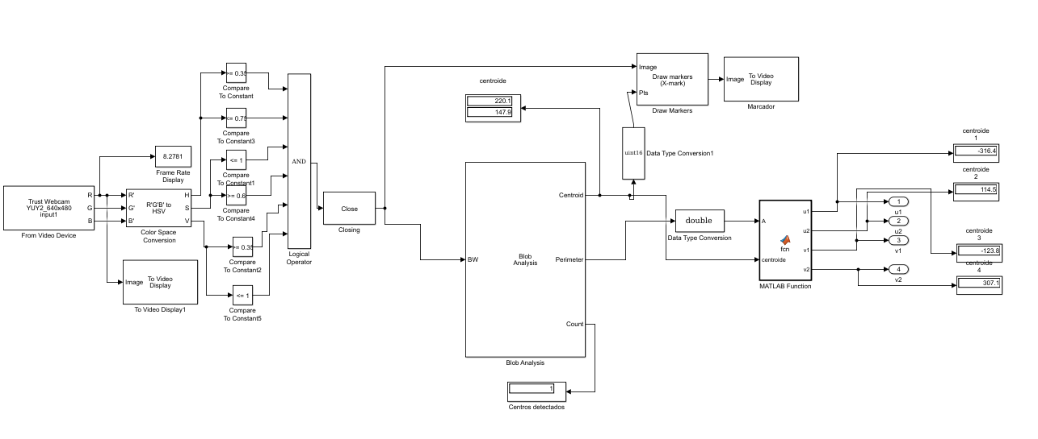
Image Aquisition

Slide 9
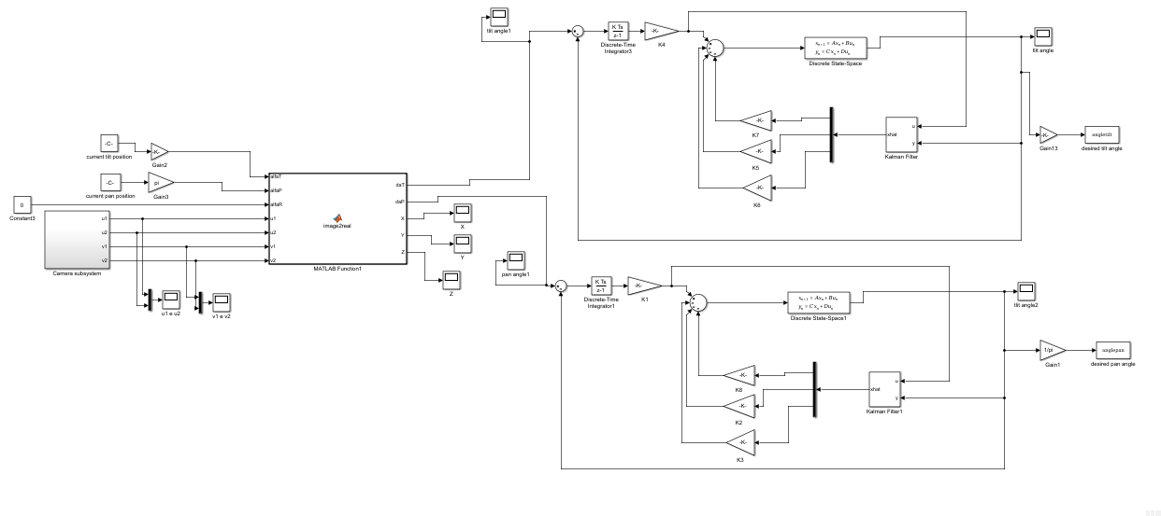
Final model

Slide 10
