Slide 1
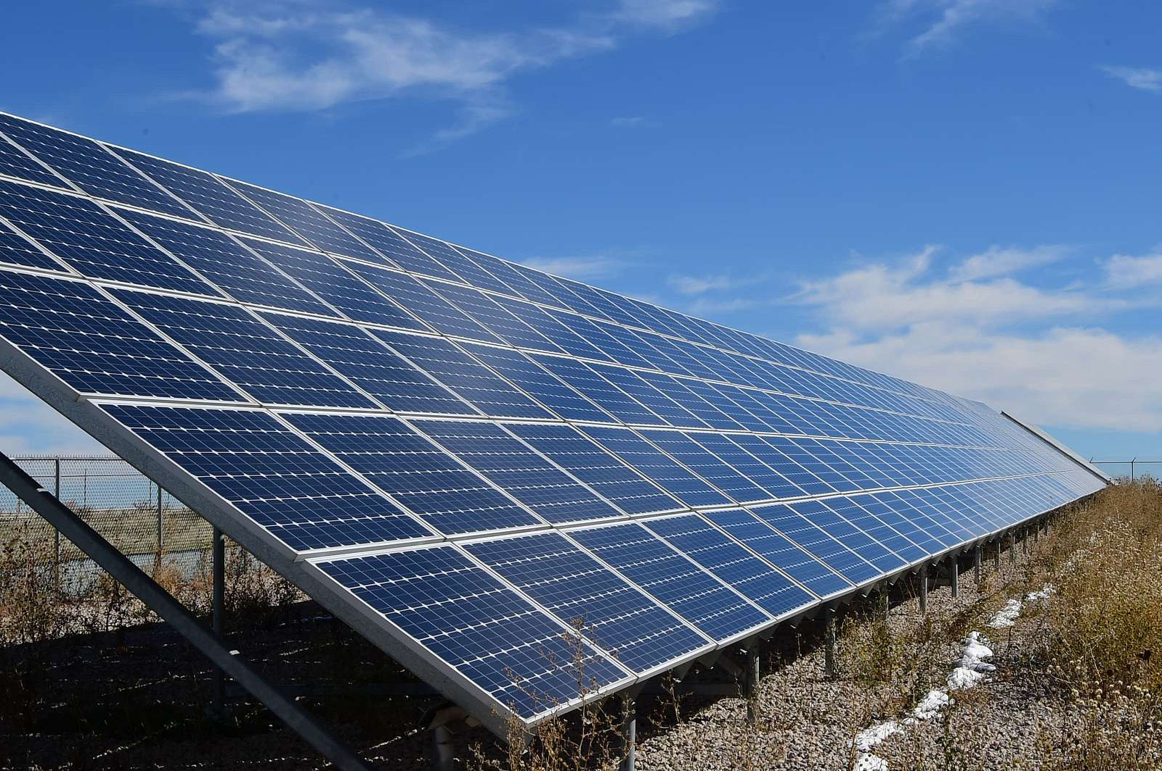


Solar power plant data analysis summary
Analysing performance data from a photovoltaic solar power plant in India
github.com/luis-cj
linkedin.com/in/luis-cj

Slide 2
Context
A renewable energy supplier owns solar power plants in India.
Two of the power plants present power production anomalies affecting the total power generation and thus reducing business income.
Prior to sending the technical team to fix the problem the data science team was required to analyse power plants’ sensors data to make a first approximation to the root cause of failure of the equipment.
What should the data science team do? How should they approach the problem?

Slide 3
Methodology
Set the project objective
Establish the variables that affect the business objective
Define the KPIs of those variables
Enumerate and classify the relevant entities involved and the data that can retrieved from them
Identify the first questions that need to be answered in order to start looking for significant insights into each of the variables affecting the business objective
Analyse the data and look for insights
Suggest an action plan
For the complete methodology description please refer to this link.

Slide 4
PROJECT INSIGHTS

Slide 5
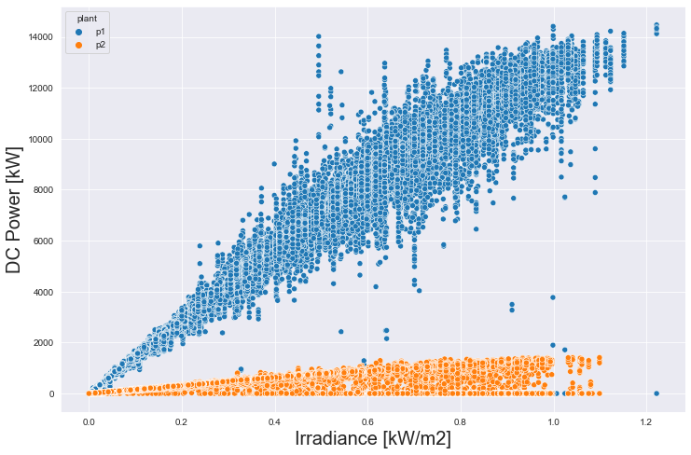
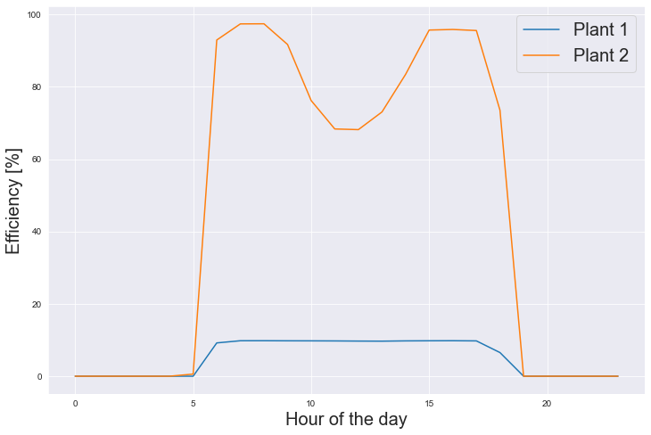
There are important data quality issues that suggest that the following statements are not conclusive
DC power generated by plant [kW]
PENDING A SECOND REVIEW
Plant efficiency throughout the day [%]
95%
DC generation in power plant 1 is around 10 times higher than in plant 2
While the efficiency conversion is only around 10%
10%
It has been required to review the data acquisition system to check if it has been a data quality issue.

Slide 6
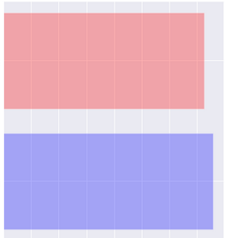
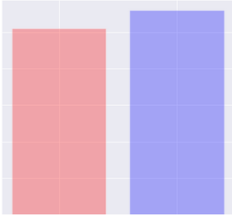
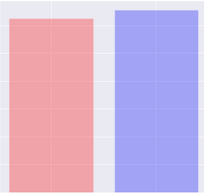
Both power plants receive high, similar amount of irradiance, with no sign of power availability problems
Total irradiance by plant [kW/m²]
Mean ambient temperature [ºC]
Mean modules’ temperature [ºC]
PLANT 1
726
26
31.1
PLANT 2
758
28
32.7
The small difference found between both power plants suggests that they should have very similar DC power generation capabilities.

Slide 7
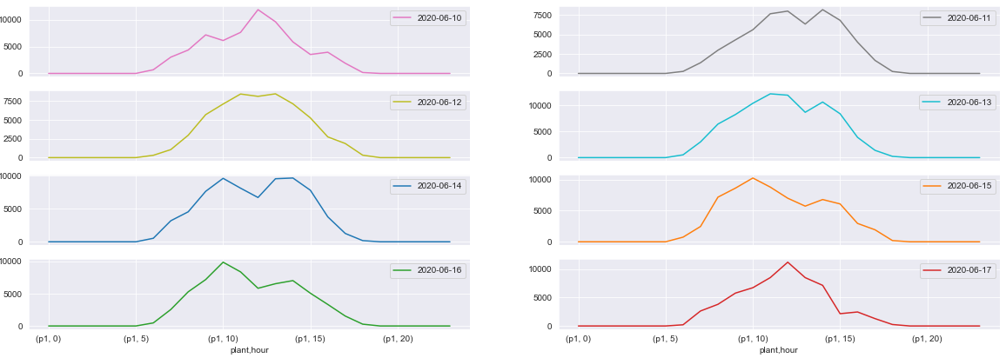
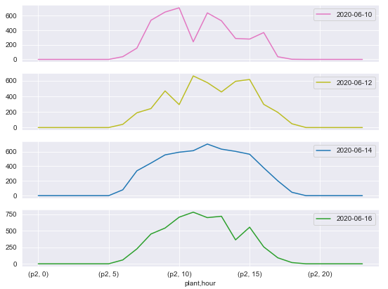
DC power generation in plant 1 is very high, approximately 10 MW of daily DC generation
PLANT 1
Mean hourly DC power generation by day [kW]
PLANT 2
10,000 kW
600 kW
Plant 1 and plant 2 have the same number of inverters but the DC power produced is around 10 times higher for plant 1. It is suspected that DC power generation in plant 1 is not measured correctly or is artificially scaled up.

Slide 8
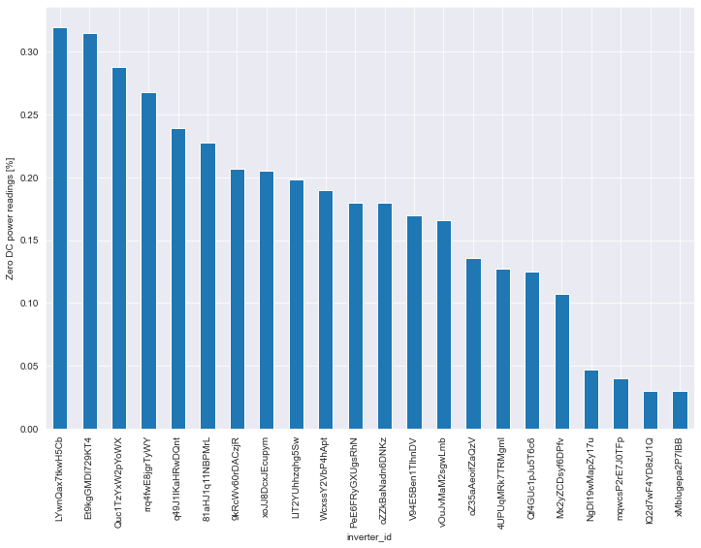
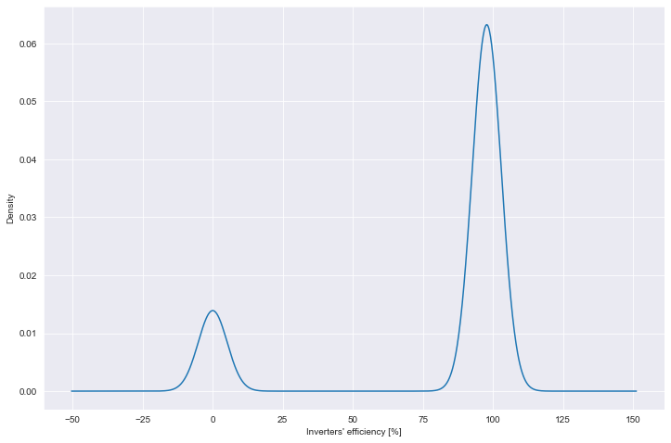
Some inverters at plant 2 fail to convert DC power 30% of the time during irradiance peak hours
Mean inverters’ efficiency [%] distribution between 09:00 and 15:00
PLANT 2
It is highly suggested to check these inverters from plant 2 in the next maintenance check.

Slide 9


After carrying out the data analysis, the following action plan is suggested:
Data quality
Irradiance
DC Production
Inverters’ efficiency
PLANT 1
PLANT 2
ACTION #1: Overall data acquisition process check.
ACTION #2: Make sure there is no artificial scaling when measuring DC production in plant 1.
ACTION #3: Maintenance of all inverters from plant 1 and the selected inverters from plant 2.

