Slide 2
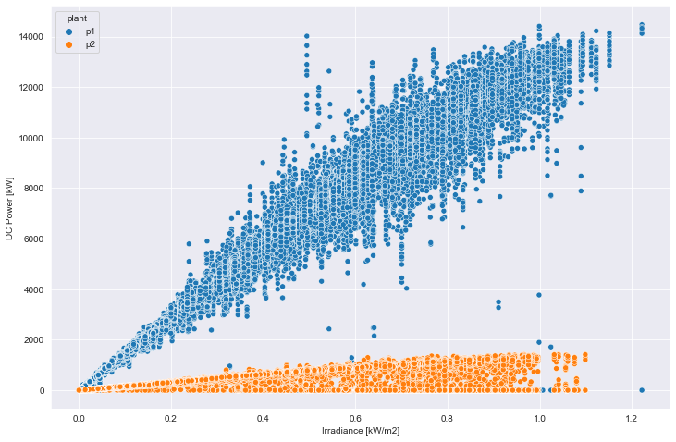
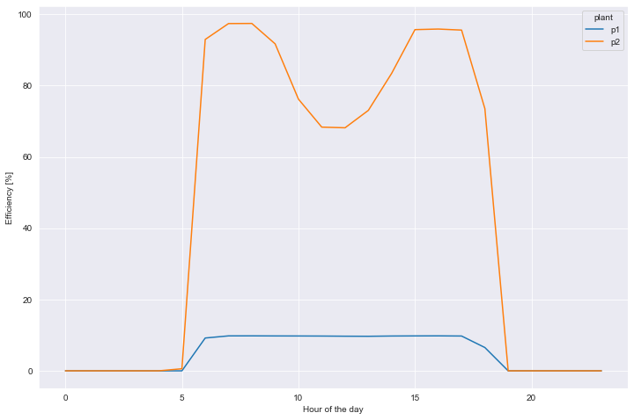
There are important data quality issues that suggest treating the following statements as not conclusive
DC power generated by plant [kW]
PENDING A SECOND REVIEW
Plant efficiency throughout the day [%]
95%
DC generation in power plant 1 is around 10 times higher than in plant 2
10%
It has been required to review the data acquisition system to check if it has been a data quality issue.

Slide 3
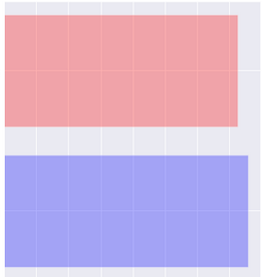
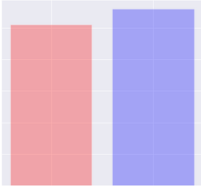
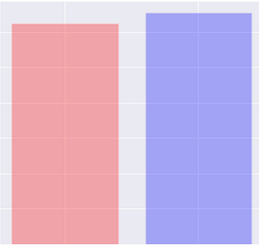
Both power plants receive high and similar amount of irradiance, with no sign of power availability problems
Total irradiance by plant [kW/m²]
Mean ambient temperature [ºC]
Mean modules’ temperature [ºC]
PLANT 1
726
26
31.1
PLANT 2
758
28
32.7
The small difference found between both power plants suggest that they should have very similar DC power generation capabilities.

Slide 4
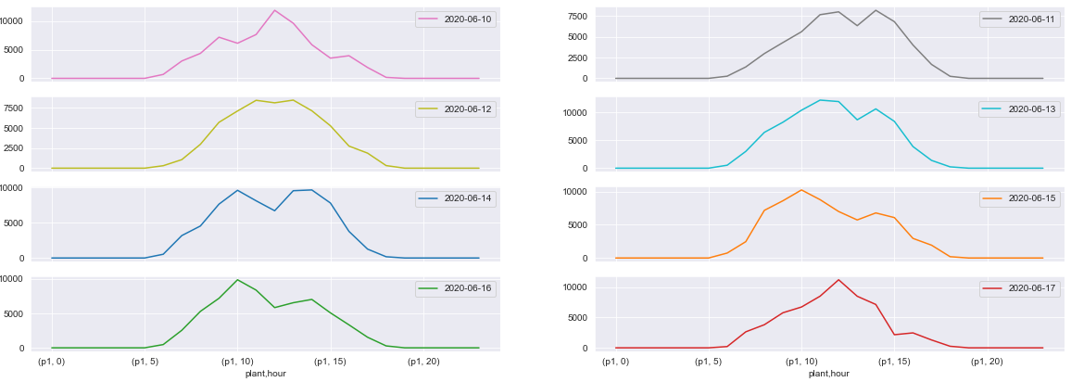
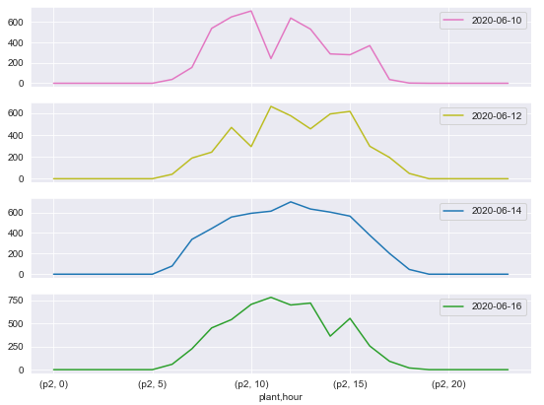
DC power generation in plant 1 is very high, on the scale of 10 MW daily generation
PLANT 1
Mean hourly DC power generation by day [kW]
PLANT 2
10,000 kW
600 kW
Plant 1 and plant 2 have the same number of inverters but the DC power produced is around 10 times higher for plant 1. It is suspected that DC power generation in plant 1 is not measured correctly or artificially scaled up.

Slide 5
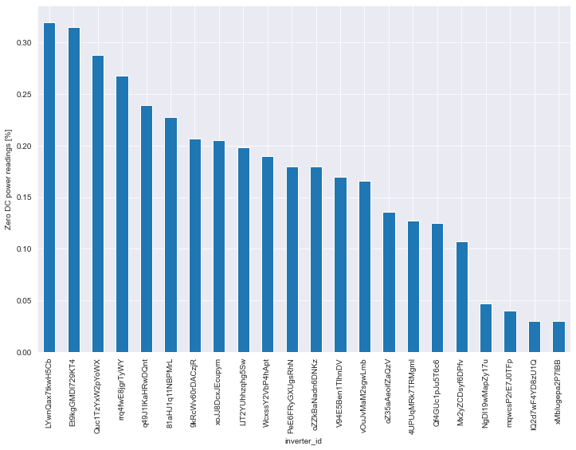
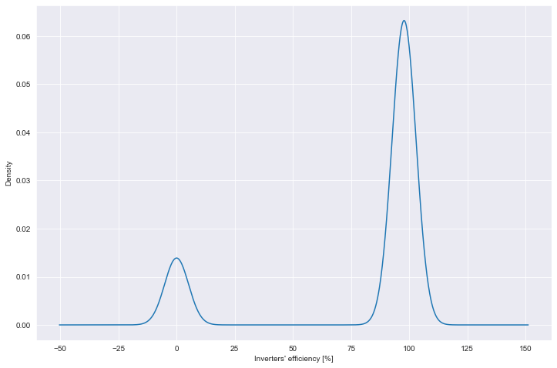
There are some inverters in plant 2 that do not produce DC power 30% of the time during irradiance peak hours
Mean inverters’ efficiency [%] distribution between 09:00 and 15:00
PLANT 2
It is highly suggested to check those inverters from plant 2 in the next maintenance check.

Slide 6


After carrying out the data analysis, the following action plan is suggested:
Data quality
Irradiance
DC Production
Inverters’ efficiency
PLANT 1
PLANT 2
ACTION #1: Overall data acquisition process check
ACTION #2:
ACTION #3: Maintenance of all inverters from plant 1 and the selected inverters from plant 2.

