Slide 1
COMP3503
Semi-Supervised Learning
Daniel L. Silver

Slide 2
Agenda
Unsupervised + Supervised = Semi-supervised
Semi-supervised approaches
Co-Training
Software
Notes:
Need to get objectives of each participant.

Slide 3
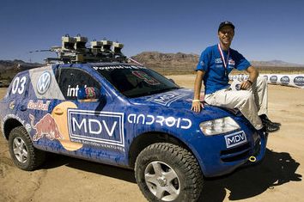
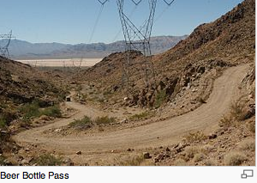
DARPA Grand
Challenge 2005
Stanford’s Sebastian Thrun holds a $2M check on top of Stanley, a robotic Volkswagen Touareg R5
212 km autonomus vehicle race, Nevada
Stanley completed in 6h 54m
Four other teams also finished
Great TED talk by him on Driverless cars
Further background on Sebastian

Slide 4
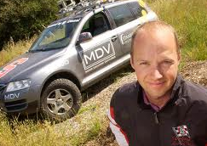
Unsupervised + Supervised = Semi-supervised
Sebastian Thrun on Supervised, Unsupervised and Semi-supervised learning
http://www.youtube.com/watch?v=qkcFRr7LqAw

Slide 5
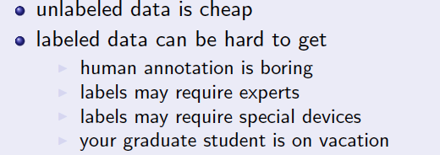
Labeled data is expensive …

Slide 6
Semisupervised learning
Semisupervised learning: attempts to use unlabeled data as well as labeled data
  The aim is to improve classification performance
Why try to do this? Unlabeled data is often plentiful and labeling data can be expensive
  Web mining: classifying web pages
  Text mining: identifying names in text
  Video mining: classifying people in the news
Leveraging the large pool of unlabeled examples would be very attractive

Slide 7
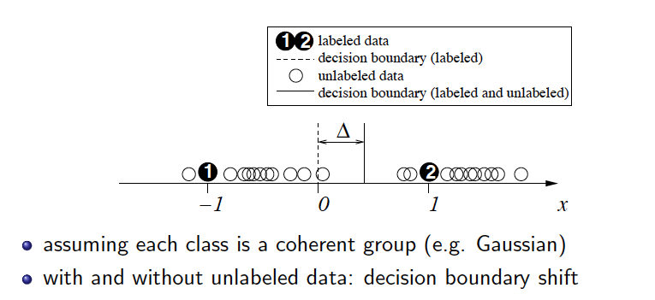
How can unlabeled data help ?

Slide 8
Clustering for classification
Idea: use naïve Bayes on labeled examples and then apply EM
    1. Build naïve Bayes model on labeled data
    2. Label unlabeled data based on class probabilities (“expectation” step)
    3. Train new naïve Bayes model based on all the data (“maximization” step)
    4. Repeat 2nd and 3rd step until convergence
Essentially the same as EM for clustering with fixed cluster membership probabilities for labeled data and #clusters = #classes
Ensures finding model parameters that have equal or greater likelihood after each iteration

Slide 9
Clustering for classification
Has been applied successfully to document classification
    Certain phrases are indicative of classes
      e.g “supervisor” and “PhD topic” in graduate student webpage
    Some of these phrases occur only in the unlabeled data, some in both sets
    EM can generalize the model by taking advantage of co-occurrence of these phrases
Has been shown to work quite well
A bootstrappng procedure from unlabeled to labeled
Must take care to ensure feedback is positive

Slide 10
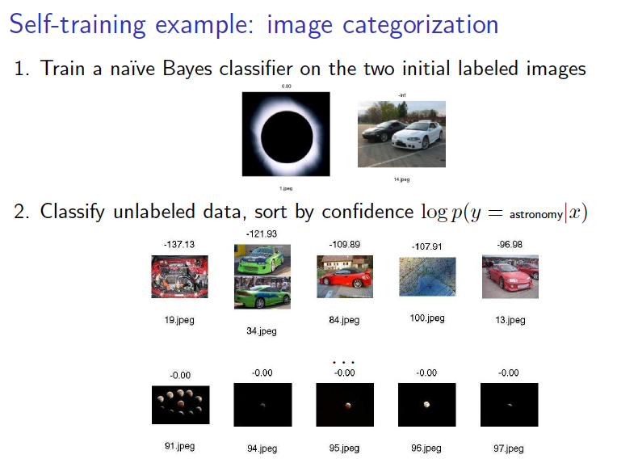
Also known as Self-training ..

Slide 11
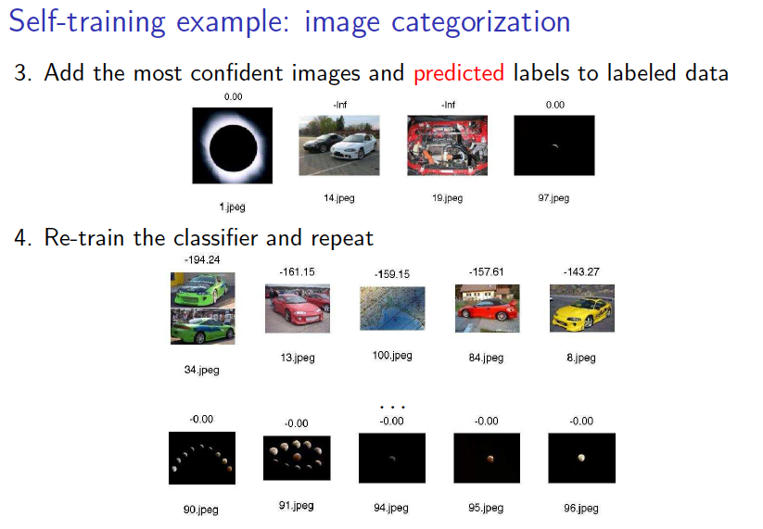
Also known as Self-training ..

Slide 12
Clustering for classification
Refinement 1:
  Reduce weight of unlabeled data to increase power of more accuracte labeled data
  During Maximization step, maximize weighting of labeled examples
Refinement 2:
  Allow multiple clusters per class
  Number of clusters per class can be set by cross-validation .. What does this mean ??

Slide 13
Generative Models
See Xiaojin Zhu slides – p. 28

Slide 14
Co-training
Method for learning from multiple views (multiple sets of attributes), eg: classifying webpages
    First set of attributes describes content of web page
    Second set of attributes describes links from other pages
Procedure:
Build a model from each view using available labeled data
Use each model to assign labels to unlabeled data
Select those unlabeled examples that were most confidently predicted by both models (ideally, preserving ratio of classes)
Add those examples to the training set
Go to Step 1 until data exhausted
Assumption: views are independent – this reduces the probability of the models agreeing on incorrect labels

Slide 15
Co-training
Assumption: views are independent – this reduces the probability of the models agreeing on incorrect labels
On datasets where independence holds experiments have shown that co-training gives better results than using a standard semi-supervised EM approach
Whys is this ?

Slide 16
Co-EM: EM + Co-training
Like EM for semisupervised learning, but view is switched in each iteration of EM
    Uses all the unlabeled data (probabilistically labeled) for training
Has also been used successfully with neural networks and support vector machines
  Co-training also seems to work when views are chosen randomly!
    Why? Possibly because co-trained combined classifier is more robust than the assumptions made per each underlying classifier

Slide 17
Unsupervised + Supervised = Semi-supervised
Sebastian Thrun on Supervised, Unsupervised and Semi-supervised learning
http://www.youtube.com/watch?v=qkcFRr7LqAw

Slide 18
Example: Object recognition results from tracking-based semi-supervised learning
http://www.youtube.com/watch?v=9i7gK3-UknU
http://www.youtube.com/watch?v=N_spEOiI550
Video accompanies the RSS2011 paper "Tracking-based semi-supervised learning".
The classifier used to generate these results was trained using 3 hand-labeled training tracks of each object class plus a large quantity of unlabeled data.
Gray boxes are objects that were tracked in the laser and classified as neither pedestrian, bicyclist, nor car.
The object recognition problem is broken down into segmentation, tracking, and track classification components. Segmentation and tracking are by far the largest sources of error.
Camera data is used only for visualization of results; all object recognition is done using the laser range finder.

Slide 19
Software …
WEKA version that does semi-supervised learning
  http://www.youtube.com/watch?v=sWxcIjZFGNM
  https://sites.google.com/a/deusto.es/xabier-ugarte/downloads/weka-37-modification
LLGC - Learning with Local and Global Consistency
  http://research.microsoft.com/en-us/um/people/denzho/papers/LLGC.pdf

Slide 20
References:
Introduction to Semi-Supervised Learning
  http://pages.cs.wisc.edu/~jerryzhu/pub/sslicml07.pdf
Introduction to Semi-Supervised Learning
  http://mitpress.mit.edu/sites/default/files/titles/content/9780262033589_sch_0001.pdf

Slide 21
THE END danny.silver@acadiau.ca

