Slide 1
Bayesian Data Analysis
Luis Manuel Sarro
Artificial Intelligence Dpt. - UNED (Madrid)
Code and slides available at
http://bakunin.uned.es/2015/
Github: https://github.com/luis-sarro/ESAC-Astrostatistics-School-

Slide 2
Session 1: A biased primer on statistics

Slide 3
Probability distributions

Slide 4
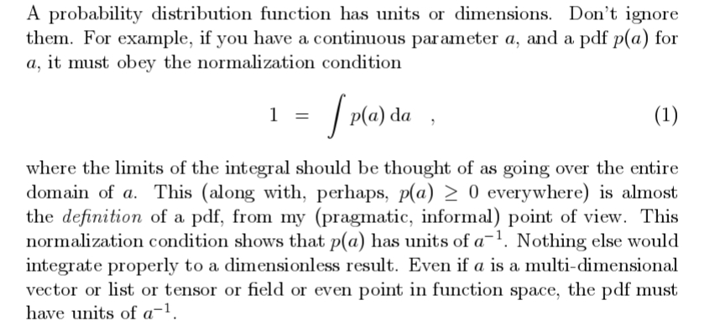
Data analysis recipes: fitting a model to data (Hogg, Bovy & Lang, 2010)

Slide 5
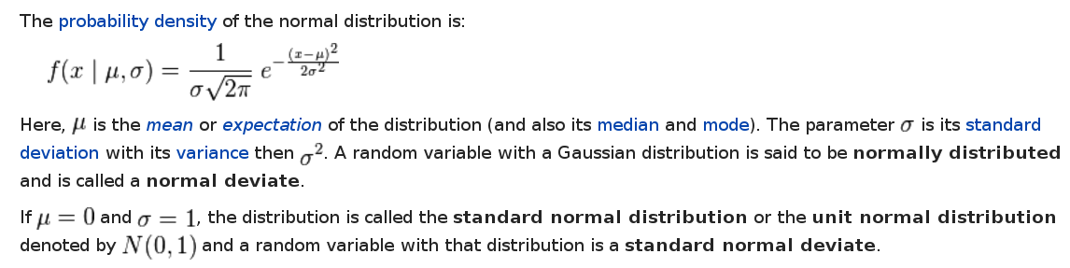

Slide 6
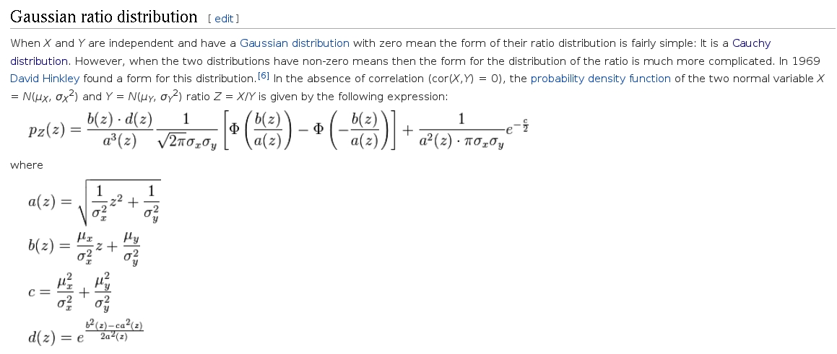
But, there are other possibilities for the random variables in the numerator and denominator...

Slide 7
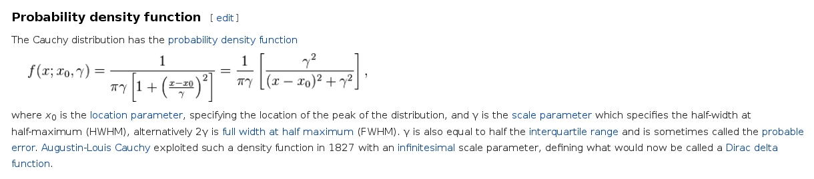

Slide 8
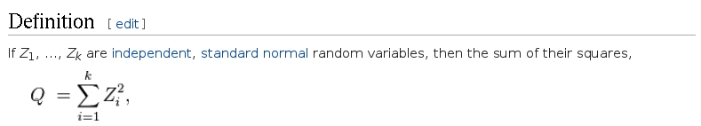
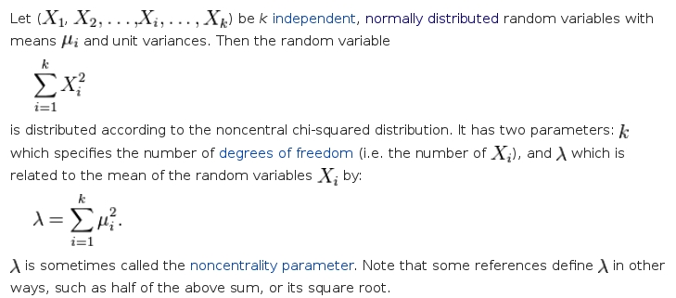

Slide 9
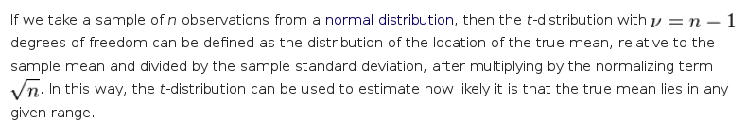

Slide 10
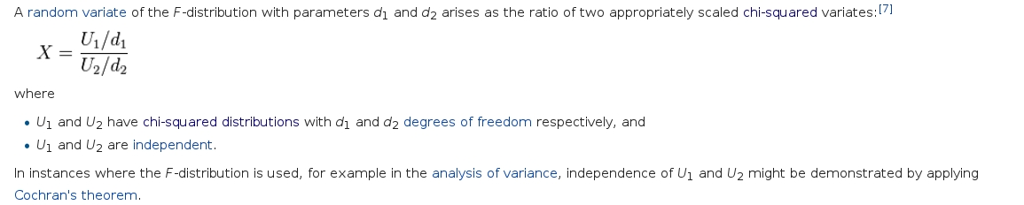

Slide 11
Conditional probabilities

Slide 12
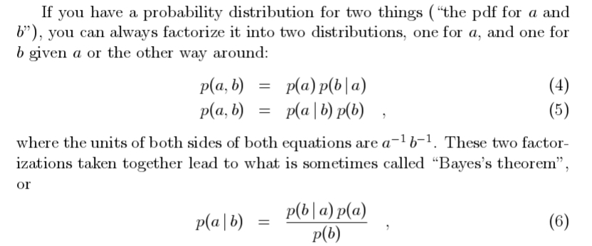
Data analysis recipes: fitting a model to data (Hogg, Bovy & Lang, 2010)

Slide 13

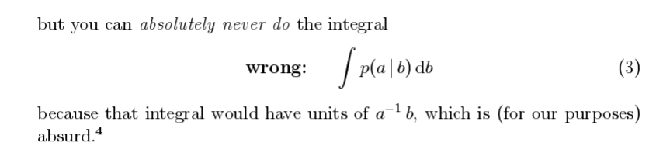
Data analysis recipes: fitting a model to data (Hogg, Bovy & Lang, 2010)

Slide 14
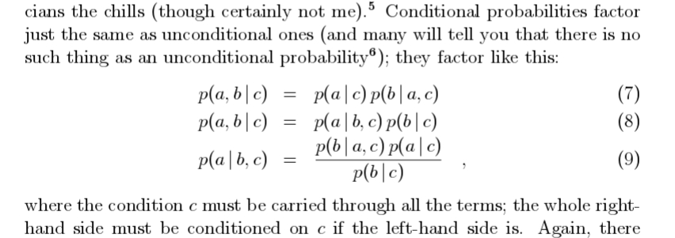
Data analysis recipes: fitting a model to data (Hogg, Bovy & Lang, 2010)

Slide 15
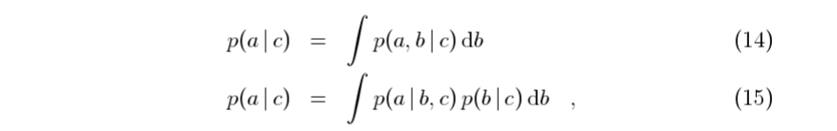
Marginalization
Data analysis recipes: fitting a model to data (Hogg, Bovy & Lang, 2010)

Slide 16
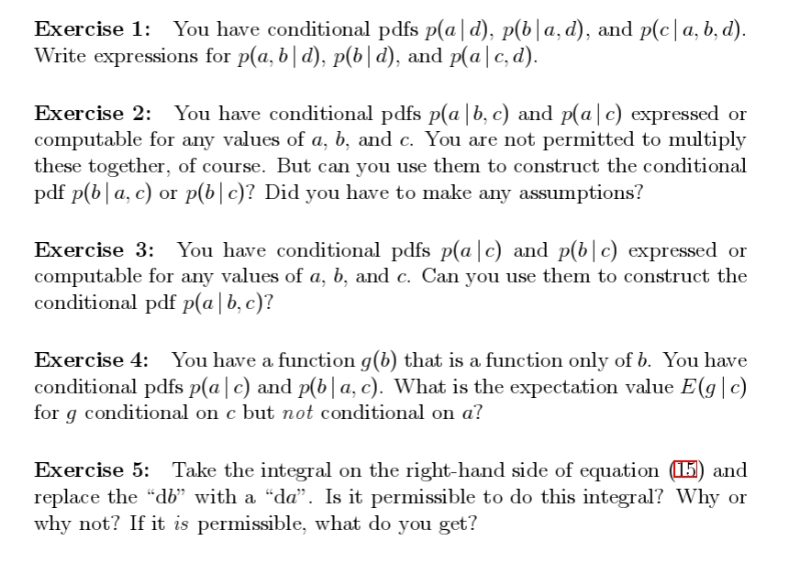
Data analysis recipes: fitting a model to data (Hogg, Bovy & Lang, 2010)

Slide 17
Concepts from Information Theory

Slide 18
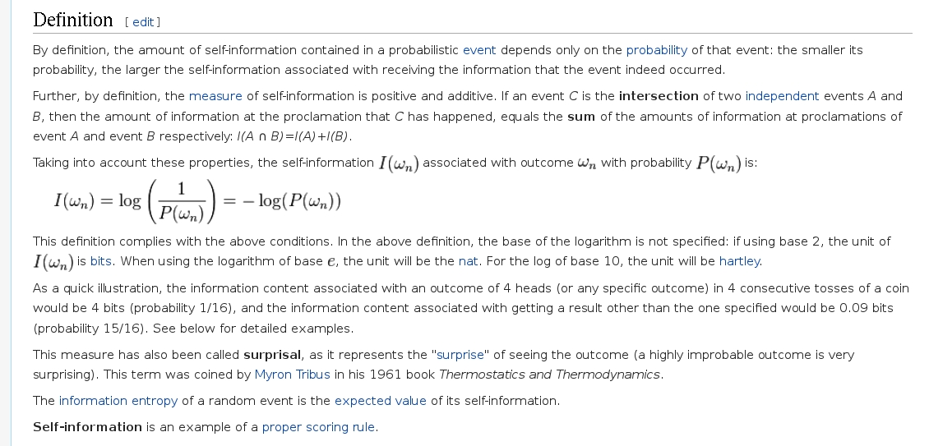
Self-information/Information content
Not to be mistaken with Fisher's information!
(more on this later)

Slide 19
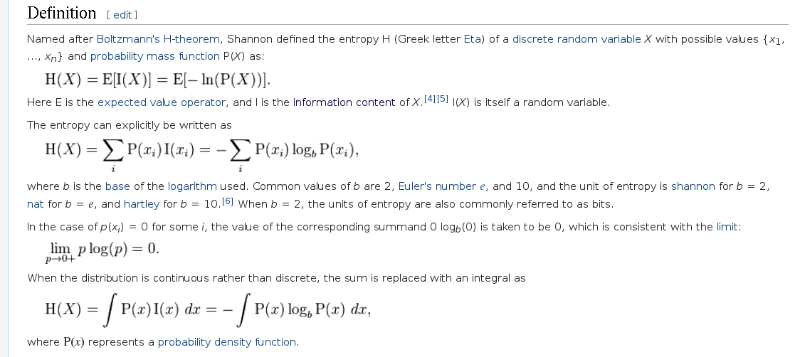
Entropy

Slide 20
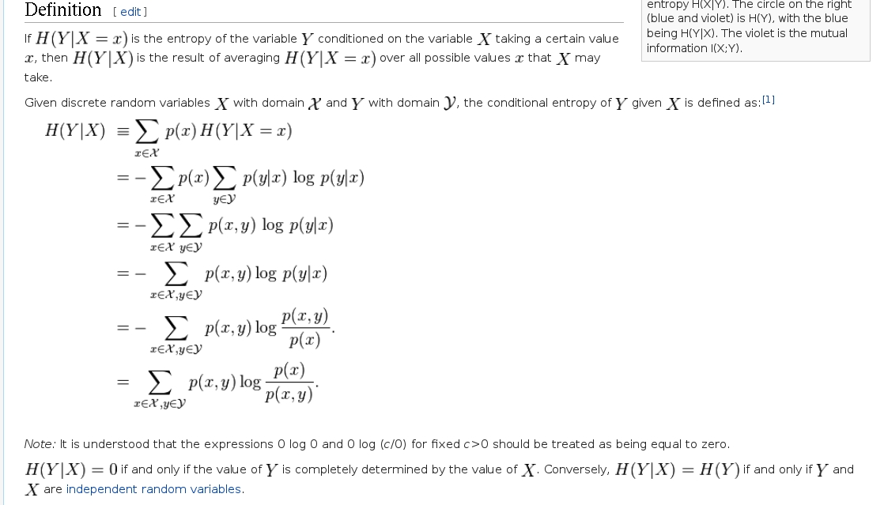
Conditional Entropy

Slide 21

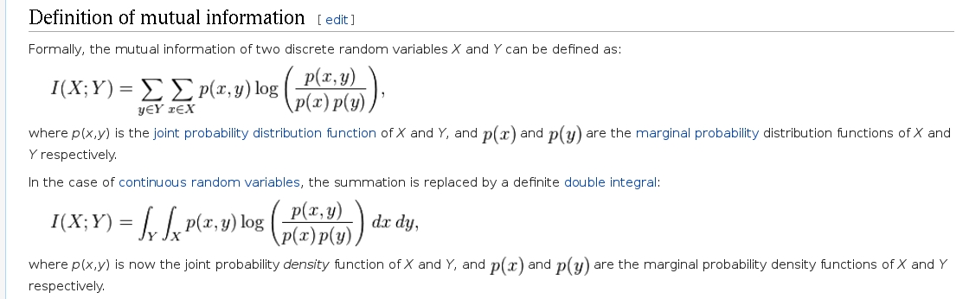
Mutual Information

Slide 22
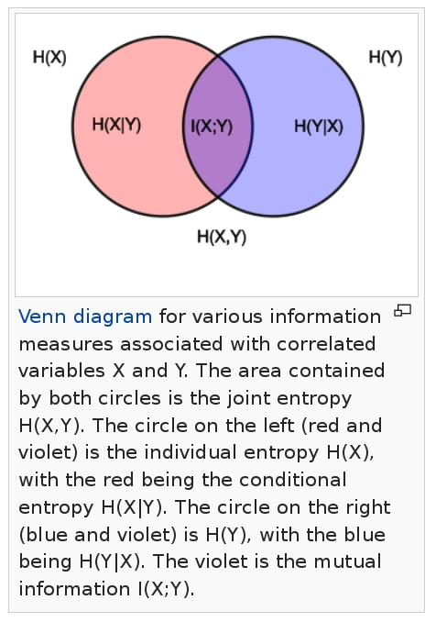

Slide 24
Session 2: Fitting a model to data.

Slide 25
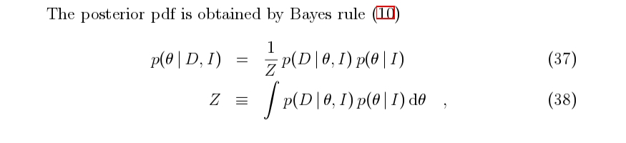
Bayes' Theorem
Data Analysis Recipes: Probability Calculus for inference (Hogg, 2012)

Slide 26
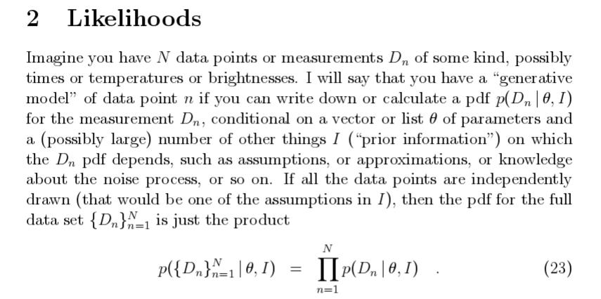
Data Analysis Recipes: Probability Calculus for inference (Hogg, 2012)

Slide 27
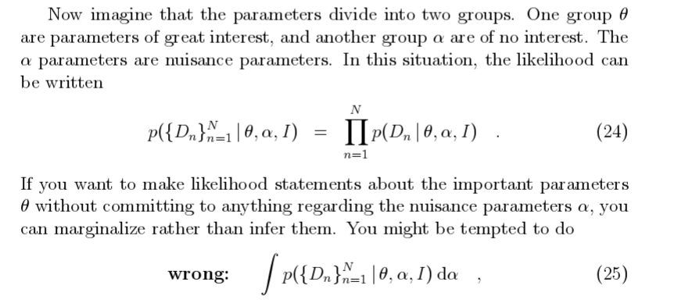
Data Analysis Recipes: Probability Calculus for inference (Hogg, 2012)

Slide 28

The score

Slide 29
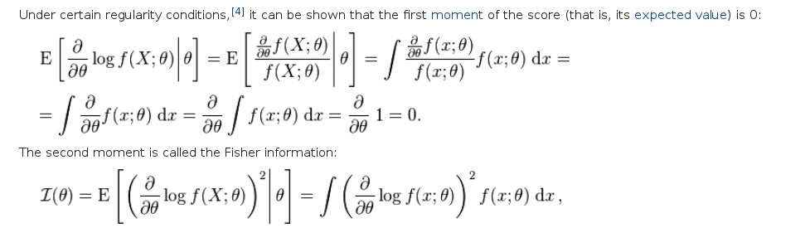
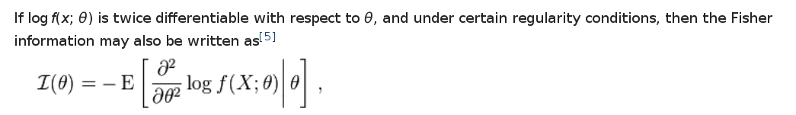
The Fisher Information

Slide 30
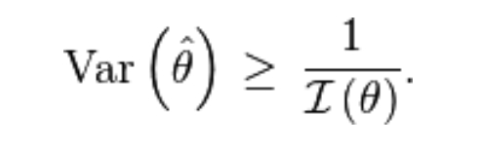
The Crame-Rao bound

Slide 31
Priors
Informative priors
Uninformative Objective priors
  Principle of indifference
  Principle of invariance under symmetries
  Principle of Maximum Entropy
  Reference priors

Slide 32

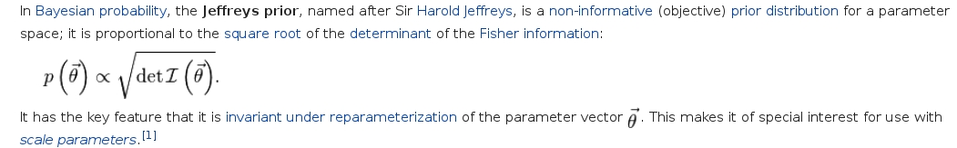
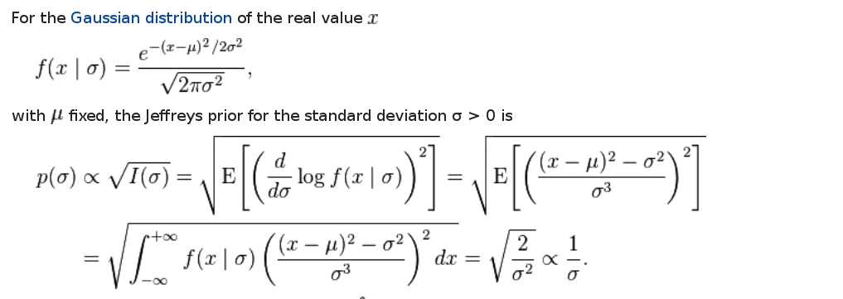
Principle of invariance

Slide 33
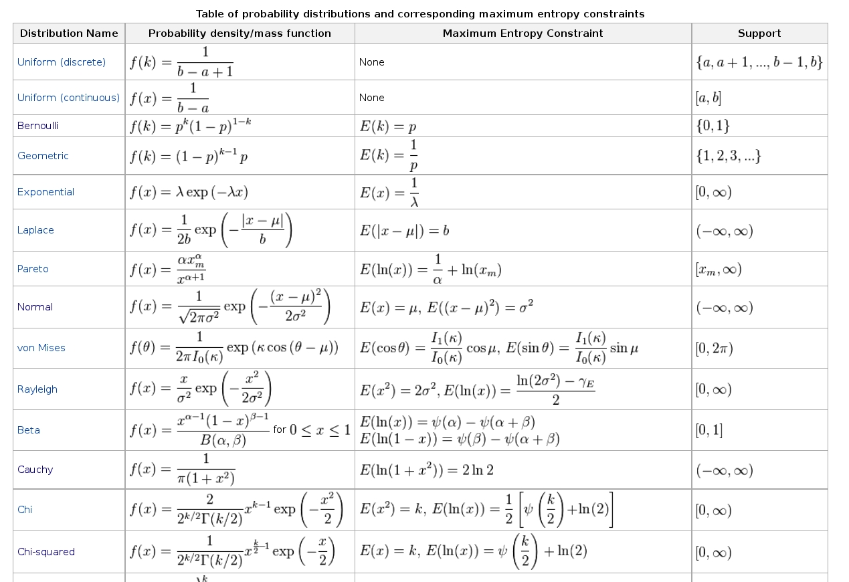

Slide 34
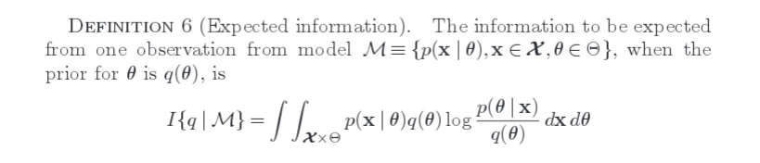
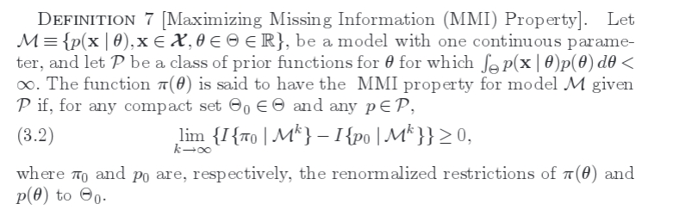
The formal definition of Reference priors
(Berger, Bernardo & Sun, 2009)
Catalog of reference priors

Slide 35
Session 3: Model Selection

Slide 36
Model selection: the bayesian approach

Slide 37
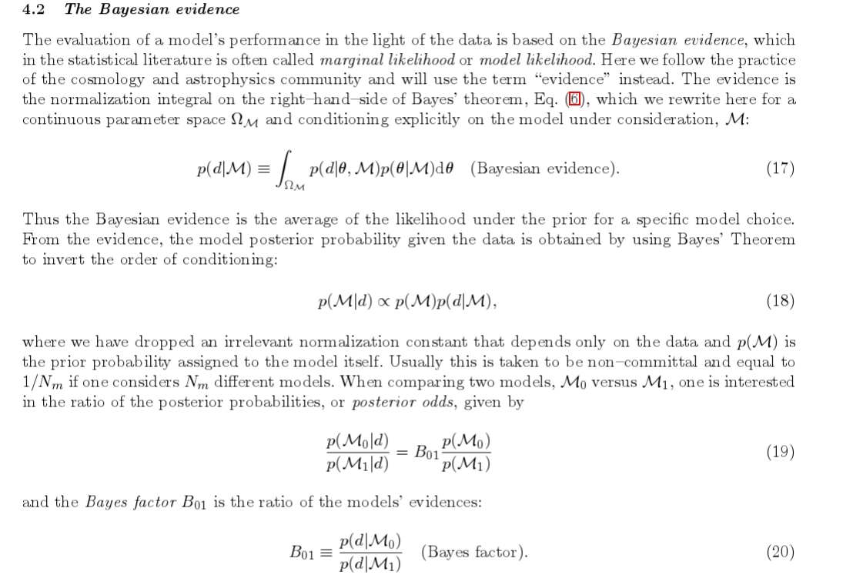
Bayes in the sky, R. Trotta (2008)

Slide 38
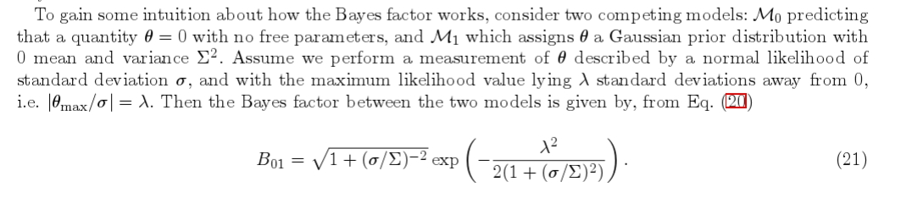
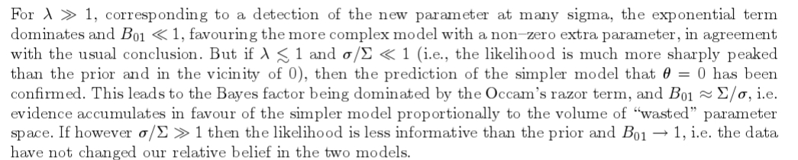
Bayes in the sky, R. Trotta (2008)

Slide 39
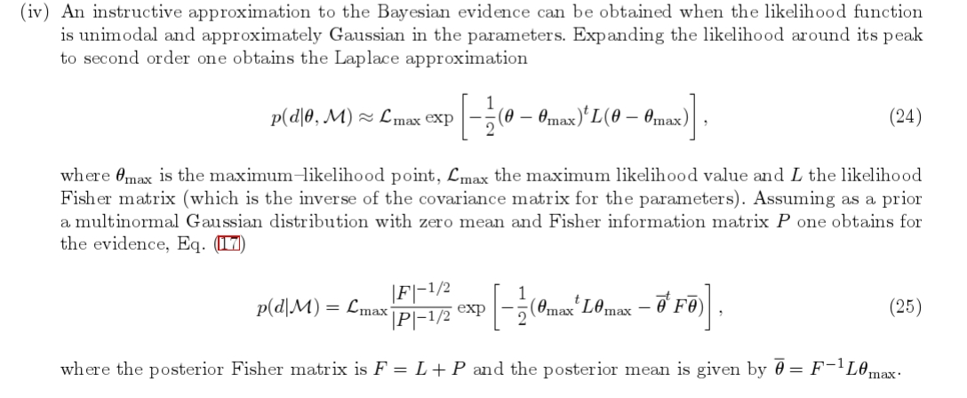
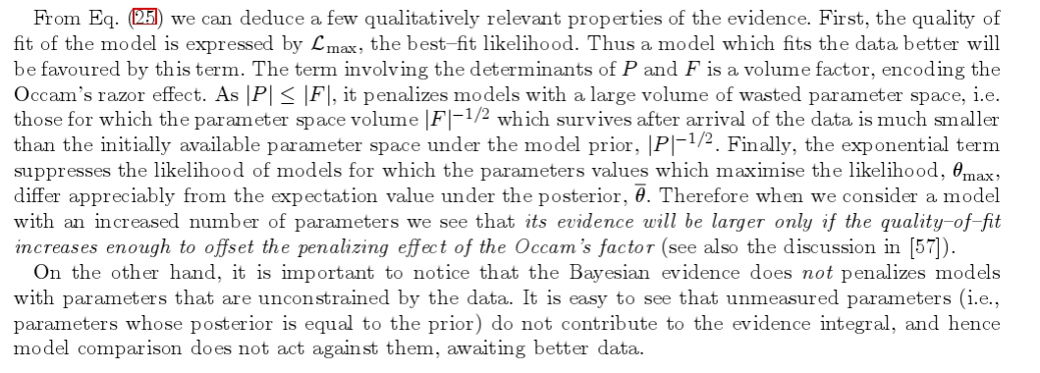

Slide 40
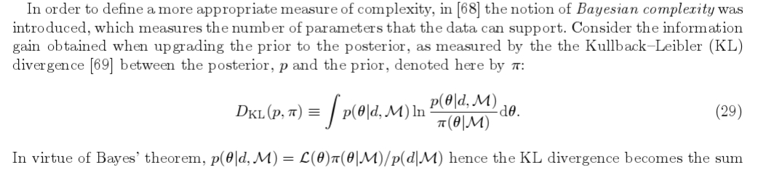
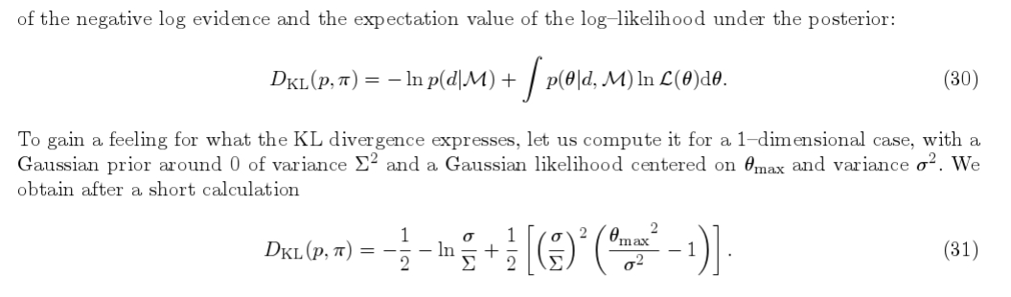
Bayes in the sky, R. Trotta (2008)

Slide 41
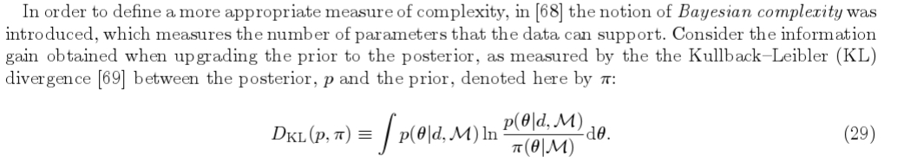


Slide 42
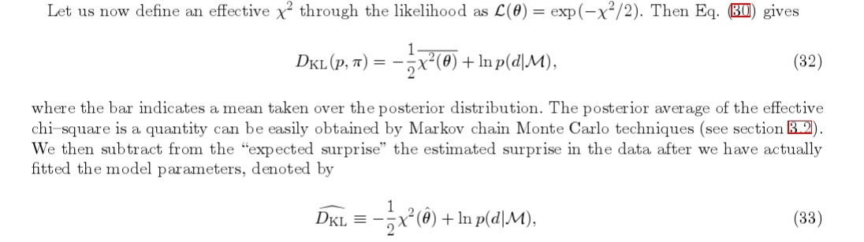

Slide 43
Model Selection: the Information approach

Slide 44
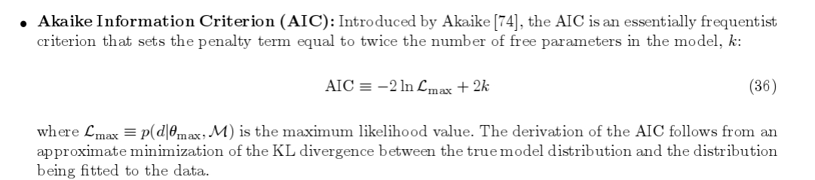

Slide 45
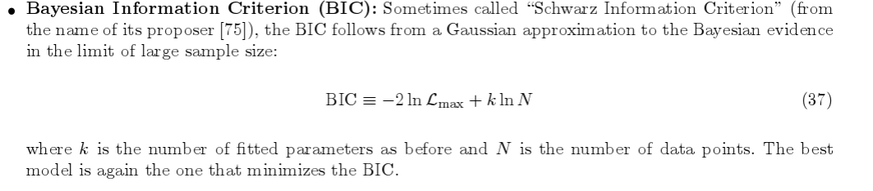

Slide 46
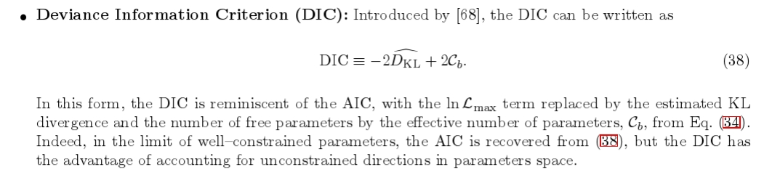

Slide 47
Session 4: Hands-on session

Slide 48
Let me quote directly from Coryn's paper:
I have (he has) shown that estimating the distance given a parallax is not trivial.
The naive approach of reporting 1/p ± σ_{p}/ p² fails for non-positive parallaxes, is extremely noisy for fractional parallax errors larger than about 20%, and gives an incorrect (symmetric) error estimate.
Probability-based inference for the general case is unavoidable.
Adopting an “uninformative” improper uniform prior over all positive r does not solve any of these problems, and is in fact both informative and implausible (viz. a volume density of stars varying as 1/r² ).
The problems can be avoided by using a properly normalized prior which necessarily decreases after some distance.

Slide 49
The use of a prior with a sharp cut-off is not recommended, because it introduces significant biases for low accuracy measurements at all distances (not just those near the cut-off).
Instead, a prior which converges asymptotically to zero as distance goes to infinity should be used.

Slide 50
The mode of the corresponding posterior is an unbiased estimator (for the case that the population observed conforms to the prior) and it provides meaningful estimates for arbitrarily large parallax errors as well as non-positive parallaxes. Bias corrections are not necessary. The variance of this estimator behaves as well as one could expect given the irreducible measurement errors.
The median and mean perform less well than the mode.

Slide 51
Distance estimates must be accompanied by uncertainty estimates. For fractional parallax errors larger than about 20%, the posterior over distance is significantly asymmetric, so we should always report confidence intervals using quantiles (e.g. 5% and 95%) rather than standard deviations.

Slide 52
Session 5: MCMC techniques
and hierarchical Bayes

Slide 53
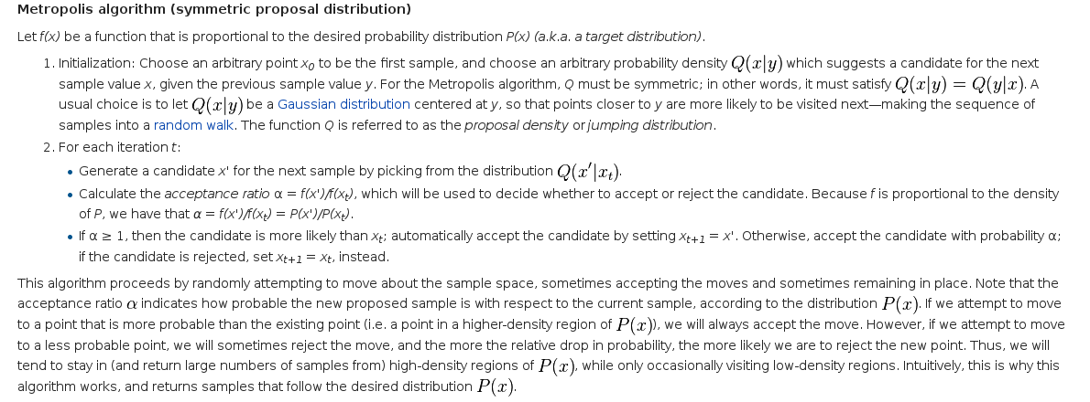
Metropolis-Hastings algorithm, the wikipedia

Slide 54
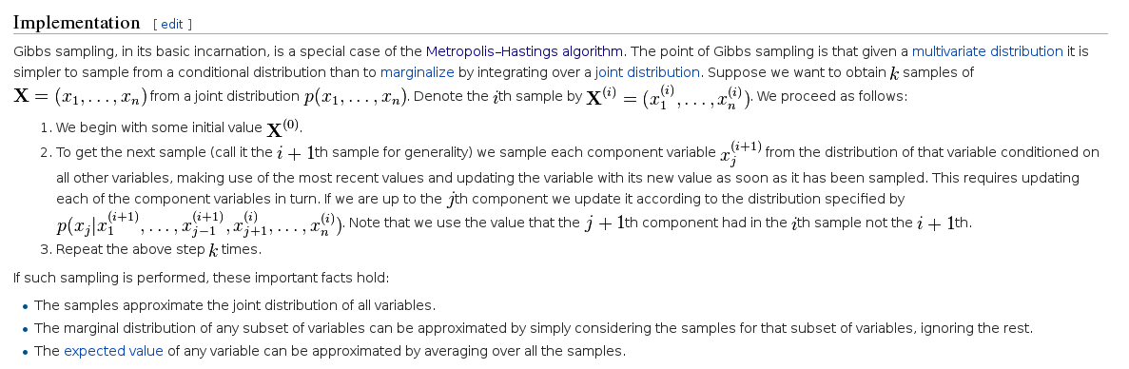
Gibbs sampling, the wikipedia

Slide 55
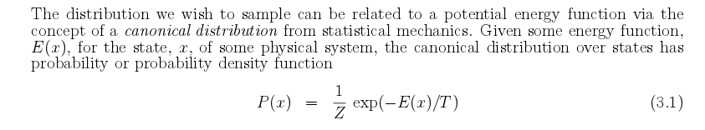
Hamiltonian Monte Carlo
R.M. Neal, MCMC using Hamiltonian dynamics

Slide 56
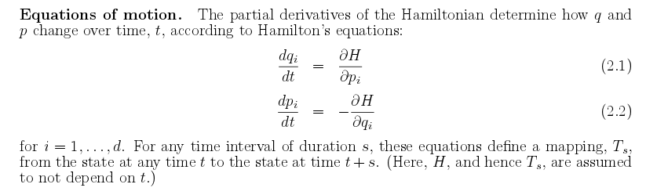
R.M. Neal, MCMC using Hamiltonian dynamics

Slide 57
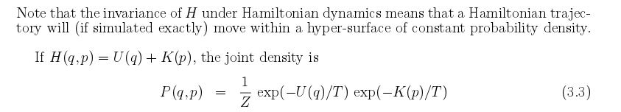
R.M. Neal, MCMC using Hamiltonian dynamics

Slide 58
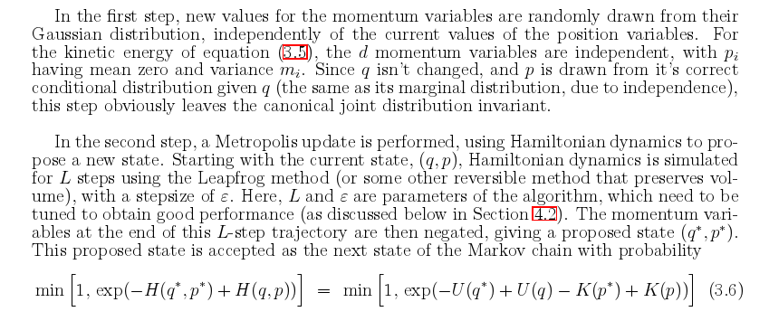
R.M. Neal, MCMC using Hamiltonian dynamics

Slide 59
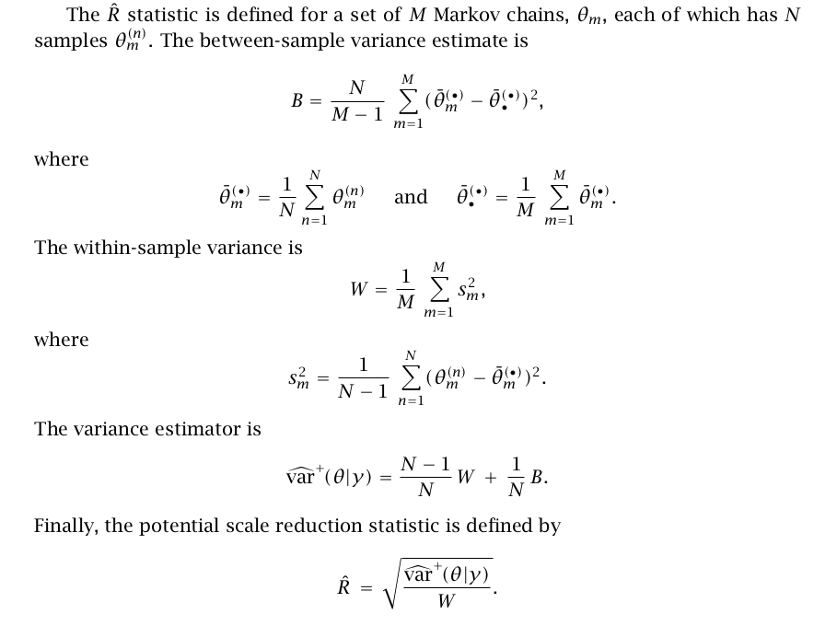
Checking for convergence: the R-hat statistic.
The stan reference manual and user's guide.

Slide 60
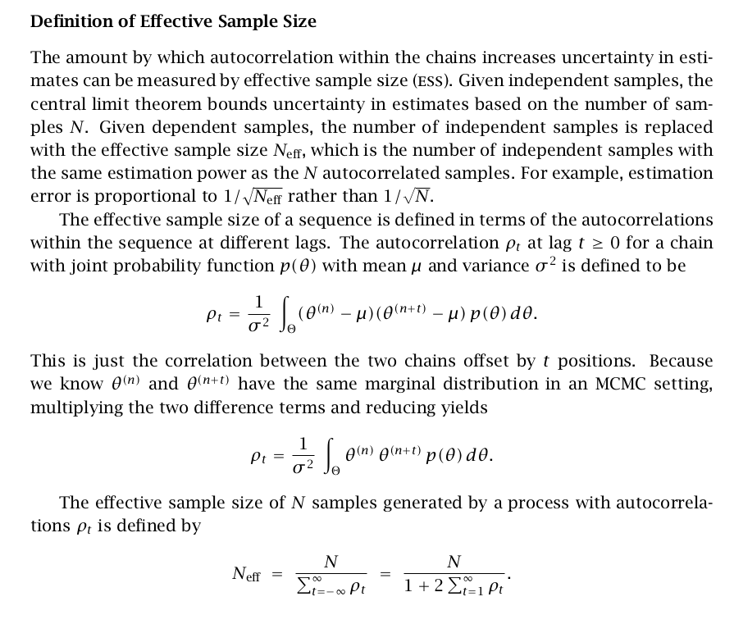
Autocorrelation of samples and effective sample size
The stan reference manual and user's guide.

Slide 61
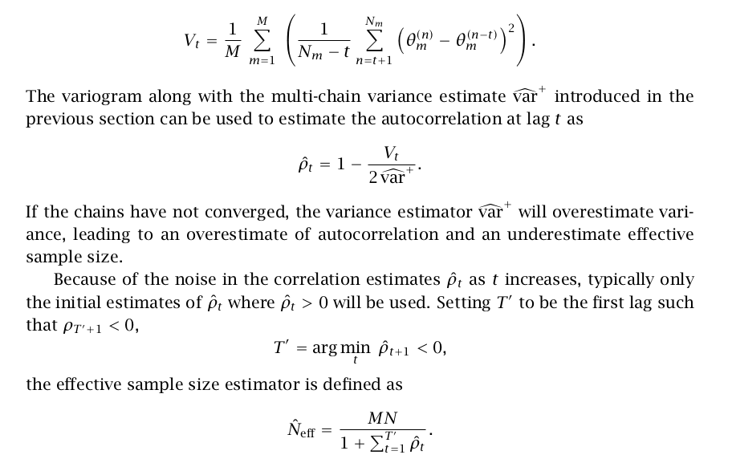
Autocorrelation and effective sample sizes: the practical approach
The stan reference manual and user's guide.

